Slide 1
Sudoku Validator
Solving Solutions
REACTO

Slide 2
Today’s Agenda
Synthesize fundamental concepts learned so far
Iteration (loops)
Data Types (Nested Arrays)
REACTO Problem Solving
REACTO
Notes:
Fellow who does Tuesday problem should slack out pairs for the week. Fellows might want to share problem with interviewers the night before.

Slide 3
R
E
A
C
T
O
e s t a t e
x a m p l e s
p p r o a c h
o d e
e s t
p t i m i z e
REACTO

Slide 4
Restate
Rephrase in your own words (diagram if useful)
Make sure you fully understand the problem
Leads very naturally into…
REACTO

Slide 5
EXAMPLES
Representative input and output
Consider edge cases
Consider errors
Write them down
REACTO

Slide 6
APpROACH
Come up with at least one conceptual solution
Don’t code yet!
Make some comments in your code file
REACTO

Slide 7
Code
Translate your Approach into working JS
FSA Admissions Team will even give partial credit for a solid approach (even if the code isn’t complete)
Make sure include all those edge cases!
REACTO
Notes:
Notice what’s not on this slide: anything having to do with problem-solving

Slide 8
Sudoku
REACTO

Slide 9
Test
Use Examples in the test specs to hone your solution
Ensure your Code works for all Examples
Debug as necessary
REACTO

Slide 10
Sudoku
Popular number puzzle from Japan
Players fill in 9 x 9 Grid of Numbers
A board is “solved” if:
Numbers [1-9] are used only once per row (no repeats!)
Numbers [1-9] are used only once per column (no repeats!)
Numbers [1-9]s are used only once per 3x3 mini-grid (no repeats!)
REACTO

Slide 11
Sudoku Solver
Create a function to check if a Sudoku board is valid
Your function should return true if the board is valid, false if it isn’t
REACTO

Slide 12
Sudoku Solver - Restate
Create a function that takes an array of arrays of integers as an argument, representing a Sudoku Board
My function will return a Boolean, based on whether the Sudoku solution is valid
REACTO

Slide 13
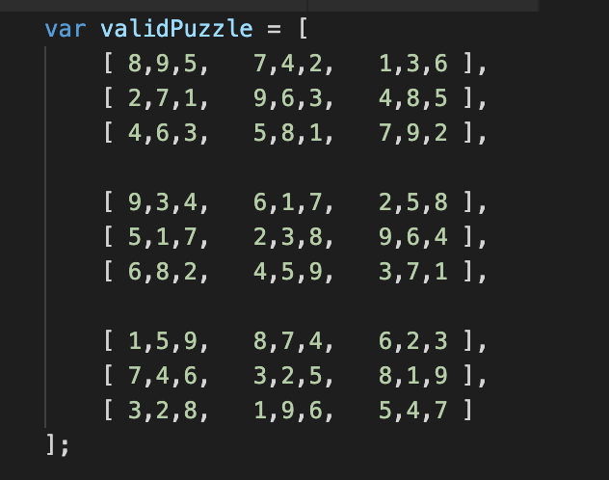
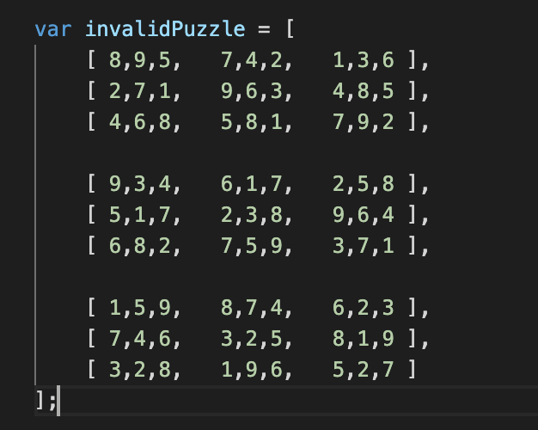
Sudoku Solver - Examples
REACTO

Slide 14
Sudoku Solver - Approach
Write helper functions to get array for a specific row, column, or subsection
Write a helper function to validate a specific row, column, or subsection
Loop over each of the 9 rows, columns, subsections, and validate each.
If any isn’t valid, return false. Otherwise, return true
REACTO

Slide 15
Sudoku Solver - Approach
Write helper functions to get array for a specific row, column, or subsection
Write a helper function to validate a specific row, column, or subsection
Loop over each of the 9 rows, columns, subsections, and validate each.
If any isn’t valid, return false. Otherwise, return true
REACTO

Slide 16
Sudoku Solver - Code
When you feel confident in your approach, translate it to code
Remember to break down complex logic into smaller helper functions
REACTO

Slide 17
optimize
The final (and least important) step!
Only if your code works and you have plenty of time
Is there a more concise way to write this code?
Are there built-in methods that can help?
Did I document my code so it is easy to understand?
REACTO

Slide 18
Sudoku Review
R
E
A
C
T
O
e s t a t e
x a m p l e s
p p r o a c h
o d e
e s t
p t i m i z e
REACTO

