Slide 1
cl_khr_image2d_from_buffer on Android
September 28th 2014, Ariel Bernal

Slide 2



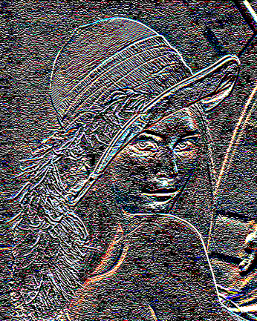

Post-Processing Pipeline
Four Kernels
Threshold
Asus8x8
ToLuminance
Asus8x8

Slide 3
Post-Processing Pipeline
Copy buffer to image back and forth
Buffer Kernels
Threshold
toLuminance
Input
B1
B2
B3
B2
B3
Output
Read only
I1
I2
I1
I2
Write only
Asus8x8
Asus8x8
Copies
Image2D Kernels

Slide 4
Post-Processing Pipeline
image2d_from_buffer
Buffer Kernels
Threshold
toLuminance
Input
B1
B2
B3
B2
B3
Output
Read only
I1
I2
I1
I2
Write only
Asus8x8
Asus8x8
Zero-copy
Read write
Image2D Kernels

Slide 5
Post-Processing Pipeline
image2d_from_buffer
Using image2d Kernels
Input
B1
B2
B3
B2
B3
Output
Read only
I1
I2
I3
I2
I3
Write only
Threshold
toLuminance
Zero-Copy
Asus8x8
Asus8x8
Read write
Image2D Kernels

Slide 6
Code snippet
// use memalign instead unsigned char *input = new char(4 * Width * Height); unsigned char *output = new char(4 * Width * Height); loadImage(“Lenna.png”, input);
cl_mem m_buf_in = clCreateBuffer(context, CL_MEM_READ_ONLY | CL_MEM_USE_HOST_PTR, 4 * Width * Height, (void*)input, &err); cl_mem m_buf_out = clCreateBuffer(context, CL_MEM_WRITE_ONLY | CL_MEM_USE_HOST_PTR, 4 * Width * Height, (void*)output, &err);

Slide 7
Code snippet cont.…
// define image format and image descriptor for the input cl_image_format img_fmt_in; img_fmt_in.image_channel_order = CL_RGBA; img_fmt_in.image_channel_data_type = CL_UNSIGNED_INT8; cl_image_desc img_desc_in; img_desc_in.image_type = CL_MEM_OBJECT_IMAGE2D; img_desc_in.image_width = Width; img_desc_in.image_height = Height; ... img_desc_in.mem_object = m_buf_in; // here it goes the input buffer // and the same for the output cl_image_format img_fmt_out; // ... Fill the structure cl_image_desc img_desc_out; //... Fill the structure img_desc_in.mem_object = m_buf_out; // here it goes the output buffer

Slide 8
Code snippet cont.…
// Create the image2d from buffer cl_mem m_img_in = clCreateImage(context, CL_MEM_READ_ONLY, &img_fmt_in, &img_desc_in, 0, &err); cl_mem m_img_out = clCreateImage(context, CL_MEM_WRITE_ONLY, &img_fmt_out, &img_desc_out, 0, &err); // The flags from the buffer and the image2d have to match! // There are also some restrictions on base address, row // pitch and size alignment.

Slide 9
Code snippet cont.…
Kernel = getKernel(“kernel_using_image2d"); clSetKernelArg(Kernel, 0, sizeof(cl_mem), (void *)&m_img_in); clSetKernelArg(Kernel, 1, sizeof(cl_mem), (void *)&m_img_out); clEnqueueNDRangeKernel(CommandQueue, Kernel, 2, NULL, gwsh, lws, 0, NULL, NULL); // That’s it, there is no need for reading back the data // clEnqueueReadImage(CommandQueue, m_img_out ... output // or // clEnqueueReadBuffer(CommandQueue, m_buf_out ... output

