Slide 1
Graph Coloring Approximations
D. Karger, R. Motwani & M. Sudan (94)
Elad Eban, May 5th 2005
Inapproximabilty Seminar

Slide 2
Lecture Main Topics
Known hardness results.
  3 coloring
  3-4 and 3-5 gap hardness
  More…
Approximation algorithms for
the 3-coloring problem.
Graph coloring using Semidefinite Programming with Min(Õ(Δ^{1/3}) , Õ(n^{1/4})) colors
  Karger, Motwani & Sudan.
  Blum, Karger (96): Õ(n^{3/14}) coloring.
The Gap between the approximation and the original problem.

Slide 3
Basic Definitions
3 colorable graph G=(V,E)
  F: V → {1,2,3}
  For all (i,j) in E
  F(i) ≠F(j)
k colorable graph G=(V,E)
  F: V → [k]
  For all (i,j) in E :
  F(i) ≠F(j)

Slide 4
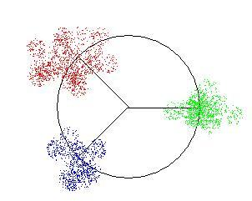
Trivial Approximate Algorithms
n coloring
  F(v_{i})=i
Works but not too clever…
Δ+1 coloring. when Δ =max(deg(v))
  For each v_{i} choose minimal j in [1..Δ+1] that is legal.
  This is possible since each v has at most Δ neighbors.
This algorithm is better.
But not very good if Δ=Θ(n)
Notes:
Image why this does not give a good approximation in terms of n

Slide 5
Semicoloring of Graphs
Definition: K - semicoloring of a graph is a legal assignment of K colors to at least half its vertices.
The Semicoloring lemma:
  If Algorithm A can k(n)- semicolor any
  n-vertex Graph G.
  A could be used to O(k(n)log(n)) color G.

Slide 6
Semicoloring Lemma
The Proof:
Using A We will construct an Algorithm A` that will color any graph.
Alg A` (V,E):
  Semi-Color (V,E) using A and K(|V|) colors.
  V` = V \ {v∈V | v is colored by A}
  Recursively Color V` with new colors.
  Explicitly A`(V`,E_{V`})

Slide 7
Semicoloring Lemma
Let C(n) the number of colors A` uses on an n-vertex graph.
C(n) ≤ C(n/2) +K(n)
C(i) satisfies: C(i) ≤ K(i)Log(i)
  By induction:
  C(n) ≤ C(n/2) +K(n) ≤ K(n/2)Log(n/2)+K(n)≤
  ≤ K(n)(Log(n/2)+1) ≤ K(n)Log(n)
Thus C(n) ≤ K(n)Log(n) as claimed.

Slide 8
Wigderson’s Algorithm
Def: N(v) = {w in V : (w,v) in E}
Notice 1: If G is a 3-colorabel Graph. For each v N(v) is 2-colorabel
Notice 2: A n-vertex 2-colorable graph can be colored in O(n²) time

Slide 9
Wigderson’s Algorithm
If there exists v in V deg(v) >√n
  Color N(v) with 2 colors and v with a third
  Remove v , N(v) from G. Repeat 1 while possibe.
If all v in V deg(v) ≤ √n : color the graph with at most √n+1 colors.

Slide 10
Wigderson’s Algorithm
Since every time we color using (1) we remove at least √n +1 vertices we will repate (1) at most √n times.
  Using at most 3√n colors.
After the maximum degree is low (2), we use at most √n +1 colors to color all the remaining graph.
For a total of Θ(√n) colors.

Slide 11
Wigderson’s Algorithm revised
Before we started from a Δ+1 coloring what if we start with a O(Δ^{1/a}) coloring algorithm?
The revised Wigderson’s algorithm is :
For v with degree higher then δ
  Color N(v) and v with 3 colors.
  Remove N(v), v from the graph and repeat while possible.
Use the O(Δ^{1/a}) alg. on the remaining graph
For a total number of colors:
O(n/ δ + δ^{1/a}) and for a good δ: O(n^{1/(a+1)})

Slide 12
SDP- Semidefinite Programming
LP: variables are x_{i}
min(c·x)
  s.t.: Ax=b
SDP: variables are vectors x_{i} ∈ R^{n}
and α_{ij} ∈ R
  s.t. x_{i} · x_{j} ≤ α_{ij}
  ||x_{j}||=1

Slide 13
Vector Relaxation of Coloring
3-vector coloring F: V→R^{n} s.t. ∀(i,j) ∈E
  s.t. ∀(i,j) ∈E : F(i)·F(j)≤ -1/2 ,F(i)·F(i)=1
k-vector coloring F: V→R^{n}
  s.t. ∀(i,j) ∈E : F(i)·F(j)≤ -1/(k-1) ,F(i)·F(i)=1
  Adjacent vertices have a large angle between them
But how is that related to Graph Coloring?

Slide 14
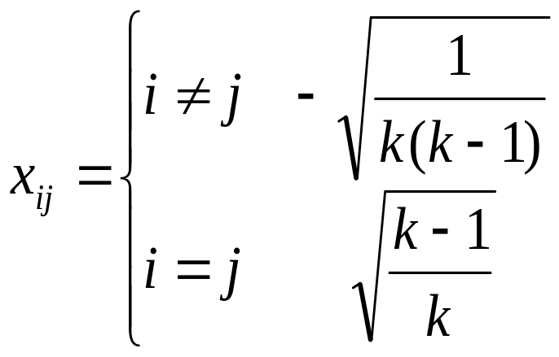
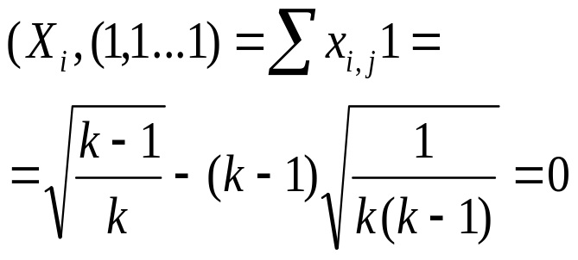
Lemma: k vectors can be distantly spread in R^{n}
Lemma: ∀ k ≤ n+1
  ∃{x_{i}}∈ R^{n} and
  x_{i}·x_{i}=1
  x_{i}· x_{j} = -1/(k-1)
Proof: It is enough to prove for k=n Vectors in R^{n}.
  Since we can always add zeros for k<n.
But… The claim is for k=n+1
{X_{i}} are all in a hyperplane in R^{n} or if we wish in R^{n-1} !
This proves the lemma

Slide 15
Vector Relaxation of Coloring
Given a K-coloring, of an n-vertex graph.
We can easily Generate a Vector
K-coloring using the previous lemma.
  That implies that vector coloring is a lower bound for graph coloring
The other way around won’t be so easy !
  That is finding a legal and good graph coloring starting from a vector solution!

Slide 16
Rounding
We know how to solve the Vector coloring.
Since it’s in SDP form.
What will we do with this solution ?
There must be a catch.
3-coloring is NP-hard , SDP is NOT.
  What is a 3.1415 coloring ??
  How can we assign a legal color from the given the matrix coloring solution ??

Slide 17
Intuition for SDP solution.
Edges between vertices
force distant vectors
Close vectors could be
colored with the same color
As we can imagine this intuition is quit far from being complete !

Slide 18
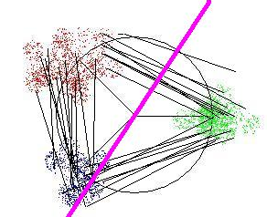
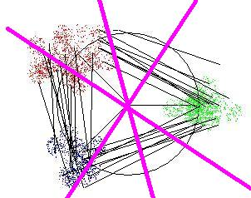
Rounding Take 1. Intuition
Let us focus on the fact that connected vertices are placed far apart.
A random hyperplane will probably cut given edge
Several random hyperplanes will cut many edges
Let us color vertices on different sides of hyperplanes in different colors !
  Using 2^{r} colors for r-hyperplanes
we will probably get a (semi) coloring

Slide 19
Rounding Take 1. More formally
We will focus on 3 colorable graphs.
The Vector-coloring solution maps every two adjacent vertices so that:
  The dot product is at most -1/2
  So the angel is at least 2π/3

Slide 20
Rounding Take 1
Lemma: The probability of two vectors at angle Θ to be separated by a random hyperplane is Θ/π
We say that H Cuts an edge e=(u,v) if H separates F(u) from F(v)
In a solution of the vector coloring problem for a 3 colorable graph.
  Pr( the edge e is cut by a random H) ≥ 2/3

Slide 21
Rounding Take 1
Pr(e is uncut by H) ≤ 1/3
If we pick r – random hyperplane
  Pr(e is uncut by any H_{1…r}) ≤ (1/3)^{r}
  E[# uncut edges in G] ≤ |E|(1/3)^{r}
Reminder: |E| ≤ nΔ/2
We set r = 2 +⎡log₃ Δ⎤
  (1/3)^{r} ≤ 1/(9Δ)
  E[# uncut] ≤|E|/(9Δ) ≤n/18

Slide 22
Rounding Take 1
E[# uncut] ≤n/18 ≤n/8
Using Markov Inequality: a>0
  Pr[X> a] ≤ E[X]/a
  Pr[# uncut > n/4] < (n/8)/(n/4)= ½
Since we can remove each end-point of every uncut edge of the graph.
  Pr[# badly colored vertices >n/2]< ½
With probability of at least ½ we get a semicoloring using 2^{r}.
Since r = 2 +⎡log₃ Δ⎤ , the number of colors
used is 2^{r}=O(Δ^{log3(2)})
Notes:
By removing each vertex of an uncut edge we achieve a semi-coloring of G with probability of at least ½.

Slide 23
Rounding Take 1. The End
We found a semi coloring algorithm to color any graph using O(Δ^{log3(2)}) colors.
We can use this algorithm recursively to O(Δ^{log3(2)} log(n)) color any graph.
  Semicoloring lemma.
By applying Widgerson’s generalized algorithm we achieve an O(n^{0.386}) coloring
  In randomized polynomial time

Slide 24
Refresh Point
As you may remember:
A Min(Õ(Δ^{1/3}) , Õ(n^{1/4})) was promised
But we found only a Min(Õ(Δ^{log3(2)}) , Õ(n^{0.386}))
And You may have guessed from “Take 1”
that there will be “Take 2”
This time we will try a different approach
Here it comes…

Slide 25
Rounding Take 2. Intuition
This time we will try to find large sized sparse sub-graphs.
Isolate an Independent set, color it’s vertices with one color and start again
Let us consider a cone around a unit vector r∈R^{n}
Vectors in this cone satisfy v·r ≥ α
  Notice that α determines the width of the cone

Slide 26
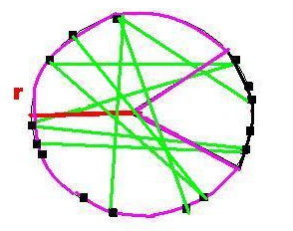
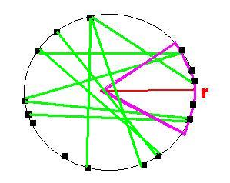
Rounding Take 2. Intuition
Looking on a k-vector coloring solution
If we choose α to be very large
  No edges will be in the cone
  But we can’t expect lots of vectors at all
On the other hand for a too small α
  We’ll probably find many vectors in the cone
  But we might find a lot of edges as well

Slide 27
Rounding Take 2. Focused Intuition
Let n’ ,m’ be the number of vertices and edges in the sub-graph defined by α.
We want to find a good α such as
E[n’- m’] is large enough
By removing one end point of each we’ll create an independent set of size n’ – m’
Color the IS with one color remove the vertices and start again

Slide 28
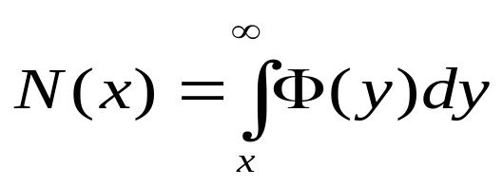
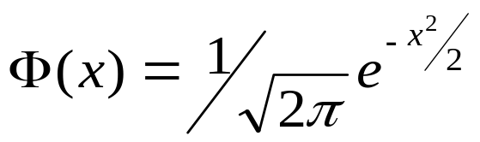
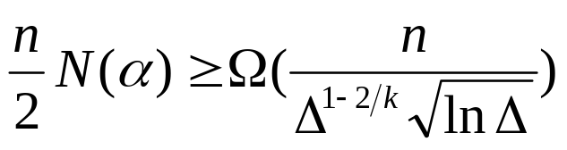
Rounding Take 2. Blue Print
Denote:
Lemma 1: for β=β(k)
  E[n’ -m’] ≥ n(N(α) – ΔN(βα)/2)
Lemma 2:
  ΔN(βα) ≤ N(α)
Corollary
  E[n’ -m’] ≥ n(N(α) –N(α)/2)=nN(α)/2
To Finalize:

Slide 29
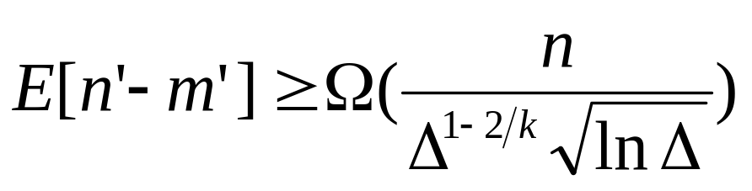

Rounding Take 2. Blue Print
Now if we have
  We can color the sub graph of size n’-m’ with one color and start again
  Using colors to semi-color G
Applying Wigderson’s algorithm archive
  min{Õ(Δ^{1/3}),Õ(n^{¼})} for 3-coloring
  min{Õ(Δ^{1-2/k}), *Õ(n^{1-3(k+1)})*} for k-coloring

Slide 30
Rounding Take 2.
Normal Distribution Facts
Reminder:
If r=(r₁,r₂ … r_{n}) and r_{i} ~ N(0,1)
for a unit vector v :
r·v ~ N(0,1) as well
Φ(x)(1/x -1/x³) < N(x) < Φ(x)/x
  This have a not-too-short technical proof

Slide 31
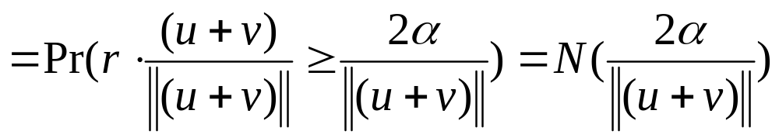
Rounding Take 2.
Lemma 1
E[n’ -m’] ≥ n(N(α) – ΔN(βα)/2)
we will bound E[n’], E[m’] separately
E[n’]= ΣE[v_{i} is selected]=
nE[v is selected]= nPr(r·v ≥ α)= nN(α)
And now E[m’] using Pr((u,v) is selected)

Slide 32
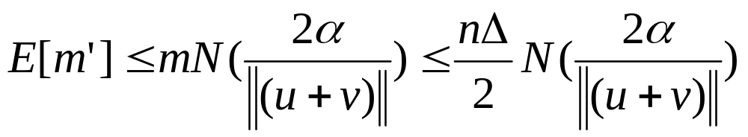
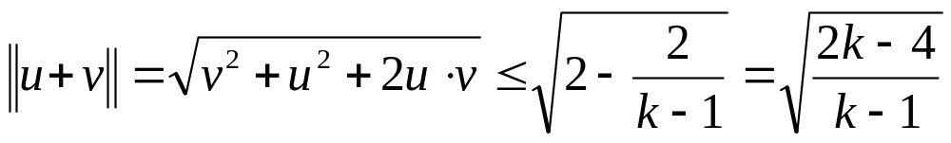
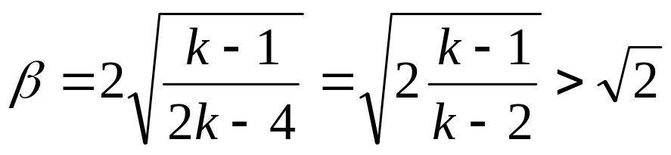
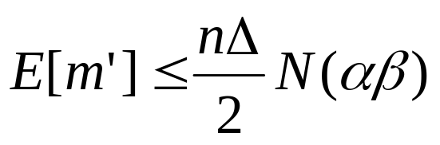
Rounding Take 2.
Lemma 1 Cont.
Assigning:
We set
That concludes Lemma 1

Slide 33
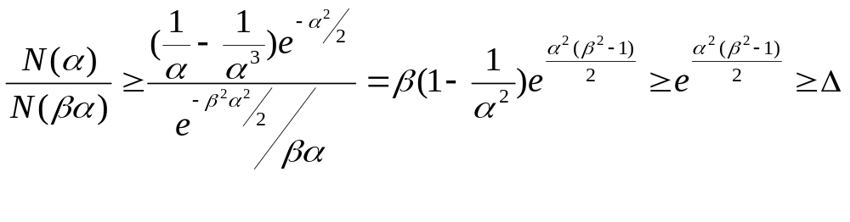

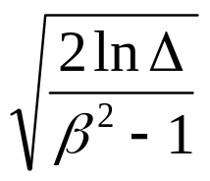
Rounding Take 2.
Lemma 2
We will prove that: ΔN(βα) ≤ N(α)
Equivalent to N(α)/N(βα) ≥ Δ
For the last inequality We set α =

Slide 34
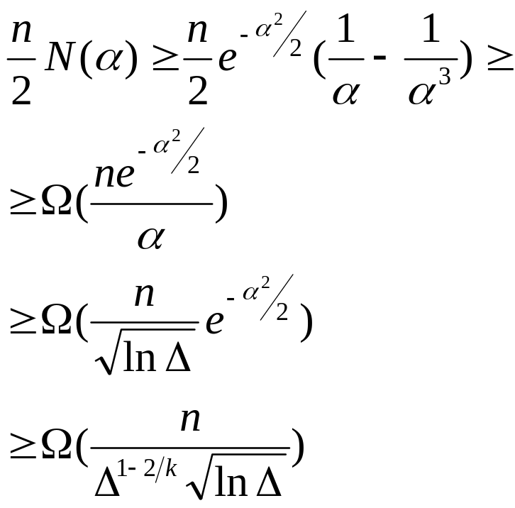
Rounding Take 2.
End
Corollary From Lemma 1,2
  E[n’ -m’] ≥ n(N(α) –N(α)/2)=nN(α)/2
To Finalize:

Slide 35
Gap between Vector-Coloring and the Chromatic Number
Our achievements so far…
The rounding approach seems far from optimum
Can we do much better using the SDP solution ???
We start a3-vector coloring only to end up with a O(nª) graph coloring!
Can we maybe get a poly-log approximation ?

Slide 36
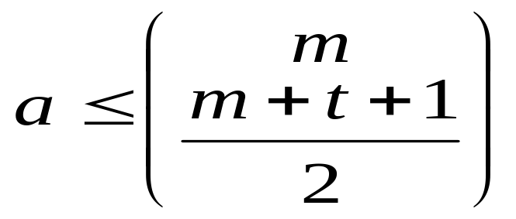
The Gap
There are graphs with a n ^{Ω(1)} chromatic number that are 3-vector colorable
Def: Kneser graph K(m,r,t)
  Vertices are all possible r-sets from m
  u,v are adjacent if |S_{u} ∩ S_{v}|<t
Milner’s Theorem: If S₁,… S_{a} ⊂[m] is an
antichain S_{v} ⊄ S_{u} . And |S_{u} ∩ S_{v}|≥t
It implies that

Slide 37
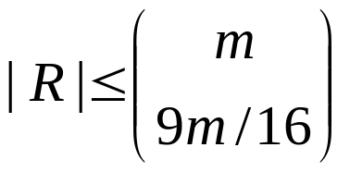
The Gap.
A hard to color graph
Define G=K(m,m/2,m/8)
  Any uni-color set of vertices R has no edge in it!
  That is R is an anti chain.
By Milner
The chromatic number of G: χ(G) ≥ n/|R|
  Using some algebra and calculation to bound R…
χ(G) ≥ n^{0.0113}

Slide 38
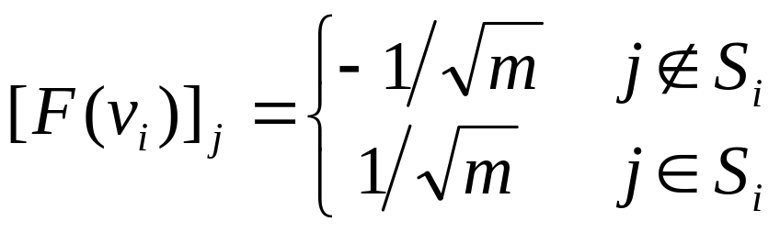
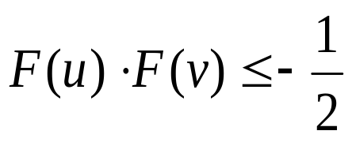
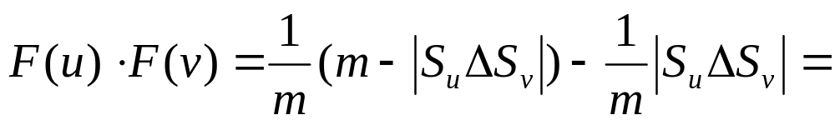
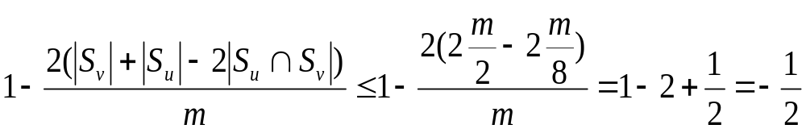
The Gap.
A 3-vector coloring
We build a 3-vector coloring for K(m,m/2,m/8)
The Color function:
we will show that:

Slide 39
The Gap.
To conclude
We found graphs that have:
  3-vector coloring
  Chromatic number of nª
That proves that using SDP in this way we will always get a Ω(nª) coloring !

Slide 40
Conclusion or What did we see today
A simple and elegant rounding technique, from vector to graph coloring.
A more complex and stronger approximation algorithms that uses Min(Õ(Δ^{1/3}) , Õ(n^{1/4})) colors
The Gap between the graph and SDP coloring problems

Slide 41
THE END

