Slide 1
The Three-Color Problem
Cindy Wu, Amy Baker, and Kim Kesting
SPWM 2011

Slide 2
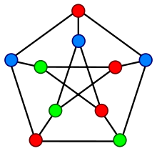
Graph Coloring
Take a graph G, with n vertices, V = {x₁, x₂, … , x_{n}}
We can color the vertices of a graph in such a way so that no two adjacent vertices have the same color.
Graph coloring has many practical and theoretical applications such as:
Air traffic control and flight scheduling,
Sudoku Puzzles!

Slide 3
What is the three-color problem?
Suppose we have a graph G with n vertices, where there is at most one edge between any two vertices.
Goal: To color the graph so that no two adjacent vertices are colored with the same color.
In the Three Color Problem, we want to see if we can color the graph so that only 3 colors are used.
If G can be colored this way, G is called
3-colorable.

Slide 4
An Application of GrÖbner Bases!
It turns out that we can use Gröbner Bases to answer the question of whether or not a particular graph G is 3-colorable!
Gröbner Basis can also help us determine how to color the vertices.

Slide 5
How do we represent the colors mathematically?
Let ξ be a cube root of unity, i.e. ξ³=1
From complex analysis and Euler’s Formula, we get:
We will represent our three colors using the three distinct cube roots of unity: 1, ξ, ξ².
For example, we may define ξ² to be the color red.
Note, 1+ξ+ξ²=0
Each vertex will be assigned one of the 3 colors 1, ξ, ξ²

Slide 6
Generating the Gröbner Basis
Let the variables x₁, x₂,…, x_{n} represent the distinct vertices of G.
Each vertex of G has a corresponding polynomial,
x_{i}³ -1= 0 for 1 ≤ i ≤ n
Since each vertex will be assigned one of the colors corresponding to one of the cube roots of unity, we know this equation will hold regardless of which root is actually assigned.

Slide 7
Generating the Gröbner Basis
Recall, if vertices x_{i} and x_{j} are connected by an edge, they need to have a different color.
Since x_{i}³= x_{j}³=1, we can derive a second polynomial:
x_{i}³ - x_{j}³ =(x_{i} - x_{j})(x_{i}² + x_{i}x_{j} + x_{j}² )=0 by factoring.
From this equation, we know that x_{i} and x_{j} will have a different color if and only if:
(x_{i}² + x_{i}x_{j} + x_{j}² )=0
Notes:
If x_{i} and x_{j} distinct vertices connected by an edge, they have a different color, so x_{i} - x_{j} can’t equal 0.

Slide 8
Generating the Gröbner Basis
Let I be the ideal of the polynomial ring C[x₁, x₂,…, x_{n} ]
Let I be generated by the polynomials corresponding to the graph G:
x_{i}³ -1= 0 for 1 ≤ i ≤ n
and
x_{i}² + x_{i}x_{j} + x_{j}² =0
where x_{i} and x_{j} are connected by an edge.
We then compute the Gröbner basis for this ideal I, which is the Gröbner basis that corresponds to our graph G.

Slide 9
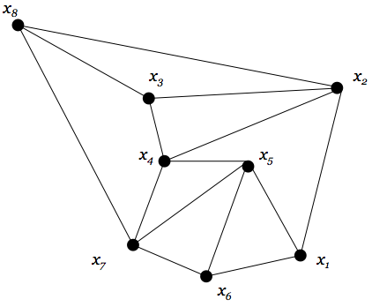
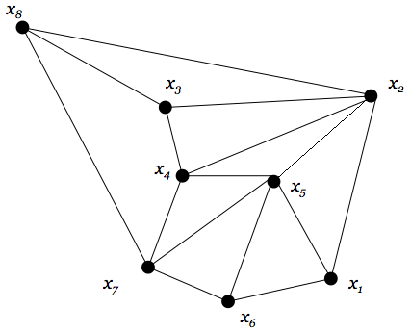
Are either of these graphs 3-colorable?
Graph 1:
Graph 2:
We can use a Gröbner basis to find out!

Slide 10
Colorable Theorem
Consider the variety V(I) contained in C^{n}
The graph G is 3-colorable
if and only if
V(I)≠ ∅
What is a variety?

Slide 11
Variety
Let K be an extension field of k.
That means that k ⊆ K where K is a field.
Let S ⊆ k[x₁, x₂,…, x_{n} ]
The variety V_{K}(S) in K^{n} is
V_{K}(S)= { (a₁, a₂, …a_{n}) ∈ K^{n} |f(a₁, a₂, …a_{n})=0 ∀f ∈ S }

Slide 12
More About Variety
If I=<f₁,f₂…,f_{s}> ⊆ k[x₁, x₂,…, x_{n} ], then we can simply apply the definition above for I:
V_{K}(I)= V_{K}(f₁,f₂…,f_{s})=
{ (a₁, a₂, …a_{n}) ∈ K^{n} |f_{i} (a₁, a₂, …a_{n})=0, 1≤i≤s}

Slide 13
Example
Let K=R
Then V_{R}(x²+y²)=
V_{R}(x,y)=
{(0,0)} ⊆R²
Another example:
V_{R}(1+x²+y²)= ∅

Slide 14
Algebraic Closure
We denote the algebraic closure of the field k by k’ where
k’={a| ∃ a nonzero polynomial in one variable with coefficients in k that has a as a root}
Every k is contained in k’.

Slide 15
Weak Hilbert-Nullstellensatz Theorem
Let I be an ideal contained in k[x₁, x₂,…, x_{n} ]. Then V_{k’} (I)= ∅ if and only I=k[x₁, x₂,…, x_{n} ]
Note that k’ is algebraically closed
Let k[x₁, x₂,…, x_{n} ] = R[X],
if 1 ∈ I then I=k[x₁, x₂,…, x_{n} ]
if 1 ∉ I then I≠k[x₁, x₂,…, x_{n} ]

Slide 16
Theorem
V_{k’} (I)= ∅ if and only 1 ∈ G.
IE: Given polynomials f₁,f₂…,f_{s} there are no solutions to the system f₁=0, f₂=0,…,f_{s}=0 in k’^{n} if and only if 1 ∈ G
Proof: By the Weak Hilbert-Nullstellensatz Theorem,
V_{k’} (I)= ∅ if and only if 1 ∈ I.
But if 1 ∈ I, then 1 ∈ G by definition.

Slide 17
Are either of these graphs 3-colorable?
Graph 1:
Graph 2:
YES!
NO
Notes:
Verbally discuss: why does adding this edge cause the graph to no longer be three colorable? – both x5 and x2 are green

Slide 18
Now back to the 3-color problem…An Example!
Consider the following graph G
x₈
x₃
x₂
x₄
x₅
x₇
x₁
x₆

Slide 19
The Polynomials for graph G
x_{i}³ -1= 0 for each of the vertices x₁, x₂, …, x₈.
x_{i}² + x_{i}x_{j} + x_{j}²=0 for each of the edges
(i,j)={(1,2),(1,5),(1,6),(2,3),(2,4),(2,8),(3,4),(3,8),(4,5),(4,7),(5,6),(5,7),(6,7),(7,8)}
We use these polynomials to generate an ideal I, and then compute the GrÖbner basis G from the ideal I.

Slide 20
The GrÖbner Basis for G
Use lex term ordering where x₁>x₂>…>x₈
The resulting Gröbner basis for our graph:
G={x₁-x_{7,} x₂+x₇+x₈, x₃-x₇, x₄-x₈, x₅+x₇+x₈, x₆-x₈,
x₇²+x₇ x₈+x₈², x₈³-1}
Since 1 ∉ G, V(I)≠ ∅, and hence, by the colorable theorem, our graph is 3-colorable!
Now, for determining the colors of the vertices…

Slide 21
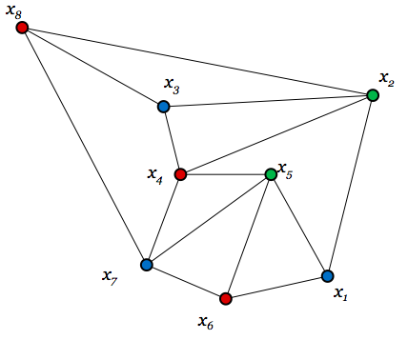
Determining the Colors
Consider x₈³-1
x₈ → RED
Since x₄-x₈ , x₆-x₈ ∈ G
x₄, x₆ → RED
x₇²+x₇ x₈+x₈² ∈ G
x₇ → BLUE
x₁-x_{7,} x₃-x₇ ∈ G
x₁, x₃ → BLUE
x₂+x₇+x₈, x₅+x₇+x₈ ∈ G
x₂, x₅ → GREEN

Slide 22
Four-Coloring of Graphs
We can use a similar process to determine if a graph is 4-colorable, only this time let ξ be a fourth root of unity.
Then our four colors will correspond to 1, -1, i and –i
Now our polynomials are:
x_{i} and x_{j} are adjacent

Slide 23
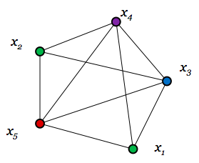
Example for Four-Coloring Graph
G={x⁴₅-1, x³₄+x²₄x₅+x₄x₅²+x₅³, x₅²+x₅x₄+x₄²+x₅x₃+x₄x₃+x₃², x₂+x₅+x₄+x₃, x₁+x₅+x₄+x₃}
Notes:
Verbally discuss: what would happen if we add in an edge between x2 and x1 – 5 colors needed

Slide 24
K colorings
In general, if we have n number of vertices in our graph G, and k number of colors, our polynomials are:
x_{i}^{k} -1= 0 for 1 ≤ i ≤ n
(x_{i}^{k-1}+x_{i}^{k-2}x_{j}+…+x_{i}x_{j}^{k-2}+x_{j}^{k-1}) =0
where x_{i} and x_{j} are connected by an edge

Slide 25
Sources
W. W. Adams, P. Loustaunau, An Introduction to Gröbner Bases, pg 61-65, 102-105, American Mathematical Society.
Wikipedia, “Graph Coloring”.

