Slide 1

Windows Phone 8 End to End
Twitter: @arielbh
Ariel Ben Horesh
www.arielbh.com
Co-founder - CodeValue
26/2/2013

Slide 2
Steps for an App
Idea – Zillion of them, most of them stupid. Can’t help you there.
Design – Panorama/Pivot, Gaming, HTML based.
Architecture – MVVM, IoC, Frameworks, Layers, PCL, WAMS
Development – XAML, async-await, Background Tasks, Phone Integration, Store integration, WP Toolkit.
Testing – Unitests! (improving)
Store – It builds? Ship it.

Slide 3


Idea
My Stupid idea for today:
My Friend just got Married yesterday (that’s why I’m hangovered here).
A Wedding app is boring but money tracing. That’s useful.

Slide 4
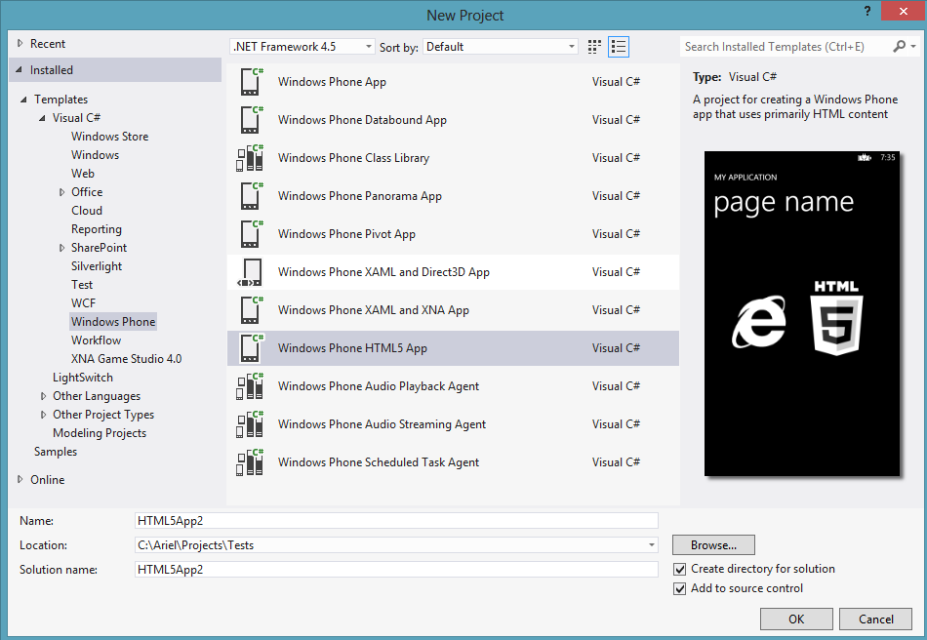
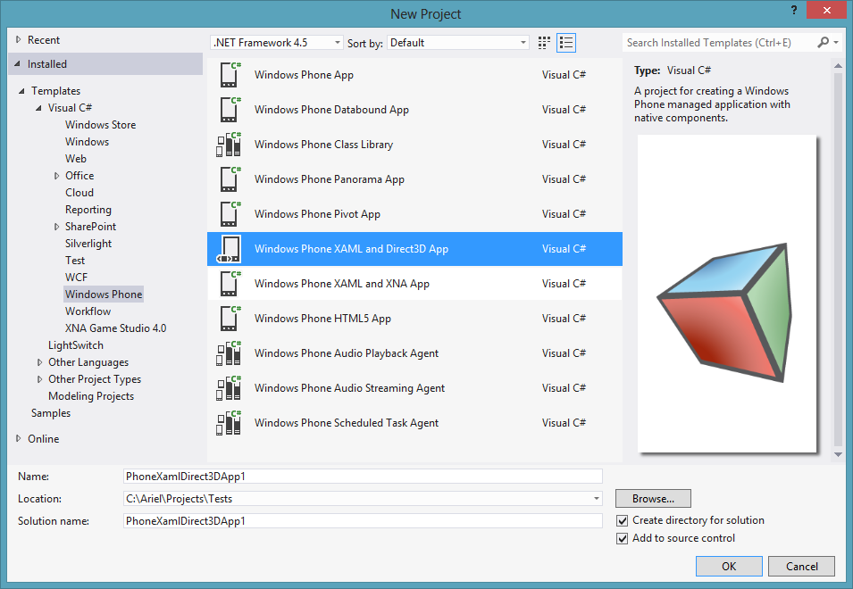
Design (1)
Clear the table
HTML
By using WebBrowser Control (IE 10).
Mostly on your own.
Phone specifc is still C#
(no WinJS, yet).
XAML + XNA/ XAML + Direct3D
Games obviously.
XNA has no future– better off with Direct3D or different approach such as Unity3d.

Slide 5
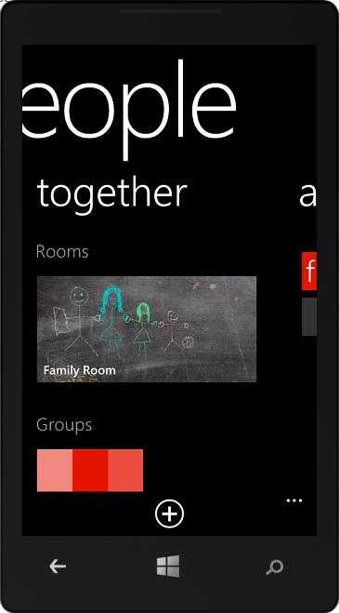
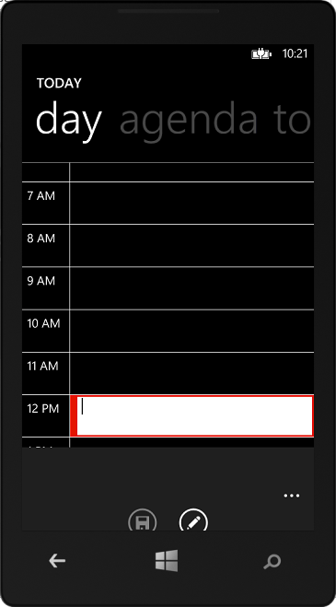

Design (2)
Pivot VS Panorama.

Slide 6
Design (3)
Use the AppBar (“Application Bar”) for “Context” operations.
Think about Navigation, Think about CustomMessageBox. Those enable flow in your application of the user.
Remember various view-states: Landscape and Portrait.
Follow the Windows Phone Guidelines.
http://msdn.microsoft.com/en-us/library/hh202915(v=VS.92).aspx

Slide 7
Architecture (1)
It Depend – But This is a common pattern.
If you want to have live tiles (and you want), you will gonna need agents.
Windows 8
Data Access + Model
(PCL?)
WP8
Agents
Server Side

Slide 8
Architecture (2)
MVVM - Use a framework, any framework. And use MVVM.
Model: Responsible for managing and delivering data.
View: Responsible for formatting and displaying data.
ViewModel: Responsible for shaping, sorting and filtering data for a view(s).
Model
View
DataBinding
ViewModel

Slide 9
Architecture (3)
By default Navigation is View-First.
App.RootFrame.Navigate(new Uri("/Views/MyView.xaml?id=“ + HttpUtility.UrlEncode(SelectedObject.ID), UriKind.Relative));
You can find frameworks that helps you handle navigation in the ViewModel is prefered.
Sometimes you will have to use the Code-Behind. But you can use Behaviors to go around it.

Slide 10

Architecture (4)
Inversion of Control
Again. It depend on how complicated is your app.
Many options: Autofac, TinyIoc, SimpleIoC, Funq. (no Unity, yet)
Alternative: static members in App. Use Interfaces.

Slide 11
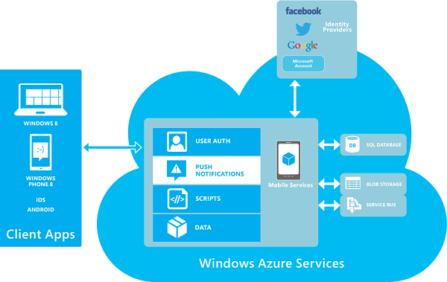
Architecture (5)
Use Windows Azure Mobile Services if relevant.

Slide 12
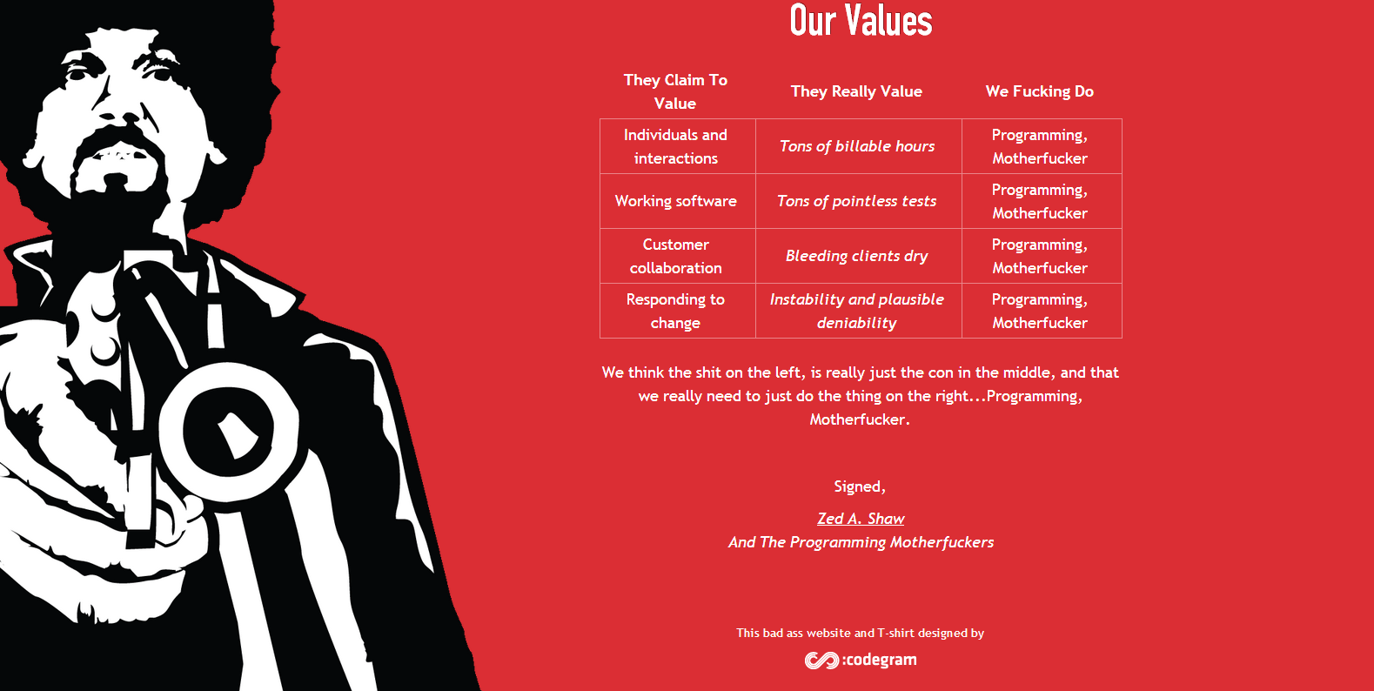
Development – Motherf*cker

Slide 13
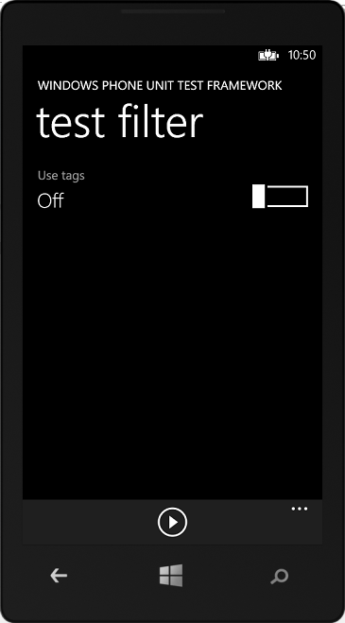
Testing
Test like no tomorrow.
Use Windows Phone 8 Unitests project.
Should become better with VS2012 update.

Slide 14
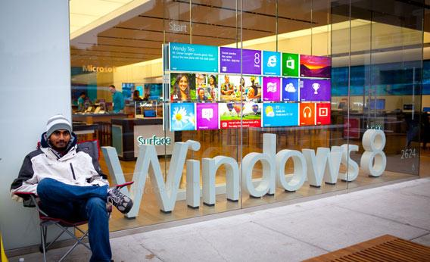
Store
Deploy quick. Increment as you go.
Use API for InApp and purchases. (Also Store Mock)
Get Bug reports and exceptions from the store.
Allow users to interact with your (better then bad reviews).
Use Store Test Kit
Before publishing.

Slide 15
Summary
Windows Phone 8 is a great opportunity.
Reuse your .NET skills effectively.
Great Phones. OS is getting better.
Market is increasing.
Israel is very Microsoft oriented.

Slide 16
Q & A

Slide 17
arielbh@CodeValue.net
054-6160650

