Slide 1

Web UI Architecture Frameworks, What is Available?
Twitter: @arielbh
Ariel Ben Horesh
www.arielbh.com
Co-founder - CodeValue
6/6/2012

Slide 2
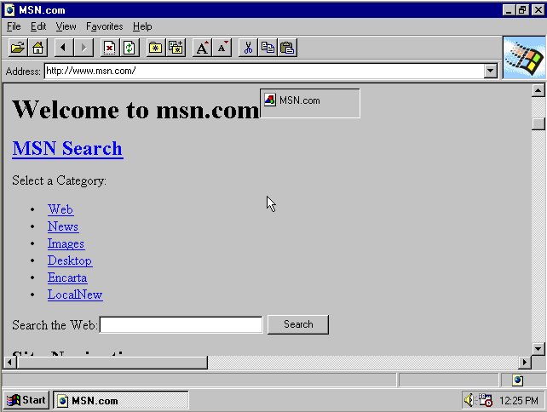
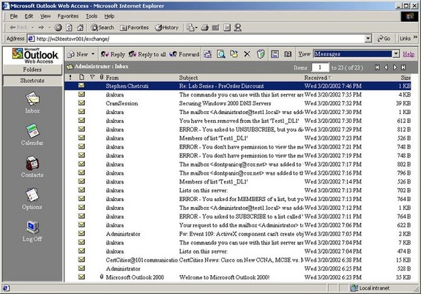
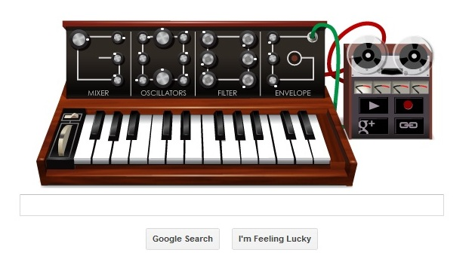
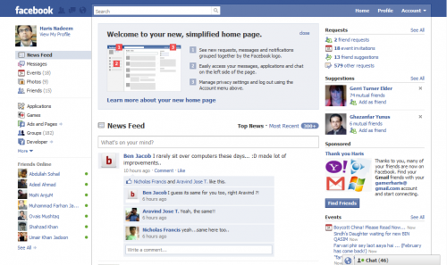
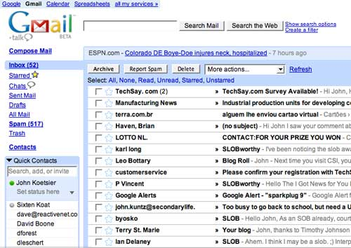
The Web is changing

Slide 3
Today’s Web Applications
Rich, responsive applications
Combining the best of web and desktop
built with HTML5 and JavaScript

Slide 4
Great user experience
Runs on any device
Can work offline
App-store deployable

Slide 5



Why Do We Need Client Side Frameworks?
Visible UI HTML/CSS
Web UI
HTML/CSS/JS
Data services
JSON/XML
Application layer JavaScript
Navigation APIs
Data access layer JavaScript
Local storage
Server
Client

Slide 6
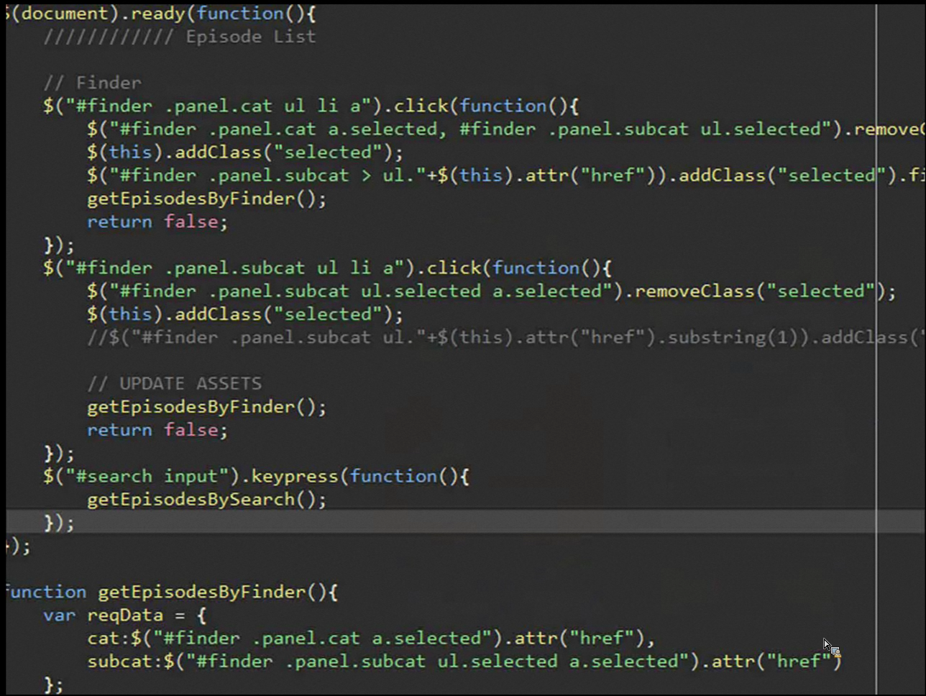

Slide 7



The Challenge
Notes:
http://www.sxc.hu/photo/833284
http://www.sxc.hu/photo/338544

Slide 8
So Much Options
Require.JS
PureMVC
Meteor
Backbone.JS
ASP.NET MVC SPA
Bootstrap
PrefixFree.JS
Spine.JS
JavaScriptMVC
Google Closure
Lawnchair.js
Sammy.JS
jQuery
Ruby on Rails
YUI Library
Knockout.JS
Agility.js
Sugar.js
Batman.js
Mustache
GWT
EXTJS4
Angular.JS
ASP.NET MVC
Cappuccino
Handlebars.js
Ember.JS
SproutCore
Underscore.JS
Dojo.js
Notes:
Need to start a new web project?
Puzzled by so many options?

Slide 9
Plan For Today
Knockout.JS
AngularJS
Backbone.JS
Ember.JS

Slide 10
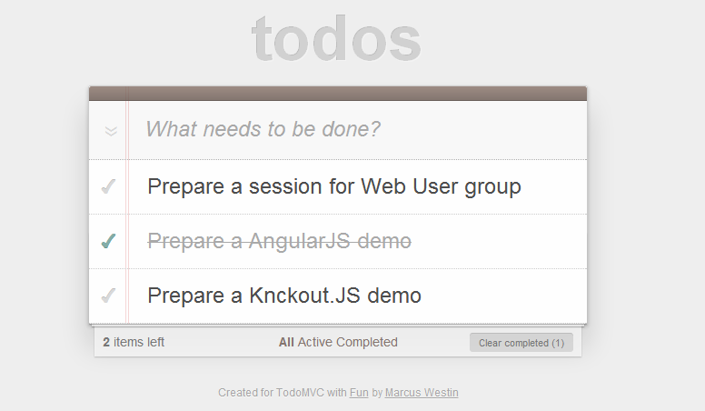
Case-Study – Todo apps

Slide 11

Knockout.JS
Author: Steve Sanderson / Community
Initial release: 5.7.2010
License: MIT
Features:
Declarative bindings
Automatic UI refresh (notifications)
Dependency tracking
Templating (pluggable)

Slide 12
What stand beyond M.V.VM?
Model: Responsible for managing and delivering data.
View: Responsible for formatting and displaying data.
ViewModel: Responsible for shaping, sorting and filtering data for a view(s).
Model
View
DataBinding
ViewModel

Slide 13
In Action

Slide 14

Backbone.JS
Author: Jeremy Ashkenas
Initial release: 9.2010
License: MIT
Features:
Highly flexible library (100% and not a framework ☺)
Automatic Model notifications
Observable Collections
Pub/Sub (Events)
Routers

Slide 15
(not)MVC (Backbone.JS Context)
View/Controller
Model/Collections: Responsible for managing and delivering data.
View/Controller: Responsible for formatting and displaying data. Also handling events.
Router/Controller: Maps URLs to functions
Router/Controller
Model

Slide 16
In Action

Slide 17
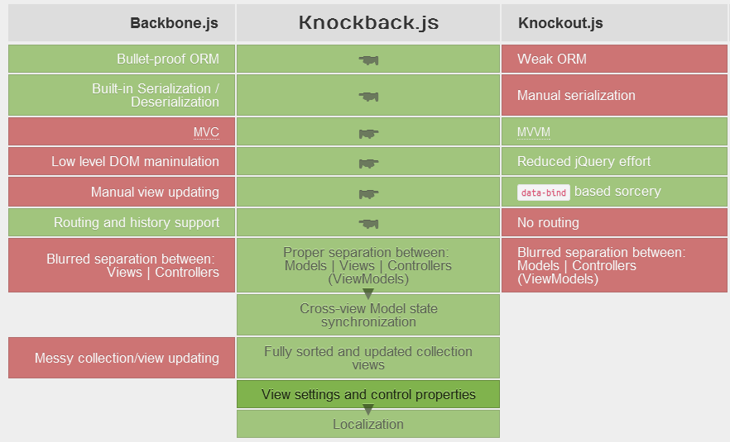
Knockback (Why Choose?)
Bring Knockout.JS power to Backbone.JS structure.

Slide 18

AngularJS
Author: Google / Community
Initial release: 2009
License: MIT
Features:
Declarative bindings
Contains IoC Container -> Easy to test.
Templating views
Routers
Modules

Slide 19
MVC (AngularJS Context)
View
Model: Responsible for managing and delivering data.
View: Responsible for formatting and displaying data.
Controller: Responsible for shaping, sorting and filtering data for a view(s).
DataBinding
Controller
Model

Slide 20
In Action

Slide 21

Ember.JS
Author: Apple / Community (Previously SproutCore)
Initial release: 2010
License: MIT
Features:
Declartive Bindings
Computed properties
Auto-updating templates
StateManager mediates transitions.

Slide 22
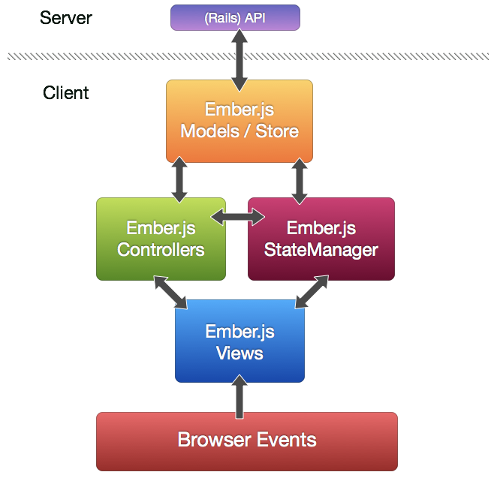
MVC (Ember.JS Context)
Model: Responsible for managing and delivering data.
View: Responsible for formatting and displaying data.
Controller: Responsible for shaping, sorting and filtering data for a view(s).

Slide 23
In Action

Slide 24
Results
TBD

Slide 25
Summary
We have come a long way, dissecting 4 JavaScript clients apps. Each different and has it’s own personality.
It’s just the tip of the Iceberg, there are dozens more beside those 4.
All are aiming at the same target, applying structure and order to the client side area of Web applications.
In the end it’s a matter of personal preference and community adoption.

Slide 26
Q & A

Slide 27
arielbh@CodeValue.net
054-6160650

