Slide 1
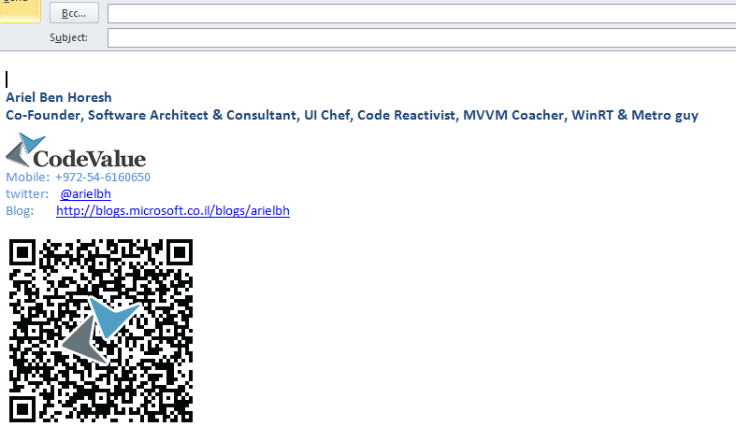
ReactiveUI
Ariel Ben Horesh
“Code Reactivist”
23/09/2012

Slide 2

Plan for today
Quick reminder
MVVM
Reactive Extensions
ReactiveUI

Slide 3
What stand beyond M.V.VM?
Model: Responsible for managing and delivering data.
View: Responsible for formatting and displaying data.
ViewModel: Responsible for shaping, sorting and filtering data for a view(s).
Model
View
DataBinding
ViewModel

Slide 4
Why do we need this?
Ease of work with designers
Loosely coupling, easiness of maintainability.
Testability – Code behind is untestable.
It is just easier to use data-binding with MVVM

Slide 5

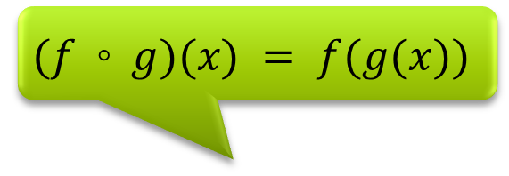
Reactive Extensions
Too hard today…
$$(f ◦ g)(x) = f(g(x))$$
Rx is a library for composing asynchronous and event-based programs using observable collections.
Queries? LINQ?
Download at MSDN DevLabs
.NET 2.0, .NET 4.X, Silverlight
JavaScript, more…?
Notes:
Speaker tips:
Quote from the MSDN DevLabs homepage for Rx. No marketing fluff a la “next-generation blah”, but a truly technical phrase highlighting the important aspects of Rx…
Emphasize how much asynchrony exists today: cloud, phone, AJAX, etc. Also refer to end-user frustration with hung applications.
Compositionality matters: today, 1 + 1 is not 2, due to all the plumbing that goes in the “+”. Too much friction and spaghetti code.
How we want to tackle this problem: by looking through the lenses of asynchronous data sources. Everyone likes LINQ, after all…
Today’s release vehicles: .NET 3.5 SP1 (really CLR 2.0 based, including backport of the TPL), Silverlight, JavaScript, on Windows Phone 7
Where does what ship?
Interfaces for observable collections (see further) in .NET 4 BCL
Separate Rx assembly contains those for downlevel platforms
Operators (see further) in Rx download

Slide 6
Reactive Extensions
interface IObservable<out T>
{
IDisposable Subscribe(IObserver<T> observer); }
interface IObserver<in T>
{
void OnNext(T value);
void OnError(Exception ex);
void OnCompleted();
}
interface IEnumerable<out T>
{
IEnumerator<T> GetEnumerator(); }
interface IEnumerator<out T> : IDisposable
{
bool MoveNext();
T Current { get; }
void Reset();
}

Slide 7
Bridging Rx with the World Why .NET events aren’t first-class…
How to pass around?
Hidden data source
form1.MouseMove += (sender, args) => {
if (args.Location.X == args.Location.Y)
// I’d like to raise another event
};
form1.MouseMove -= /* what goes here? */
Lack of composition
Resource maintenance?
Notes:
Speaker tips:
Big message:
Primitive constructor operators are great, but we’d like to do something of more interest…
Rx doesn’t aim at replacing existing sources of asynchrony in the framework
Instead we can bridge with those worlds
First common source of asynchrony are .NET events
Suffer from some problems:
Nobody thinks of a mouse as a database of points
Mouse database is not “preprogrammed” (like: “give me a mouse that can move once across the screen”) but is an infinite source
Have to dot into the EventArgs object to obtain the data (sometimes it isn’t even there!)
Events cannot be grabbed
No objects that can be passed to a method, stored in a field, put in an array, etc.
How’d you write a GPS visualizer that expects to get passed an event producing points? Can’t pass a .NET event along!
Composition suffers
Everyone has to write logic in event handlers, e.g. an if to filter
Can’t hire a mathematician to write a generic filter that works with all events
Also, we’d like a filtered event still to be an event (stay in the same “world”) → we have to settle for procedural code today
Resource maintenance requires state
Have to remember what you gave to += in order to get rid of it using -= → use a field?
Same C# code passed to -= won’t work (there is no value equality between delegates based on what code they contain)
Notice resource management gets even harder in the face of composition
Say that applying a hypothetical generic filter to an event gives you a new event “object”
Now if you unhook a handler from the filtered event, you want it to unhook from the original event
→ Cascading effect with lots of state maintenance!

Slide 8
Bridging Rx with the World …but observables sequences are!
Objects can be passed
Source of Point values
IObservable<Point> mouseMoves = Observable.FromEvent(frm, "MouseMove");
var filtered = mouseMoves
.Where(pos => pos.X == pos.Y);
var subscription = filtered.Subscribe(…);
subscription.Dispose();
Can define operators
Resource maintenance!
Notes:
Speaker tips:
How does Rx improve on this?
FromEvent methods → here reflective overload being used
Notice: omits a few things…
Generic parameter for EventArgs
Fact it returns an IObservable<IEvent<…>> → correct this in the demo
Rationale: focus on the essence here
Comparison to before:
Look at the type to see the (no longer hidden) data source → source of Point values (thanks to generics)
Objects a la IObservable<Point> can be passed, e.g. to our GPS visualizer
Just like LINQ to Objects does, we can define operators on objects → compositionality enters the picture
Resource maintenance can be done using a “subscription handle”
Yes, you still need to store it somewhere, but you don’t need to remember what you gave it
The old world is like subscribing to a magazine but keeping your hands on the check so you can take it back!
In the new world you get an unsubscription card (the Dispose method) you can send in to unsubscribe…
Notice state maintenance for unsubscription can be encapsulated now too
E.g. Merge operator that merges n number of observable sequences into one
Subscription causes a subscribe on all of the sequences
Unsubscribe should unsubscribe from all of the underlying sequences
Needs a list of IDisposable objects → we have an algebra over IDisposable in System.Disposables
Can hide those from the outside world!

Slide 9
And finally… Reactive UI
Bring the async goodness of Rx to the MVVM scene.
Concept | RxUI | Explanation
ViewModelBase | ReactiveObject | PropertyChanged notifications
ObservableCollection | ReactiveCollection | CollectionChanged notifications
Commands | ReactiveCommands | ICommand done right
Messaging | MessageBus | Pub/Sub
Routing/Navigation | Router | ViewModel based navigation

Slide 10
Where is the Codez?
This Session
https://github.com/arielbh/ReactiveUI-Intro
ReactiveUI
https://github.com/reactiveui/ReactiveUI
ReactiveUI Samples (I accept Pull Request!)
https://github.com/reactiveui/ReactiveUI.Samples

Slide 11
Summary

Slide 12
Q & A

Slide 13
arielbh@CodeValue.net
054-6160650

