Slide 1
Developing Windows Phone Apps
Ariel Ben Horesh & Alon Fliess
CodeValue

Slide 2
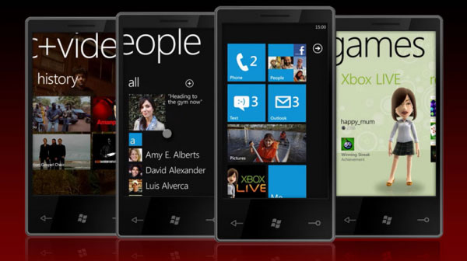
Agenda
Introduction to developing Windows Phone Apps
Why?
How?
Languages
Tools
Code, Code, Code

Slide 3
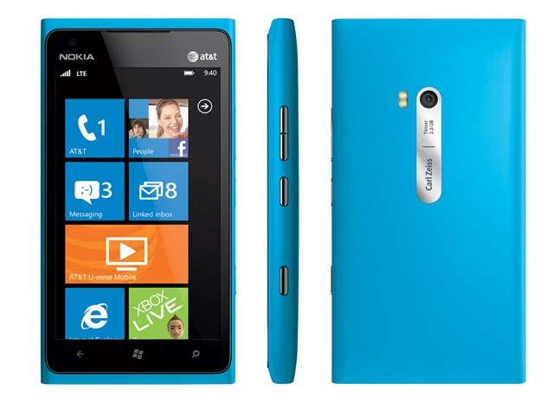
The Device
new platform
based on familiar technologies and tools
multiple hardware vendors
consistent baseline (cpu, resolution, etc.)

Slide 4

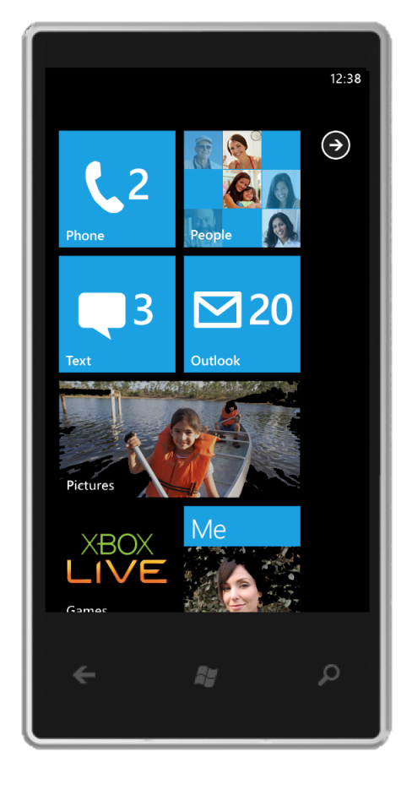
The Developer Story
METRO IS WINDOWS PHONE’S DESIGN LANGUAGE. IT’S MODERN AND CLEAN. IT’S ABOUT TYPOGRAPHY AND CONTENT.
Silverlight - a subset of the .NET framework and WPF
XAML – XML Application Markup Language
C# - Modern C based high productive language
Visual Studio – Integrated development environment
Expression Blend - Takes your ideas all the way from concept to completion
XNA – Video game development platform for the PC, Xbox & Windows Phone

Slide 5
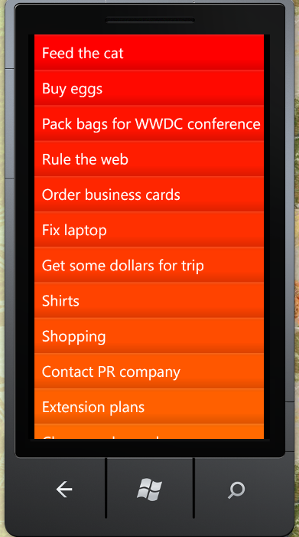
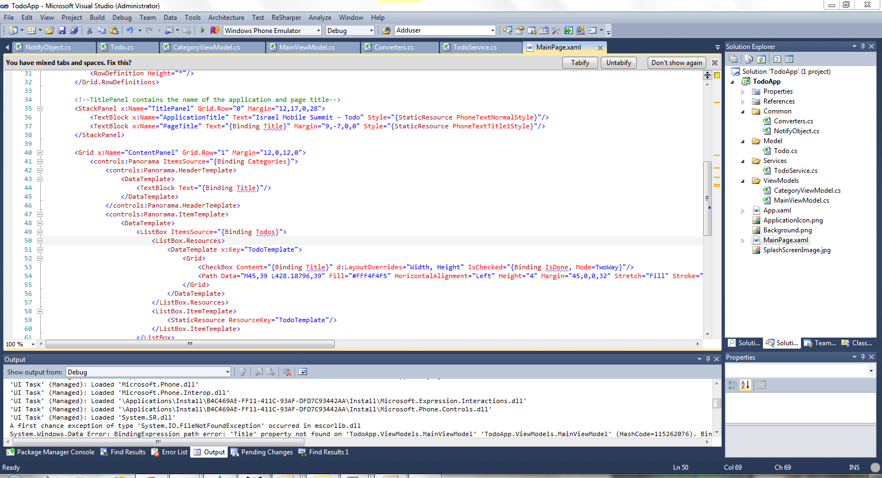
Lets Code

Slide 6
Resources
Download the SDK/VS Express
http://www.microsoft.com/en-us/download/details.aspx?id=27570
iPhone to WP7 “Official” Guide
http://windowsphone.interoperabilitybridges.com/articles/windows-phone-7-guide-for-iphone-application-developers
Android to WP7 “Official” Guide
http://windowsphone.interoperabilitybridges.com/articles/windows-phone-7-guide-for-android-application-developers

Slide 7
Summary
Windows Phone is Cool
The Metro concept is Fast & Fluid
The development process is mature
The development tools provide fast and creative developing experience

Slide 8
Q & A

