Slide 1
Homelessness in Maryland Counties
GROUP MEMBERS: ARIEL DUNN, PORTIA ANYAMBA, IRINA FEDOROVA, ALLISON DORION, MATTHEW YURICH

Slide 2
Hypothesis and Motivations
Hypothesis: Homelessness trends are not evenly distributed amongst racial and economic groups in the state of Maryland.
Motivations:
We all live in different counties in Maryland and are interested in the homeless populations.
What can we do to improve national issues surrounding racial and socioeconomic situations?

Slide 3
Questions and Summary
Question 1: What have the trends of total homelessness been over time per CoC?
Question 2: How is homelessness divided amongst racial groups in each CoC?
Question 3: Does median income and the number of unemployed people relate to homelessness in each CoC?
The objective of our research and data analysis is to compare trends in homelessness by CoCs in the state of Maryland. We will evaluate the data to see if there is any relationship between homelessness and its division amongst racial groups and average median household income.
Key Terms
CoC: Continuum of Care
Defined by HUD as, “a regional or local planning body that coordinates housing and services funding for homeless families and individuals.”

Slide 4


Relevance of Data Sources
1. Trends in homeless populations over time
Is homeless spread evenly amongst counties? What have been the recent changes in the homeless population in each CoC, if any?
2. Homelessness in Different Racial Groups
Do certain racial groups have a higher count of homeless people? Are the racial divides in the homeless population consistent across counties in the state?
Data Source Used: 2007-2020-PIT-Estimates-by-CoC.xlsx
Excel workbook obtained from the US Department of Housing and Urban Development (HUD) portal
Contains information pertaining to
Overall homelessness for each CoC
How overall homelessness is divided amongst racial groups in each CoC

Slide 5
Relevance of Data Sources cont.
3. Socioeconomic environments and homelessness
Do CoCs with a higher median income and lower number of unemployed people also have a lower number of homeless people?
Data Source Used: Unemployment.xlsx
Excel workbook obtained from the USDA Economic Research service
Contains data pertaining to
Average median income per county
Total number of unemployed people per county

Slide 6
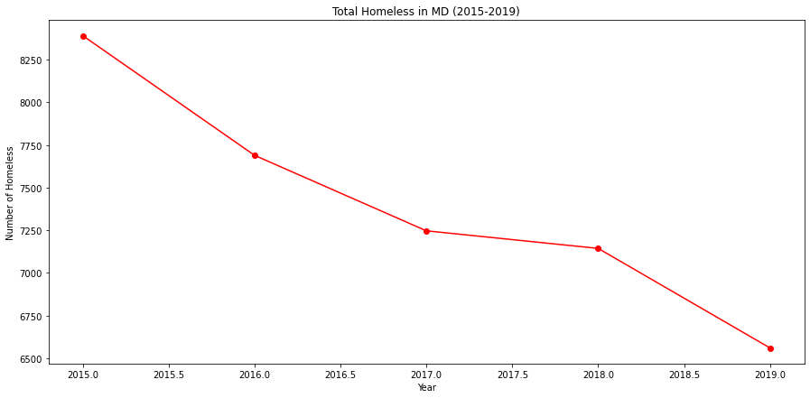
State trends 2015-2019
Overall homelessness in Maryland has been on a steady decline
In 2015 the state had 8,390 homeless people and by 2019 it was down to 6,561
The greatest decrease in homelessness occurred between 2015-2016

Slide 7
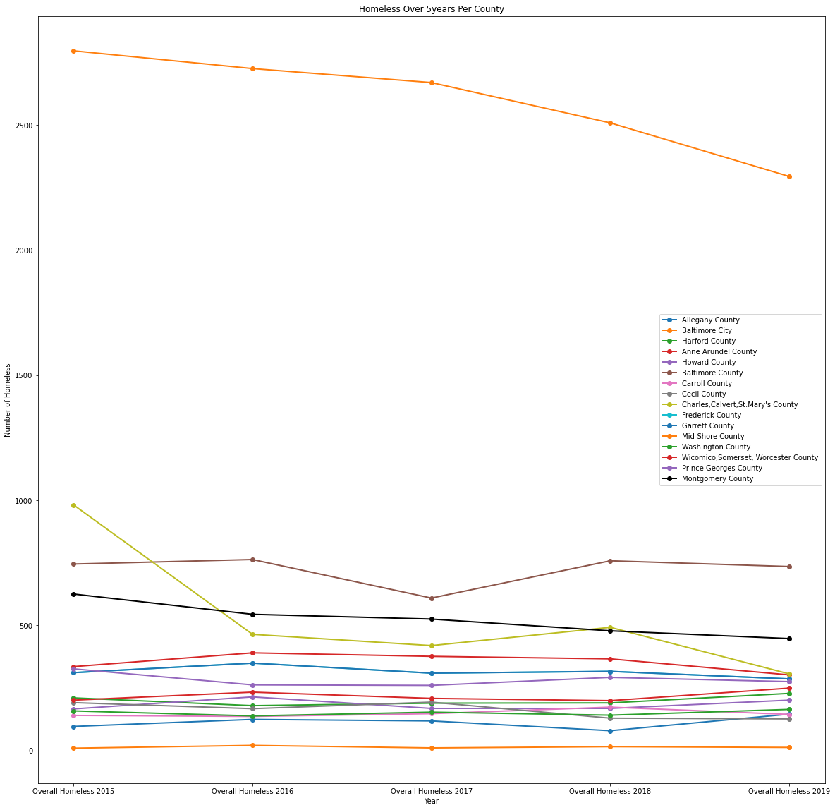
CoC trends 2015-2019
Baltimore County has the highest number of homeless people but shows a steady decline over time
Total number of homeless people decreased from 2,796 in 2015 to 2,294 in 2019
Other counties have had insignificant fluctuations, with the exception of Baltimore County in 2017
Baltimore County had a significant reduction of numbers in 2017
The number of homeless people has been steadily declining in the following CoCs
Montgomery County: 1,100 to 647
Charles, Calvert, St Mary’s Counties 981 to 306
Prince George’s County: 625 to 447

Slide 8
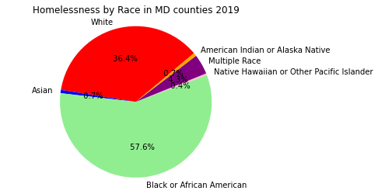
Divisions In The State of Maryland’s Overall Homeless Population by Racial Groups
“Black/African American”: 57.6%
“White”: 36.4%
“Multi Races”: 4.3%
Other racial groups are negligible by numbers as each one is accountable for less than 1%

Slide 9
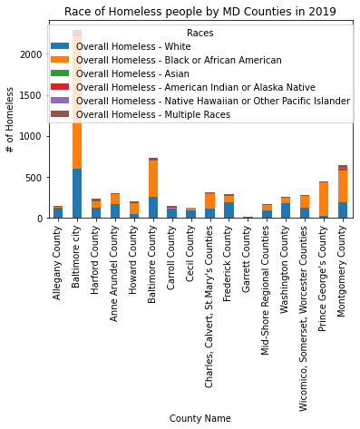
Racial Divisions in Homeless populations by CoC
Prince George’s County has the highest ”Black or African American” homeless population by percentage (91%)
Second highest number of overall homeless people
Baltimore County: 735
Although the homeless population is almost 3x less than Baltimore City’s, the racial disparity proportions are the same (2 Black: 1 White)
Highest number of overall homeless people
Baltimore City: 2,294
“Black or African American”: 1,609
“White”: 602

Slide 10
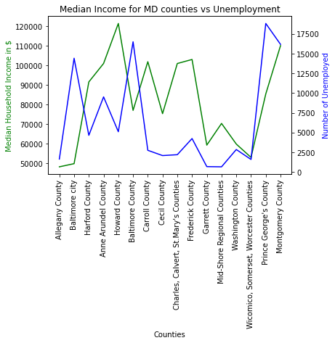
How did median income and unemployment relate to homelessness in each CoC in 2019?
The CoCs with higher average median incomes generally have a lower number of unemployed people
No significant relationship was found between the strength of a CoCs economy and their homeless population for the year of 2019

Slide 11
Data Clean up and Exploration
Both raw data sets have a lot more information and needed to be consolidated
USDA Economic Research Service
Removed data for all of the years that were not in our studied range (2019)
1. HUD dataset
Removed data for all of the states’ CoCs except for Maryland’s
Removed sheets for years that were not in our studied range (2015-2019)

Slide 12
Data Clean up
1. Looked for files with the same column headings to be merged together
2. Consolidated counties into CoC groups in one data set to match the CoC groups in the other
3. Merged the files by County ID
4. Renamed columns to be user friendly
5. Reformatted the data from string to numeric

Slide 13
Data Analysis & Discussion
Homelessness in Maryland as a state has been decreasing but only some individual CoCs show consistent trends in decreasing homeless populations
The “Black and African American” racial group alone accounts for more than half of the homeless population in each CoC
CoCs with higher average median incomes do have lower numbers of unemployed people, but no significant relationship was found between those factors and homelessness for the year of 2019
Conclusion
The decrease in overall homelessness in the state is not an accurate representation of decrease trends in all areas of the state
The “Black and African American” racial group does experience more homelessness in CoCs than the “White” racial group
To further evaluate if socioeconomic factors are related to homelessness in each CoC, a more detailed analysis needs to take place

Slide 14
Post Mortem
Difficulties That Arose
Narrowing in on specific topics to develop questions necessary to test our hypothesis
Finding the most relevant data and filtering out unnecessary data
How We Would Expand Our Research Given More Time
Compare the trends in overall homelessness in Maryland to national statistics
Explore the racial divisions of homeless populations of each state individually
Expand the exploration of economic and workforce environments of each county in Maryland over time

