Slide 1

Helldivers 2 Community Crisis
Sentiment & Retention Impact Assessment — PSN Account Requirement Controversy
PREPARED BY EZEQUIEL ARIEL GONZALEZ
POWER BI · EXCEL · DATA VISUALIZATION

Slide 2
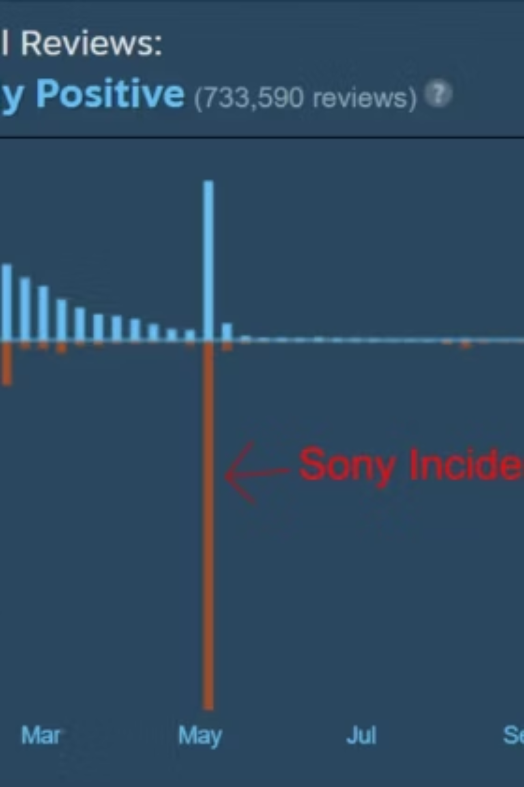
Project Objective
What We Studied
Impact of PSN requirement on sentiment, engagement & retention
Key Question
Short-term perception issue — or long-term player decline?

Slide 3

The PSN Controversy
What Happened
Sony mandated PSN accounts for PC players — triggering massive backlash
Sony's Response
Decision reversed shortly after controversy escalated

Slide 4
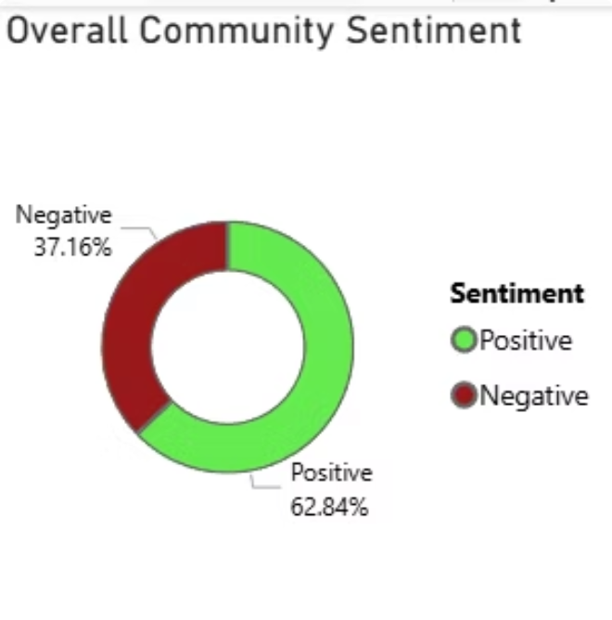
Community Sentiment at a Glance
915K
541K
Positive Reviews
Negative Reviews
155K
458K
Peak Negative Day
Peak Player Count
Overall Sentiment
62.64% Positive vs. 37.36% Negative — community stayed predominantly positive

Slide 5
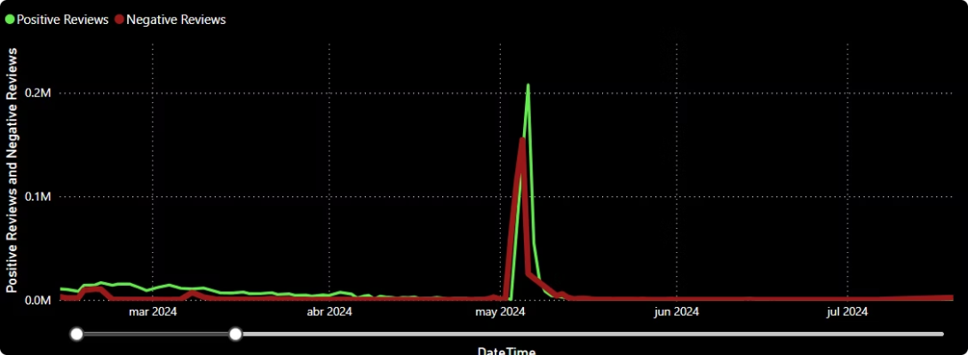
Review Bombing: May 2024
155K Negative Reviews
In a single day — historic review bombing event
Community Resilience
Outrage peaked, but player engagement remained high

Slide 6
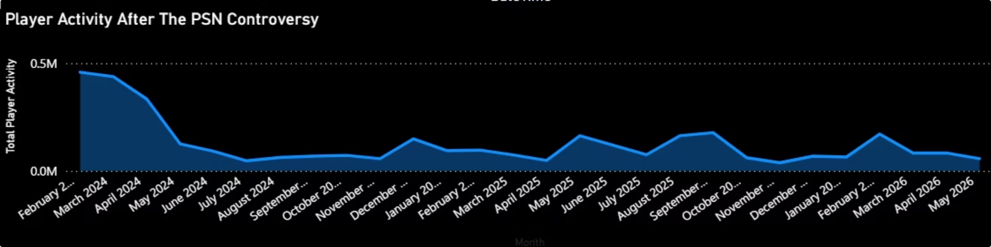
Player Activity After the Controversy
Feb–Apr 2024
May 2024
Apr 2024-May 2024
Successful premiere
Controversy — declining activity
334k peak player activity drops to 126k

Slide 7
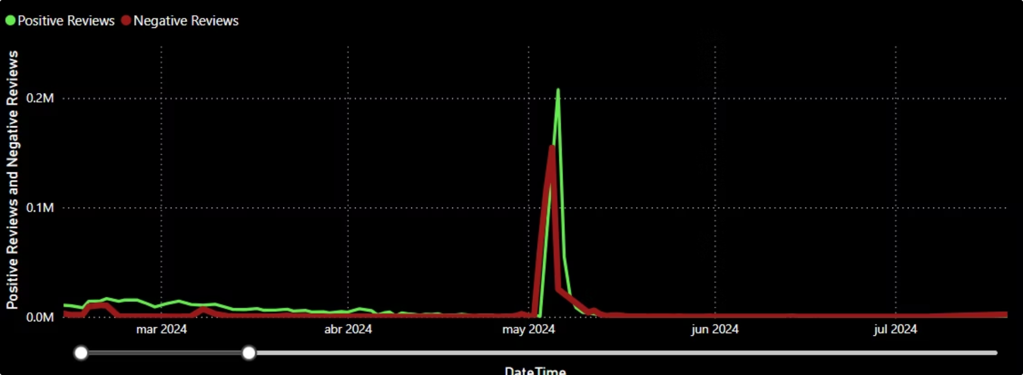
Review Volume: Positive vs. Negative
Both review types spiked in May 2024 — negative peaked at ~155K, positive at ~200k. Both returned to baseline shortly after.

Slide 8

Sentiment vs. Retention
Key Finding
Sentiment & retention do not always move in parallel
Sharp negative spike — then recovery
Player activity remained stable throughout
No sustained decline in participation

Slide 9

Key Insights
155K negative reviews in one day
62.8% positive sentiment overall
Player activity stayed stable
Short-term reputational impact only
No long-term player base collapse

Slide 10

Conclusion
What This Means
Loyal player bases are resilient — but proactive communication is essential
Reputational crises ≠ retention crises
Stakeholder management reduces damage
Community trust must be preserved

