Slide 1
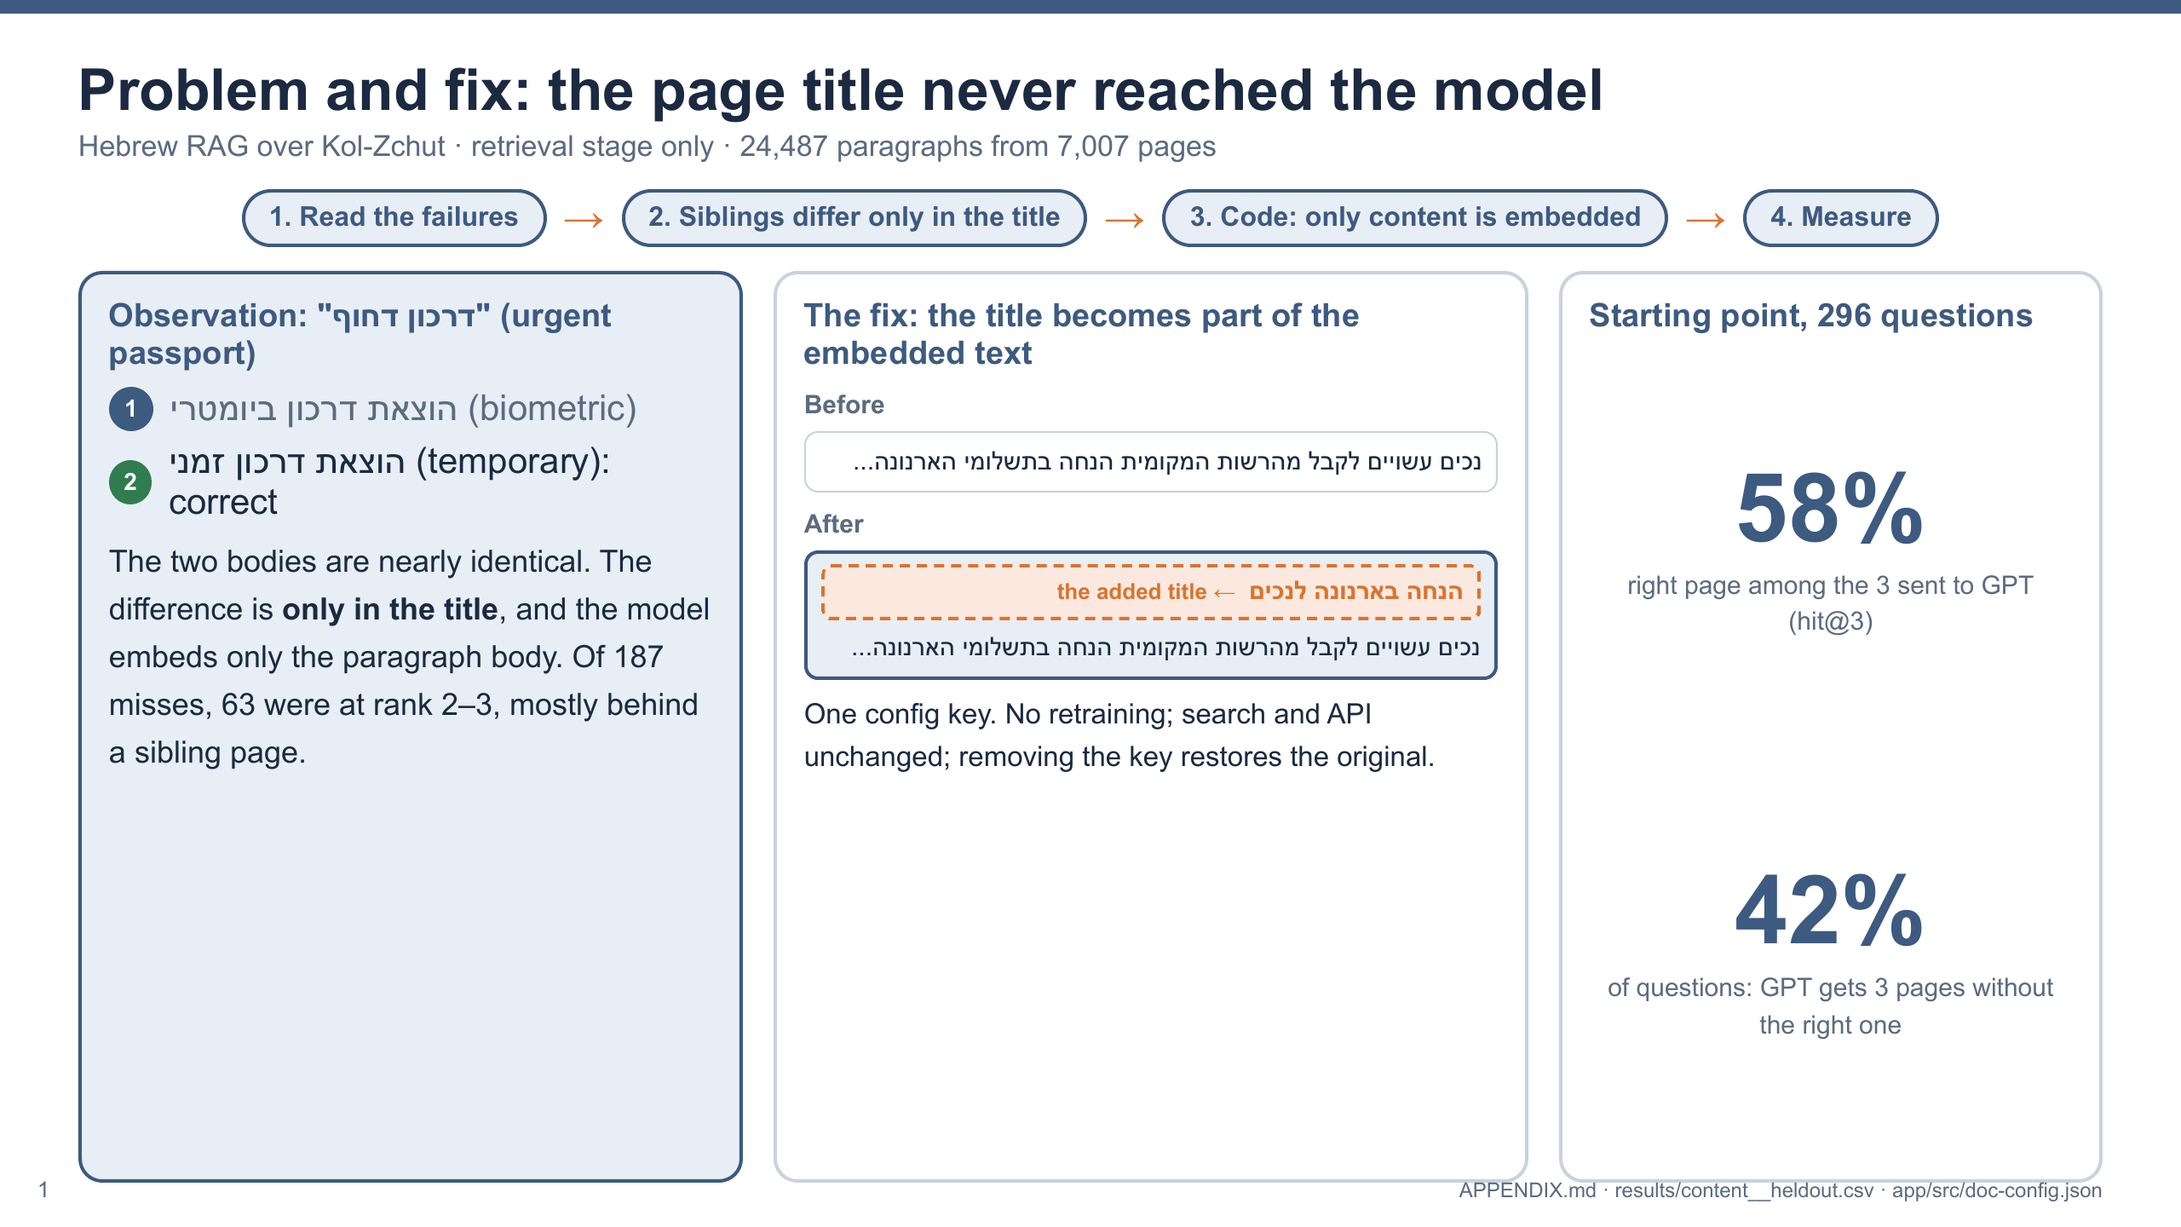
Notes:
How I found the problem: I ran the system on 296 questions and read the failures. 63 of 187 were at rank 2 or 3, mostly behind a sibling page, like temporary vs biometric passport. The difference is in the title, and the config embeds only the content. The fix: one config key puts the page title into the embedded text, no retraining and no change to search. Starting point: the right page is among the 3 pages GPT receives for only 58% of questions.

Slide 2
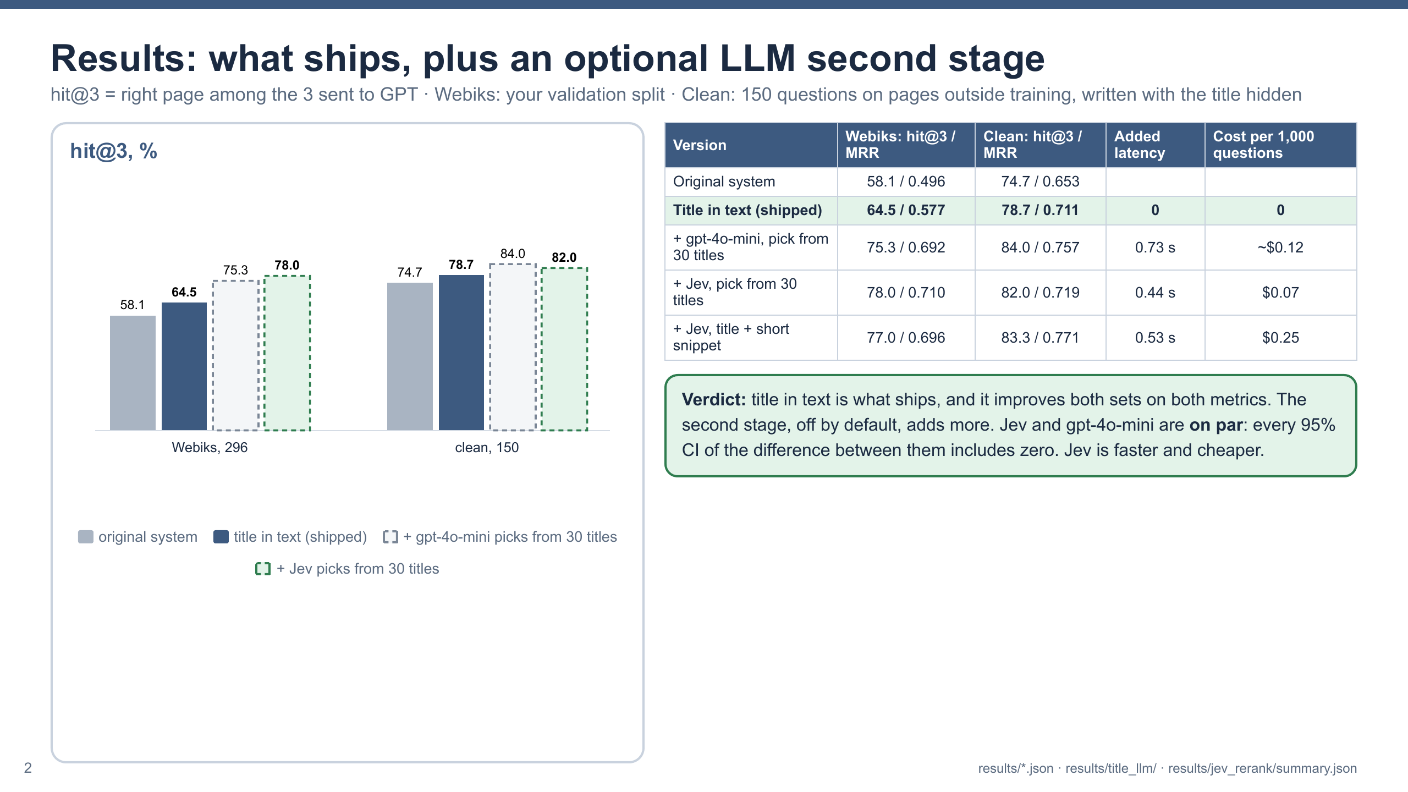
Notes:
Results on two sets: Webiks' validation split, and a clean set of 150 questions on pages outside training, written with the title hidden. Title in text, what ships: top 3 from 58% to 65% on Webiks and from 75% to 79% on the clean set, with MRR up on both. On top, an optional second stage, off by default: an LLM chooses among the top 30 titles. I tested two providers. gpt-4o-mini reached 75% and 84%, Jev 78% and 82%. The differences between them are within the confidence intervals, so they are on par, and Jev is faster, 0.44 s vs 0.73 s, and cheaper.

Slide 3
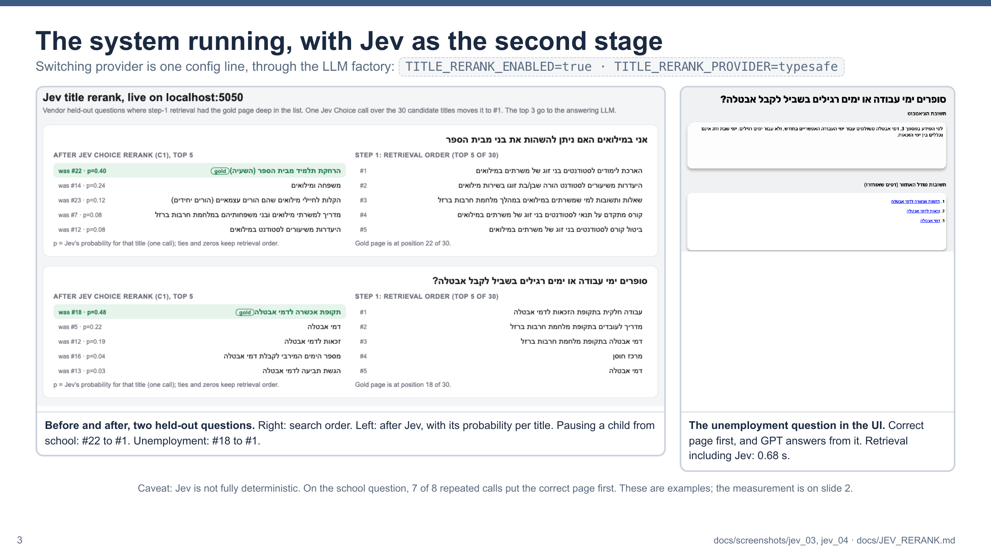
Notes:
The system running locally with Jev as the second stage. Switching provider is one config line through the LLM factory. On two held-out questions where search alone put the right page deep: pausing a child from school moved from #22 to #1, and the unemployment question from #18 to #1, and GPT answers correctly from it. Caveat: Jev is not fully deterministic; 7 of 8 repeated calls gave the same result. These are examples; the measurement is on the previous slide.

