Slide 1
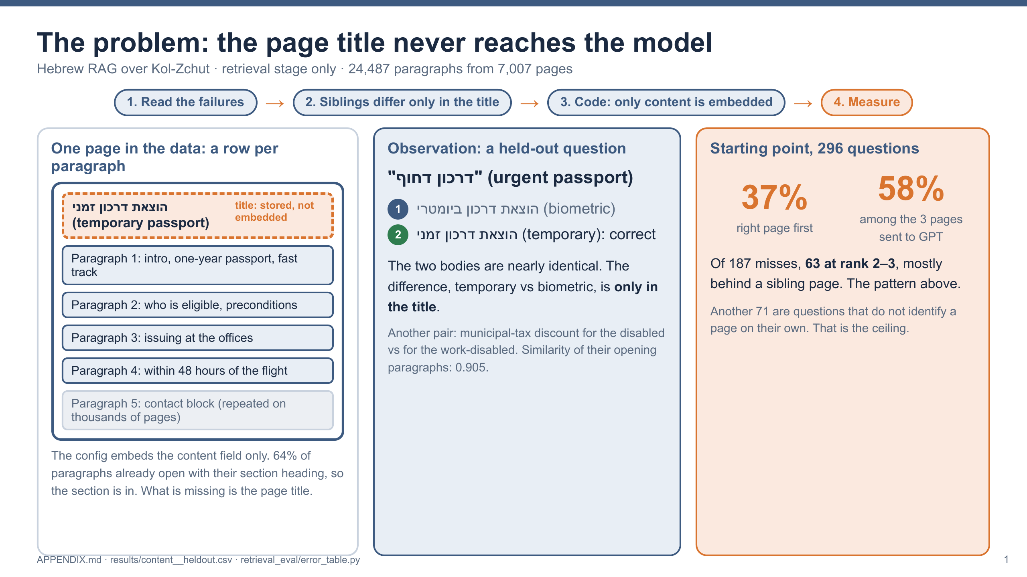
Notes:
How I found the problem. I ran the original system on 296 questions and read the failures: 63 of 187 were at rank 2 or 3, mostly behind a sibling page, like temporary vs biometric passport. Hypothesis: the difference is in the title. The config embeds content only. 64% of paragraphs already start with their section heading, so the page title is what is missing. Starting point: 37% at rank 1, 58% in the top 3, so for 42% of questions GPT never gets the right page.

Slide 2
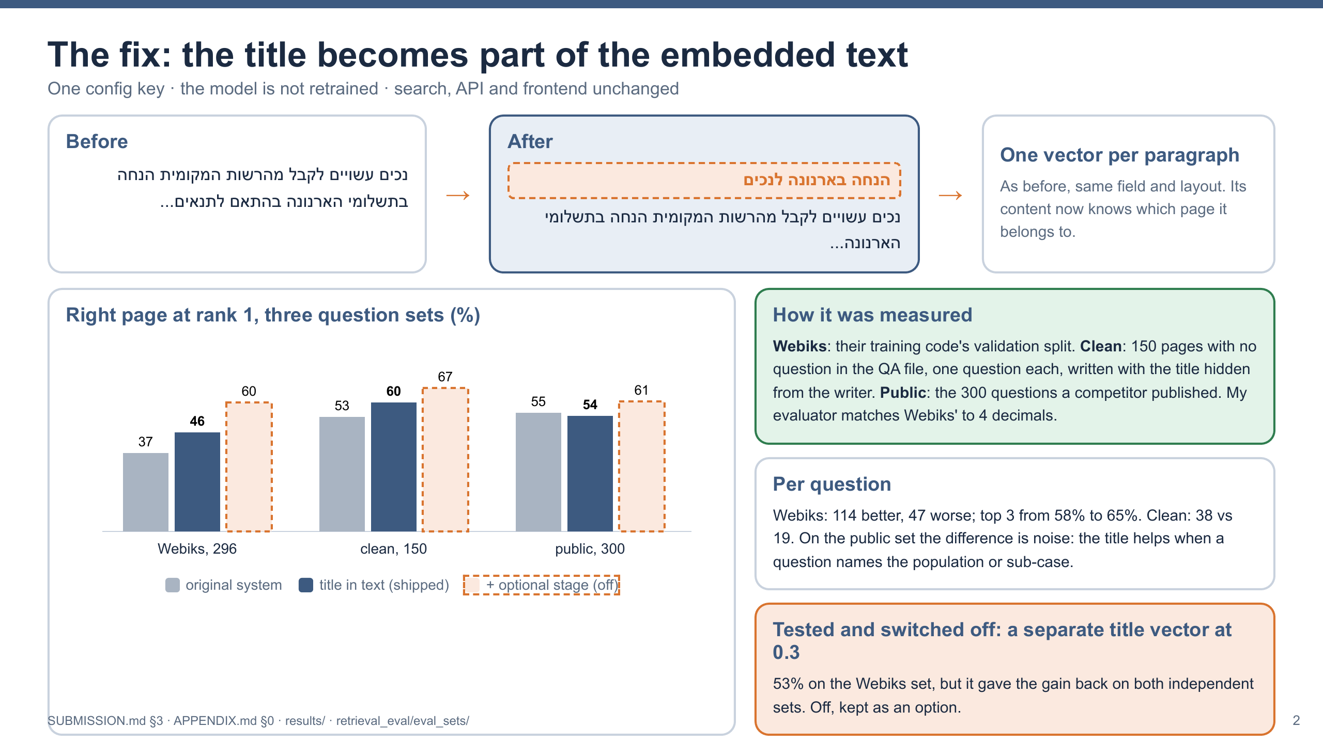
Notes:
The fix: one config key puts the title into the embedded text. No retraining; search and API unchanged. Measured on three sets: Webiks' split, a clean set I built with titles hidden from the writer, and a competitor's public set. Webiks 37% to 46%, clean 53% to 60%, public within noise. A variant with a separate title vector reached 53% on the Webiks set but did not hold on the clean sets, so I switched it off before submitting.

Slide 3
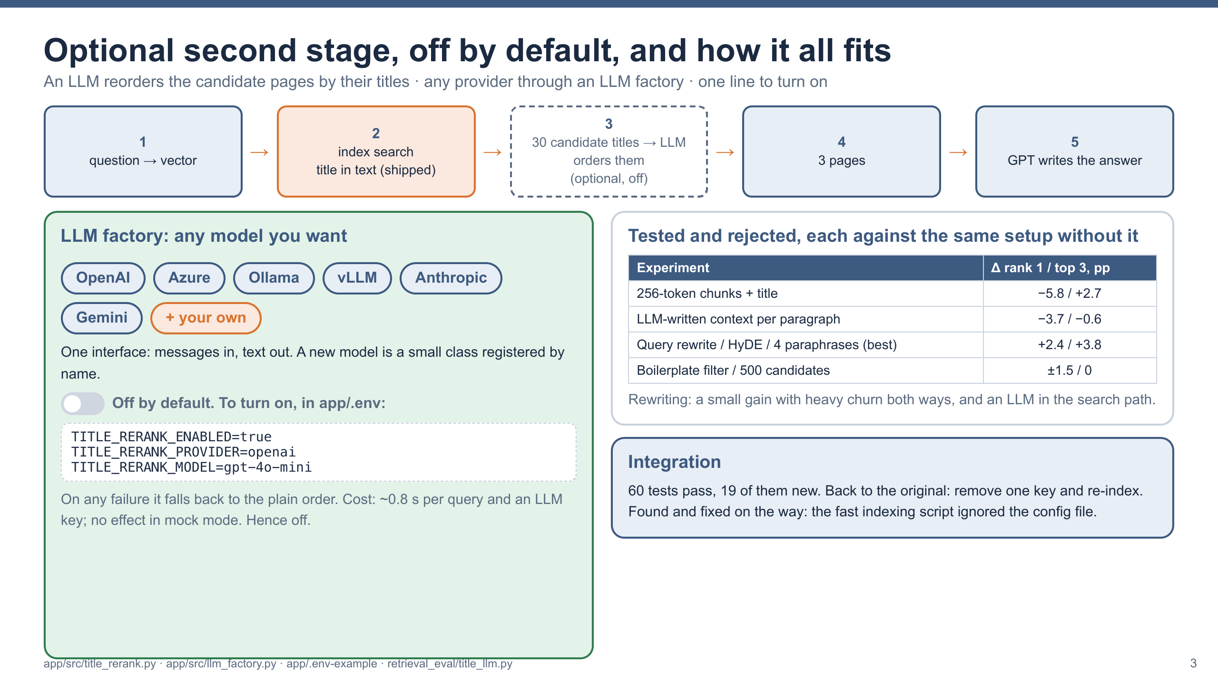
Notes:
Optional second stage, off by default: an LLM reorders 30 candidate pages by title. With it, 60% on Webiks and 67% on the clean set. The LLM factory accepts any provider. It is off because it puts an LLM call in the search path: ~0.8 s, a key, and no effect in mock mode. Rejected: smaller chunks, LLM-written context, query rewriting. 60 tests pass; removing one key restores the original.

