Slide 1
Research Questions
How does seasonality influence the occurrence of algal blooms within Loch Leven?
What are the drivers (chemical and physical) of algal blooms in Loch Leven?
How does environmental drivers influence the composition of phytoplankton communities within Loch Leven?

Slide 2
Variables | Ranking for lmer | References | Notes
SRP | 1 | 10.1007/s10750-011-0923-x 10.1111/j.1365-2427.2007.01865.x 10.1080/20442041.2020.1827891 10.1007/s10750-013-1525-6 10.1016/j.ecolind.2022.109560 10.1016/j.hal.2019.02.002 | Nutrient availability (10.1016/j.envpol.2020.116210)
SD | 9 | 10.1007/s10750-011-0923-x
NO3 | 3 | 10.1007/s10750-011-0996-6 10.1007/s10750-013-1525-6 10.1016/j.ecolind.2022.109560 10.1016/j.hal.2019.02.002 | Total N played a more important role for phytoplankton richness than total P (10.1007/s10750-011-0996-6)
Salinity |  | 10.3390/w15061116 | Talks about salinity in brackish coastal lakes – relevant?
Daphnia | 4 | 10.100 7/s10750-011-0923-x
DO | 8 | 10.1080/20442041.2020.1827891
pH | 5 | 10.1007/s10750-013-1525-6 10.1016/j.ecolind.2022.109560
Temperature | 6 | 10.1007/s10750-011-0923-x 10.1080/20442041.2020.1827891 | Some found that temperature had little effect (10.1111/j.1365-2427.2007.01865.x) Spilt findings
Water Depth | 7 | 10.1016/j.ecolind.2022.109560
Phytoplankton Group | 2
Season | 2 | 10.1016/j.ecolind.2022.109560 | the plankton community was the least diverse in winter and the most stable during the spring-to-summer transition

Slide 3
ModNo | Response Variable | Fixed Effects | Interaction | Random Effects | Dataset | Is the model happy? | AIC | R2
1 | Total.Biovolume | SRP | - | Year | alldata | Y | 450.7465 | 0.02892068
3 | Biovolume | SRP, Season, Phytoplankton Group | Season* PhytoplanktonGroup |  | alldatalong | Y | 2063.5528 | 0.4661754
4 |  | SRP, Season, Phytoplankton Group, NO3
 |  |  |  |  |  | Y | 703.4487 | 0.4399829
5 |  | SRP, Season, Phytoplankton Group, NO3, Daphnia |  |  |  | Y | 706.8337 | 0.454438
6 |  | SRP, Season, Phytoplankton Group, NO3, Daphnia, pH |  |  |  | N | 522.7784 | 0.4856075
7 |  | SRP, Season, Phytoplankton Group, NO3, Daphnia, pH, Temperature |  |  |  | N | 527.1982 | 0.4881119
8 |  | SRP, Season, Phytoplankton Group, NO3, Daphnia, pH, Temperature, Water Depth |  |  |  | N | 506.0372 | 0.5222546
9 |  | SRP, Season, Phytoplankton Group, NO3, Daphnia, pH, Temperature, Water Depth, DO |  |  |  | Y | 286.9359 | 0.4901466

Slide 4
ModNo | Response Variable | Fixed Effects | Interaction | Random Effects | Dataset | Is the model happy? | AIC | R2
1 | Total.Biovolume | SRP | - | Year | alldata | Y | 450.7465 | 0.02892068
3 | Biovolume | SRP, Season, Phytoplankton Group | Season* PhytoplanktonGroup |  | alldatalong | Y | 2063.5528 | 0.4661754
4 |  | SRP, Season, Phytoplankton Group, NO3
 |  |  |  |  |  | Y | 703.4487 | 0.4399829
5 |  | SRP, Season, Phytoplankton Group, NO3, Daphnia |  |  |  | Y | 706.8337 | 0.454438
7a |  | SRP, Season, Phytoplankton Group, NO3, Daphnia, Temperature |  |  |  | Y | 711.7142 | 0.4555228
8a |  | SRP, Season, Phytoplankton Group, NO3, Daphnia, Temperature, Water Depth |  |  |  | Y | 693.1178 | 0.4744143
9a |  | SRP, Season, Phytoplankton Group, NO3, Daphnia, Temperature, Water Depth, DO |  |  |  | Y | 287.6417 | 0.4956113

Slide 5
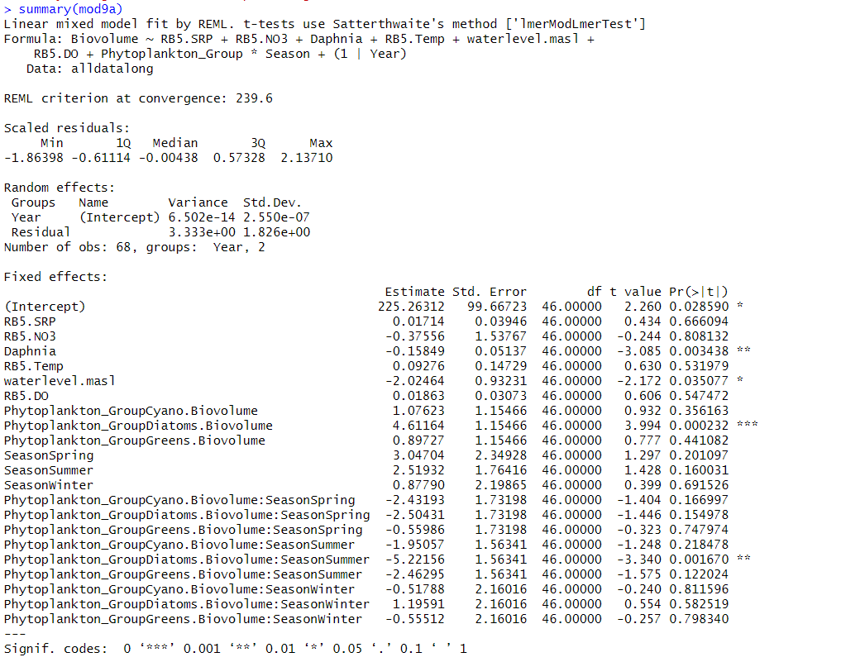
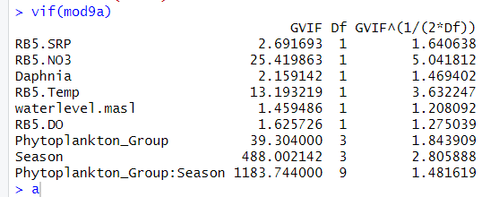
NO3 and temperature are multicollinear
DIN at the lake sediment-water interface exhibited a strongly positive relationship with temperature, suggesting that high temperature conditions lead to greater DIN release from sediments. Cold temperatures cause DIN accumulation in sedimentary pore water, providing sufficient substrate for N-related bacteria in the sediment under cold temperature conditions
10.1016/j.jes.2021.09.032

Slide 6
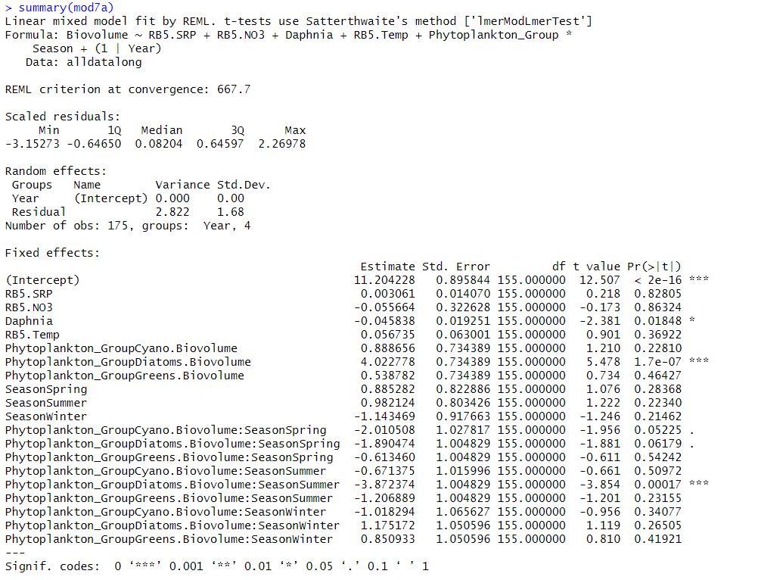

Slide 7
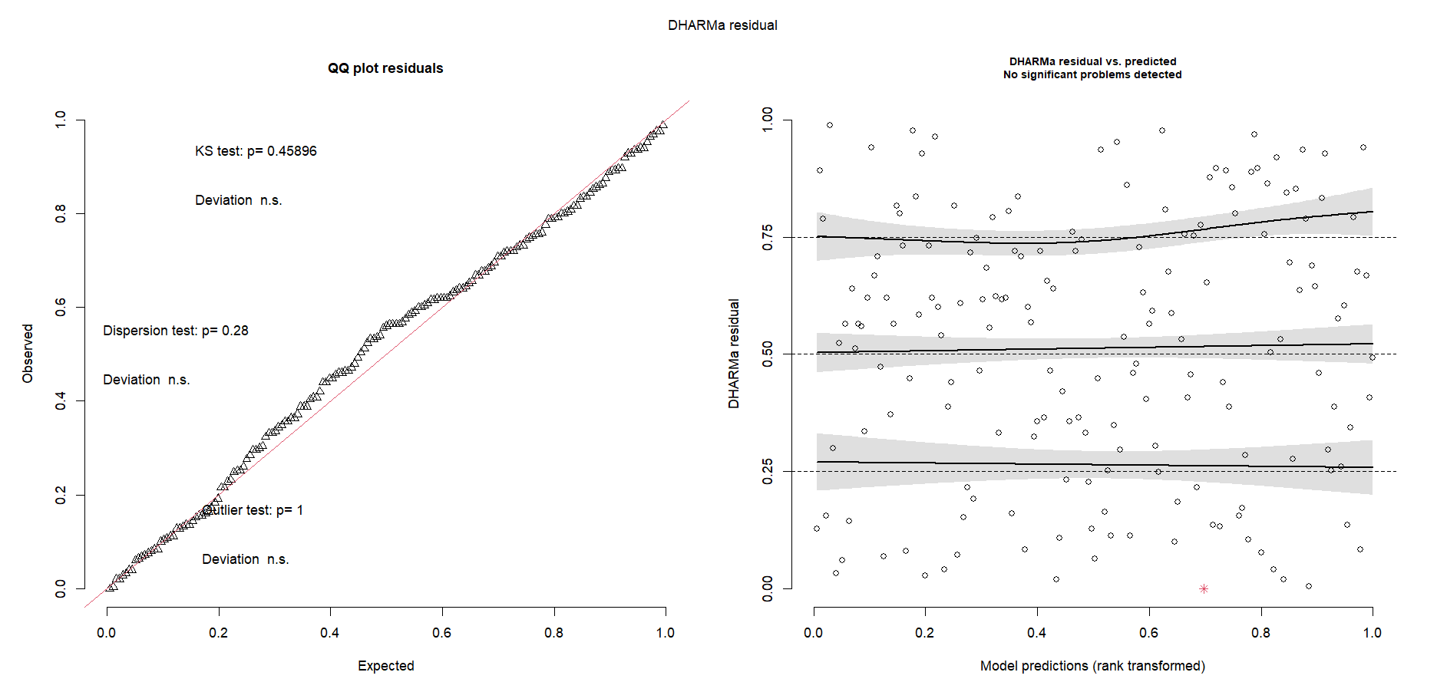

Slide 8
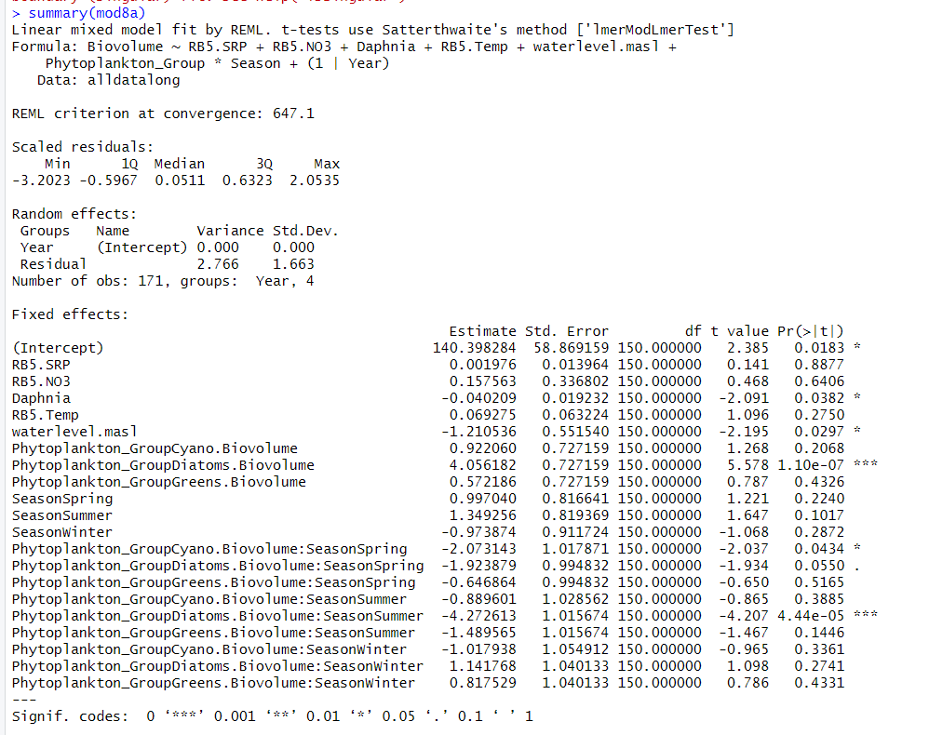

Slide 9
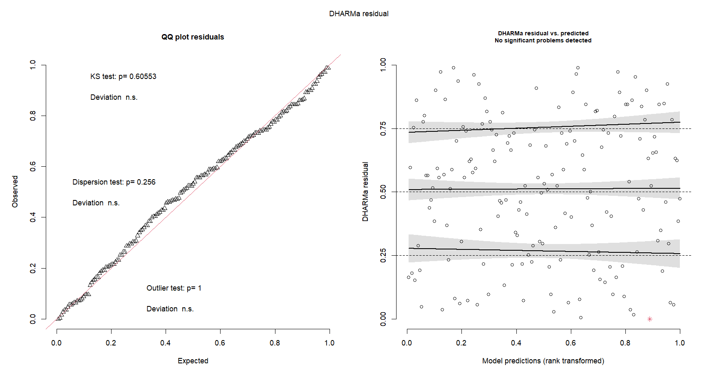

Slide 11
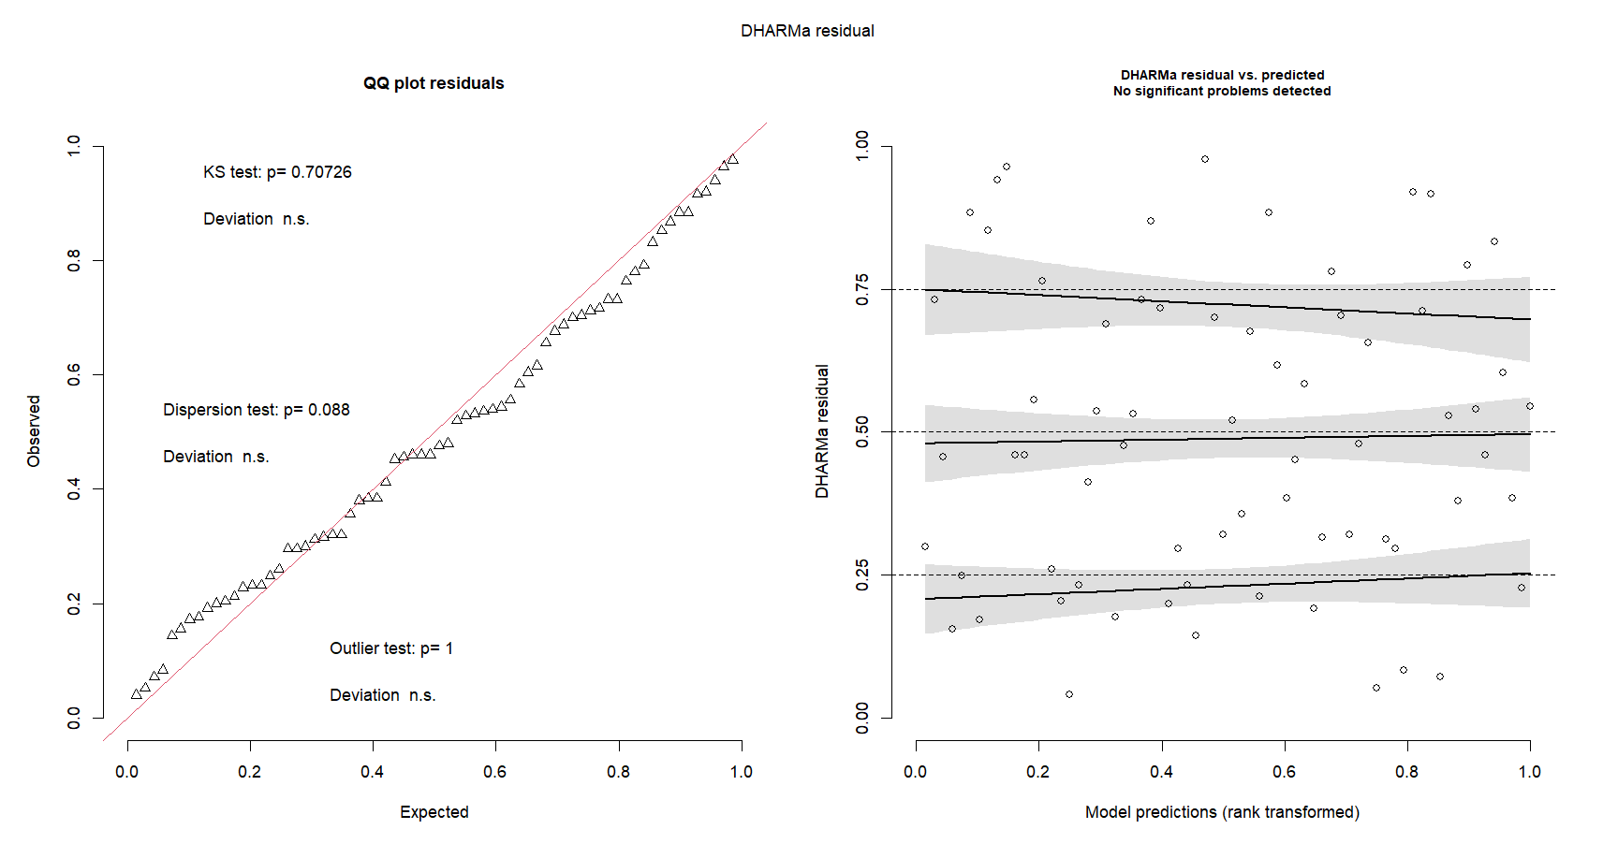

Slide 12
ModNo | Response Variable | Fixed Effects | Interaction | Random Effects | Dataset | Is the model happy? | AIC | R2
1 | Total.Biovolume | SRP | - | Year | alldata | Y | 450.7465 | 0.02892068
3 | Biovolume | SRP, Season, Phytoplankton Group | Season* PhytoplanktonGroup |  | alldatalong | Y | 2063.5528 | 0.4661754
5b |  | SRP, Season, Phytoplankton Group, Daphnia |  |  |  | Y | 2056.0258 | 0.4873192
7b |  | SRP, Season, Phytoplankton Group, Daphnia, Temperature |  |  |  | Y | 2058.9468 | 0.4928073
8b |  | SRP, Season, Phytoplankton Group, Daphnia, Temperature, Water Depth |  |  |  | Y | 1572.2913 | 0.4805001
9b |  | SRP, Season, Phytoplankton Group, Daphnia, Temperature, Water Depth, DO |  |  |  | Y | 852.1185 | 0.5428273

Slide 13
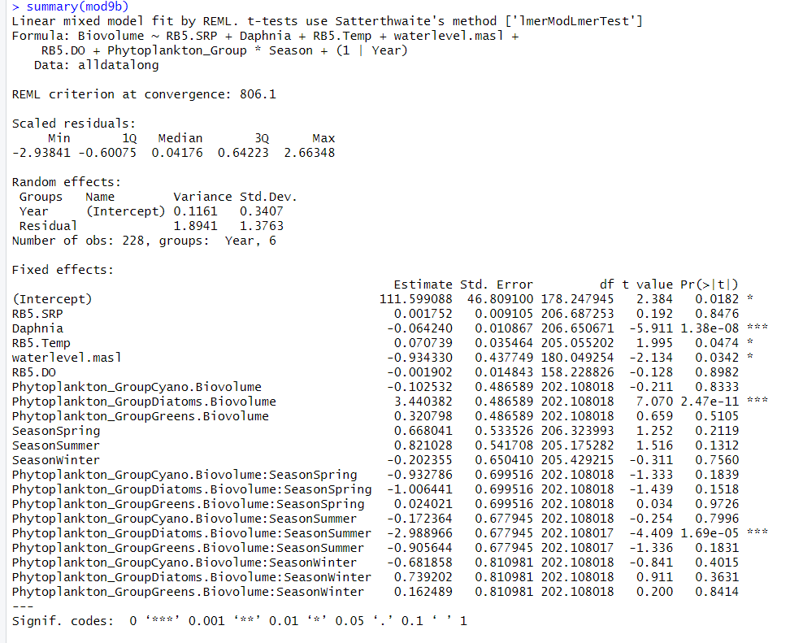
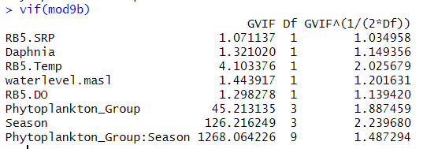

Slide 14
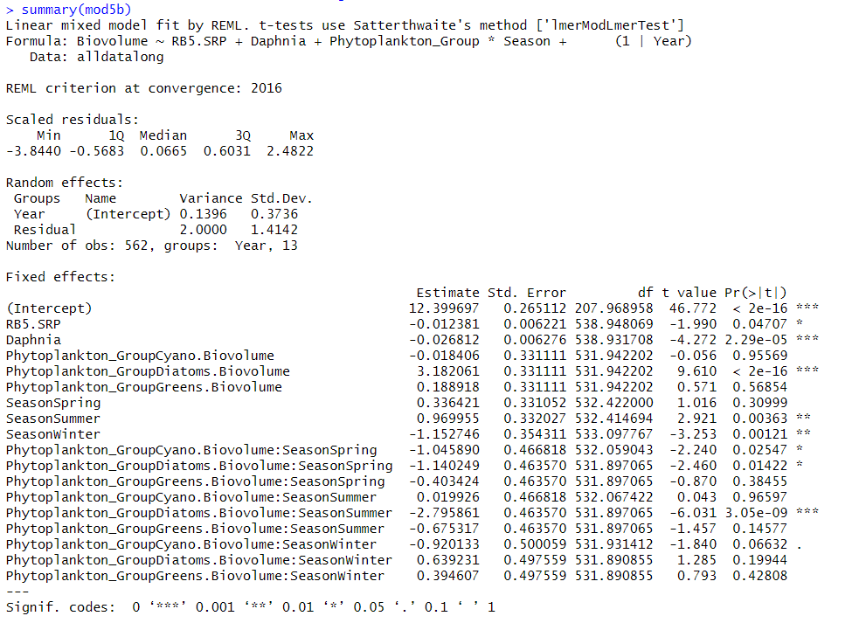

Slide 15
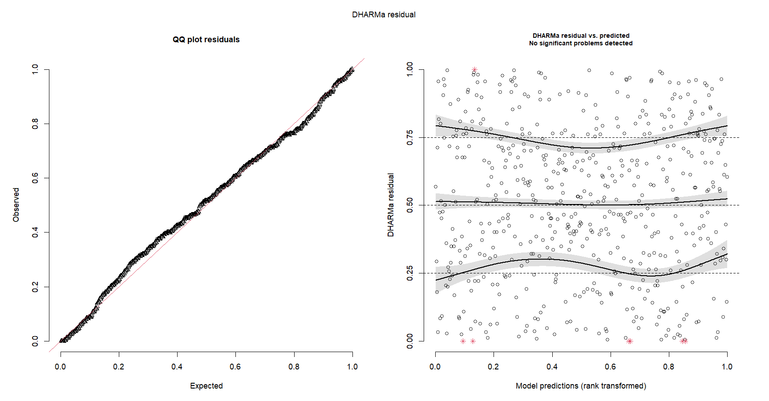

Slide 16
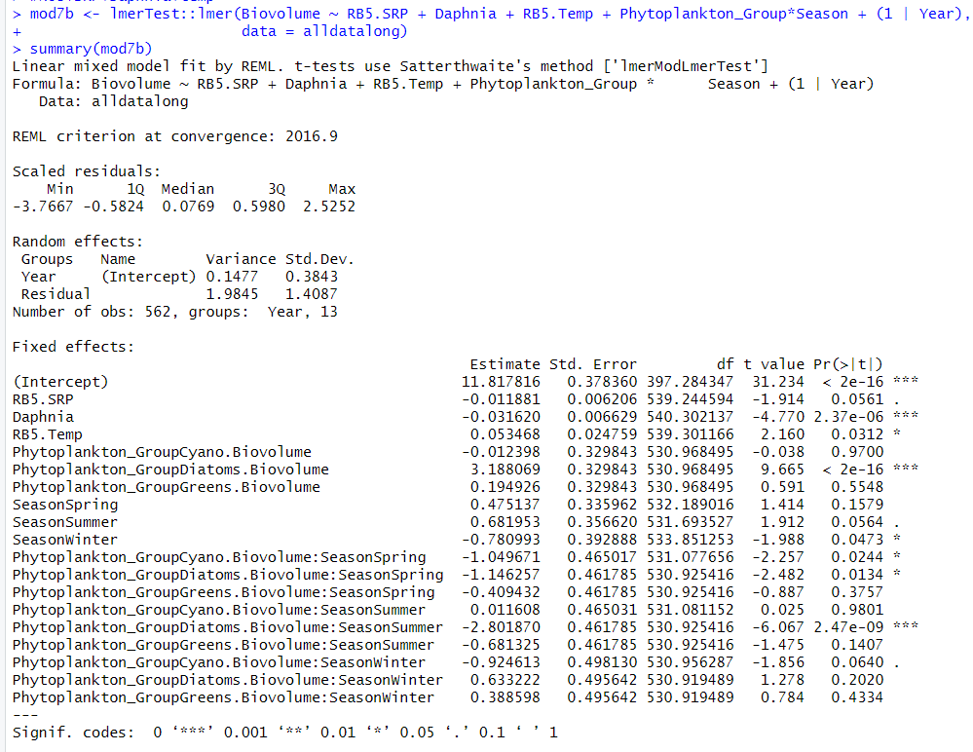

Slide 17
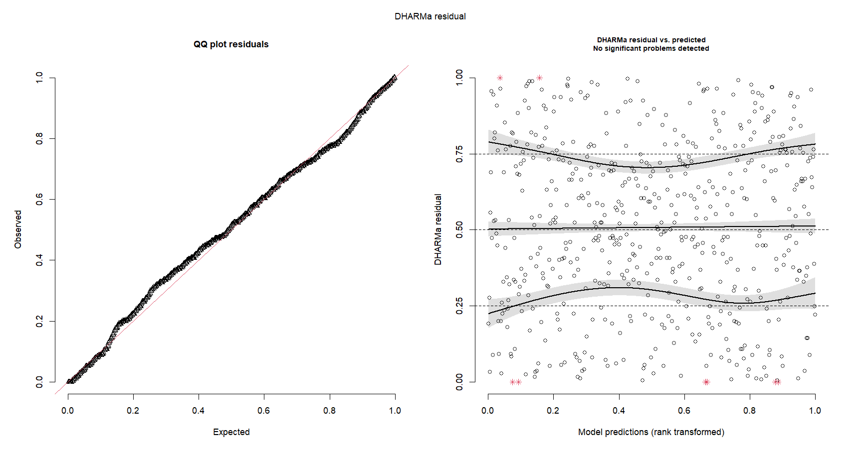

Slide 18
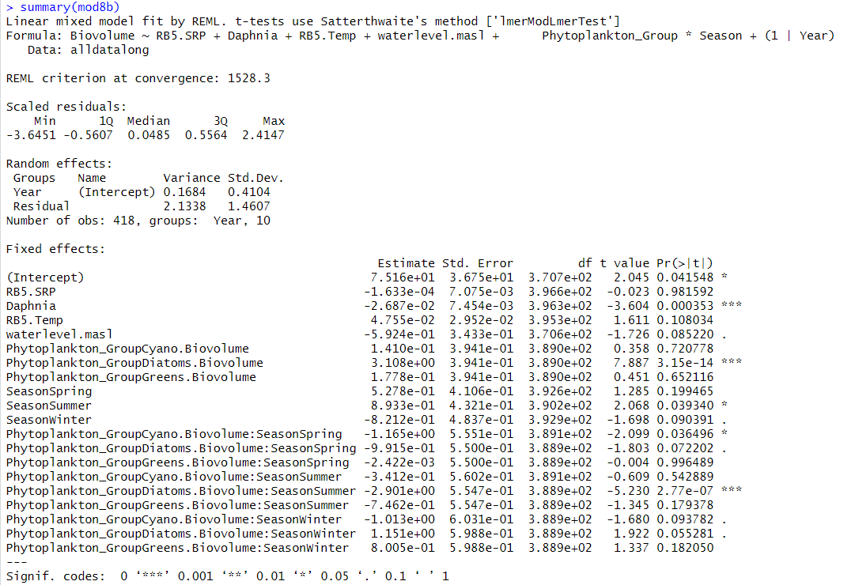

Slide 19
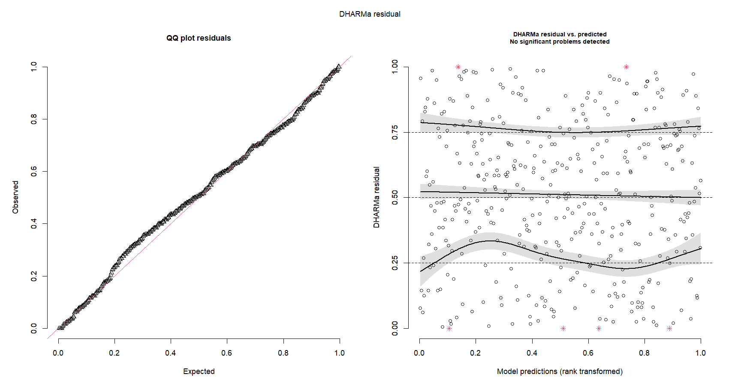

Slide 21
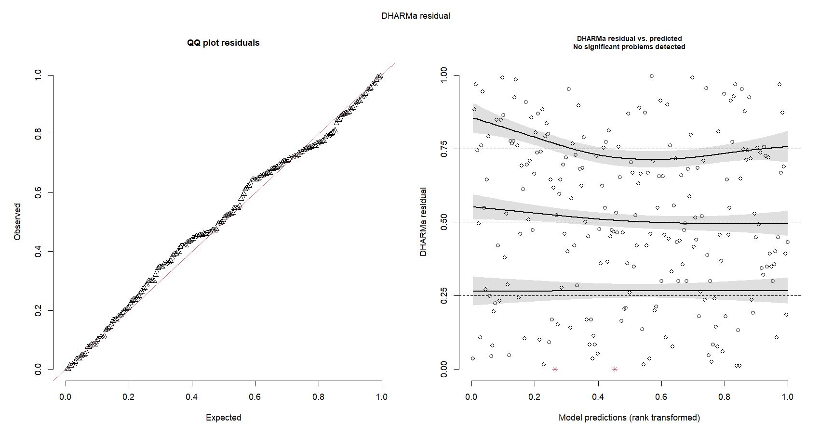

Slide 22
No | Fixed Effects | AIC | R2 | No | No pH | AIC | R2 | No | No Nitrate & pH | AIC | R2
1 | SRP | 450.75 | 0.029
3 | SRP, Season, Phytoplankton Group | 2063.55 | 0.466
4 | SRP, Season, Phytoplankton Group, NO3 | 703.45 | 0.440
5 | SRP, Season, Phytoplankton Group, NO3, Daphnia | 706.83 | 0.454 |  |  |  |  | 5b | SRP, Season, Phytoplankton Group, Daphnia | 2056.03 | 0.487
6 | SRP, Season, Phytoplankton Group, NO3, Daphnia, pH | 522.78 | 0.486
7 | SRP, Season, Phytoplankton Group, NO3, Daphnia, pH, Temperature | 527.20 | 0.488 | 7a | SRP, Season, Phytoplankton Group, NO3, Daphnia, Temperature | 711.71 | 0.456 | 7b | SRP, Season, Phytoplankton Group, Daphnia, Temperature | 2058.95 | 0.493
8 | SRP, Season, Phytoplankton Group, NO3, Daphnia, pH, Temperature, Water Depth | 506.04 | 0.522 | 8a | SRP, Season, Phytoplankton Group, NO3, Daphnia, Temperature, Water Depth | 693.12 | 0.474 | 8b | SRP, Season, Phytoplankton Group, Daphnia, Temperature, Water Depth | 1572.29 | 0.481
9 | SRP, Season, Phytoplankton Group, NO3, Daphnia, pH, Temperature, Water Depth, DO | 286.94 | 0.490 | 9a | SRP, Season, Phytoplankton Group, NO3, Daphnia, Temperature, Water Depth, DO | 287.64 | 0.496 | 9b | SRP, Season, Phytoplankton Group, Daphnia, Temperature, Water Depth, DO | 852.12 | 0.543
Keep 1, 3, 4,5 7a, 8a, 9a
Report AIC, R2, estimate + std error + significance

Slide 23
PCA? Nvm
Nmds – visualisation – plotting
Seasons and communities only

Slide 24
How to test the effect of seasonality on phytoplankton groups
Tried nesting season within year – models didn’t converge – so didn’t continue with it
Can we go through how to label the letters again? Im a bit confused
Tukey HSD
A, b, c according to which are the same group
Check if successfully logged axis – im a bit confused
When reporting differences report using actual biovolumes (unlog)
Bquote – superscript
Try to remove the boxes
Colour blind

Slide 25
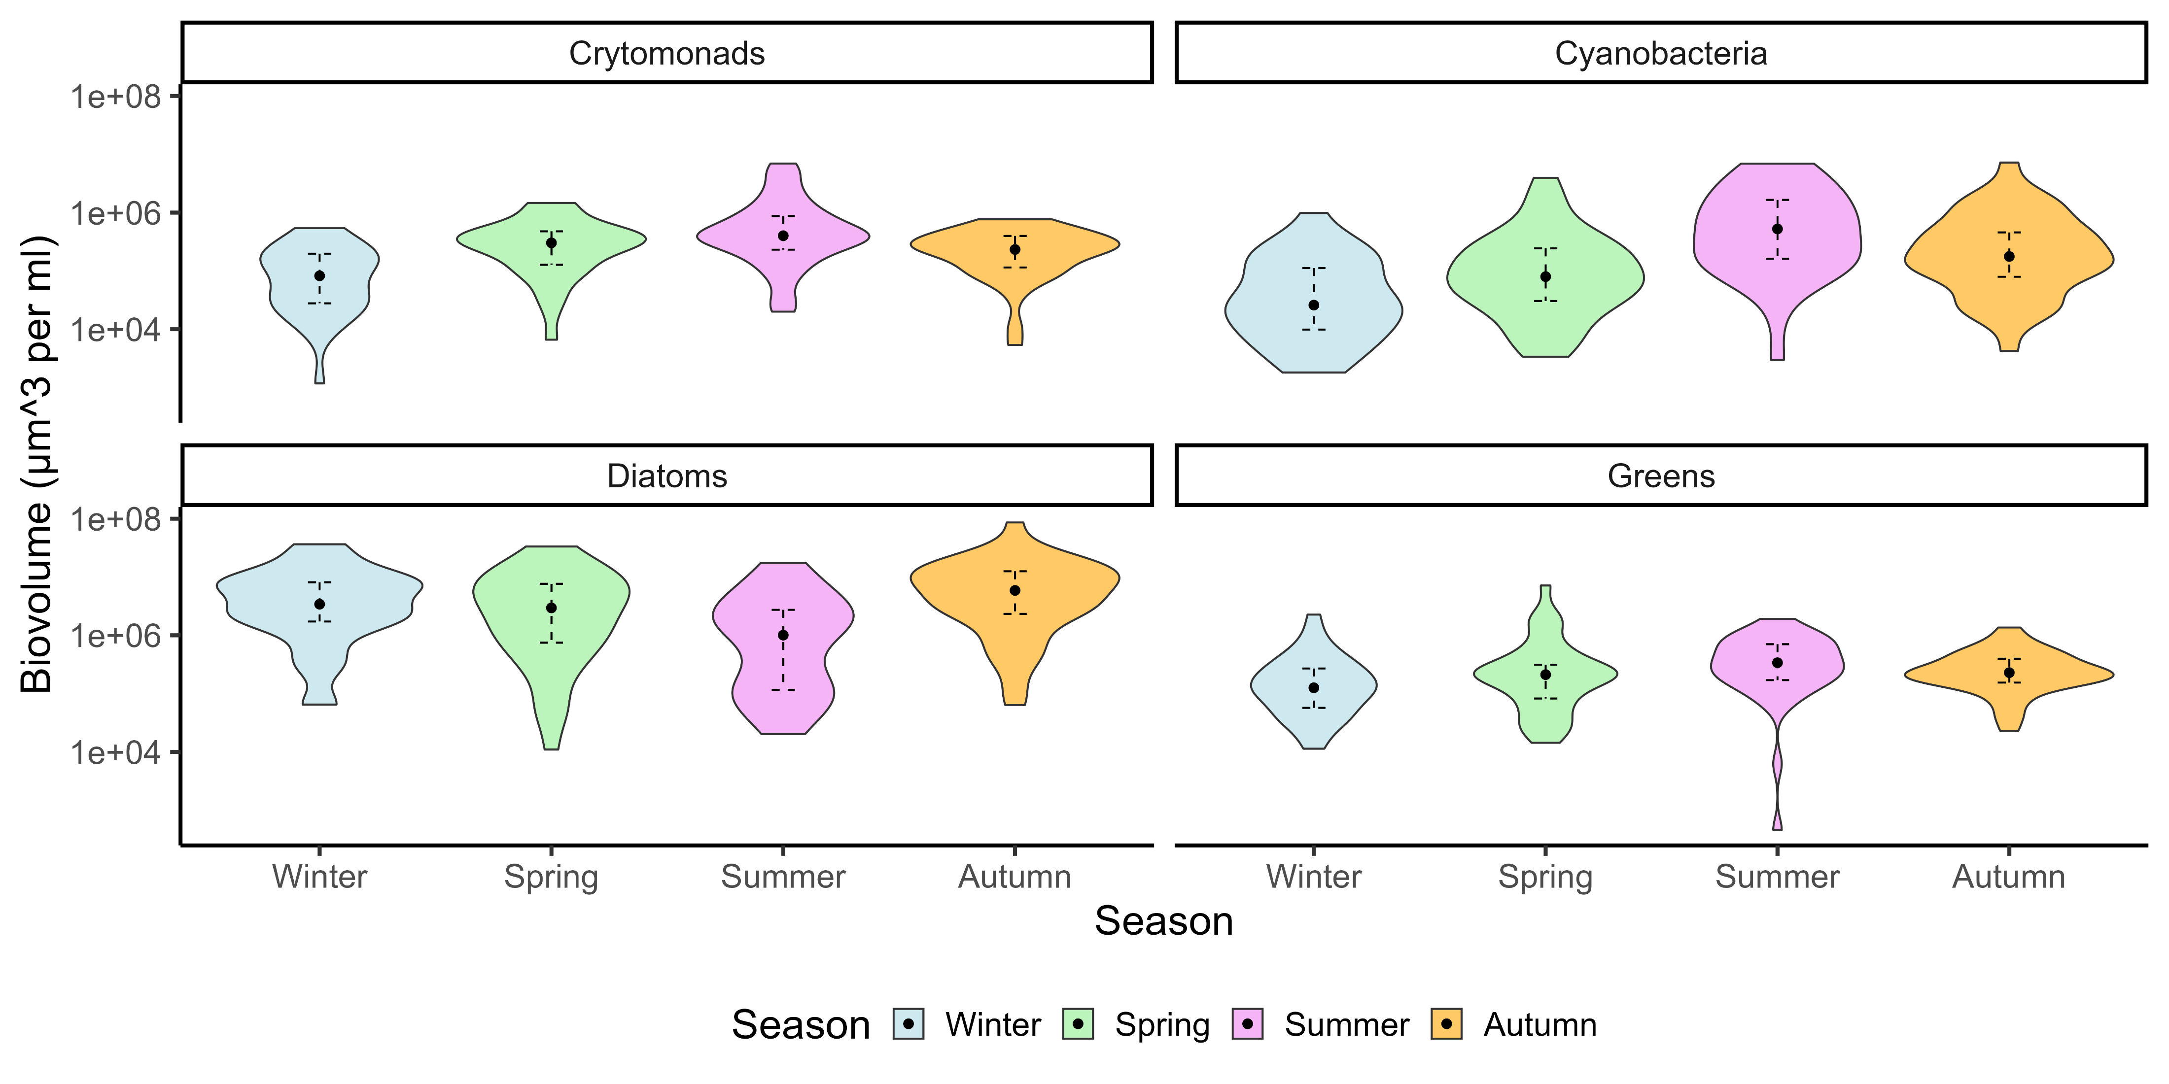

Slide 26
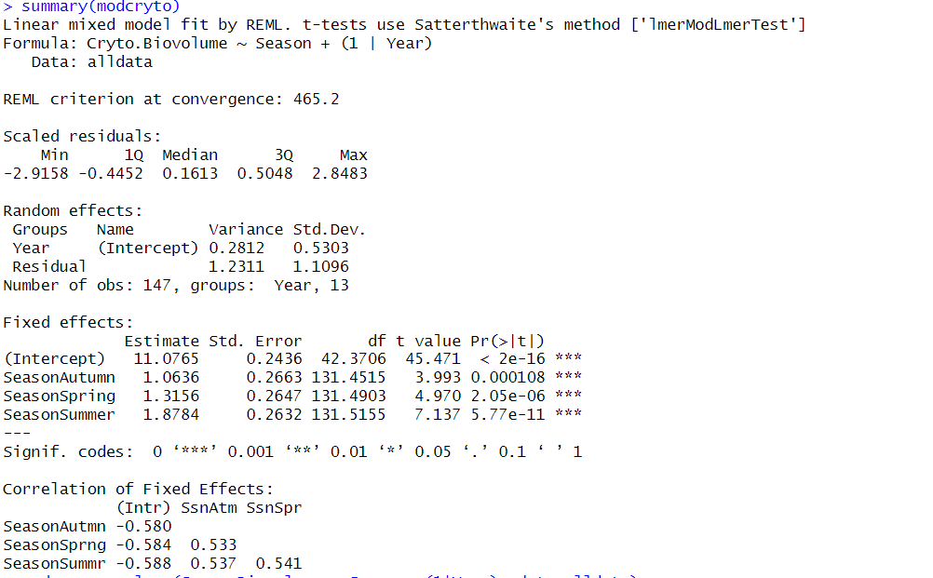

Slide 27
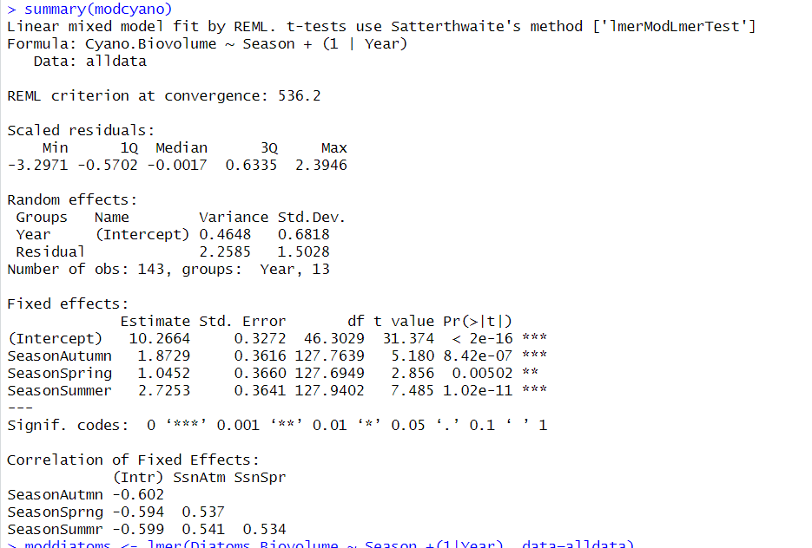

Slide 28
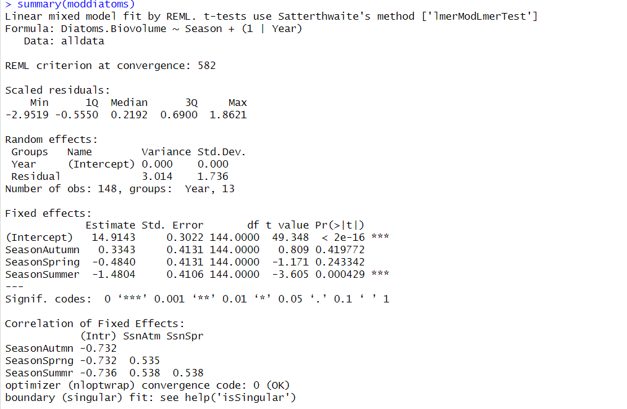

Slide 29
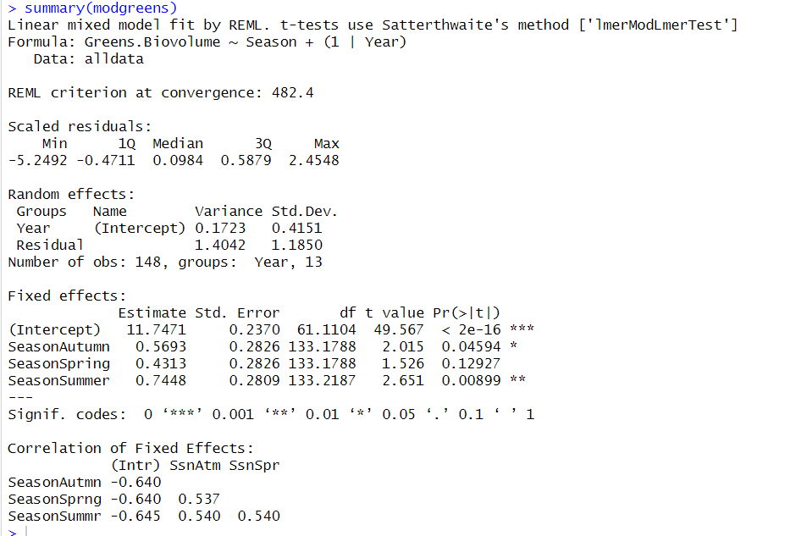

Slide 30
Seasonal Daphnia Trends
Question about Logging the y-axis – I just cant do it LOL
Question about the 1:1 line – scale the gradient to the range
Try to e to x10^{x}
Remove the middle y axis
Copy and paste the legends

Slide 31
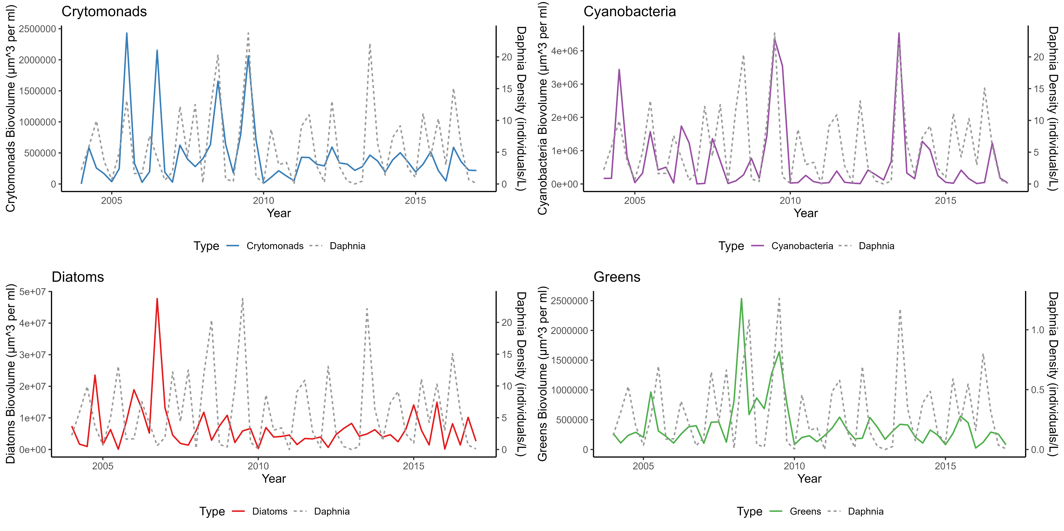

Slide 32
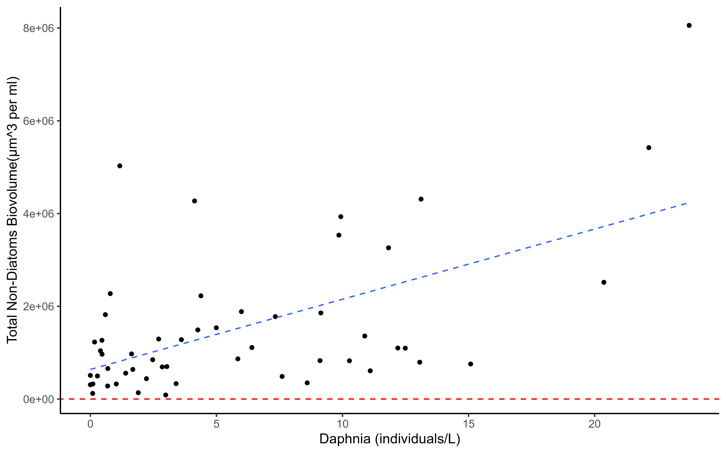

Slide 33
Random forest regression

Slide 34
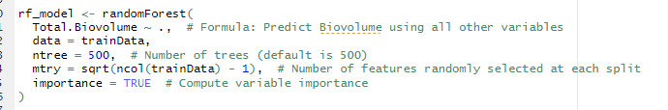
Imputed data to fill in gaps – should I do this or just remove NAs?
Divide data into training data + testing data
Running randomForest on training data

Slide 35
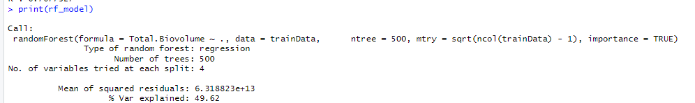
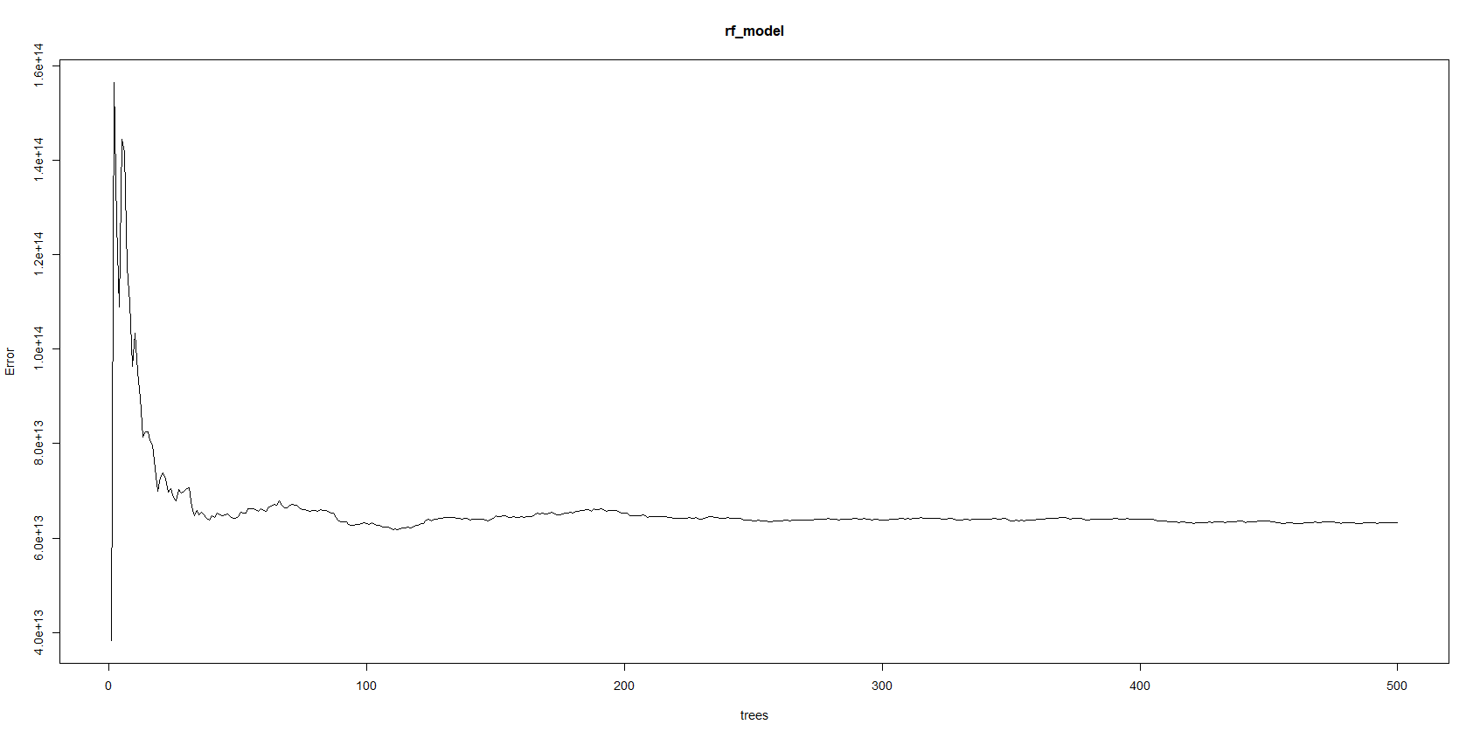
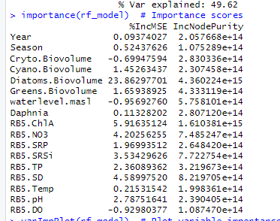

Slide 36
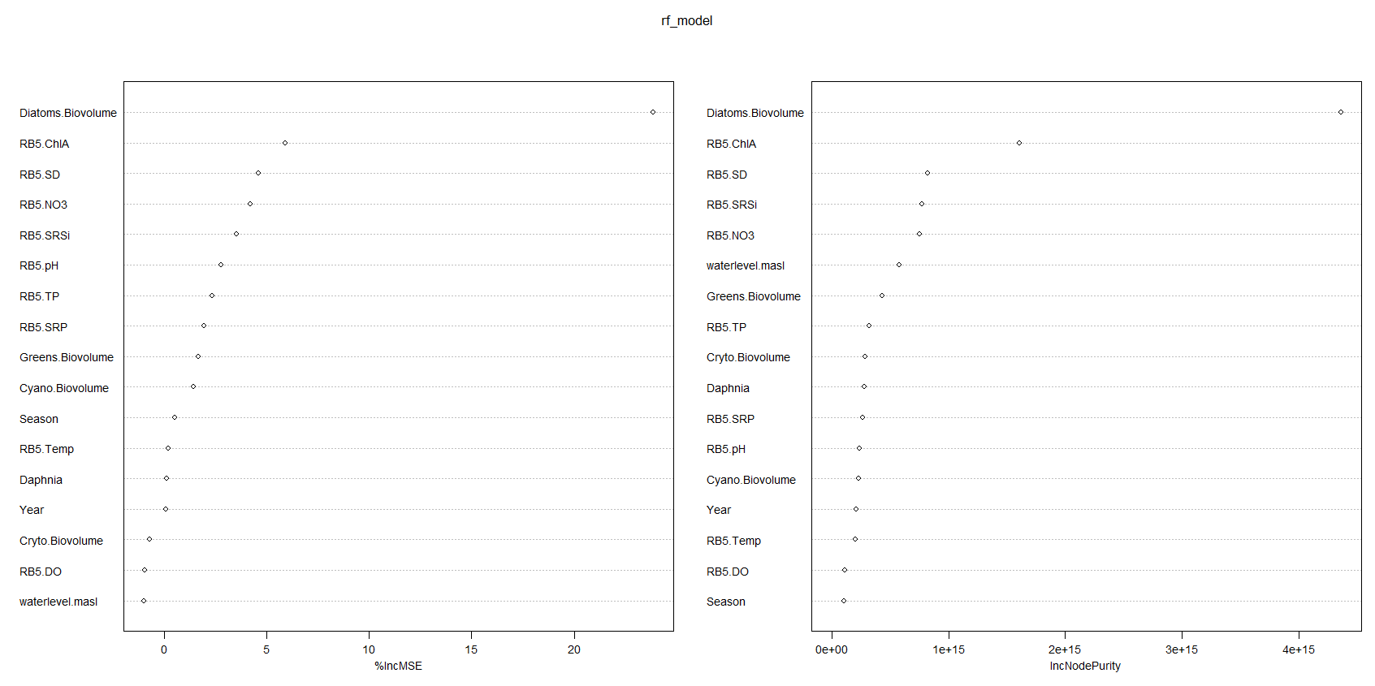

Slide 37
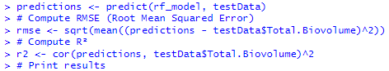

Using model to predict using Test data – computing model’s ability to predict using new unseen data – test data RMSE
R2 - Pearsons row

Slide 38
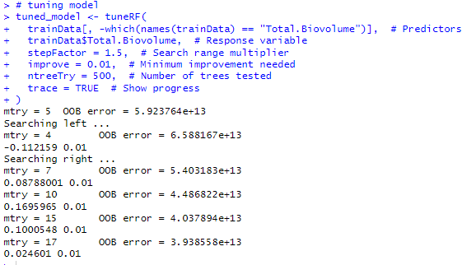
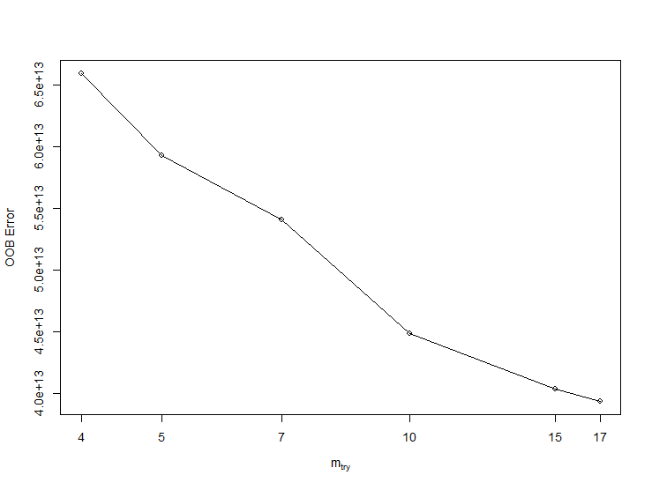
Tuning model to decrease out-of-bag error

Slide 39
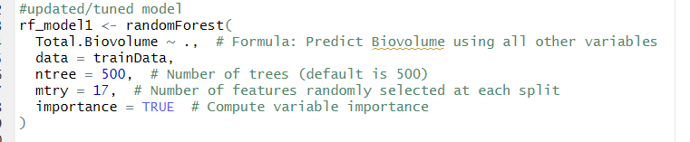
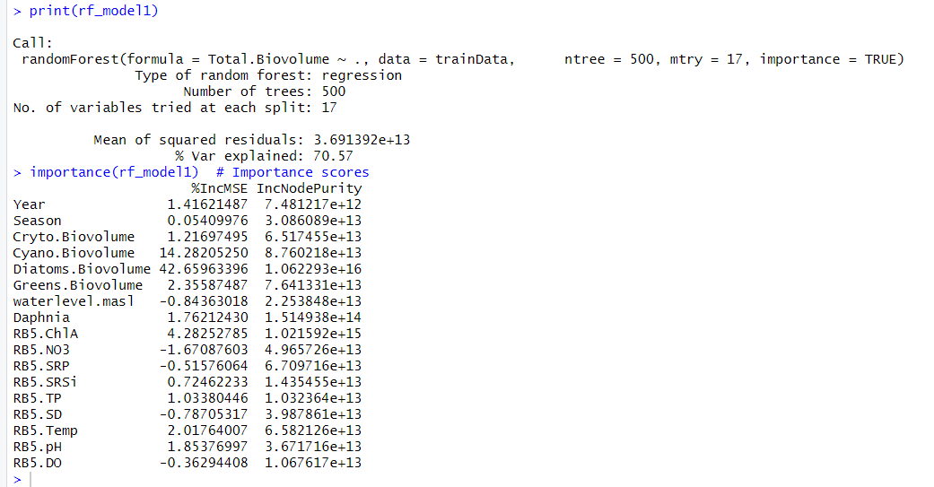
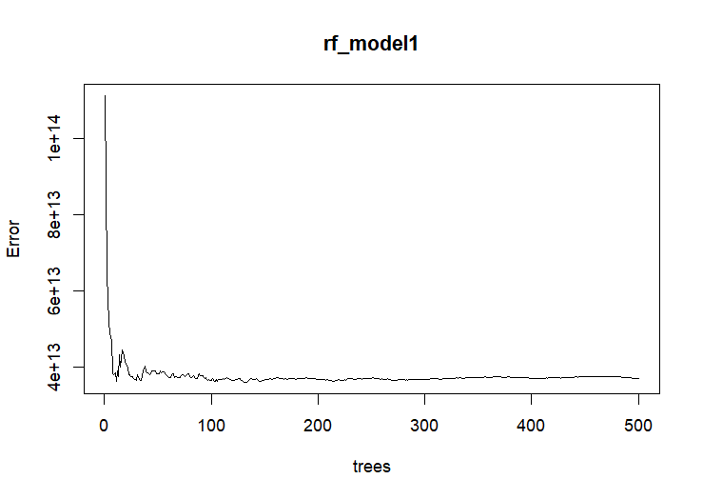
Fine-tuned model with optimised mtry value – ntree stays the same bc it stabilises around 300

Slide 40

