Slide 1
Research Questions
How does seasonality influence the occurrence of algal blooms within Loch Leven?
What are the drivers (chemical and physical) of algal blooms in Loch Leven?
How does environmental drivers influence the composition of phytoplankton communities within Loch Leven?

Slide 2
Variables | Ranking for lmer | References | Notes
SRP | 1 | 10.1007/s10750-011-0923-x 10.1111/j.1365-2427.2007.01865.x 10.1080/20442041.2020.1827891 10.1007/s10750-013-1525-6 10.1016/j.ecolind.2022.109560 10.1016/j.hal.2019.02.002 | Nutrient availability (10.1016/j.envpol.2020.116210)
SD | 9 | 10.1007/s10750-011-0923-x
NO3 | 3 | 10.1007/s10750-011-0996-6 10.1007/s10750-013-1525-6 10.1016/j.ecolind.2022.109560 10.1016/j.hal.2019.02.002 | Total N played a more important role for phytoplankton richness than total P (10.1007/s10750-011-0996-6)
Salinity |  | 10.3390/w15061116 | Talks about salinity in brackish coastal lakes – relevant?
Daphnia | 4 | 10.100 7/s10750-011-0923-x
DO | 8 | 10.1080/20442041.2020.1827891
pH | 5 | 10.1007/s10750-013-1525-6 10.1016/j.ecolind.2022.109560
Temperature | 6 | 10.1007/s10750-011-0923-x 10.1080/20442041.2020.1827891 | Some found that temperature had little effect (10.1111/j.1365-2427.2007.01865.x) Spilt findings
Water Depth | 7 | 10.1016/j.ecolind.2022.109560
Phytoplankton Group | 2
Season | 2 | 10.1016/j.ecolind.2022.109560 | the plankton community was the least diverse in winter and the most stable during the spring-to-summer transition

Slide 3
Model No | Response Variable | Fixed Effects | Interaction | Random Effects | Dataset | Is the model happy? | AIC
1 | Total.Biovolume | SRP | - | Year | alldata | Y | 450.7465
3 | Biovolume | SRP, Season, Phytoplankton Group | Season* PhytoplanktonGroup |  | alldatalong | Y | 2063.5528
4 |  | SRP, Season, Phytoplankton Group, NO3
 |  |  |  |  |  | Y | 703.4487
5 |  | SRP, Season, Phytoplankton Group, NO3, Daphnia |  |  |  | Y | 706.8337
6 |  | SRP, Season, Phytoplankton Group, NO3, Daphnia, pH |  |  |  | N | 522.7784
7 |  | SRP, Season, Phytoplankton Group, NO3, Daphnia, pH, Temperature |  |  |  | N | 527.1982
8 |  | SRP, Season, Phytoplankton Group, NO3, Daphnia, pH, Temperature, Water Depth |  |  |  | N | 506.0372
9 |  | SRP, Season, Phytoplankton Group, NO3, Daphnia, pH, Temperature, Water Depth, DO |  |  |  | Y | 286.9359
10 |  | SRP, Season, Phytoplankton Group, NO3, Daphnia, pH, Temperature, Water Depth, DO, SD |  |  |  | N | 287.8010

Slide 4
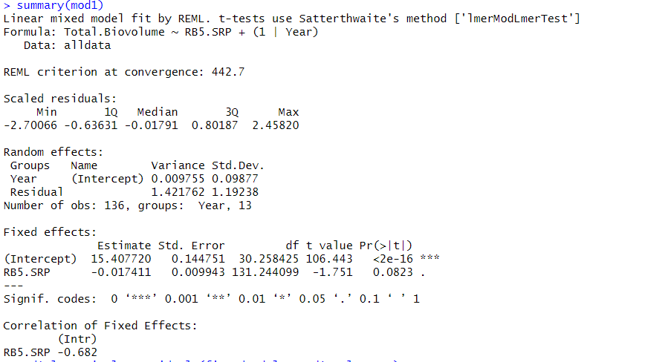

Slide 5
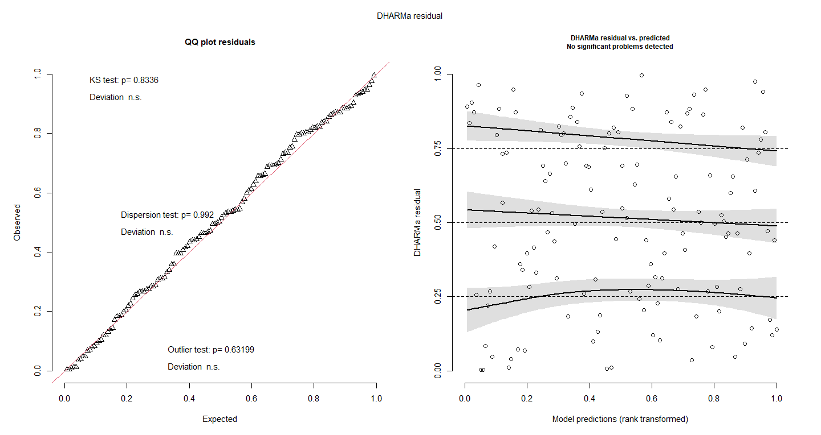

Slide 6
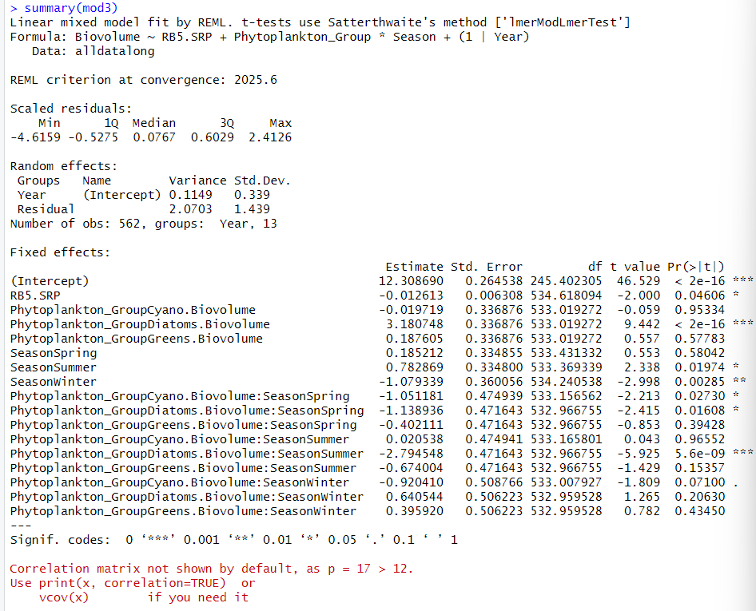

Slide 7
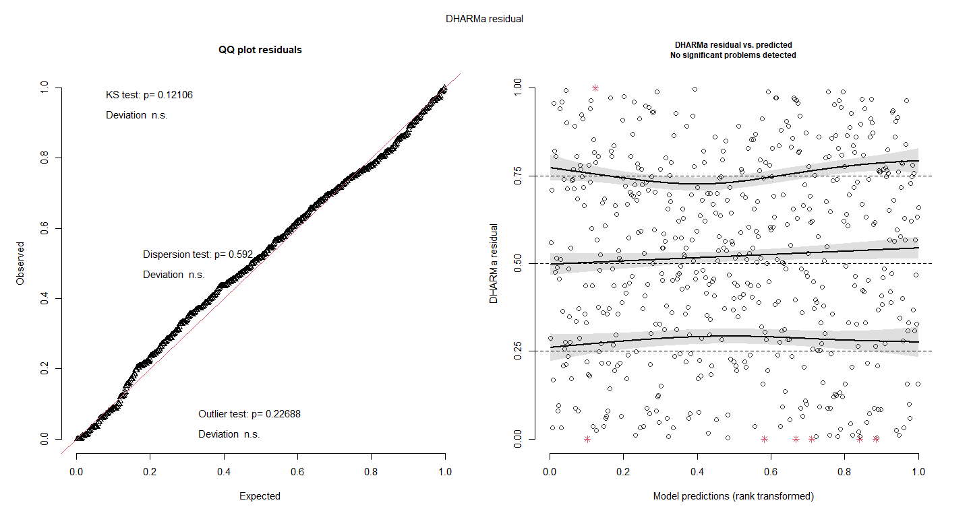

Slide 8
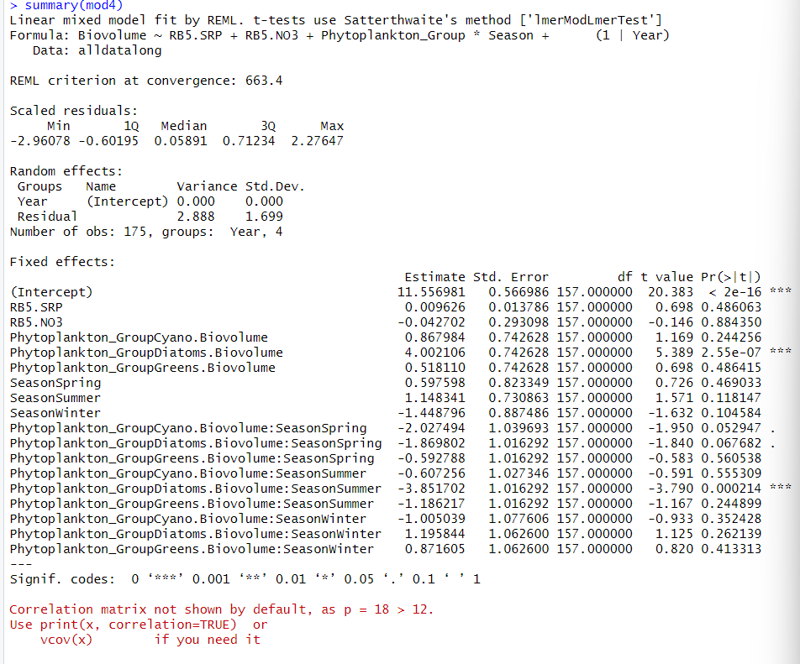

Slide 9
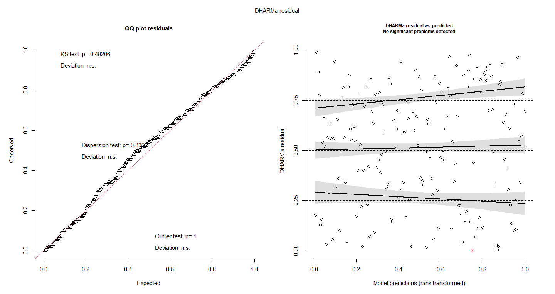

Slide 10
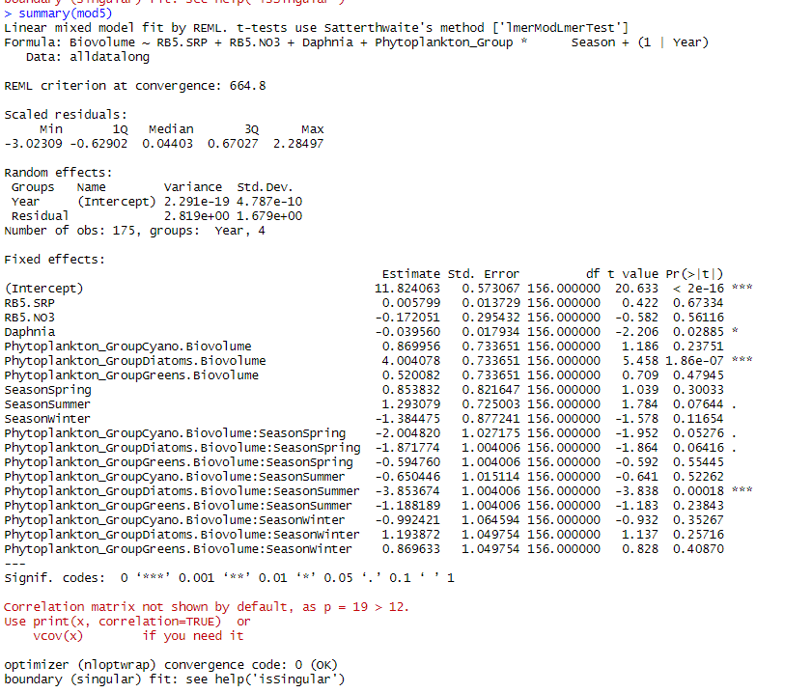

Slide 11
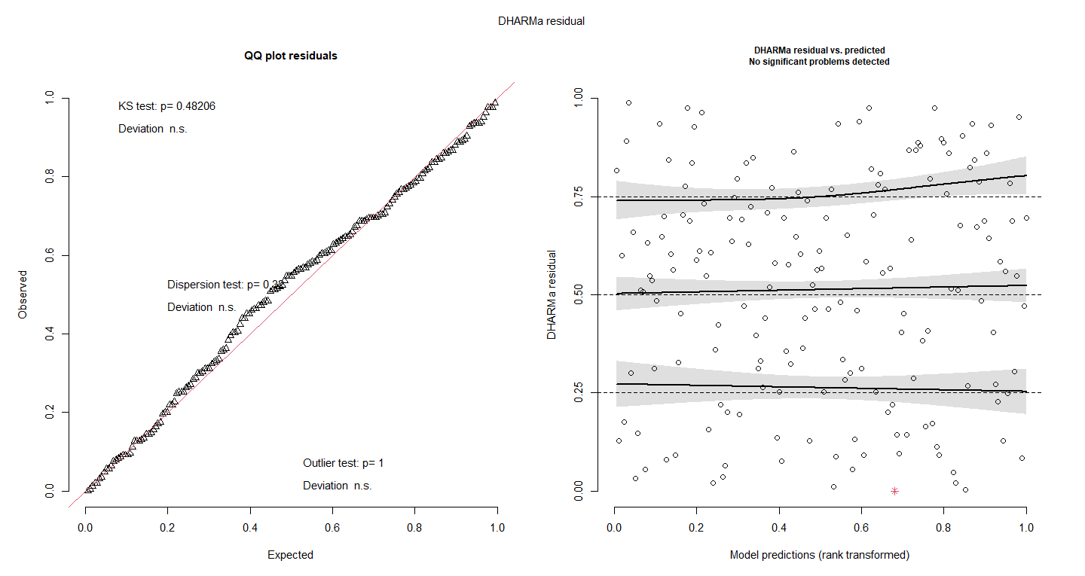

Slide 12
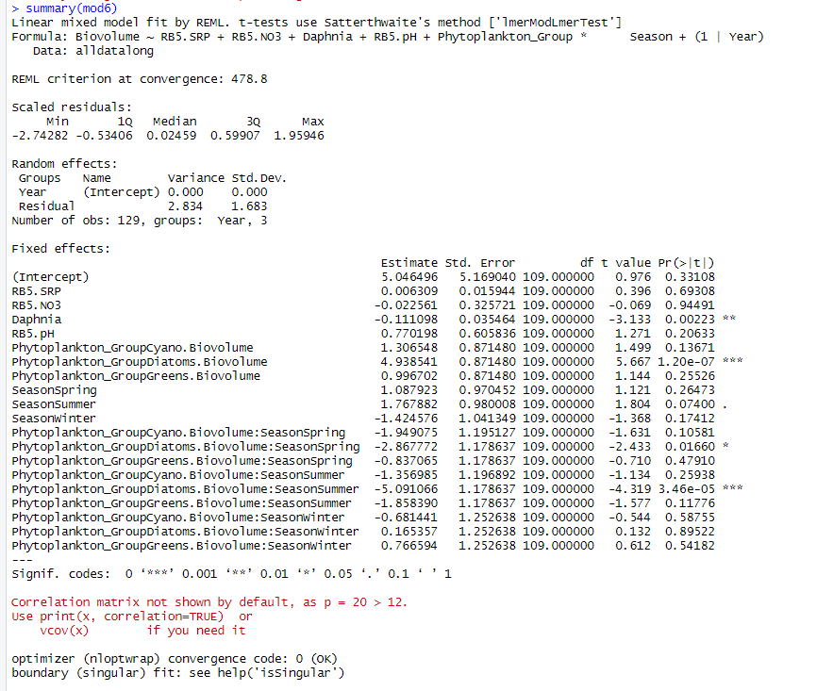
Try to scale pH or normalisation
Read about it – how to approach scaling or normalising for pH

Slide 13
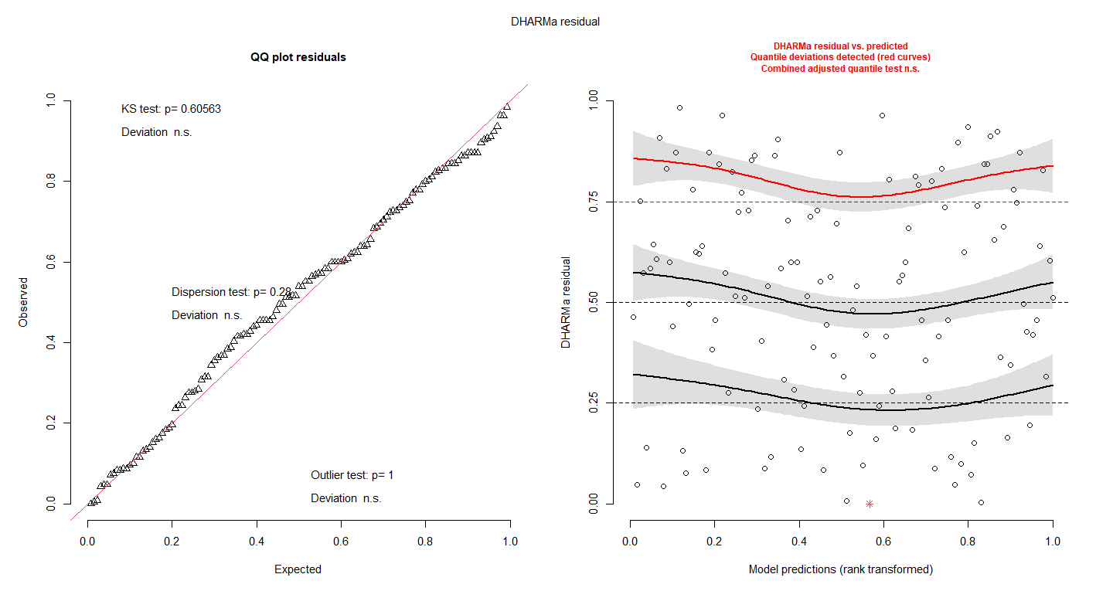

Slide 14
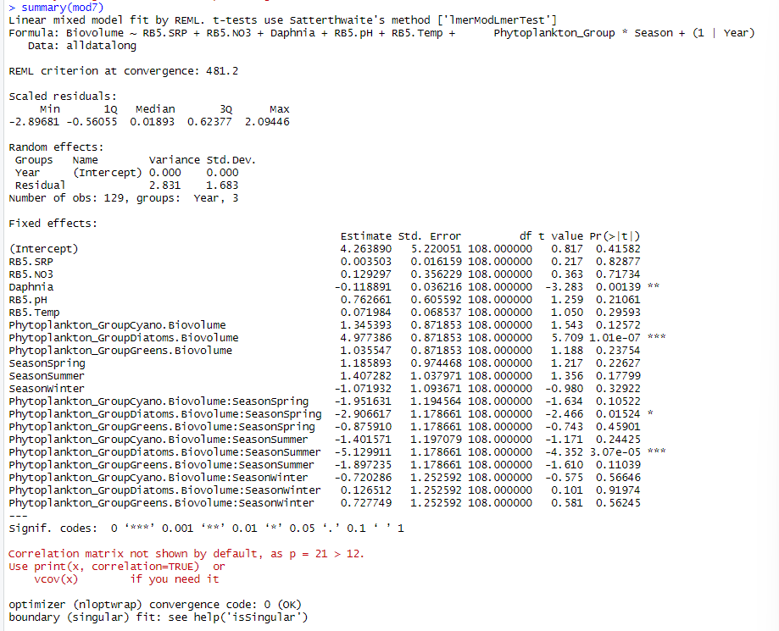

Slide 15
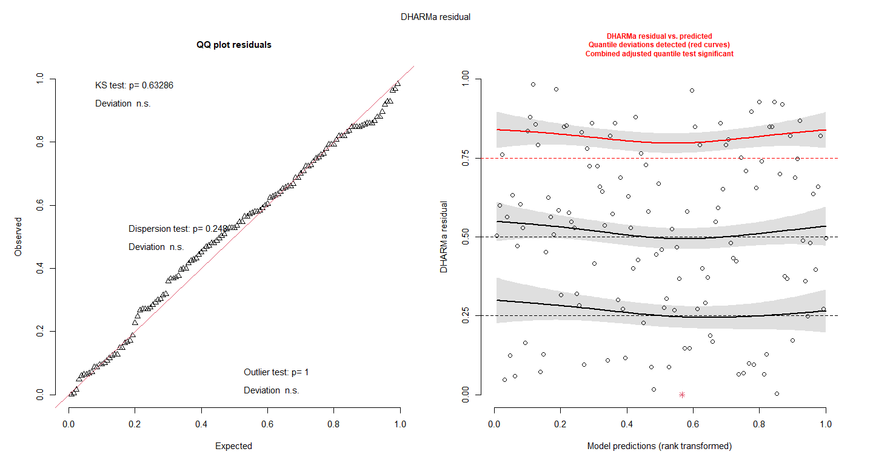

Slide 16
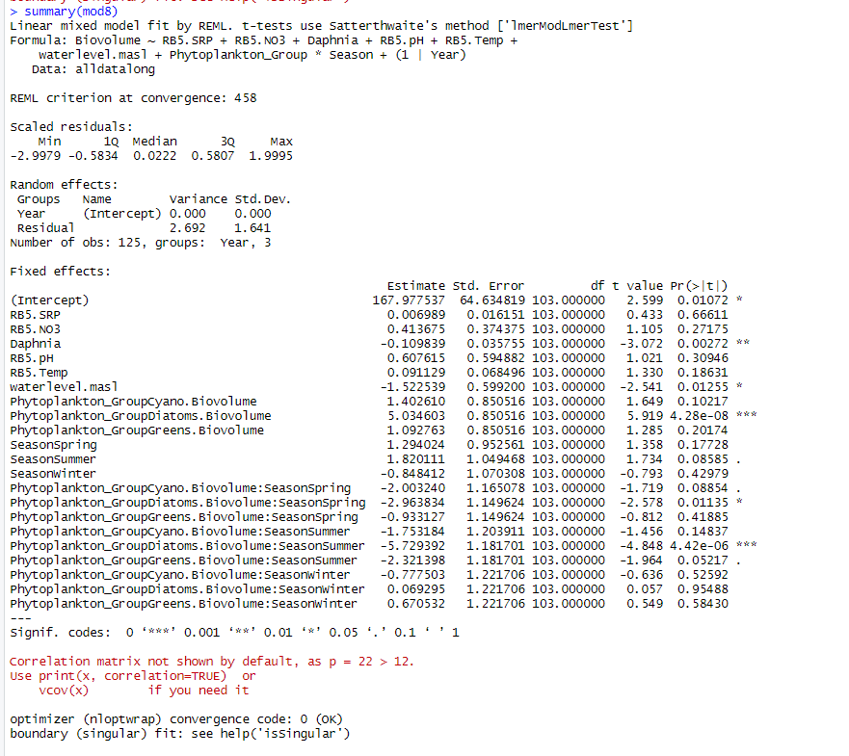

Slide 17
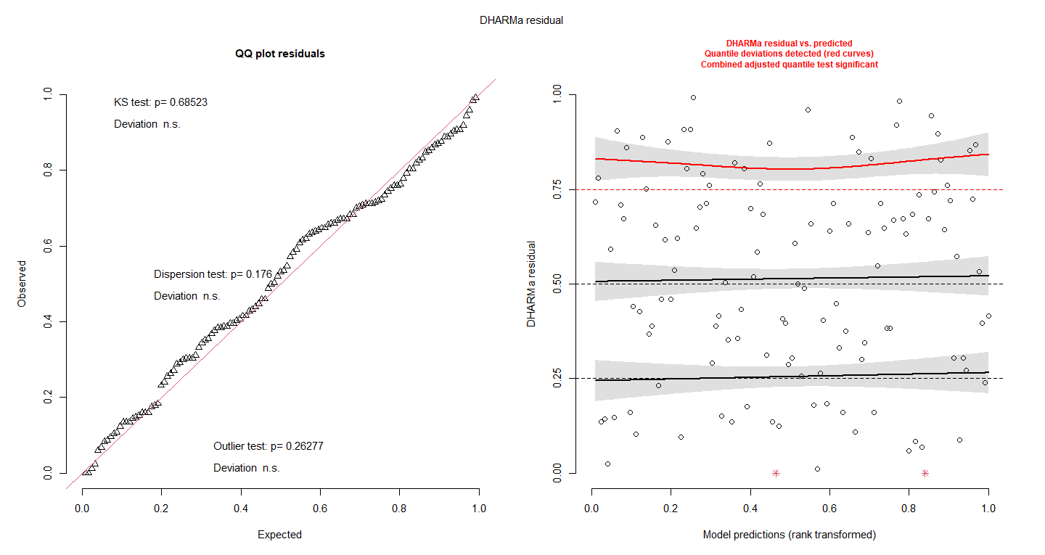

Slide 18
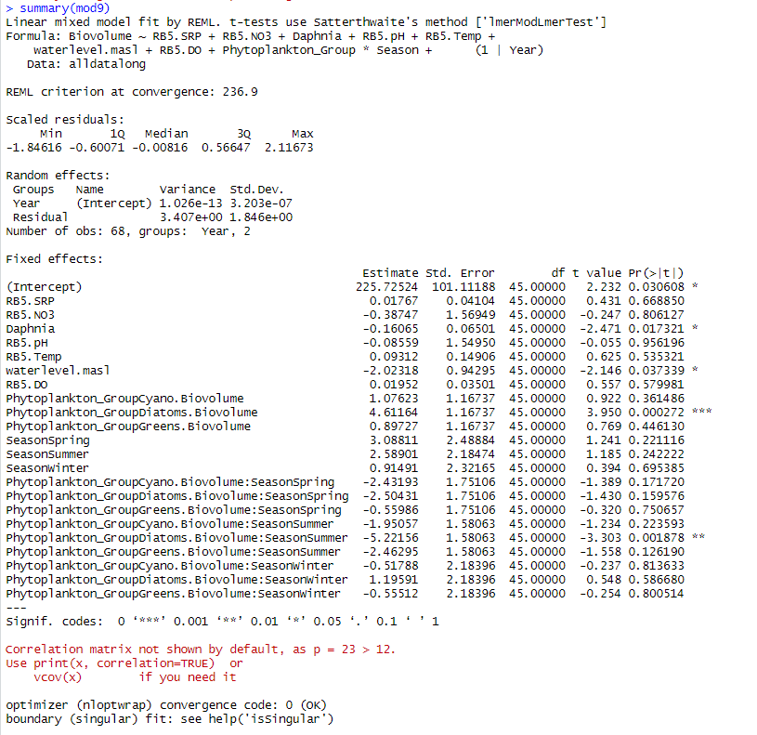

Slide 19
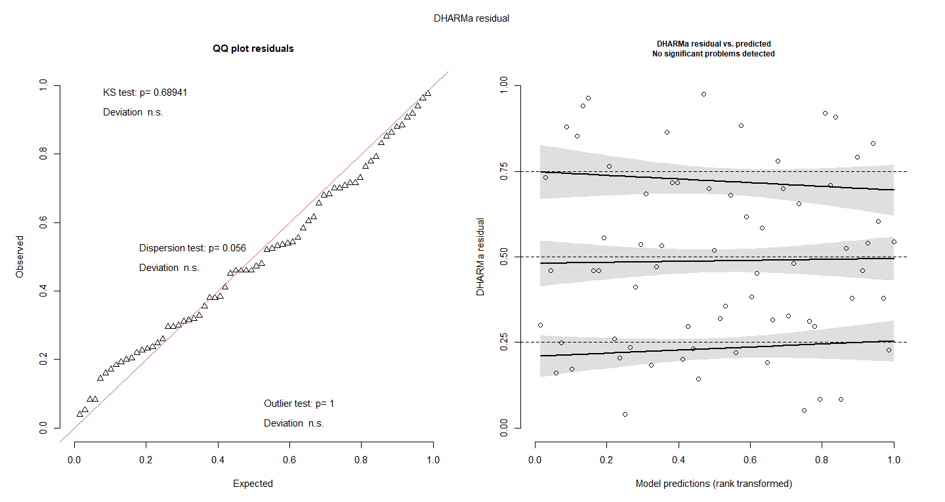

Slide 20
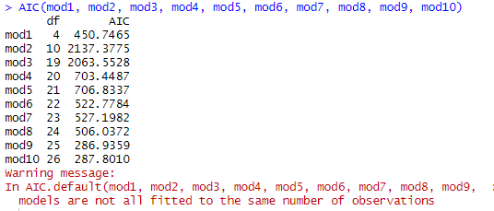
R2 doesn’t punish for overfitting
But AIC does punish for overfitting – and its still getting lower – so its getting better
Run everything without nitrate??
Table that has models with NO3 and models without NO3 and then AIC and R2
Look at multicollinearity – DO and temperature – build a justification – then test
choose which one to take out
VIF over 10 then remove one
Quality control

Slide 21
How to test the effect of seasonality on phytoplankton groups
Tried nesting season within year – models didn’t converge – so didn’t continue with it
Can we go through how to label the letters again? Im a bit confused
When reporting differences report using actual biovolumes (unlog)

Slide 22
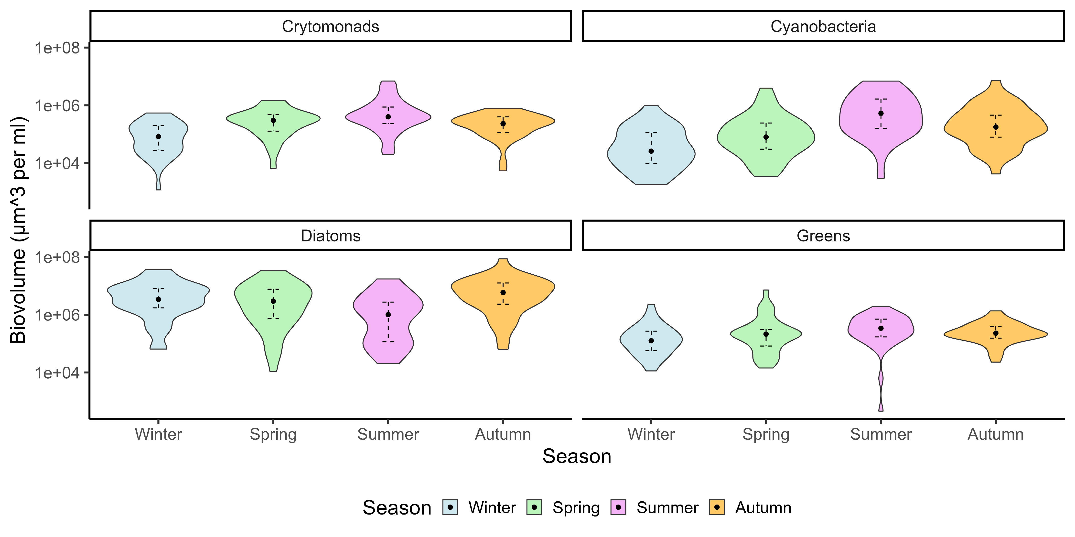

Slide 23
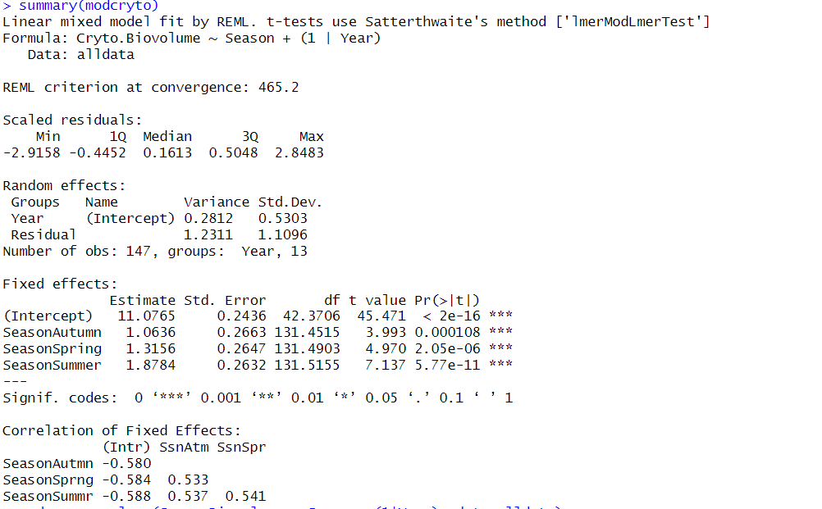

Slide 24
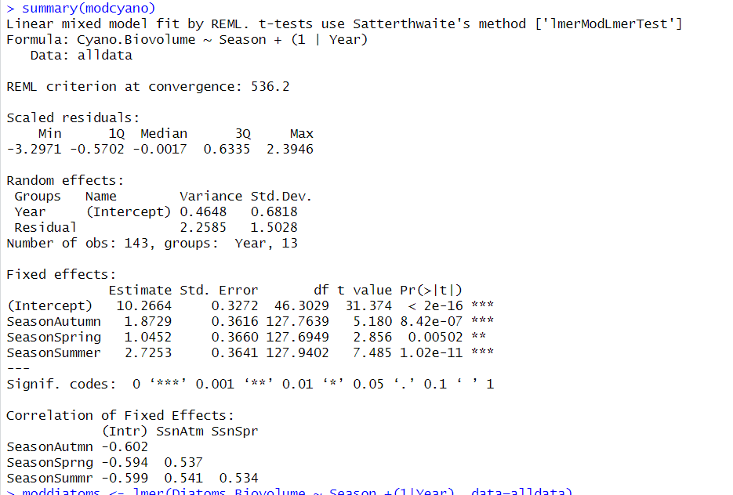

Slide 25
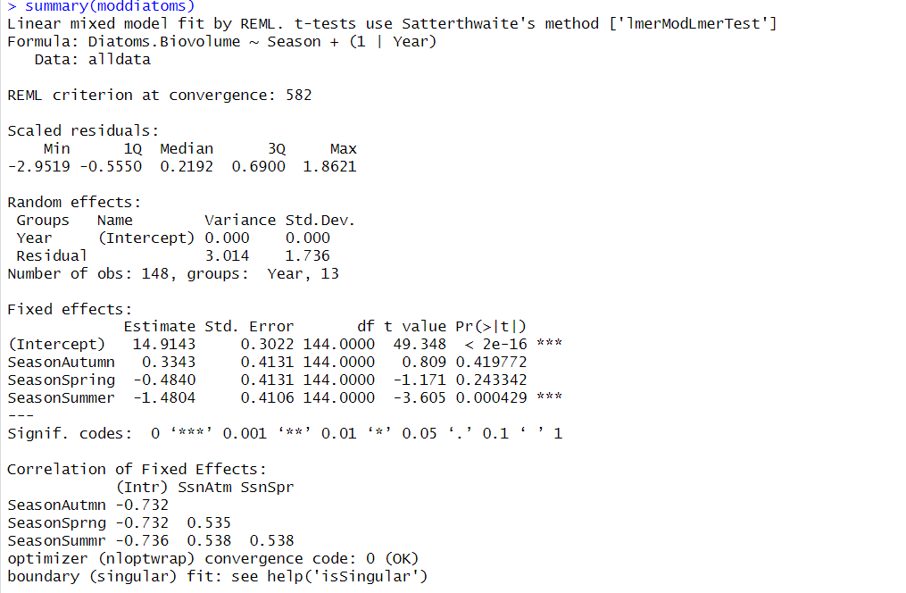

Slide 26
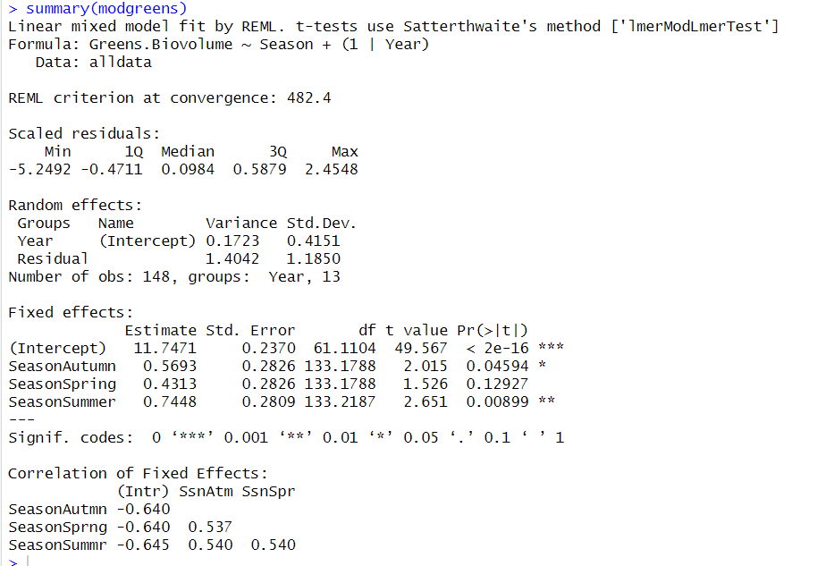

Slide 27
Seasonal Daphnia Trends
Question about Logging the y-axis – I just cant do it LOL
Question about the 1:1 line – because the difference in range of values is so high – do I log the value?

Slide 28
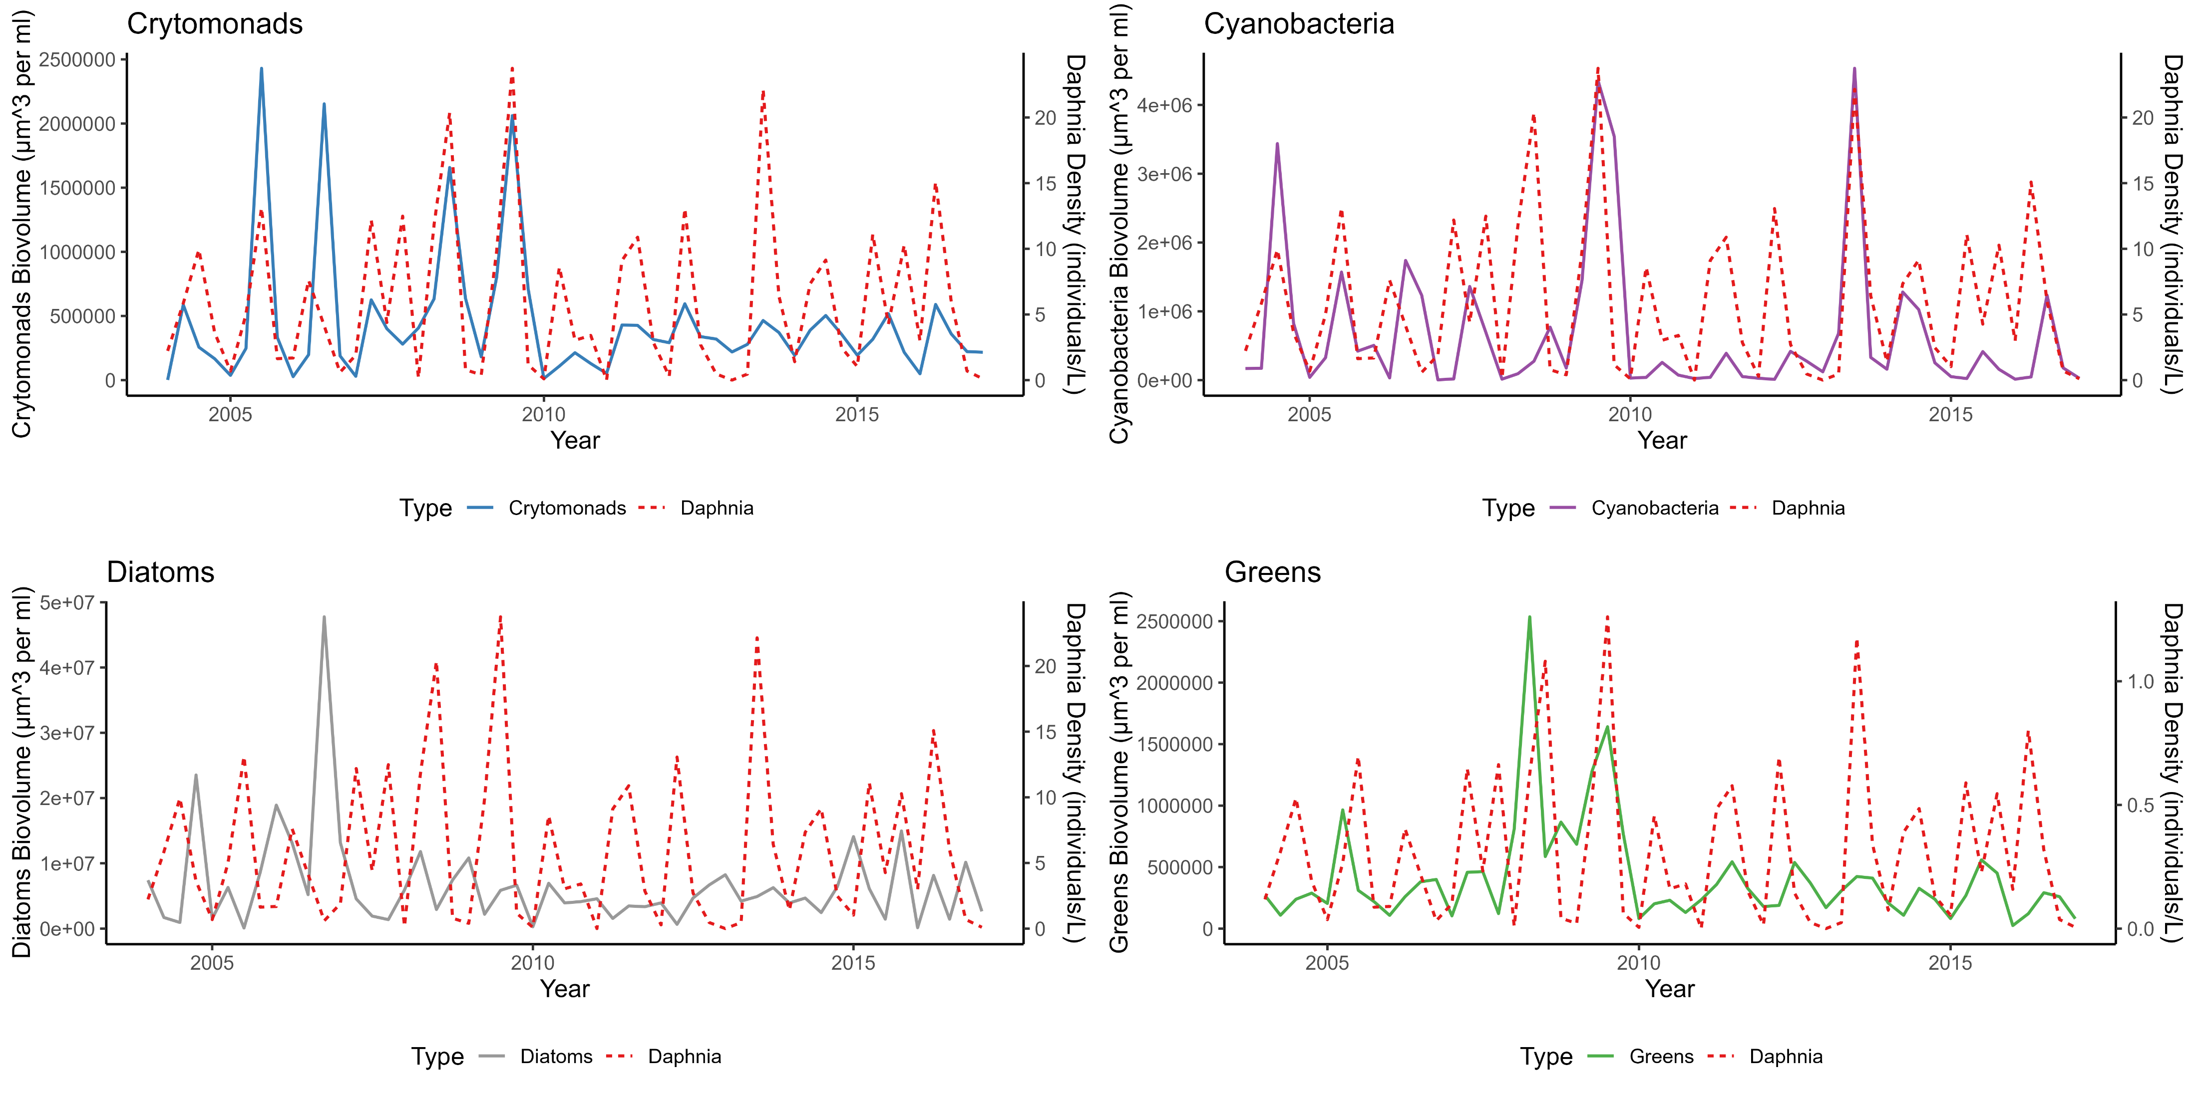

Slide 29
