Slide 1

ARIELLE
CERINI
MFA PhD
Creative Problem Solver & Strategic Thinker
Zenith Design System
VIEW PORTFOLIO
PHONE
EMAIL
(631) 655-6245
arielle@acerinidesigns.com
WEBSITE
ADDRESS
acerinidesigns.com
411 South Street Mechanicville, NY 12118

Slide 2
Zenith
Position UX Manager & Platform Strategist
Design System
Role Project Lead & Design System Architect
BAM Technologies
Tools & Technology Adobe XD & Outsystems
Worked to develop a design system to support an enterprise platform that was using a low-code development software called Outsystems. The design system was built to be completely themeable and with the intent of supporting all projects worked on at the organization.
VIEW PROJECT PAGE

Slide 3
Design Goal
Development teams are tasked with creating intuitive user experiences that are consistent across the platform. Presently, there is a lack of continuity throughout the platform, as well as a disconnect between the created mockups and the executed designs.
How can we empower teams to better adhere to platform standards and deliver the best end-user experience possible?
Assumptions:
The lack of consistency occurs within the platform because of the following: there is no on-boarding process for new developers; there is a lack of comprehensive documentation on what tools exist for the development teams; three is no central location where best practices and documents exist; there is a lack of awareness of the design system and what it is; the definition of done does not take the business language and user experience into consideration.
If teams were to have the information and guidance needed, we would see an increase in consistency across the platform.
The reason why repeat functionality exists within the platform is that teams were unaware that the tools they needed already existed.

Slide 4
Problem Statements
Throughout the company, there are the following:
a lack of design resources available for individual project teams
repeat functionality and UI Elements being built
a lack of resources to resolve problems previously solved by others
a lack of clearly defined standards and best practices
Within the platform, there are the following:
valuable resources being wasted to rebuild already existing functionality
a lack of time and resources devoted to maintaining and implementing a design system (both in design and development)
a lack of knowledge on how to use the design system
a lack of clearly defined best practices for UI design and front-end implementation

Slide 5
Solution
Create a fully searchable and dynamic style guide with clear documentation for using the design system.
Develop a company resource site that contains the best practices, resources, etc., for all disciplines working on development teams. This site should serve as an easy-to-use resource hub for the development teams; it is the source of truth.
The creation of this shared internal resource is intended to help support the growth and development of all people at the company and set employees up for success. Through the creation of this platform, it is believed that the company will be able to simplify the development process for creating new features, allowing a greater focus to be spent on ensuring teams are solving the right problems. In addition, creating a central resource hub for the company will allow for knowledge to be shared across the different projects. This will help to create more of a ‘community’ within the workplace and prevent time being spent resolving issues that the company has already invested time and resources into solving.

Slide 6
Scope
Phase 1
Creating and implementing design system in low-code environment
It is proposed that the initial focus for the team be on creating the design system for the low-code environments because that is where many of the company’s high-priority projects exist. Although the emphasis will be placed on low code, all development work should be done so that it can be easily translated into high-code.
Phase 2
Expanding system to be used in high-code environments
In the second phase of this project, the focus will shift toward the high-code environments. Working in conjunction with teams currently using Angular, the design system will be translated into Storybook so that it can easily be consumed by their projects.

Slide 7
Outcome
There are several key outcomes for this project.
An intuitively designed design system that focuses on continuity, reusability, and communication, drastically decreasing the time taken to develop and implement new designs.
Creating a fully themeable design system that can be applied to all pre-existing and future projects.
The creation of readymade screen templates for all frequently used layouts and workflows, allowing developers to drag in a template and tie it directly into the backend.
The development of design resources and documentation
Custom internal libraries and resources to improve upon the design and development process

Slide 8
Metrics (Measuring Success)
Success can be measured through the analysis of the following :
Decrease in the time spent on stories in DevOps It is hypothesized that by providing teams with a well-established design system and accompanying documentation, there will be a decrease in the time needed to create and implement a design solution.
Decrease in the number of high-fidelity mockups It is hypothesized that by investing time and resources into the design system, we will be able to construct a library of ready-made template layouts and blocks that will decrease the number of high-fidelity mockups required, allowing development teams to shift their focus to solving the user’s problems.
Time spent analyzing It is hypothesized that having a well-established design system will allow for an increase in the time teams spend analyzing user needs and decrease the time focused on UI and front-end development.

Slide 9
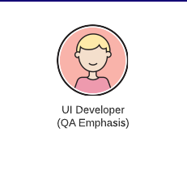
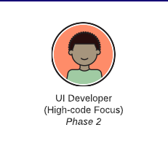
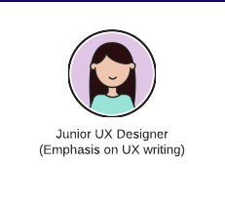

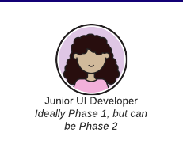
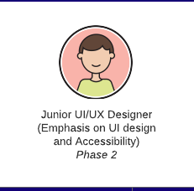
Team Composition
A team of designers and developers whose sole focus is working on the design system.

Slide 10
Solution
Part One: Design System Structure
Properties
UI Element Breakdown
Libraries
Part Two: Live Style Guide
Micro Service Architecture
Information Architecture
Site Design

Slide 11
Part 1: Design System Structure
Properties

Slide 12
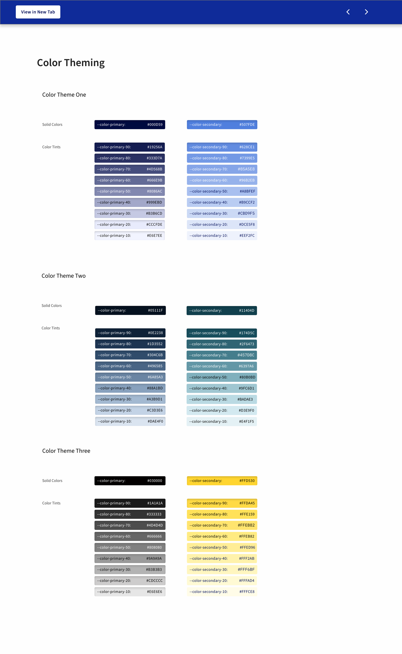
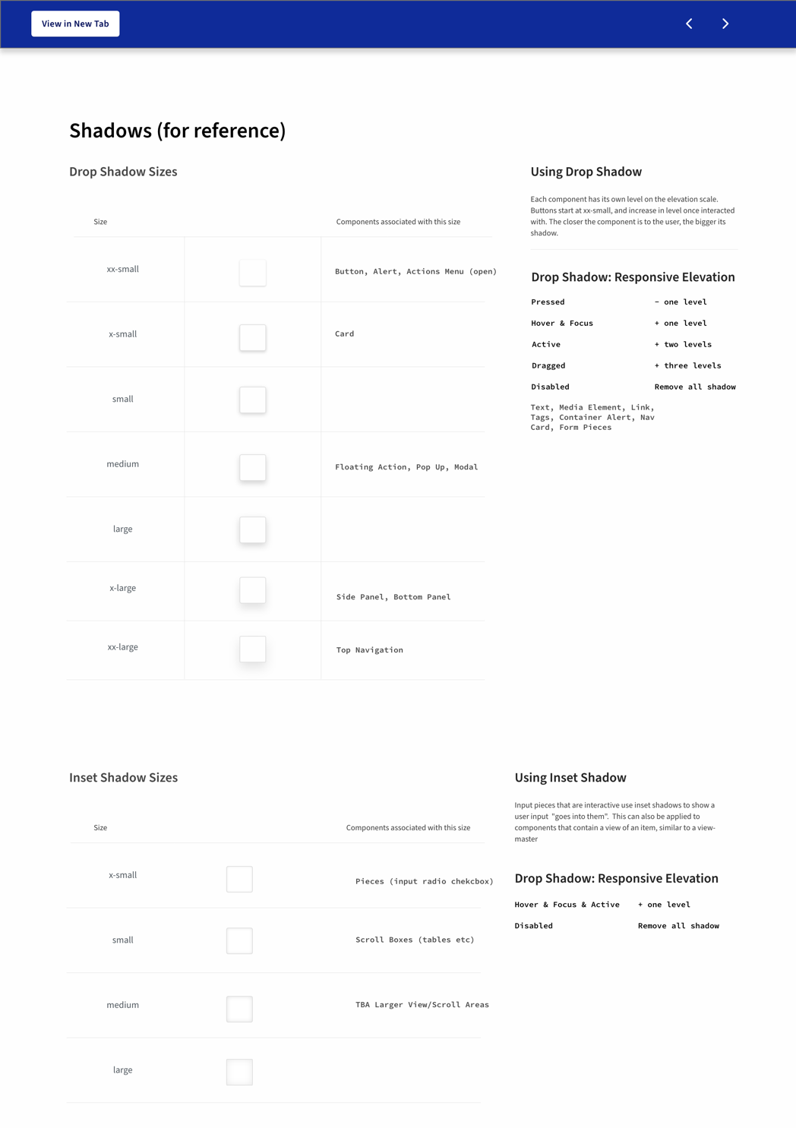
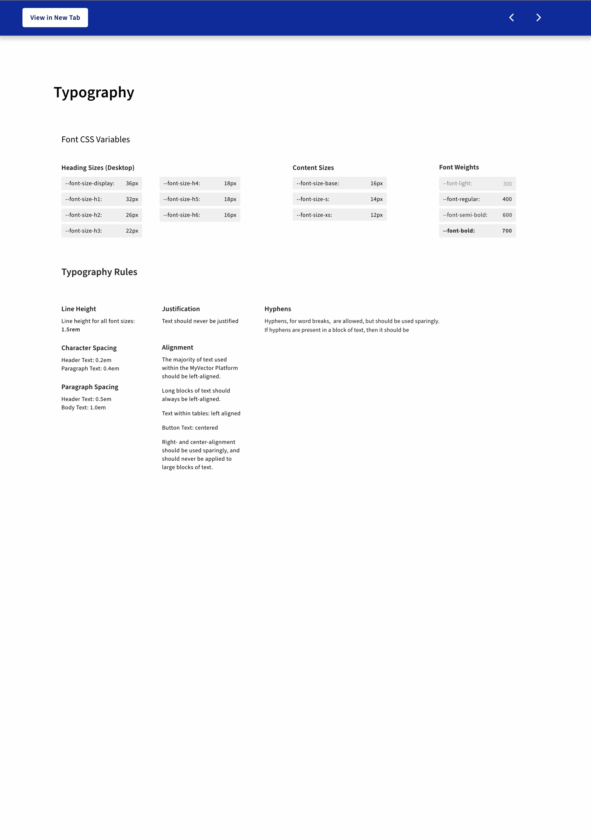
CSS_Lib
View in Browser
Design System Structure
Properties

Slide 13
Design System Structure
Properties
context | design attribute | property | state/varient | hierarchy
body | color | background | — | —
$body-color-background
Default background color for the whole app.

Slide 14
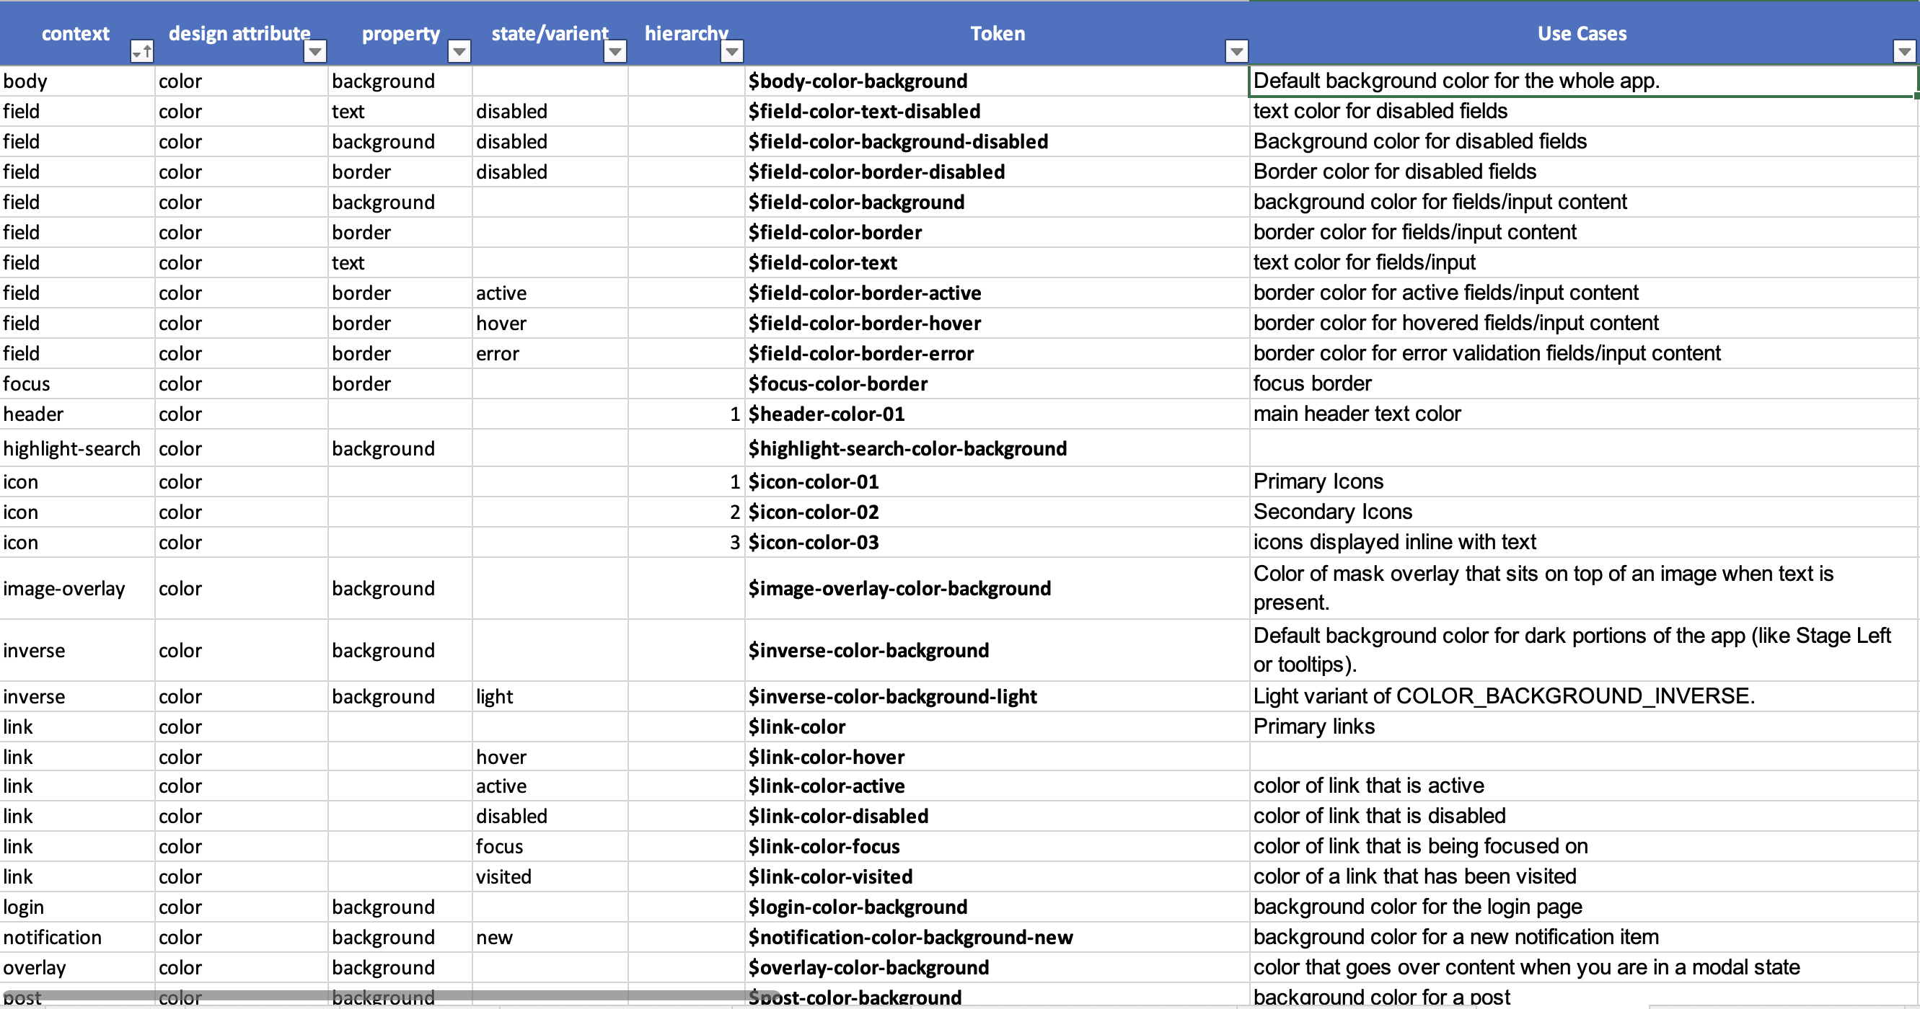
Design System Master List
View in Browser
Design System Structure
Properties

Slide 15
Part 1: Design System Structure
UI Element Breakdown

Slide 16
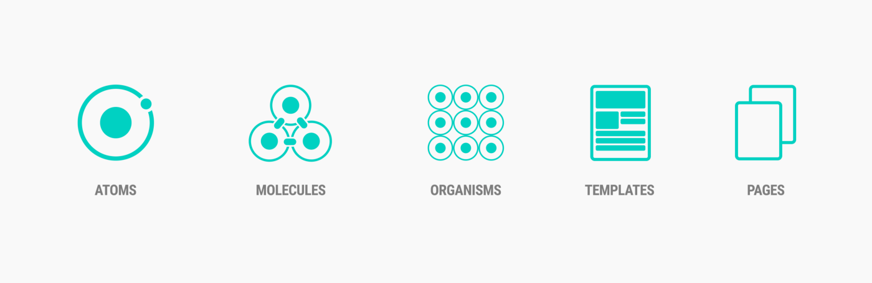
Design System Structure
UI Element Breakdown: Atomic Design

Slide 17
Initially tried Atomic Design, but development teams had a tough time understanding the terminology.

Slide 18
Design System Structure
UI Element Breakdown: Atomic Design (Inspired)
Pieces
Components
Patterns &
Widgets

Slide 19
Design System Structure
UI Element Breakdown: Atomic Design (Inspired)
Properties
Pieces
Components
Patterns
Widgets
Templates

Slide 20
Design System Structure
UI Element Breakdown
Properties: the design tokens, classes, and principles the element uses
Pieces: the elements that make up the component; pieces can never stand alone
Components: a unique UI element with no intended purpose; for it to exist in a design, it needs to be given a purpose for being there
Patterns: a unique UI element with a specific purpose
Widgets: a UI element or series of UI elements that are tied to business logic
Templates: a single page or series of pages that represent a complete business solution

Slide 21
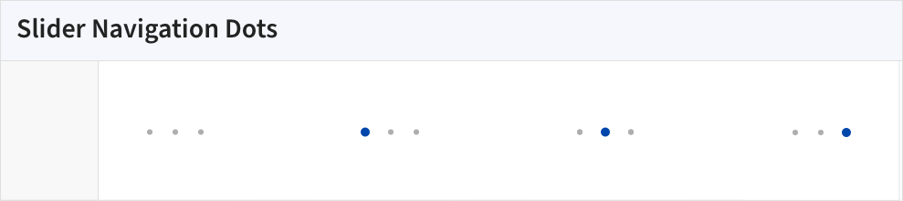
Design System Structure
Pieces
Pieces are localized to a specific library and are necessary for building other UI Elements but cannot stand on their own.
An example of a piece is a Slider Navigation Dot. The navigation dots are repeated throughout different elements but will never be used on their own and aren’t needed outside of the context of a slider. Creating a reusable piece makes it easier to maintain consistency across different elements and streamlines the process of updating them.

Slide 22
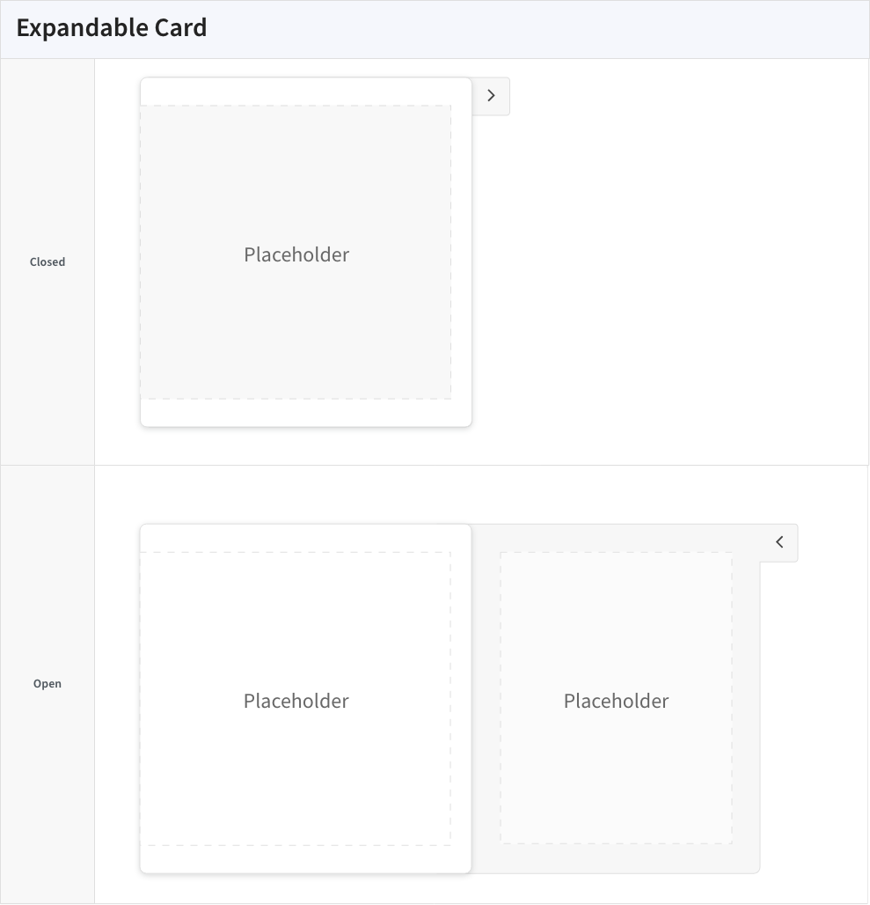
Design System Structure
Components
Components are distinct variations of a base UI Element. An example of a component is an Expandable Card. The base UI Element is a Card, and the distinction is the fact that the card is expandable.
Naming conventions: Distinction + Base UI Element UI Flow: Plural form of the Base UI Element

Slide 23
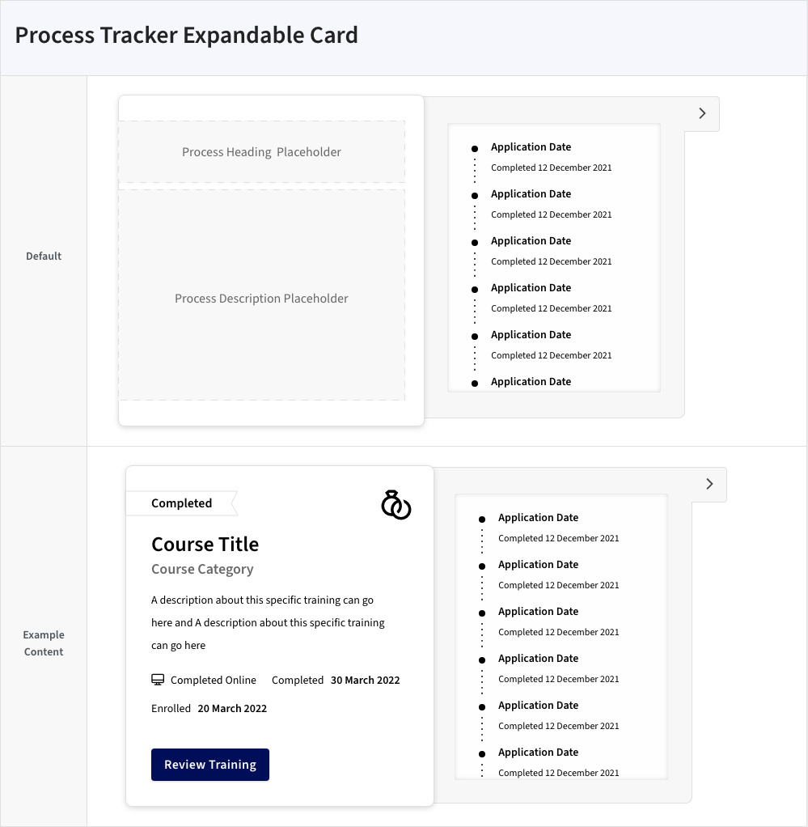
Design System Structure
Patterns
Patterns are versions of components that have a fixed purpose. An example of a pattern is a Process Tracker Expandable Card. The purpose is to track a process, the distinction is that the card is expandable, and then the base UI Element is a card.
Naming conventions: : Purpose + Distinction + Base UI UI Flow: Plural form of the Distinction + Base UI Element

Slide 24
Part 1: Design System Structure
Libraries

Slide 25
Design System Structure
Libraries
Design System Breakdown
View in Browser
Taking an inventory of the system to determine how best to organize the UI Elements.

Slide 26
Design System Structure
Libraries
ID | Name | UI Layer (later) | UI SubLayer (later) | Description (keep)
1 | CoreUI | Base Foundation | BottomLayer | HTML elements, stylistic components, and basic interactive elements.
2 | DynamicDataUI | Content | SecondaryLayer | Patterns and components related to data visualizations. This is where the form and information UI is combined.
3 | FormUI | Content | BaseLayer | Form input patterns and pre-made form templates.
4 | InformationUI | Content | BaseLayer | Tags, alerts, typesetting, and other patterns and components related to displaying/encoding information.
5 | LayoutUI | Base Foundation | SecondaryLayer | Sections, containers, cards, and other patterns and components related to the layout of the page.
6 | ThemePatterns | Theme Structuring And Styling | TopLayer | Patterns constructed to be used within pre-defined containers and layouts. This includes page layout patterns, application progress patterns, header patterns, etc.
7 | ResourceUI | Base Foundation | BottomLayer | JavaScript libraries containing basic functionality required throughout the platform. (In the near future, this will be merging with ReusableClientActions_Lib)
8 | ReusableClientActions | Base Foundation | BottomLayer | Client actions that are not contained within basic OutSystems UI functionality. These are required throughout the platform to ensure consistent formatting of information.
9 | CSS | Theme Structuring And Styling | TopLayer | Reusable CSS classes that are built using CSS variables so they can be repurposed across OutSystems projects.

Slide 27
Design System Structure
Libraries
Primarily Components
Primarily Patterns
Widgets, Templates, and Patterns (Not Themeable)
Core UI
Information UI
Theme Patterns
Layout UI
Form UI
Dynamic Content

Slide 28
Part 2: Live Style Guide
Micro Service Architecture

Slide 29
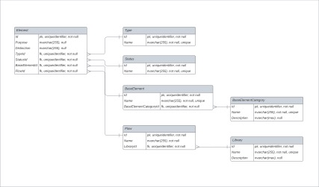
Live Style Guide
Micro Service Architecture

Slide 30
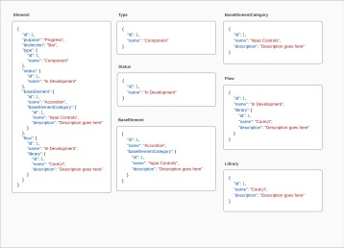
Live Style Guide
Micro Service API

Slide 31
Part 2: Live Style Guide
Information Architecture

Slide 32
Live Style Guide
Information Architecture
Live Style Guide IA
View in Browser

Slide 33
Part 2: Live Style Guide
Site Design

Slide 34
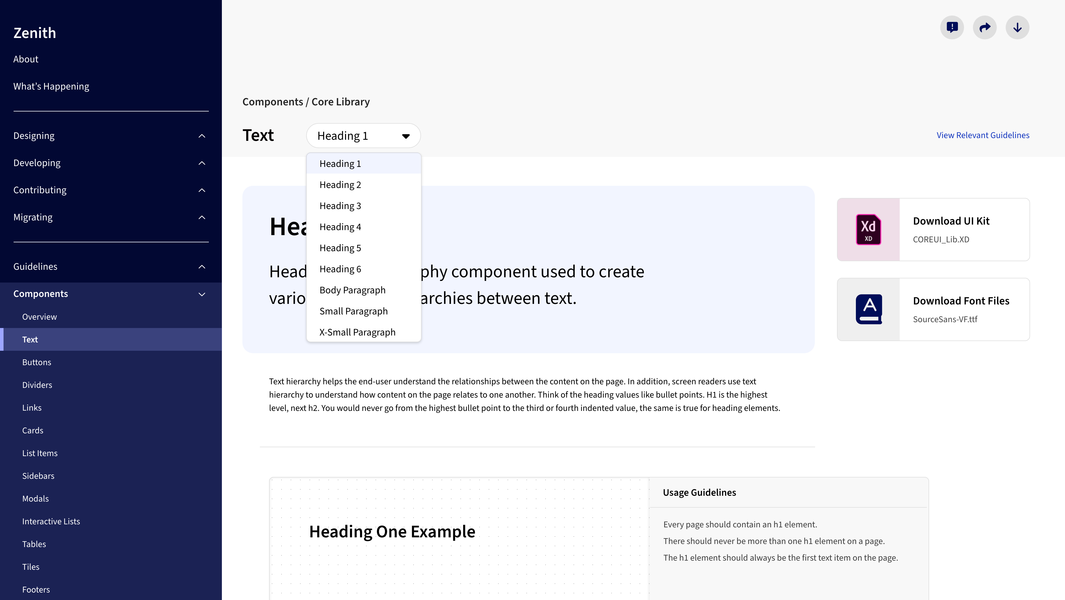
Live Style Guide
End Design

Slide 35
Final Design
Other Details:
SASS followed a 7-in-1 architecture.
The same naming conventions were followed for both design and development work.
A series of classes were constructed using mix-ins that allowed developers to figure out what classes existed in the system quickly.
position: absolute -> .position-absolute
Audits were conducted to help with the following initiatives: - defining iconography - creating repeat patterns i.e. person cards - creating a series of reusable dashboard layouts …
Implemented Solution
Project Page
View Project Page
Additional process documentation is available in the shared folder.

