Slide 1




Functional analysis and interpretation of RNA-seq data
June 4th, 2026
Ariel Madrigal
Arsham Mikaeili Namini
Notes:
Do introduction

Slide 2
Notes:
The McGill initiative on Computational Medicine was formed in 2017 and aims to deliver inter-disciplinary research programs and empower the use of data in health research and health care delivery
Located at the Genome Center
They have a newsletter were you can subscribe to
more info on the web site

Slide 3
Outline:
1
Experimental design and model specification using DESeq2
2
GSEA and ORA
3
Resources
4
Concluding remarks

Slide 4
Acknowledgements
Material:
Reinnier Padilla
Adrien Osakwe
Exercises:
DESeq2 vignette
fgsea vignette
Enrichr vignette
Data:
Link

Slide 5
This is an interactive workshop :)
Feel free to interrupt or raise your hand to ask questions

Slide 6
A small recap…
Quality control of FASTQ files
Genome alignment
Read counting
Differential expression

Slide 7
Part 1: Experimental design and model specification using DESeq2
A brief overview of the DESeq2 model
Introduction to design matrices for gene expression experiments
Interpreting coefficients
Multi-factor designs
Detecting batch effects and outliers
Hands-on activity 1

Slide 8
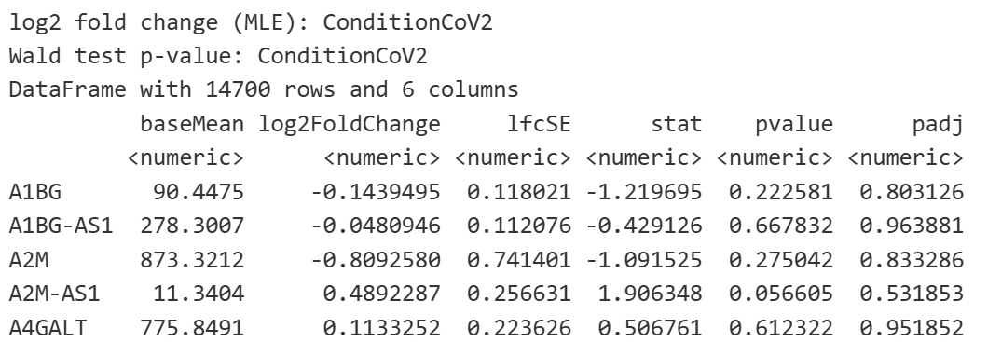
DESeq2 output
What does this all mean?
Love, M. et al (2014) Genome Biology

Slide 9
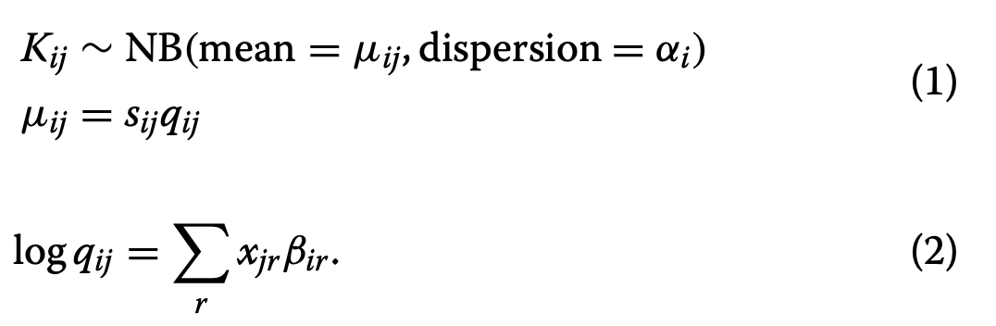
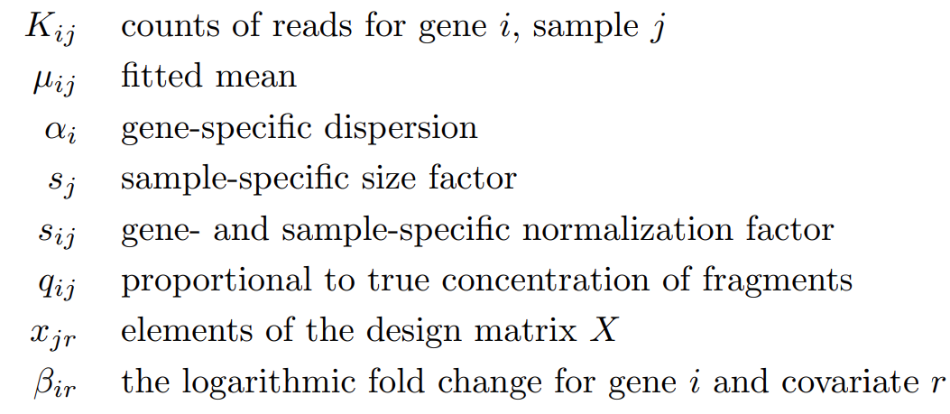
Model used in DESeq2
DESeq2 models the counts using a negative binomial distribution
Love, M. et al (2014) Genome Biology

Slide 10
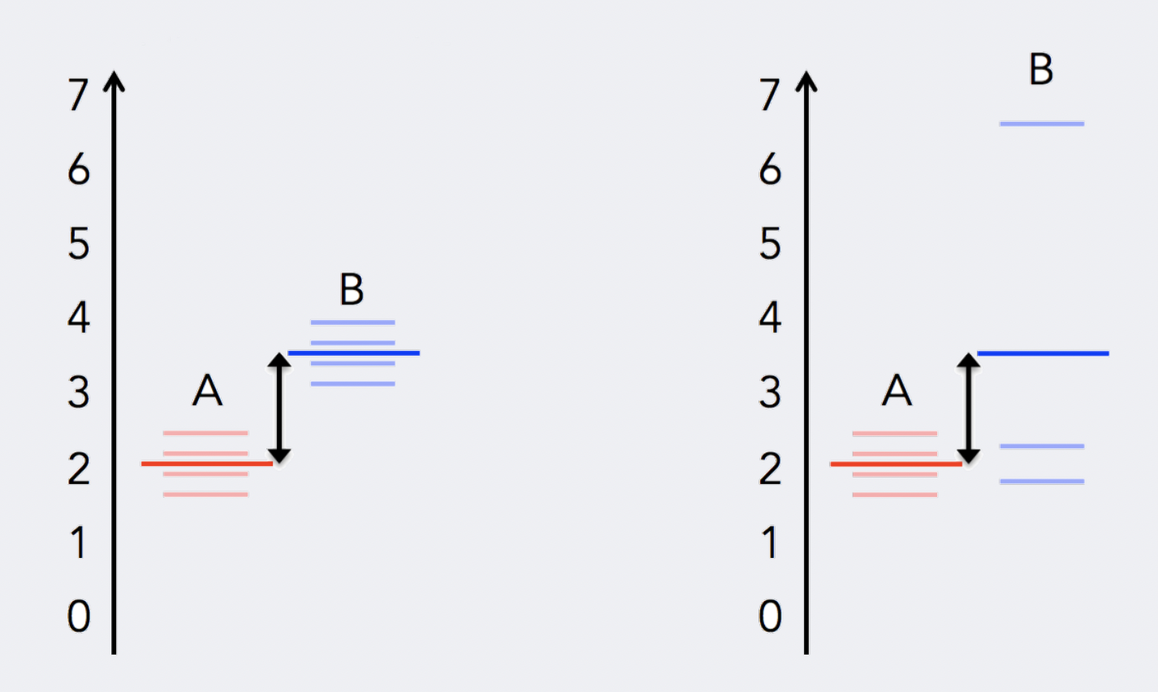
Uneven distribution of information
Replication introduces variance
Adapted from: https://hbctraining.github.io/DGE_workshop_salmon_online/schedule/links-to-lessons.html
Notes:
To determine differentially expressed genes, we evaluate the variation of expression between groups (of interest) and compare that to the variation within the groups (between replicates).

Slide 11

What is dispersion?
Within-group variability (the variability between replicates), is modeled by the dispersion parameter
Love, M. et al (2014) Genome Biology

Slide 12
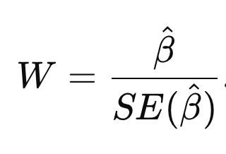
Wald tests
Log2 Fold Change in gene expression
We can assume the log fold change under the null hypothesis to be distributed normally with mean zero and variance that depends on the standard error.
From there, we can compute a two-sided p-value
Love, M. et al (2014) Genome Biology

Slide 13
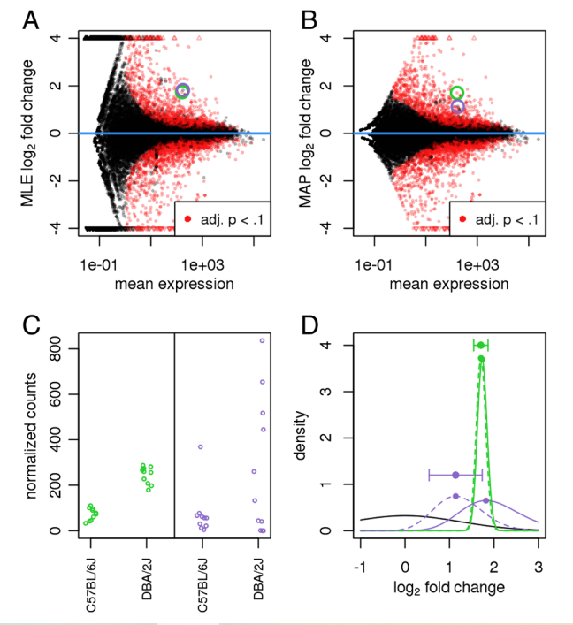
Log-fold shrinkage
Shrinkage of FC addresses two issues:
Log-fold changes are noisier when counts are low
Genes with high dispersion should be less reliable
Love, M. et al (2014) Genome Biology

Slide 14
Part 1: Experimental design and model specification using DESeq2
A brief overview of the DESeq2 model
Introduction to design matrices for gene expression experiments
Interpreting coefficients
Multi-factor designs
Detecting batch effects and outliers
Hands-on activity 1

Slide 15
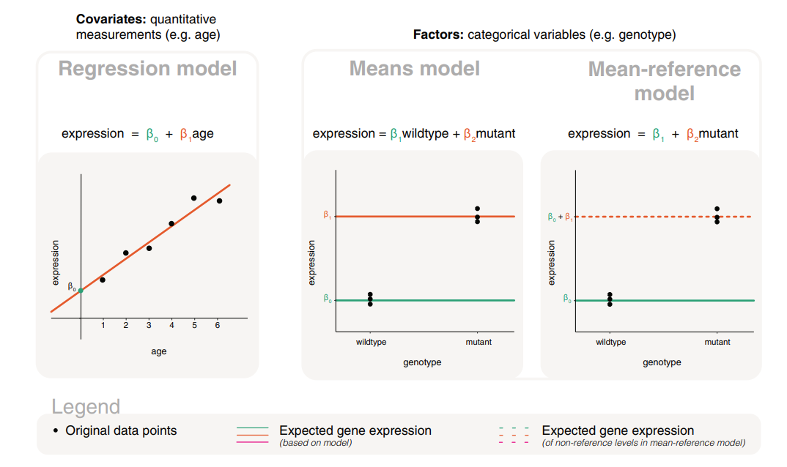
Models for covariate and factor variables
Law, C. et al (2020) F1000 Research

Slide 16
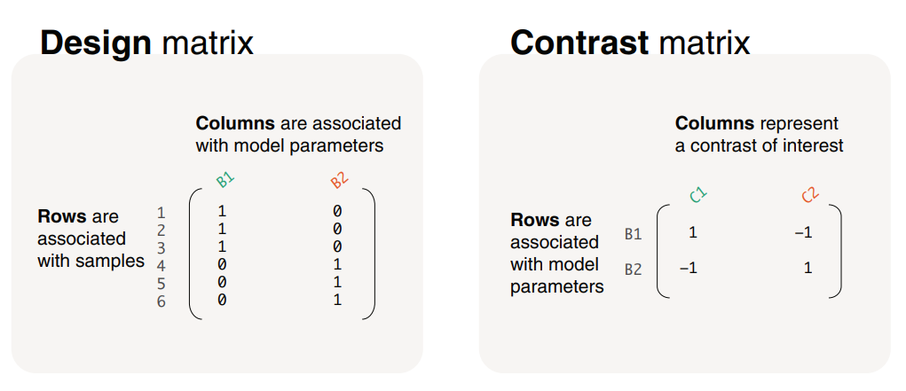
Design and contrast matrices
Law, C. et al (2020) F1000 Research

Slide 17
Part 1: Experimental design and model specification using DESeq2
A brief overview of the DESeq2 model
Introduction to design matrices for gene expression experiments
Interpreting coefficients
Multi-factor designs
Detecting batch effects and outliers
Hands-on activity 1

Slide 18
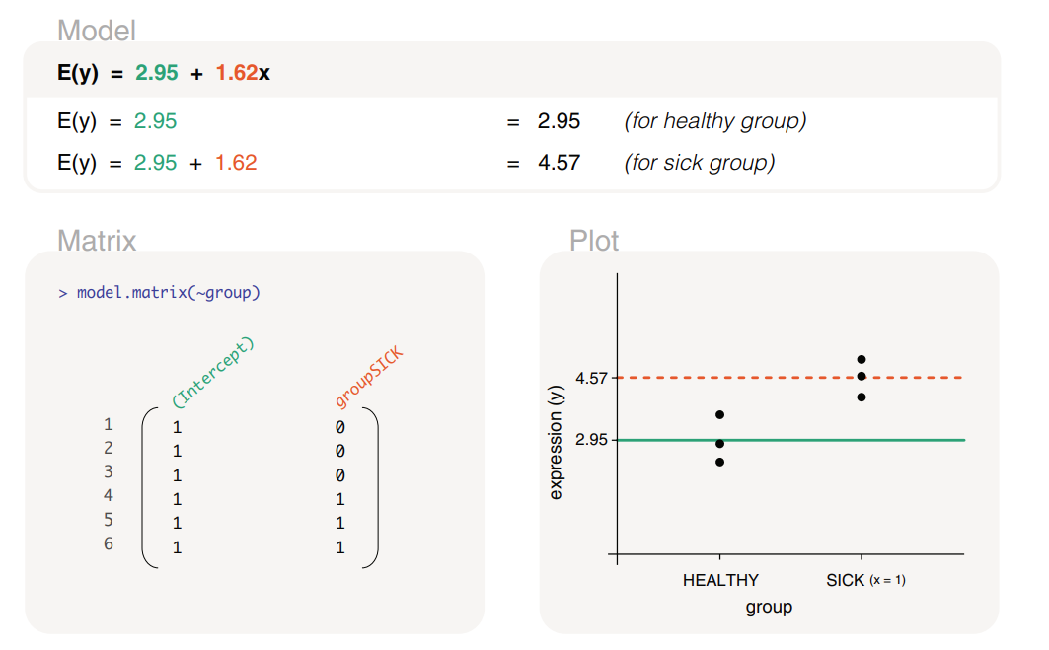
Gene expression modelled by a group factor
~ group
Law, C. et al (2020) F1000 Research

Slide 19
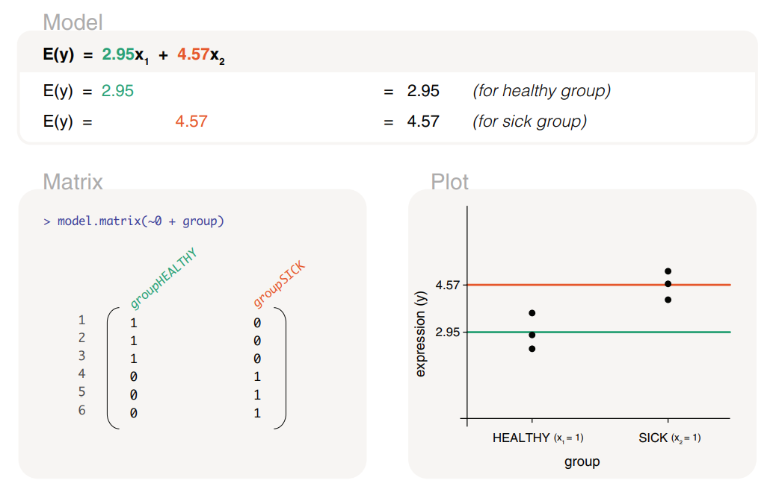
Gene expression modelled by a group factor
(excluding intercept)
~ 0 + group
A contrast will be needed to extract the actual log2FC
Law, C. et al (2020) F1000 Research

Slide 20
Part 1: Experimental design and model specification using DESeq2
A brief overview of the DESeq2 model
Introduction to design matrices for gene expression experiments
Interpreting coefficients
Multi-factor designs
Detecting batch effects and outliers
Hands-on activity 1

Slide 21
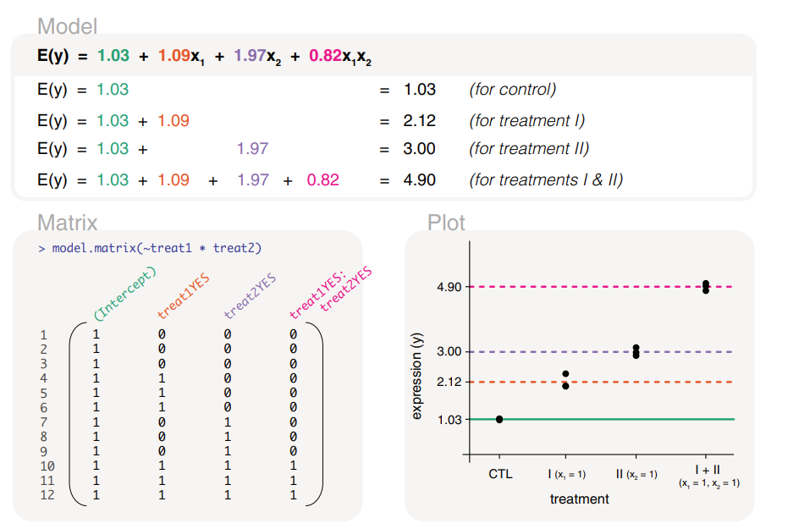
An interaction model captures a synergistic effect
~ treat1 * treat2 equivalent to ~ treat1 + treat2 + treat1:treat2
One plus one is greater than two
Law, C. et al (2020) F1000 Research

Slide 22
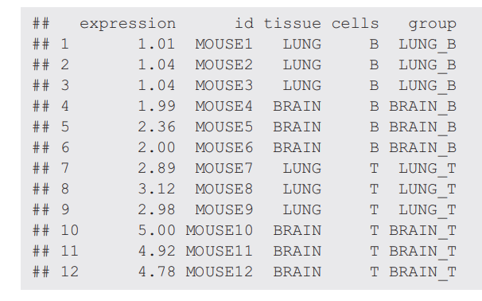
A group factor can represent two factors (tissue sample and cell type)
Law, C. et al (2020) F1000 Research

Slide 23
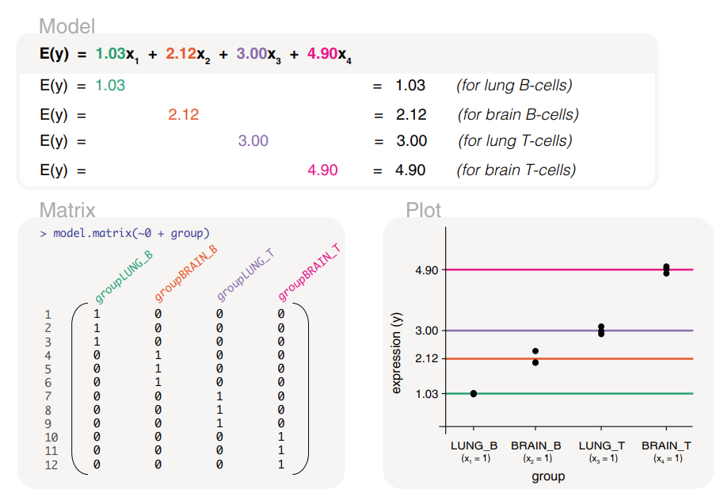
A group factor can represent two factors (tissue sample and cell type)
~ 0 + group
Law, C. et al (2020) F1000 Research

Slide 24
Part 1: Experimental design and model specification using DESeq2
A brief overview of the DESeq2 model
Introduction to design matrices for gene expression experiments
Interpreting coefficients
Multi-factor designs
Detecting batch effects and outliers
Hands-on activity 1

Slide 25
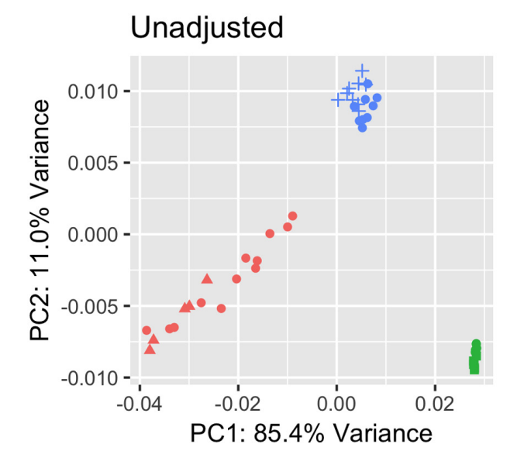
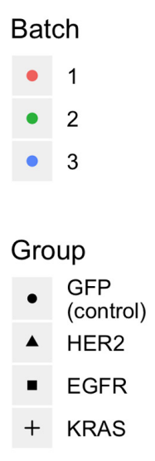
Batch effects
Zhang, Y. et al (2014) NAR Genomics and Bioinformatics

Slide 26
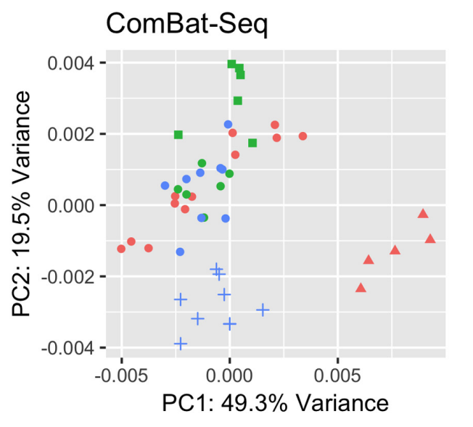
Batch effect removal
Zhang, Y. et al (2014) NAR Genomics and Bioinformatics

Slide 27
DESeq2 output
The log2 fold change depends on the design that we use and the contrast (if any)
Love, M. et al (2014) Genome Biology

Slide 28

Hands-on 1

Slide 29
Part 2: GSEA and ORA
Statistical concepts used in GSEA
Statistical concepts used in ORA
When to use GSEA or ORA?
Hands-on activity 2

Slide 30
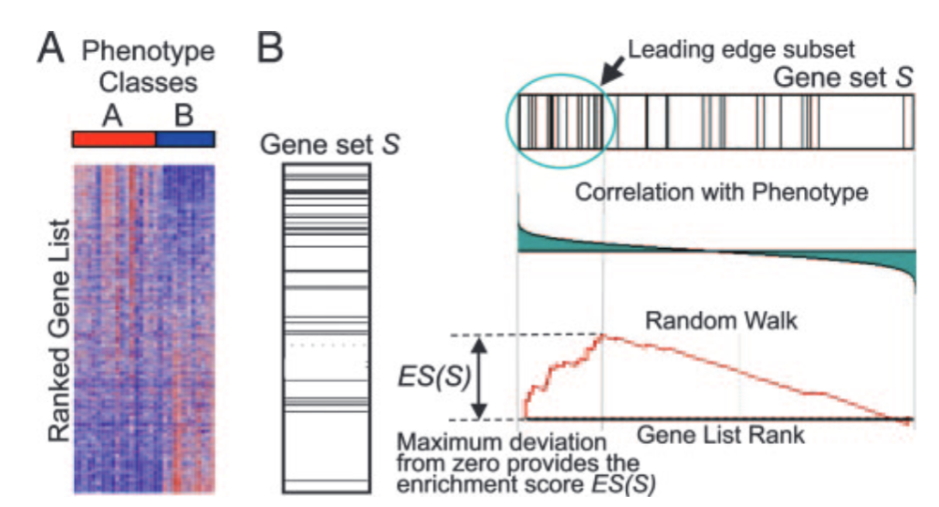
Gene Set Enrichment Analysis (GSEA)
Subramanian, A. et al (2005) PNAS

Slide 31
Part 2: GSEA and ORA
Statistical concepts used in GSEA
Statistical concepts used in ORA
When to use GSEA or ORA?
Hands-on activity 2

Slide 32

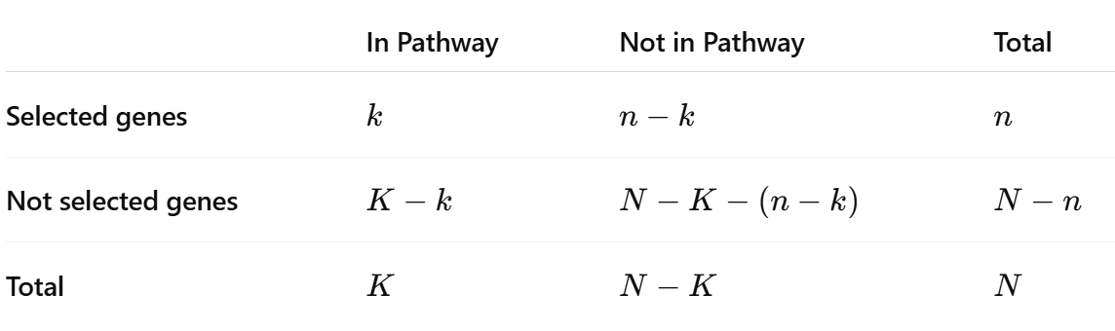
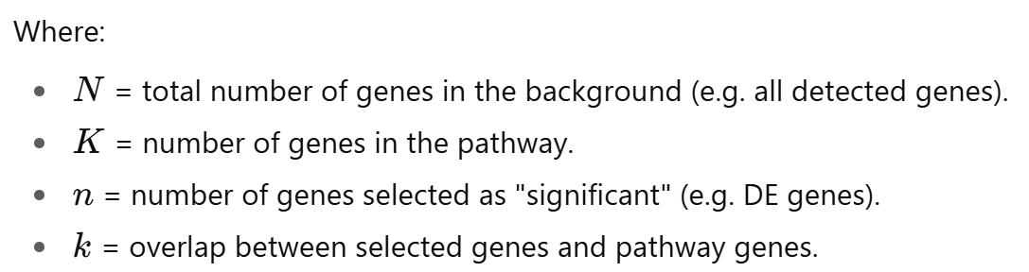
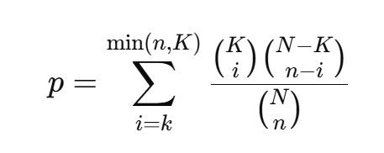
Enrichr
P-value comes from a hypergeometric test
Chen E. et al (2013) BMC Bioinformatics

Slide 33
Part 2: GSEA and ORA
Statistical concepts used in GSEA
Statistical concepts used in ORA
When to use GSEA or ORA?
Hands-on activity 2

Slide 34
When to use GSEA or ORA?
 | GSEA | ORA
Input | Ranked list of all genes | Significant gene list + background
Test type | Running-sum enrichment score + permutation | Hypergeometric
Uses cutoff? | No | Yes(DE)
ORA asks: Are my DE genes enriched in this pathway?
GSEA asks: Are genes from this pathway enriched towards the top or bottom of the ranked list?

Slide 35
Hands-on 2

Slide 36
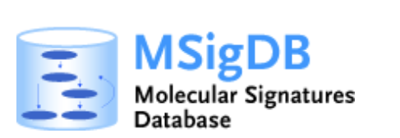




Part 3: Resources
MsigDB
Gene Ontology
KEGG
Reactome
Enrichr
Panther

Slide 37
Part 4: Concluding remarks
Now you are ready to:
Perform a standard DGE, GSEA and ORA analyses
Modify design matrices to address biological questions
Choose between GSEA and ORA depending on the question at hand

Slide 38

Thanks for your attention!
info-micm@mcgill.ca
https://www.mcgill.ca/micm/
Keep an eye for the workshops offered by the MiCM!

Slide 39
References
Love, M., Anders, S., & Huber, W. (2014). Differential analysis of count data–the DESeq2 package. Genome Biol, 15(550), 10-1186.
Subramanian, A., Kuehn, H., Gould, J., Tamayo, P., & Mesirov, J. P. (2007). GSEA-P: a desktop application for Gene Set Enrichment Analysis. Bioinformatics, 23(23), 3251-3253.
Chen, E. Y., Tan, C. M., Kou, Y., Duan, Q., Wang, Z., Meirelles, G. V., ... & Ma’ayan, A. (2013). Enrichr: interactive and collaborative HTML5 gene list enrichment analysis tool. BMC bioinformatics, 14(1), 128.
Law, C. W., Zeglinski, K., Dong, X., Alhamdoosh, M., Smyth, G. K., & Ritchie, M. E. (2020). A guide to creating design matrices for gene expression experiments. F1000Research, 9, 1444.

Slide 41

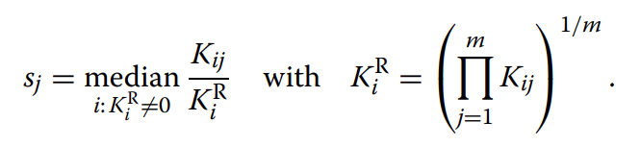
Normalization in DESeq2
Median of ratios
Size factor
Geometric mean
Love, M. et al (2014) Genome Biology

Slide 42
Statistical modelling concepts used in DESeq2 and its differences with respect to edgeR
 | edgeR | DESeq2
Dispersion | Negative Binomial dispersions capture global trend, quasi-dispersions account for gene-specific variability. | Gene-specific dispersion shrunken towards the trend using a MAP
Normalization | TMM | Median of ratios
Test | Quasi-likelihood F-tests | Wald-tests
Notes:
Both are GLM using NB to model counts

Slide 43
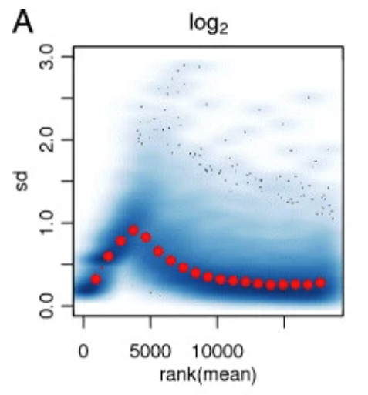
Uneven distribution of information
Love, M. et al (2014) Genome Biology

Slide 44
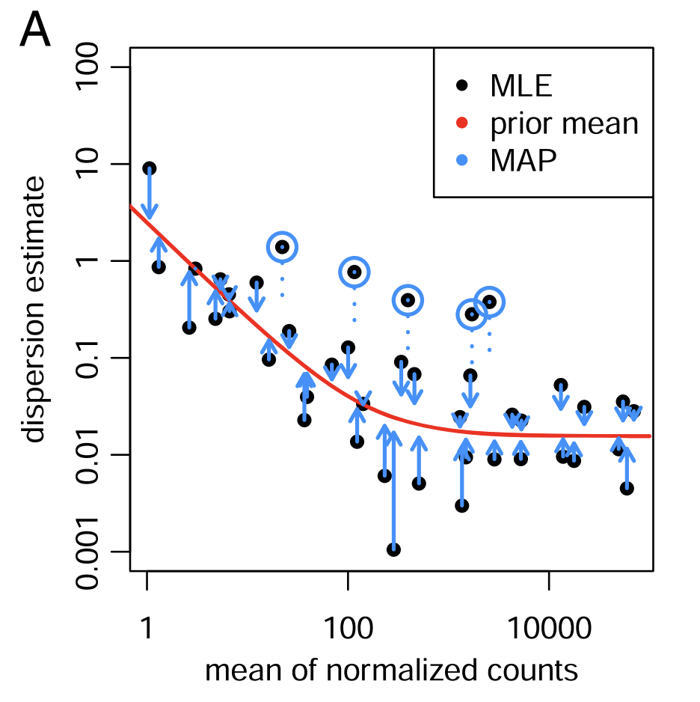
Shrinkage estimation of dispersion
Fig 1A, adapted from: Love, M. et al (2014) Genome Biology

