Slide 1



RNA-seq analysis II
Notes:
Do introduction

Slide 2
Notes:
The McGill initiative on Computational Medicine was formed in 2017 and aims to deliver inter-disciplinary research programs and empower the use of data in health research and health care delivery
Located at the Genome Center
They have a newsletter were you can subscribe to
more info on the web site

Slide 3
Outline:
1
Differential expression using DESeq2
2
GSEA and ORA
3
Concluding remarks

Slide 4
Acknowledgements
Material:
Reinnier Padilla
Adrien Osakwe
Exercises:
DESeq2 vignette
fgsea vignette
Enrichr vignette
Data:
Link

Slide 5
This is an interactive workshop :)
Feel free to interrupt or raise your hand to ask questions

Slide 6
Part 1: Differential Expression using DESeq2
Statistical modelling concepts used in DESeq2
Log-fold shrinkage
Introduction to design matrices for gene expression experiments
Multi-factor designs
Hands-on activity 1

Slide 7
Statistical modelling concepts used in DESeq2 and its differences with respect to edgeR
 | edgeR | DESeq2
Dispersion | Negative Binomial dispersions capture global trend, quasi-dispersions account for gene-specific variability. | Gene-specific dispersion shrunken towards the trend using a MAP
Normalization | TMM | Median of ratios
Test | Quasi-likelihood F-tests | Wald-tests
Notes:
Both are GLM using NB to model counts

Slide 8
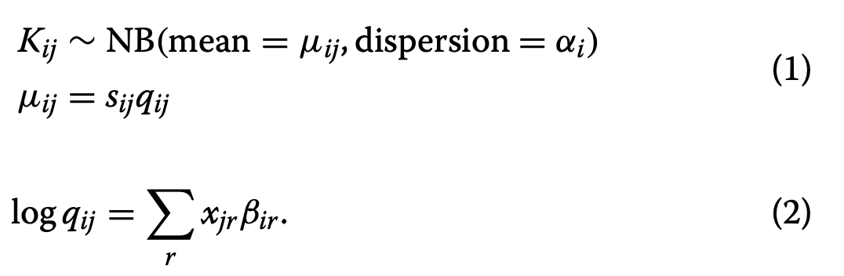
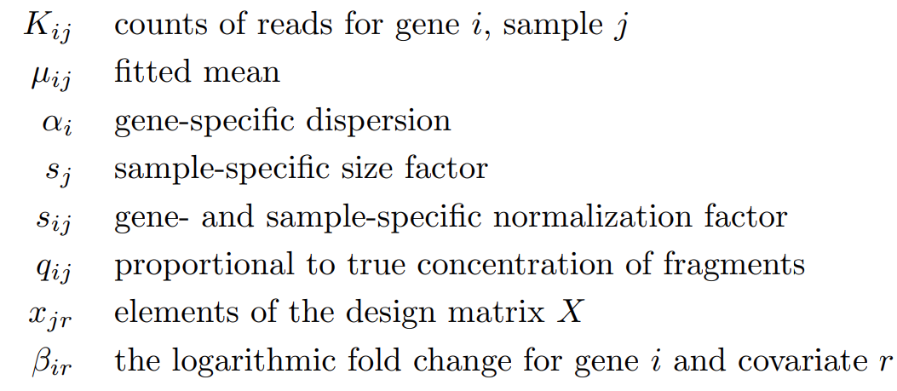
Model used in DESeq2
DESeq2 models the counts using a negative binomial distribution
Love, M. et al (2014) Genome Biology

Slide 9
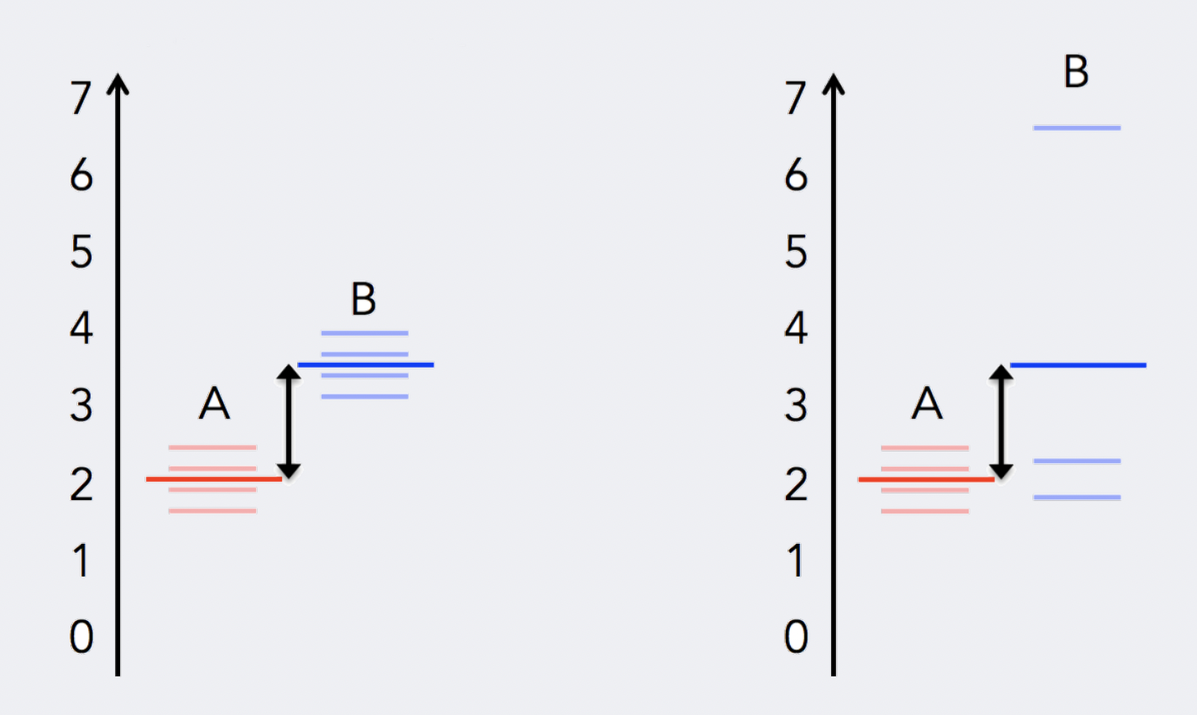
Uneven distribution of information
Replication introduces variance
Adapted from: https://hbctraining.github.io/DGE_workshop_salmon_online/schedule/links-to-lessons.html
Notes:
To determine differentially expressed genes, we evaluate the variation of expression between groups (of interest) and compare that to the variation within the groups (between replicates).

Slide 10
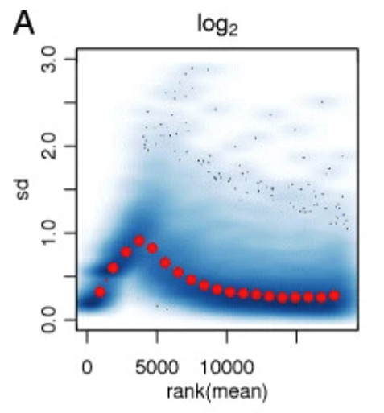
Uneven distribution of information
Love, M. et al (2014) Genome Biology

Slide 11

What is dispersion?
Within-group variability (the variability between replicates), is modeled by the dispersion parameter
Love, M. et al (2014) Genome Biology

Slide 12
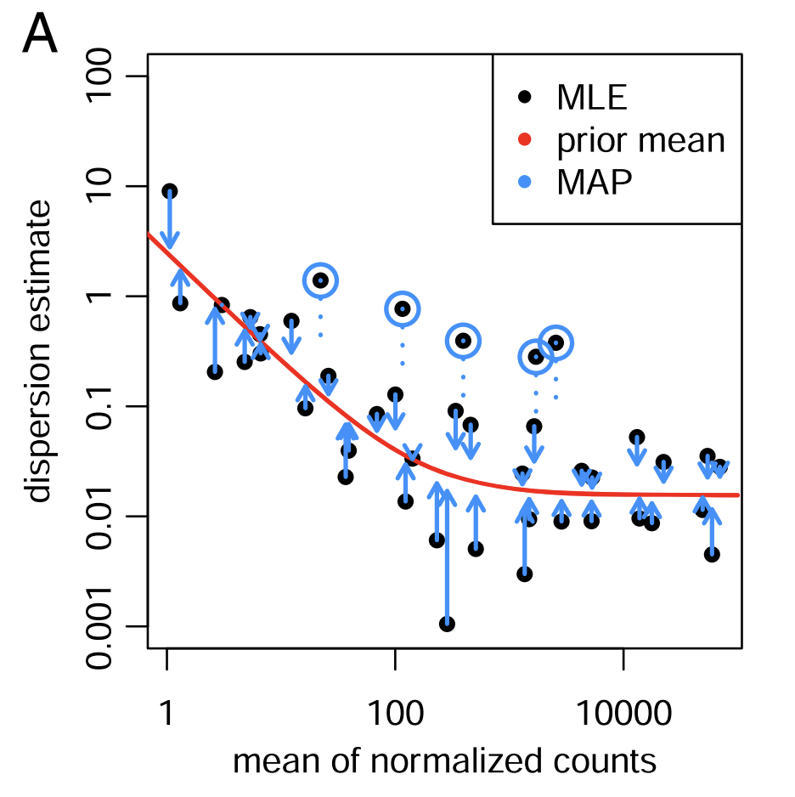
Shrinkage estimation of dispersion
Fig 1A, adapted from: Love, M. et al (2014) Genome Biology

Slide 13
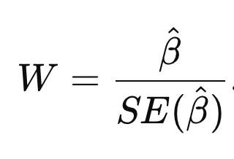
Wald tests
We can assume the log fold change under the null hypothesis to be distributed normally with mean zero and variance that depends on the standard error.
From there, we can compute a two-sided p-value
Love, M. et al (2014) Genome Biology

Slide 14
Part 1: Differential Expression using DESeq2
Statistical modelling concepts used in DESeq2
Log-fold shrinkage
Introduction to design matrices for gene expression experiments
Multi-factor designs
Hands-on activity 1

Slide 15
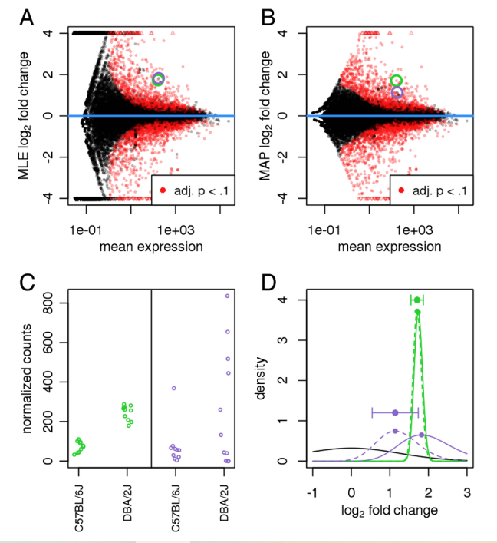
Log-fold shrinkage
Shrinkage of FC addresses two issues:
Log-fold changes are noisier when counts are low
Genes with high dispersion should be less reliable
Love, M. et al (2014) Genome Biology

Slide 16
Part 1: Differential Expression using DESeq2
Statistical modelling concepts used in DESeq2
Log-fold shrinkage
Introduction to design matrices for gene expression experiments
Multi-factor designs
Hands-on activity 1

Slide 17
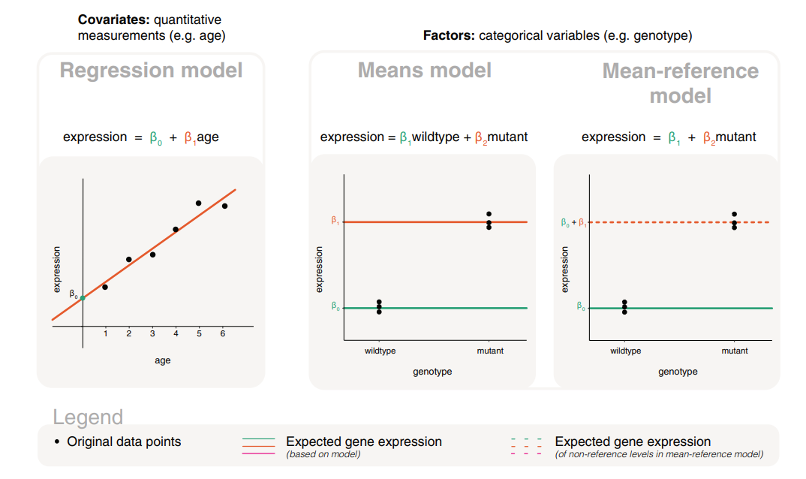
Models for covariate and factor variables
Law, C. et al (2020) F1000 Research

Slide 18
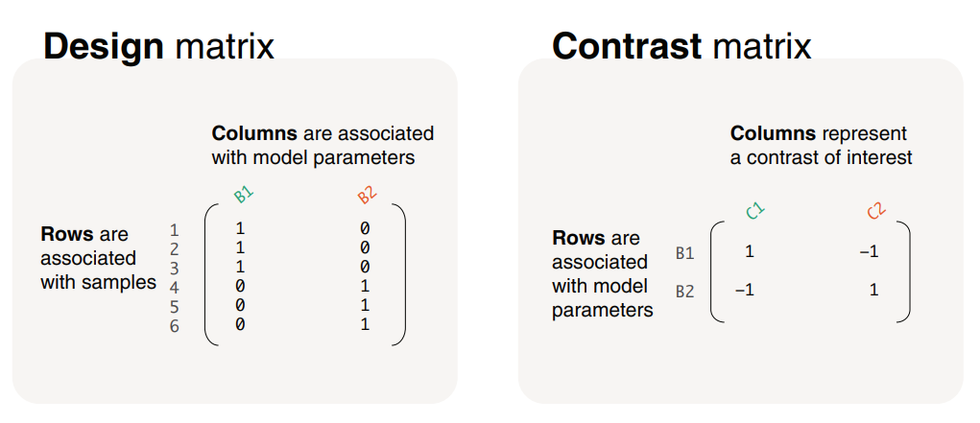
Design and contrast matrices
Law, C. et al (2020) F1000 Research

Slide 19
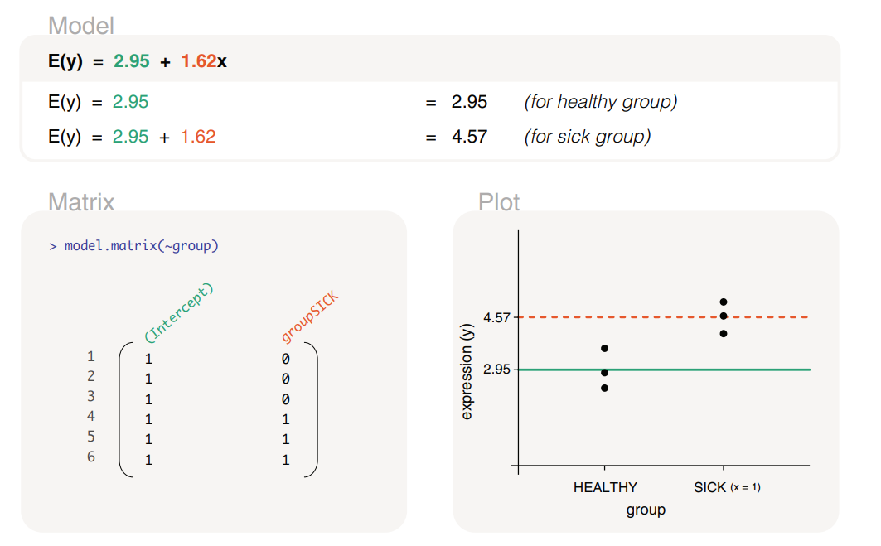
Gene expression modelled by a group factor
~ group
Law, C. et al (2020) F1000 Research

Slide 20
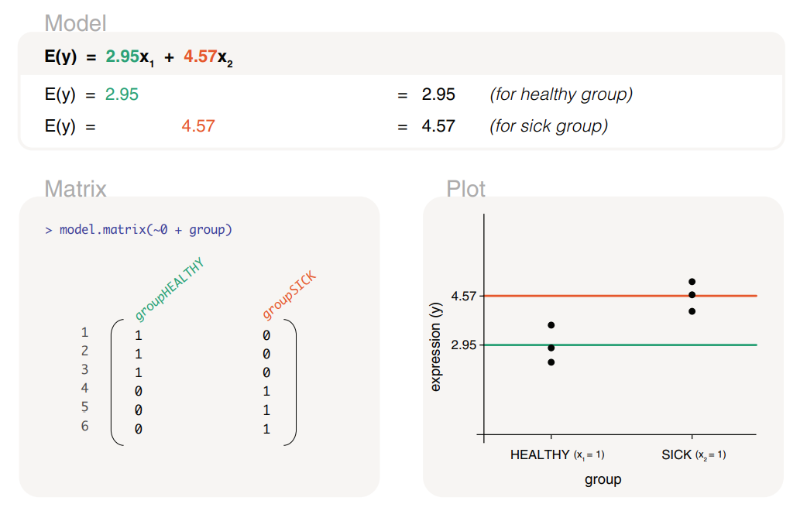
Gene expression modelled by a group factor
(excluding intercept)
~ 0 + group
Law, C. et al (2020) F1000 Research

Slide 21
Part 1: Differential Expression using DESeq2
Statistical modelling concepts used in DESeq2
Log-fold shrinkage
Introduction to design matrices for gene expression experiments
Multi-factor designs
Hands-on activity 1

Slide 22
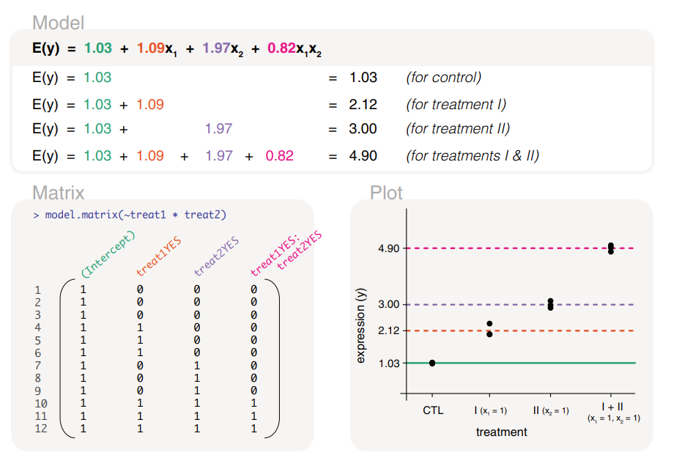
An interaction model captures a synergistic effect
~ treat1 * treat2 equivalent to ~ treat1 + treat2 + treat1:treat2
One plus one is greater than two
Law, C. et al (2020) F1000 Research

Slide 23
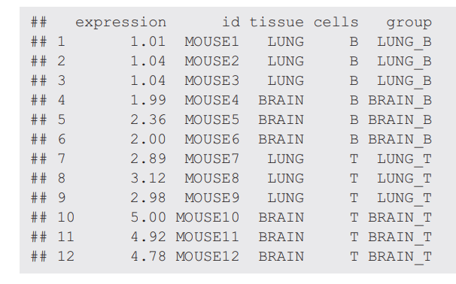
A group factor can represent two factors (tissue sample and cell type)
Law, C. et al (2020) F1000 Research

Slide 24
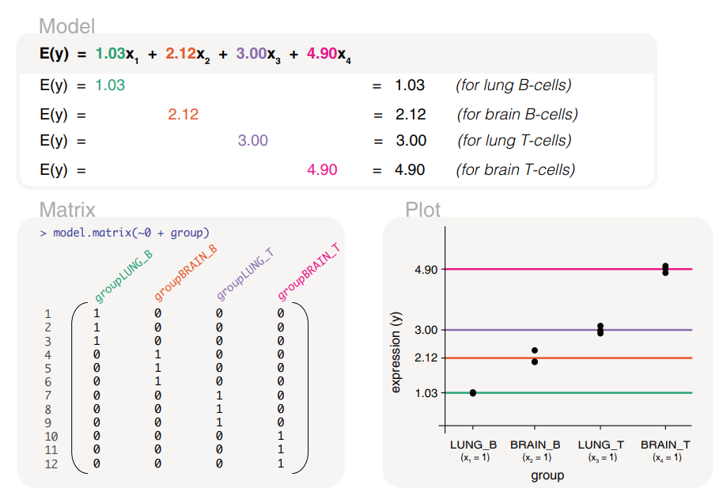
A group factor can represent two factors (tissue sample and cell type)
~ 0 + group
Law, C. et al (2020) F1000 Research

Slide 25

Hands-on 1

Slide 26
Part 2: GSEA and ORA
Statistical concepts used in GSEA
Statistical concepts used in ORA
When to use GSEA or ORA?
Hands-on activity 2

Slide 27
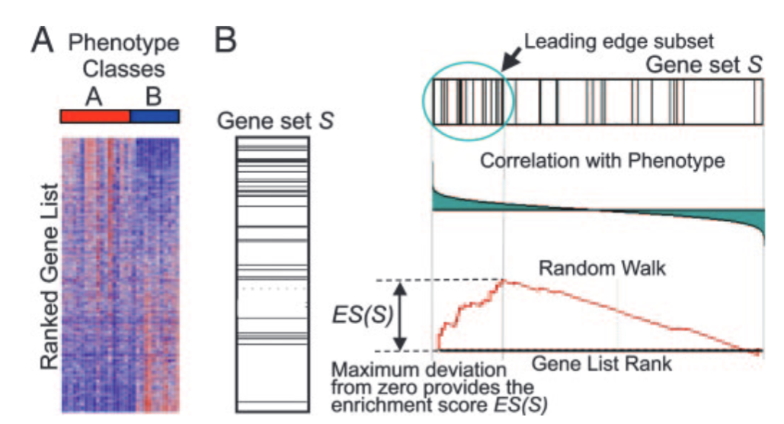
Gene Set Enrichment Analysis (GSEA)
Subramanian, A. et al (2005) PNAS

Slide 28
Part 2: GSEA and ORA
Statistical concepts used in GSEA
Statistical concepts used in ORA
When to use GSEA or ORA?
Hands-on activity 2

Slide 29

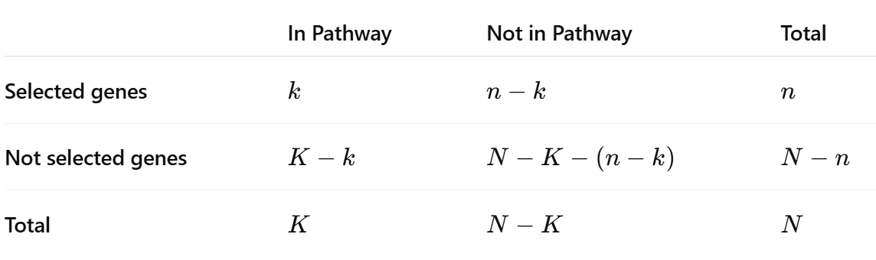
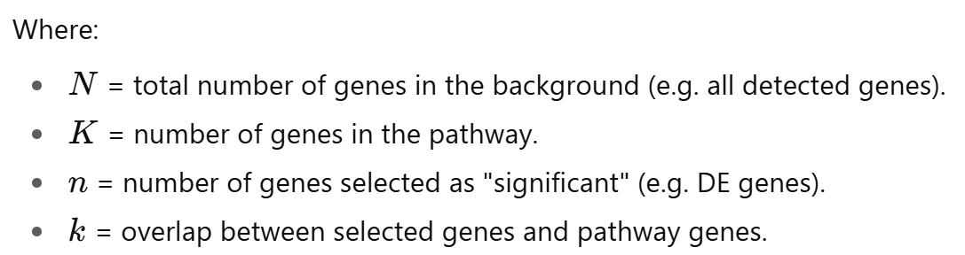
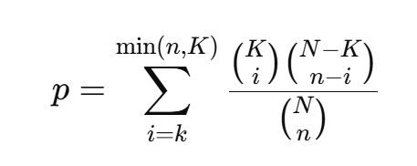
Enrichr
P-value comes from a hypergeometric test
Chen E. et al (2013) BMC Bioinformatics

Slide 30
Part 2: GSEA and ORA
Statistical concepts used in GSEA
Statistical concepts used in ORA
When to use GSEA or ORA?
Hands-on activity 2

Slide 31
When to use GSEA or ORA?
 | GSEA | ORA
Input | Ranked list of all genes | Significant gene list + background
Test type | Running-sum enrichment score + permutation | Hypergeometric
Uses cutoff? | No | Yes (DE)
ORA asks: Are my DE genes enriched in this pathway?
GSEA asks: Are genes from this pathway enriched towards the top or bottom of the ranked list?

Slide 32
Hands-on 2

Slide 33
Part 3: Concluding remarks
Now you are ready to:
Perform a standard DGE, GSEA and ORA analyses
Modify design matrices to address biological questions
Choose between GSEA and ORA depending on the question at hand

Slide 34

Thanks for your attention!
info-micm@mcgill.ca
https://www.mcgill.ca/micm/
Keep an eye for the workshops offered by the MiCM!

Slide 35
References
Love, M., Anders, S., & Huber, W. (2014). Differential analysis of count data–the DESeq2 package. Genome Biol, 15(550), 10-1186.
Subramanian, A., Kuehn, H., Gould, J., Tamayo, P., & Mesirov, J. P. (2007). GSEA-P: a desktop application for Gene Set Enrichment Analysis. Bioinformatics, 23(23), 3251-3253.
Chen, E. Y., Tan, C. M., Kou, Y., Duan, Q., Wang, Z., Meirelles, G. V., ... & Ma’ayan, A. (2013). Enrichr: interactive and collaborative HTML5 gene list enrichment analysis tool. BMC bioinformatics, 14(1), 128.
Law, C. W., Zeglinski, K., Dong, X., Alhamdoosh, M., Smyth, G. K., & Ritchie, M. E. (2020). A guide to creating design matrices for gene expression experiments. F1000Research, 9, 1444.

Slide 37

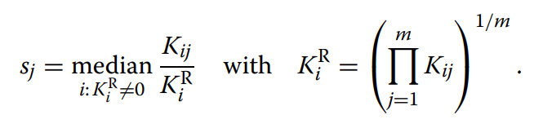
Normalization in DESeq2
Median of ratios
Size factor
Geometric mean
Love, M. et al (2014) Genome Biology

