Slide 1
HTML/ CSS Framework
Updates

Slide 2
Revision History
Date | Version | Notes
02-17-2015 | 3.3.2 | Please check next slide

Slide 3
What’s new?
Updated bootstrap CSS and JS to the latest version (3.3.2)
Removed WordPress plugin page for a reason.
Updated latest jQuery and font-awesome.
Updated theme.html page (with bootstrap style theme bootstrap-theme.css – if you want the bootstrap 2 gradient thingy)
Updated latest style.css

Slide 4
What to expect?
Much cleaner comment. Easy to find and locate comment using numbers or titles e.g. 11.0 or Media Queries
The size of the stylesheet increased from 6kb to 7kb due to new style features added on underscore_S.

Slide 5
What you should do?
Familiarize the latest framework specially the style.css
Some of you guys place styles ABOVE the Page Layout. You must place all of your style in 9.0 Page Layout (Author Styles proceed here)
All your class modifiers that you think not part of the element must be placed in MISC (10.0 Misc) for example;
.pad-holder or .margin-holder
.head-border or .footer-border
.half-bottom or .half-top

Slide 6
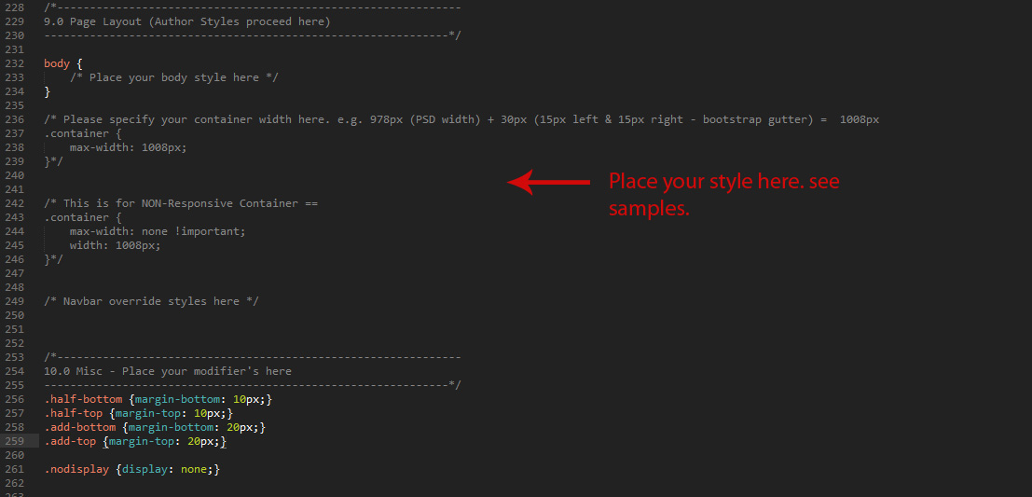
What you should do?

Slide 7
Questions?
If you have any questions or clarifications, please let us know.

Slide 8
End

