Slide 1
Industrial photonics
Assignment 04

Slide 2

A Review on Optical Fiber Sensors for Environmental Monitoring Hang-Eun Joe, Huitaek Yun, Seung-Hwan Jo, Martin B.G. Jun, and Byung-Kwon Min
Environmental monitoring, nowadays is a must for most facilities. In the ones that happens to operate in harsh conditions, optical fiber sensors (OFS) have some great advantages:
resistance to electromagnetic interference
resistance under extreme pressure
resistance under extreme temperature
low losses
small sizes
Cable layer vessel “Leonardo da Vinci”
Industrial photonics
Assignment 04

Slide 3
Comparison between sensors
Electrochemical
low power
linear
selective
Micro-electromech.
small size
cheap
short life
disturbance
Optical fiber
high bandwidth
compatible with existing infrastructure
resistance to electromagnetic interference
resistance under extreme pressure
resistance under extreme temperature
low losses
small sizes
Industrial photonics
Assignment 04

Slide 4
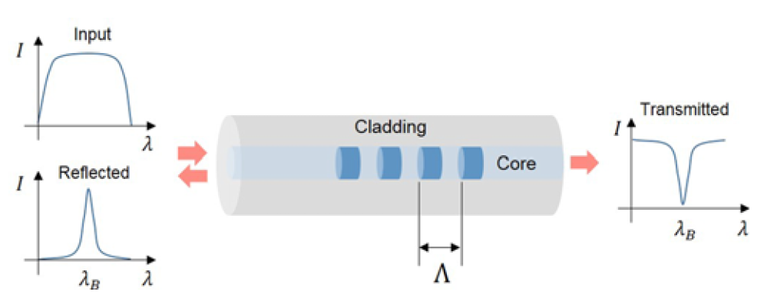
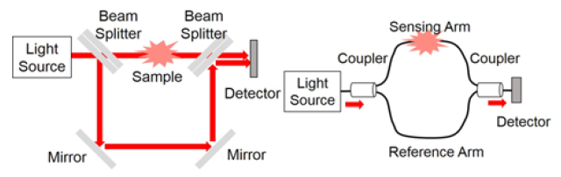
Types of OFS
Point-Based – sensitivity / selectivity
fiber gratings ( sensing T, ε, correlated)
inline interferometer (a lot of phis. quantities)
Industrial photonics
Assignment 04

