Slide 1
Industrial photonics
Assignment 04

Slide 2
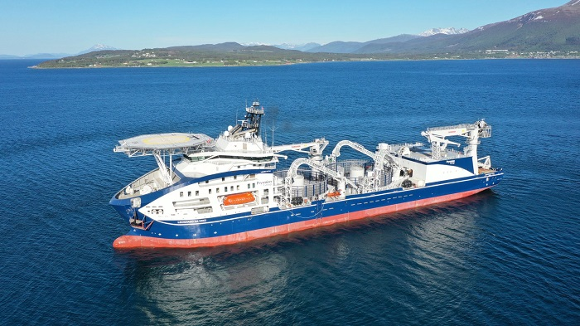
A Review on Optical Fiber Sensors for Environmental Monitoring Hang-Eun Joe, Huitaek Yun, Seung-Hwan Jo, Martin B.G. Jun, and Byung-Kwon Min
Environmental monitoring, nowadays is a must for most facilities. In the ones that happens to operate in harsh conditions, optical fiber sensors (OFS) have some great advantages:
resistance to electromagnetic interference
resistance under extreme pressure
resistance under extreme temperature
low losses
small sizes
Cable layer vessel “Leonardo da Vinci”
Industrial photonics
Assignment 04

Slide 3
Comparison between sensors
Electrochemical
low power
linear
selective
Micro-electromech.
small size
cheap
short life
disturbance
Optical fiber
high bandwidth
compatible with existing infrastructure
resistance to electromagnetic interference
resistance under extreme pressure
resistance under extreme temperature
low losses
small sizes
Industrial photonics
Assignment 04

Slide 4
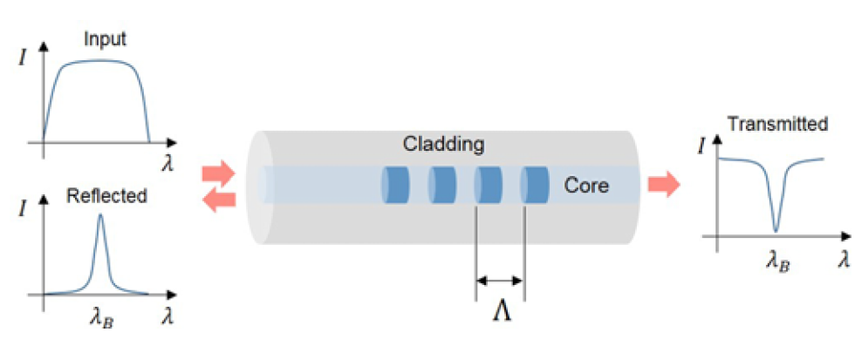
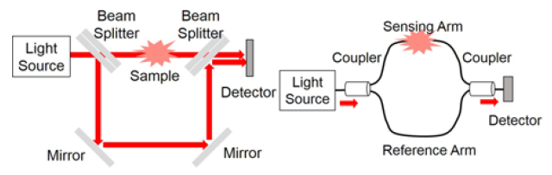
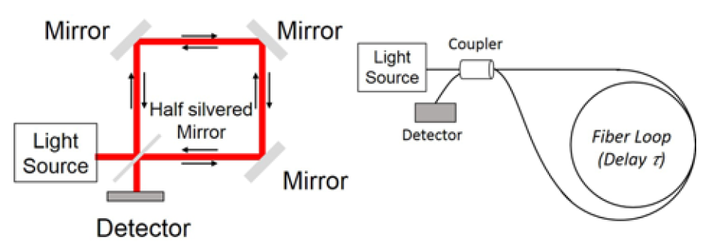
Types of OFS
Point-Based – sensitivity / selectivity
fiber gratings ( sensing T, ε, correlated)
inline interferometer (a lot of phis. quantities)
Distributed – spatial and temporal domain
Optical Time-Domain Interferometer
Optical Frequency Interferometer
Scattering
Raileigh
Brillium
Raman
From Bulky equipment to fiber based
Industrial photonics
Assignment 04

Slide 5
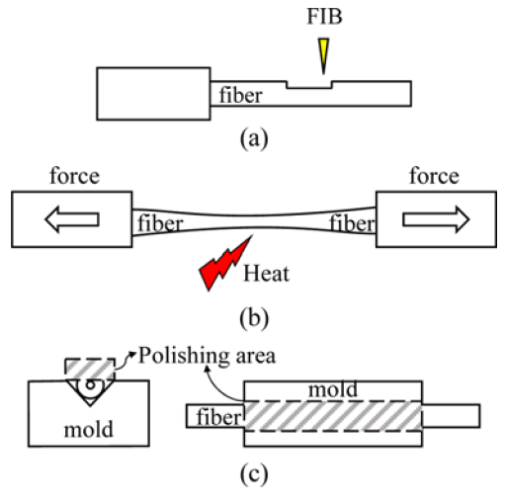

Fabrication process
Grating inscription
Laser processing of the core of the fiber without damaging the coatings
Interference lithography
Functional coating
Physical vapor deposition
Chemical vapor deposition
Atomic layer deposition
Shaping
Machining
Tapering
Polishing
Splicing
Industrial photonics
Assignment 04

Slide 6
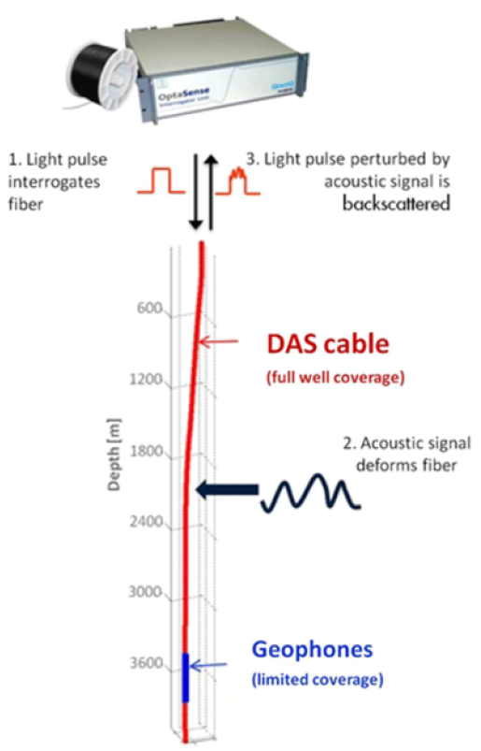
Example of application
Earthquake monitoring (or well)
Oil and Gas
Leakages
Corrosion
Span hundreds of km with a resolution in the orders of meters
Civil
Dams/landslides/dikes
Structural health monitoring
Aviation/Space
Real time monitoring of composite materials
Agriculture
Air/Soil/Water/Chemical monitoring
Industrial photonics
Assignment 04

