Slide 1
Quantum Parameter Estimation with Neural Networks
Yakov Solomons & Ariel Smooha
15.08.2021
Greplova Eliska, et al. arXiv preprint arXiv:1711.05238 (2017)
Notes:
Yakov and myself are from the department of chemical physics. The project we will present today is dealing with quantum parameter estimation with NN. We were inspired by Eliska (professor at the Netherlands, who is cited here) who presented a work in the field.

Slide 2
Contents
Background
Our goal
Data
Models & Methods
Results
Notes:
The presentation will be organized as shown here. We will first start with some background, explaining the basics of the project. Then we will define our goal and explain how we generated the data used for training our NN. Later, we will discuss the different methods used, and finally present the obtained results.

Slide 3


Open quantum systems
2 level system
$$\left.\left|excited\right.\right\rangle$$
$$γ$$
$$Ω_{p}$$
Noise and dissipation
$$\left.\left|ground\right.\right\rangle$$
Notes:
To start with, we deal with open quantum systems, in our case we deal with a simple two level system where the system can be in the ground state or in the excited state. For example, the system can be an atom which can flip to the excited state from the ground state by applying a driving force which is an oscillating E.M field with a specific frequency corresponding to the energy gap. Until now, I described an harmonic system without any perturbation. However, in real world every system is exposed to noise and dissipation processes. The noise is described by gamma, the decay rate which makes our system noisy and harms its harmonicity. The atom is decaying back to the ground state with decay rate gamma.

Slide 4
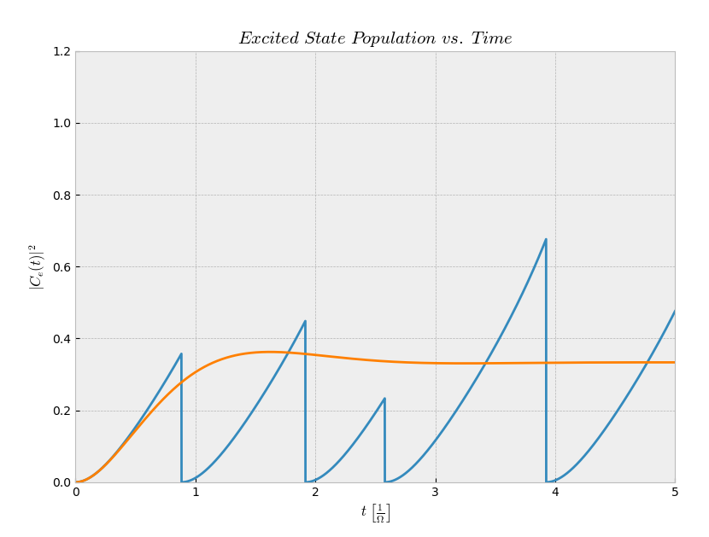
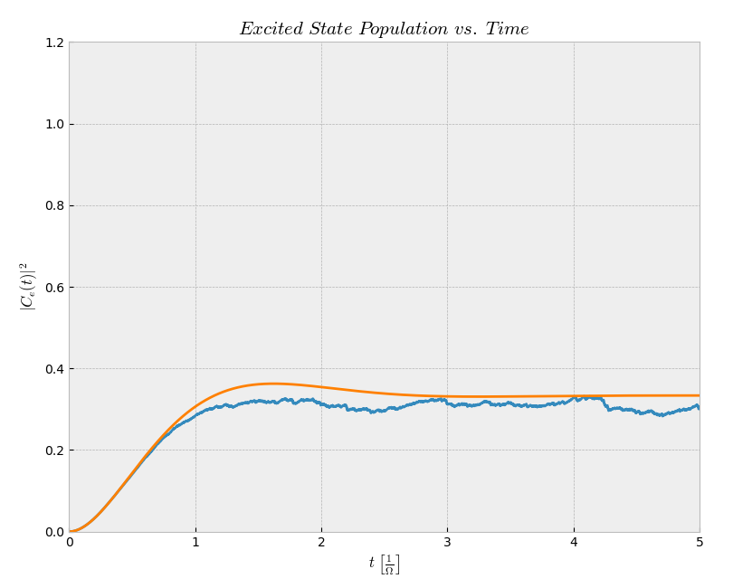
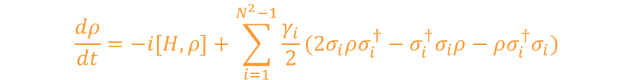
Measurements are noisy!
$$\frac{dρ}{dt}=−i\left[H,ρ\right]+\sum_{i=1}^{N^{2}−1}{\frac{γ_{i}}{2}(2σ_{i}ρσ_{i}^{†}−σ_{i}^{†}σ_{i}ρ−ρσ_{i}^{†}σ_{i})}$$
1 repetition
400 repetitions
Mølmer Klaus. JOSA B 10.3 (1993): 524-538
Notes:
So to summarize the previous slide, measurements are noisy. To the left, you can see a blue graph, describing the probability to be in the excited state, which is obtained from one repetition. You can see that the graph is pretty noisy and that the oscillations are hindered due to dissipation processes that are causing to random jumps. Only when having many repetitions and averaging them as can be seen in the right figure in blue we can get to the equation explaining how our system behaves in average (orange graph and the orange equation, master equation). Therefore, if you are given one single measurement it is not possible to tell what are the parameters governing the process, specifically what were the driving field omega and the decay rate gamma.

Slide 5

What is our goal?
Find the physical parameters from a single shot measurement!
$$Ω−Rabi frequency (driving field)$$
$$γ−decay rate$$
Notes:
Inspired by the paper cited at the first slide. Me and Yakov wanted to investigate this issue. Namely, if we have a single measurement, is it still possible in this case to anyhow characterize the system. This can be useful for analyzing our system and confirming we are working at the right conditions much more efficiently, without the need to repeat the measurement many times.
So our goal is actually to extract the parameters of the system, namely omega and gamma, from a single measurement by applying neural network. At the beginning we were pretty skeptic and thought it might be very hard considering the noisy graphs we will show soon, but surprisingly the NN managed to cope with this task amazingly.

Slide 6
import numpy as np import random import time import matplotlib.pyplot as plt from tqdm.notebook import tqdm from matplotlib import style
“””””””””””””””””””””””””””
“”””””””””””””””””””””””””” “””””””””””””””””””””””””””
for r in range(repetition): for w in omega_vec: omega = w for g in gamma_vec: gamma = g for d in delta_vec: delta = d for jj in range(leng): c = np.zeros((2, int(T / dT)), dtype=np.complex128) # |C(2,:)|^2 is the excited state population c[0, 0] = 1 for n in range(int(T / dT)-1): rand = random.uniform(0,1) if rand < (2 * gamma * dT * (abs(c[1, n])) * (abs(c[1, n]))): c[0, n + 1] = 1 c[1, n + 1] = 0 else: c[0, n + 1] = 1j * dT * (omega * c[1, n]) + c[0, n] c[1, n + 1] = 1j * dT * (omega * c[0, n]) + c[1, n]-c[1, n] * gamma * dT + 1j * dT * (delta * c[1, n]) + 1j * delta * dT * c[1, n] c[0, n + 1] = c[0, n+1] / np.sqrt(abs(c[0, n + 1])*abs(c[0, n + 1]) + abs(c[1, n + 1])*abs(c[1, n + 1])) c[1, n + 1] = c[1, n + 1] / np.sqrt(abs(c[0, n + 1]) *abs(c[0, n + 1]) + abs(c[1, n + 1]) * abs(c[1, n + 1])) c_mean[jj] = (abs(c[1])) * (abs(c[1])) np.save(r'C:\Users\ariel\Dropbox (Weizmann Institute)\Deep Learning\project\Dataset\validation\repetition={} omega={} gamma={} delta={}'.format(r + 1, w, gamma, delta(w-1)*10+gamma-1, c_mean[jj])
Generating the Data
Monte Carlo simulation
Training set : 10,000 files (about 30 min to generate) Corresponding to 100 repetitions per each combination of omega and gamma, 400 MB
Evaluation set : 5,000 files (about 15 min to generate), 200MB
10 values for omega × 10 values for gamma = 100 combinations
× 100 repetitions = 10,000 files
Notes:
So now I will discuss about how we generated the data fed for the NN. We applied the Monte Carlo method which is a way to simulate random quantum processes. By this method, we generated graphs including 5000 coordinates each. Overall, we generated 10,000 .npy files which are more efficient to work with in comparison to .txt files or .csv files (with which it takes much more time for loading and reading the data). This corresponds to 100 repetitions per each combination of omega and gamma where omega has been given ten possible values between 1-10 and also gamma has been given ten possible values between 1-10 as well. It took us around 30 min to generate the data and it weighted around 400MB because each file weights 40KB. We also generated of course the validation dataset which included 5,000 files and weighted 200MB. Thus, overall we had 0.6GB of data.

Slide 7
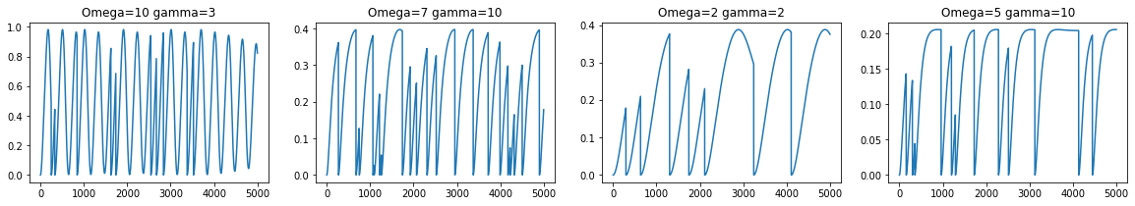
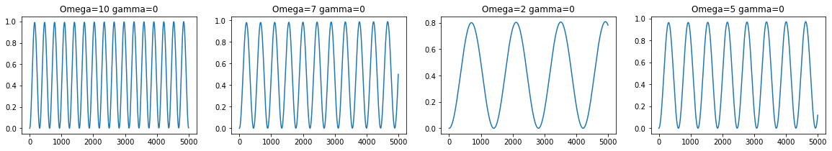
Generating the Data - examples
Comparison: Data without noise
Notes:
Here you can see example of the generated data out of 15,000 graphs. We generated noisy data as explained and you can see that it is much more difficult to infer the parameters of the system in this case just by dealing with the graph as is. For comparison, without the noise, this task is pretty easy to perform because we have unperturbed oscillations.

Slide 8


import torch
import numpy as np
import torch.nn as nn
from torch.nn import ReLU
class Net(nn.Module):
def __init__(self):
super().__init__()
self.features1 = nn.Sequential(
ReLU()
,nn.Linear(5000,100)
,ReLU()
,nn.Linear(100,100)
,ReLU()
,nn.Linear(100,100)
,ReLU()
,nn.Linear(100,10)
,ReLU()
,nn.Linear(10,10,bias = False)
,nn.BatchNorm1d(10)
)
self.features2 = nn.Sequential(
nn.ReLU()
,nn.Linear(5000,100)
,ReLU()
,nn.Linear(100,100)
,ReLU()
,nn.Linear(100,100)
,ReLU()
,nn.Linear(100,10)
,ReLU()
,nn.Linear(10,10,bias = False)
,nn.BatchNorm1d(10)
)
def forward(self, x):
out1 = self.features1(x)
out2 = self.features2(x)
return out1, out2
Models
Method 1
Method 2
Two NN for classification, one for $Ω$ and one for $γ$
One net for classification of two parameters simultaneously
$$Ω \& γ$$
FCNN
CNN
FCNN
CNN
Notes:
Therefore, we applied NN for this task. We used two methods. In the first method we used two NN for the classification of omega and gamma separately, applying two label tensors, one for omega and one for gamma. We applied FCNN and also CNN in order to optimize the classification task.
We also applied a different method where we only used one label tensor for omega and gamma with 100 possible values, corresponding to using one NN. Here we classified omega and gamma simultaneously, by using FCNN and CNN.
From here, Yakov will continue and discuss the obtained results.

Slide 9
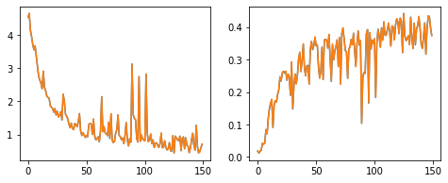
Results – method 1
FCNN
Reaching a low and limited accuracy
Loss vs. epochs
Accuracy vs. epochs
Loss
Accuracy
Epochs
Epochs
Notes:
So, as you can see, this is the results of method 1, in which we used two different NN, for classification of the two set of parameters, omega, and gamma. In this case we used a fully connected NN. As you can see, the accuracy is limited, we reached accuracy up to 40%. in addition, the training process was quite noisy and unstable, there are lots of jumps and falls during the learning.

Slide 10
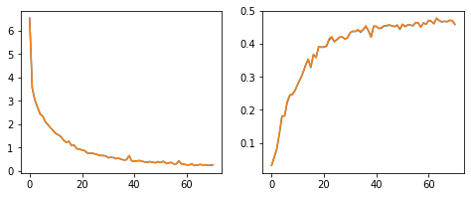
Results – method 1
CNN
Reaching similar accuracy but much stable process!
Simple CNN in this case
Loss vs. epochs
Accuracy vs. epochs
Loss
Accuracy
Epochs
Epochs
Notes:
And here you can see the results of a CNN, still in method 1, meaning we had two different CNN, for the two sets of parameters, omega and gamma. Here, the learning process was much more stable, the graph is smooth and nice, without jumps. But we are still limited in our accuracy, this time we reached something about 50%.

Slide 11
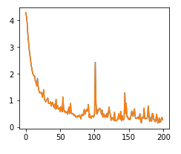
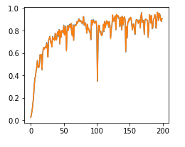
Results - method 2
FCNN
Reaching better accuracy in spite of the jumps
Loss vs. epochs
Accuracy vs. epochs
Loss
Accuracy
Epochs
Epochs
Notes:
Now we move on to method 2, in this method we have only a single NN for the whole big set of parameters, omega and gamma together, here you see the results of a fully connected NN, we still have many jumps and the training process is not stable, but we managed to reach accuracy of about 90%, which is already great.

Slide 12
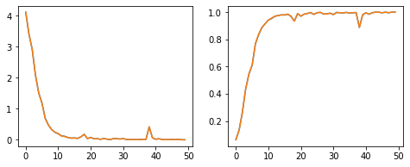
Results – method 2
CNN
Reaching great accuracy without jumps!
Loss vs. epochs
Accuracy vs. epochs
Loss
Accuracy
Epochs
Epochs
Notes:
And lastly, here are the results of method 2, meaning using a single NN for classification of the whole parameters at once, but this time with a CNN, this is our best results, you see that we reached accuracy of 100%! It was something like 0.9999, and also the learning process is very stable and the graph is very clean. We planed to do 150 epochs but we stopped the training after 50 epochs, because we already reached 100%!

Slide 13
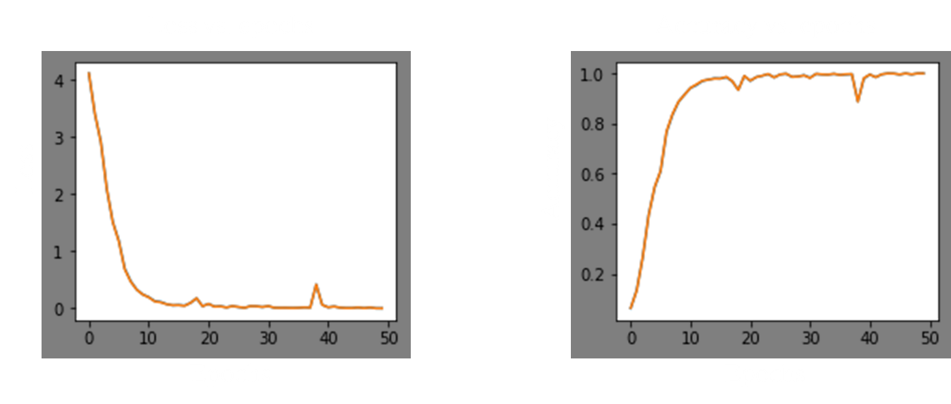

Results – method 2: CNN – 1D
Notes:
This is a demonstration of the 1D CNN used in this method, starting from vector of 5000 points (which represents the measurement over time) and ending up a vector corresponding to 100 parameters.

Slide 14
“””””””””””””””””””””””””” class CNN_Net(nn.Module): def __init__(self): super().__init__() self.features = nn.Sequential( Conv1d(3, 64, kernel_size=3, stride=1, padding=1) # 300, 64, 5000 ,ReLU(inplace=True) ,MaxPool1d(kernel_size=2, stride=2, padding=0, dilation=1, ceil_mode=False) # 300, 64, 2500 ,Conv1d(64, 128, kernel_size=3, stride=1, padding=1) ,ReLU(inplace=True) # 300, 128, 2500 ,MaxPool1d(kernel_size=2, stride=2, padding=0, dilation=1, ceil_mode=False) # 300, 128, 1250 ,Conv1d(128, 256, kernel_size=3, stride=1, padding=1) ,ReLU(inplace=True) # 300, 256, 1250 ,Conv1d(256, 256, kernel_size=3, stride=1, padding=1) ,ReLU(inplace=True) # 300, 256, 1250 ,MaxPool1d(kernel_size=2, stride=2, padding=0, dilation=1, ceil_mode=False) # 300, 256, 625 ,Conv1d(256, 512, kernel_size=3, stride=1, padding=1) ,ReLU(inplace=True) # 300, 512, 625 ,Conv1d(512, 512, kernel_size=3, stride=1, padding=1) ,ReLU(inplace=True) # 300, 512, 625 ,MaxPool1d(kernel_size=2, stride=2, padding=0, dilation=1, ceil_mode=False) # 300, 512, 312 ,Conv1d(512, 512, kernel_size=3, stride=1, padding=1) ,ReLU(inplace=True) # 300, 512, 312 ,Conv1d(512, 512, kernel_size=3, stride=1, padding=1) ,ReLU(inplace=True) # 300, 512, 312 ,MaxPool1d(kernel_size=2, stride=2, padding=0, dilation=1, ceil_mode=False) # 300, 512, 156 ) self.classifier = nn.Sequential( Linear(512*156,100) )
def forward(self,x): out = self.features(x) out = torch.flatten(out,1) out = self.classifier(out) return out

Slide 15
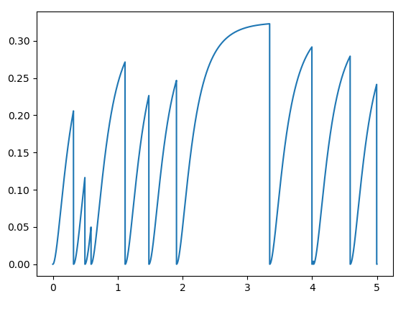


Is it possible to solve it “classically”?
Only if there is an analytical solution for the master equation
Possible solution:
Cut the measurement to pieces
Sum them together
Fit to the analytical solution
$$Ω=3γ_{0} γ=5γ_{0}$$
|C_{e}(t)|²
t $γ_{0}$
Notes:
So, as Ariel told you before, we were quite surprised by how the system managed to solve the problem so good. So we started to think maybe there is also a “classical” solution, a way to do this task without NN, and indeed we thought about something, which perhaps can explain what the NN is doing.
So the idea is that if the measurement vector is long enough, and assuming we have a classical solution for the master equation which describes how the system behaves in average, then we can give a recipe to solve this problem of classification.
First we should cut the measurement vector into equal pieces, all starting with the same initial condition – starting with the system in the ground state (these are the points where the graph reach zero again). Then we sum all the pieces together, and we average, and the resulting graph can be fitted to the known analytical solution (assuming we have an analytical solution), to find the parameters omega and gamma.

Slide 16
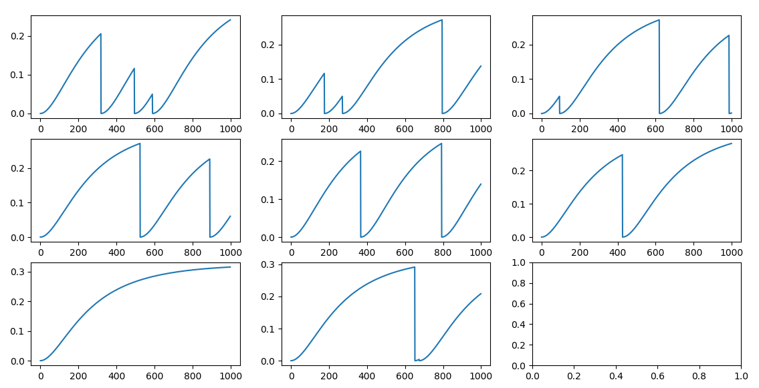
Step 1 – Cut the function to pieces
Notes:
Here you see, we took the graph and cut it to pieces, we have 8 pieces all starting from zero, and all of the same length.

Slide 17
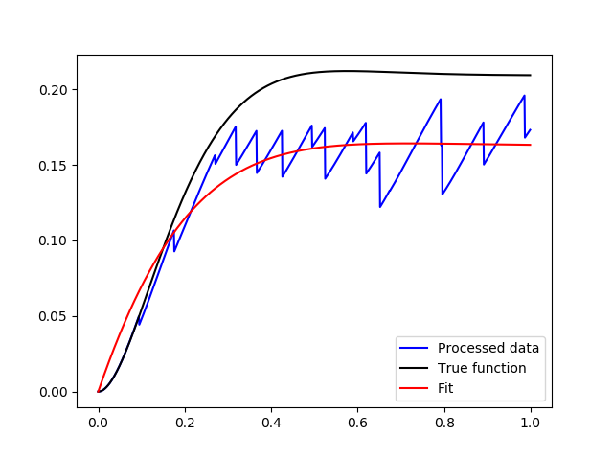


Steps 2 & 3 – Summing and Fitting
$$True: Ω=3γ_{0} γ=5γ_{0}$$
$$Fit: Ω=4γ_{0} γ=7γ_{0}$$
Notes:
We sum them together and we did fitting to the known solution of the master equation, the results in not so accurate, we got omega = 4 and the true value was 3, and we got gamma =7 when the true value was 5, but you can see in the graph that this is not very bad, it starts to look similar to the average behavior.
We speculated that maybe the CNN is doing something similar, maybe that the reason the CNN was better than the FCNN, because the CNN looks at prats of the graph separately and then mix them together in a kind of complicated way, but of course we don’t know for sure.
Still the CNN is much better, we got 100% of accuracy, and more importantly we can solve also problems of which the solution of their corresponding aster equation is unknown. But thinking on this method we got a small filling of what’s is going on.

Slide 18
Prospects
Regression task
Dealing with more complex problems
Notes:
With this system we can do more complicated tasks, the first thing we thought of is to do regression instead of classification, so we can get a continues prediction, instead of choosing a variable out of a list.
In addition we can try more complicated system, such as three level systems, where we have more than one channel of dissipation and many kinds of noise.
Thank you for your attention!

Slide 19
Maxpool
lD
Maxpool
lD
Maxpool
lD
Maxpool
1D
Maxpool
lD
Maxpool
lD
Linear layer
conv1D
conv1D
conv1D
conv1D
conv1D
conv1D
conv1D
conv1D
5000
5000
2500
2500
1250
1250
1250
625
625
625
312
312
312
156
3
64
64
128
128
256
256
256
512
512
512
512
512
512
100

