Slide 1
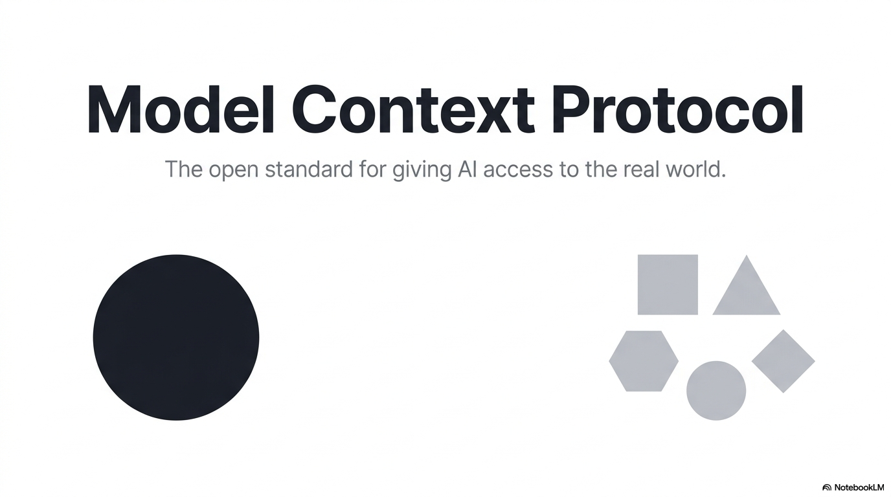

Slide 2
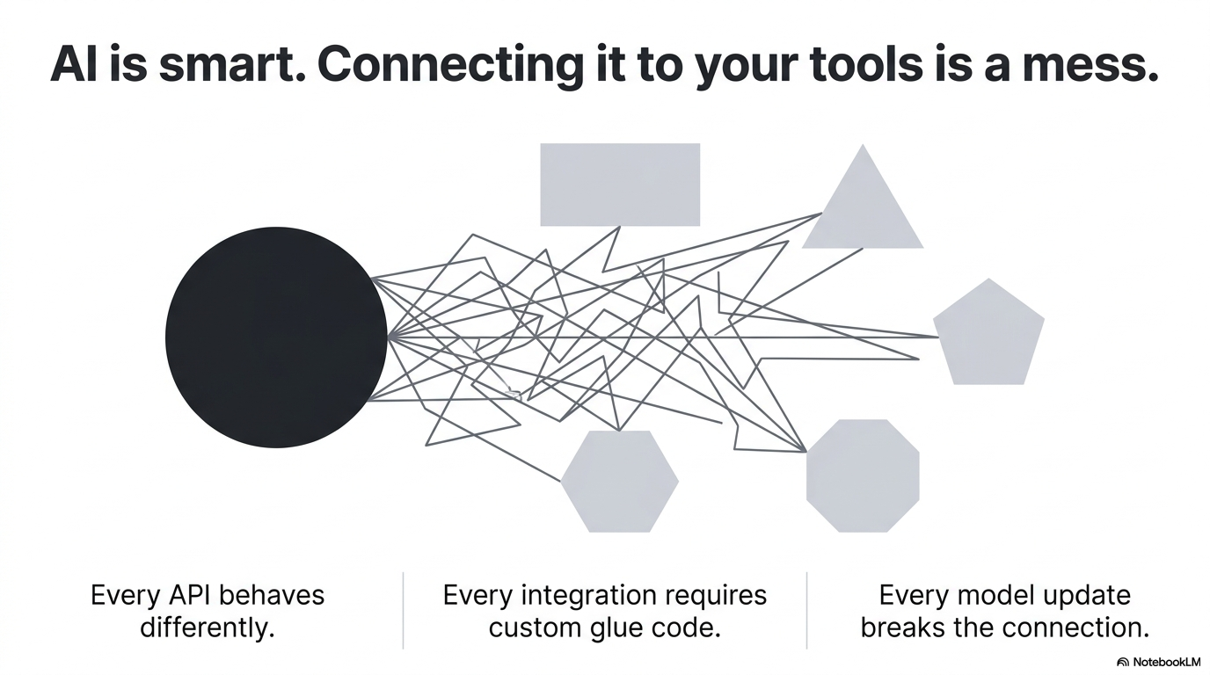

Slide 3
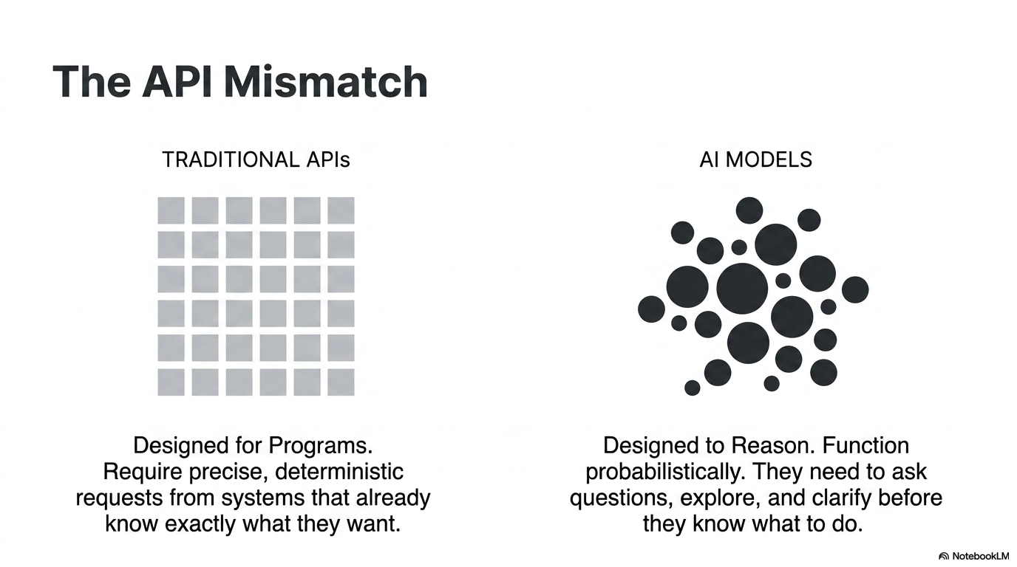

Slide 4
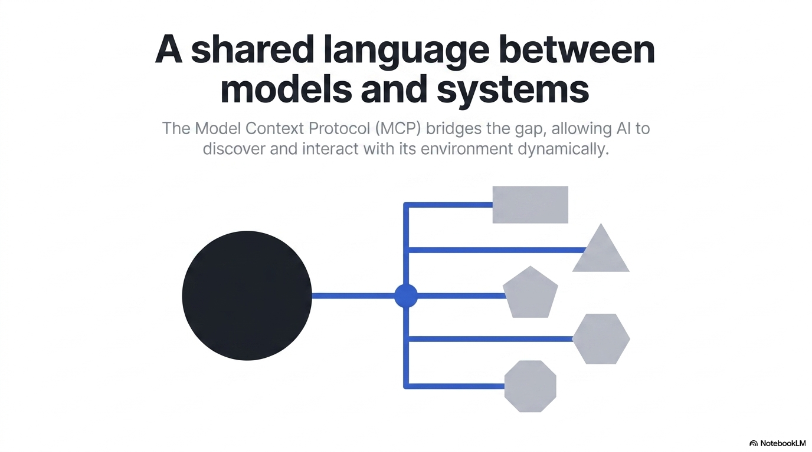

Slide 5
The architecture: three roles, not two.
Host, Client, Server — and the language model is none of them.
THE HOST
The app with the chat window — Claude Desktop, Goose, your own script.
The Server
your Python file
The Model
reasons
The Client
speaks MCP
The model is NOT the client. The model reasons; the client is the plumbing inside the host that speaks the protocol.
The server exposes tools, resources, and data — a database, the file system, a web service.
MCP Workshop · Day 1

Slide 6
What the AI can actually see and use
Every MCP server can offer three primitives. Three — not four.
Tools
Resources
Prompts
Actions the model can invoke
(e.g., Search Database, Send Email).
Pieces of data and state the host reads
(e.g., text documents, database rows).
Reusable templates the user triggers
for specific tasks.
Where did “context” go? “Context” is not a fourth primitive — it's the RESULT. These three are how context reaches the model's context window.
MCP Workshop · Day 1

Slide 7
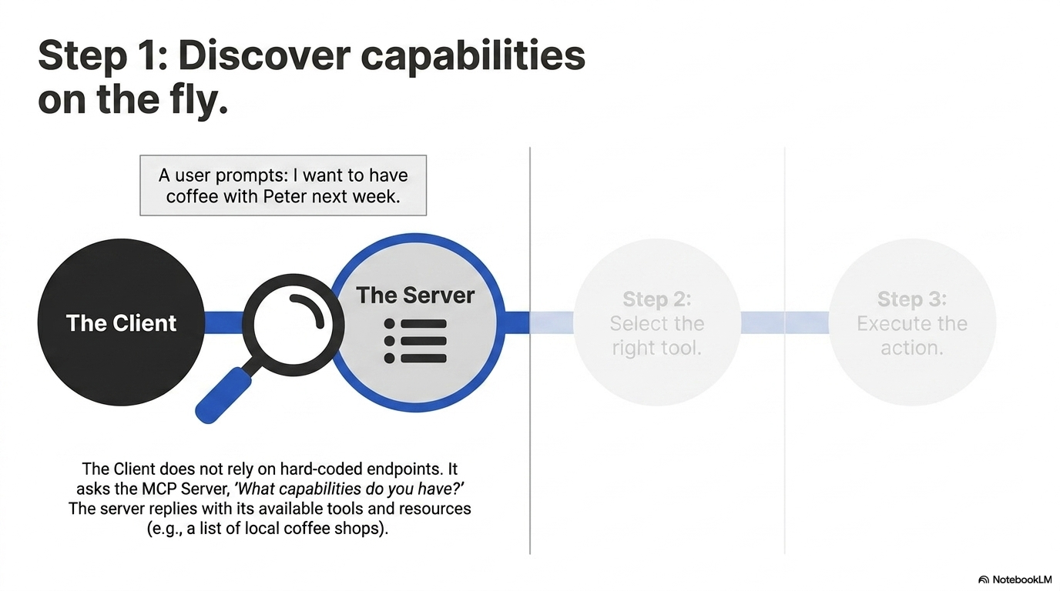

Slide 8
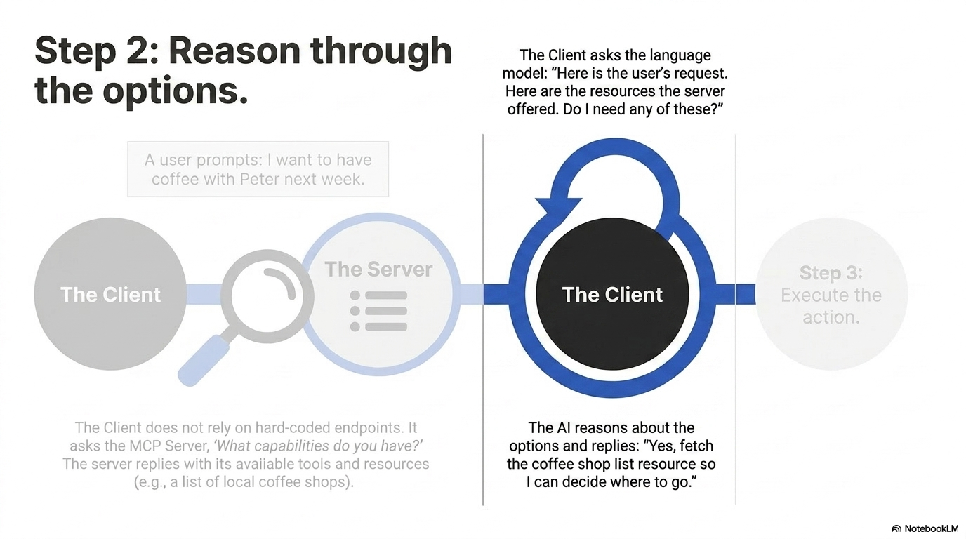

Slide 9
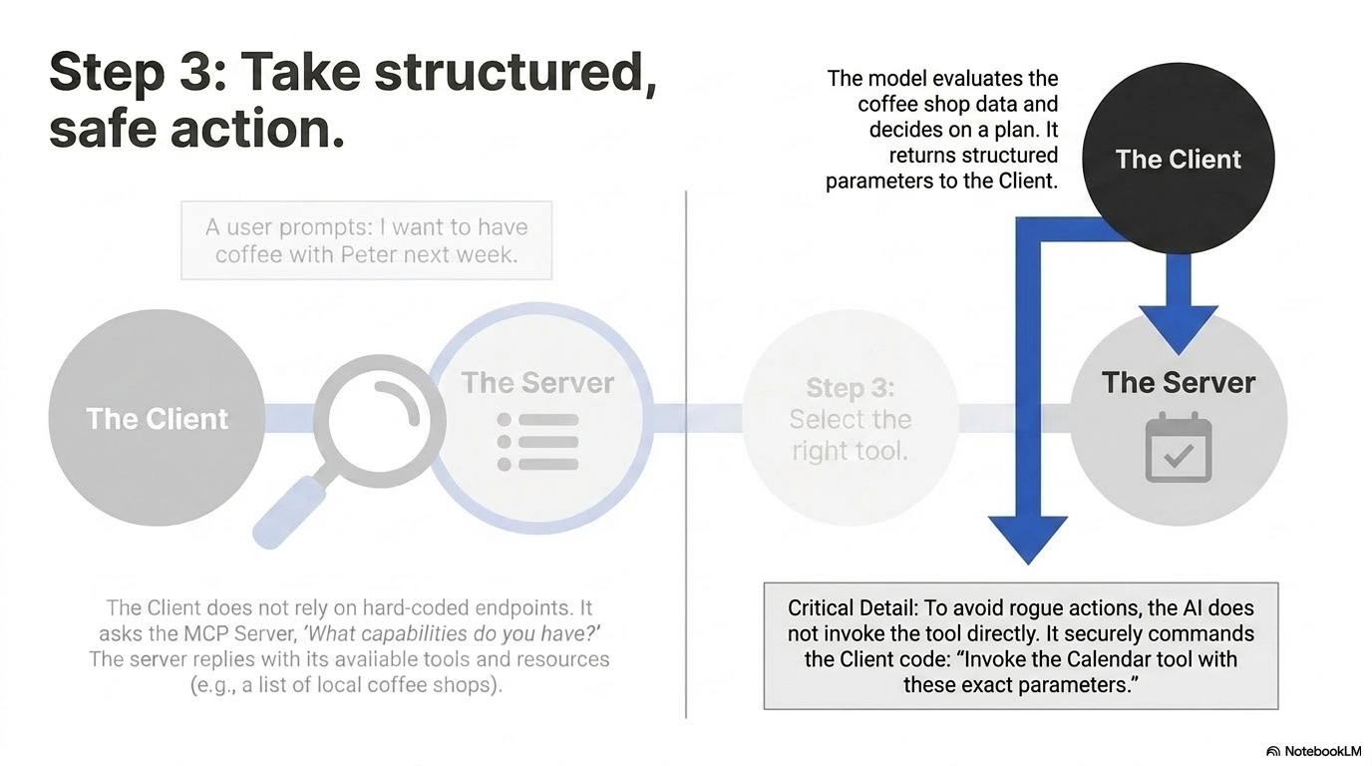

Slide 10
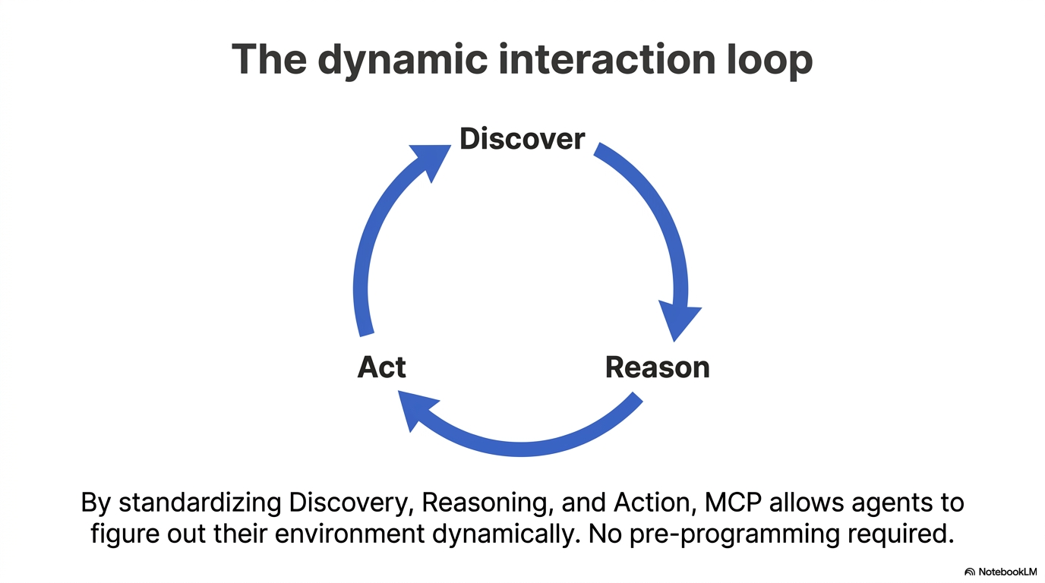

Slide 11
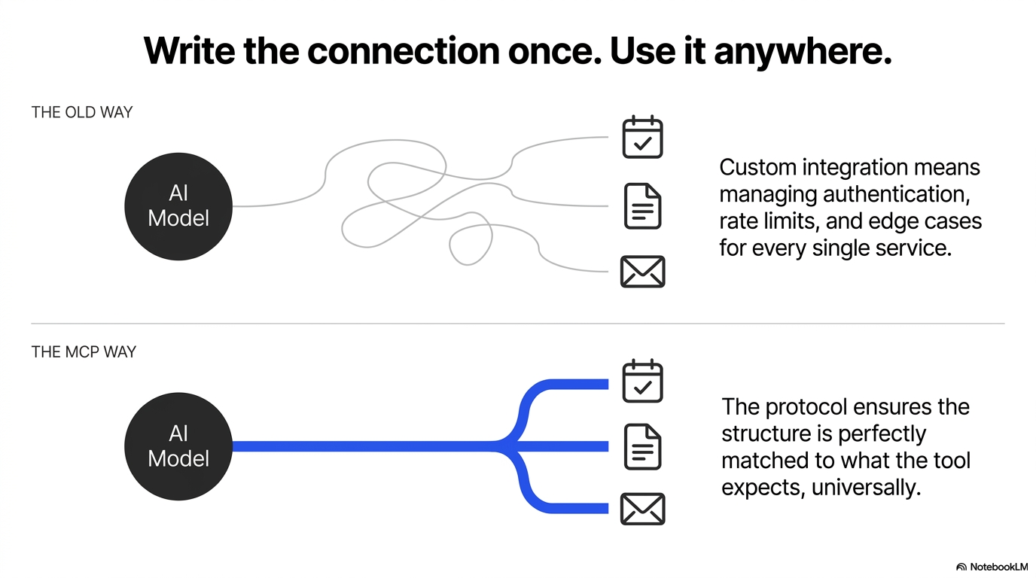

Slide 12
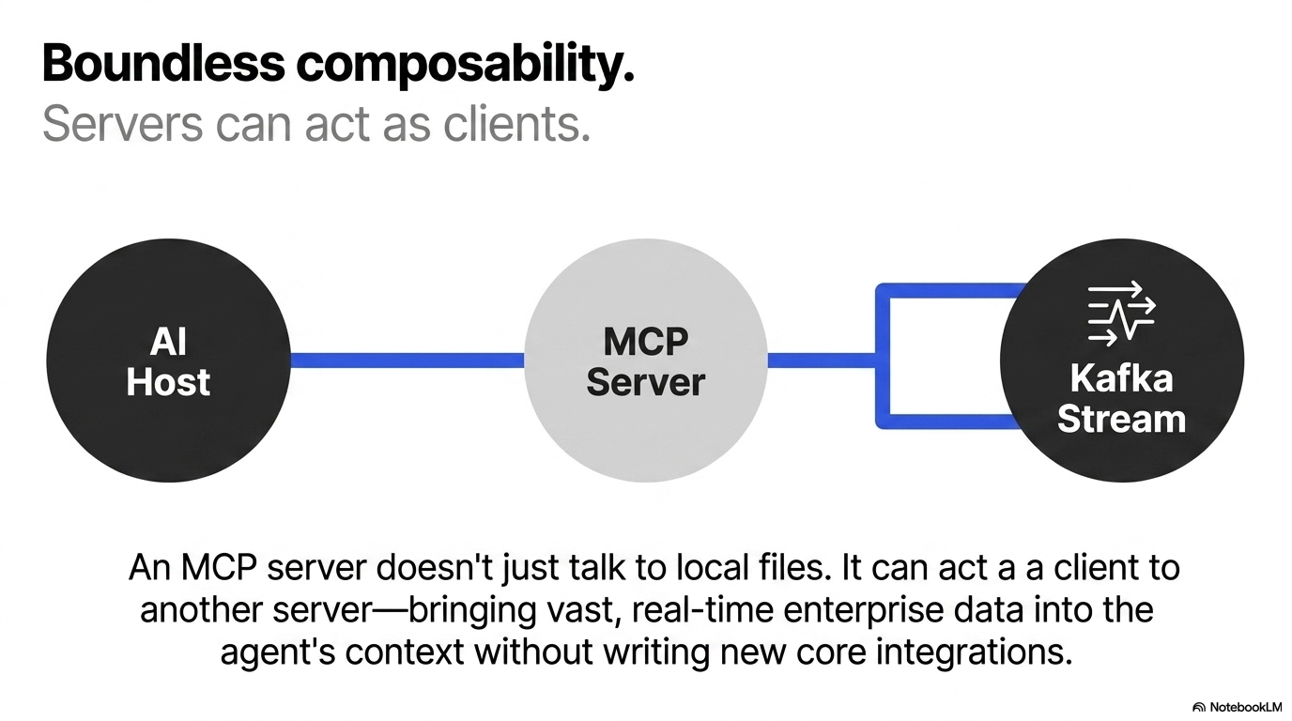

Slide 13
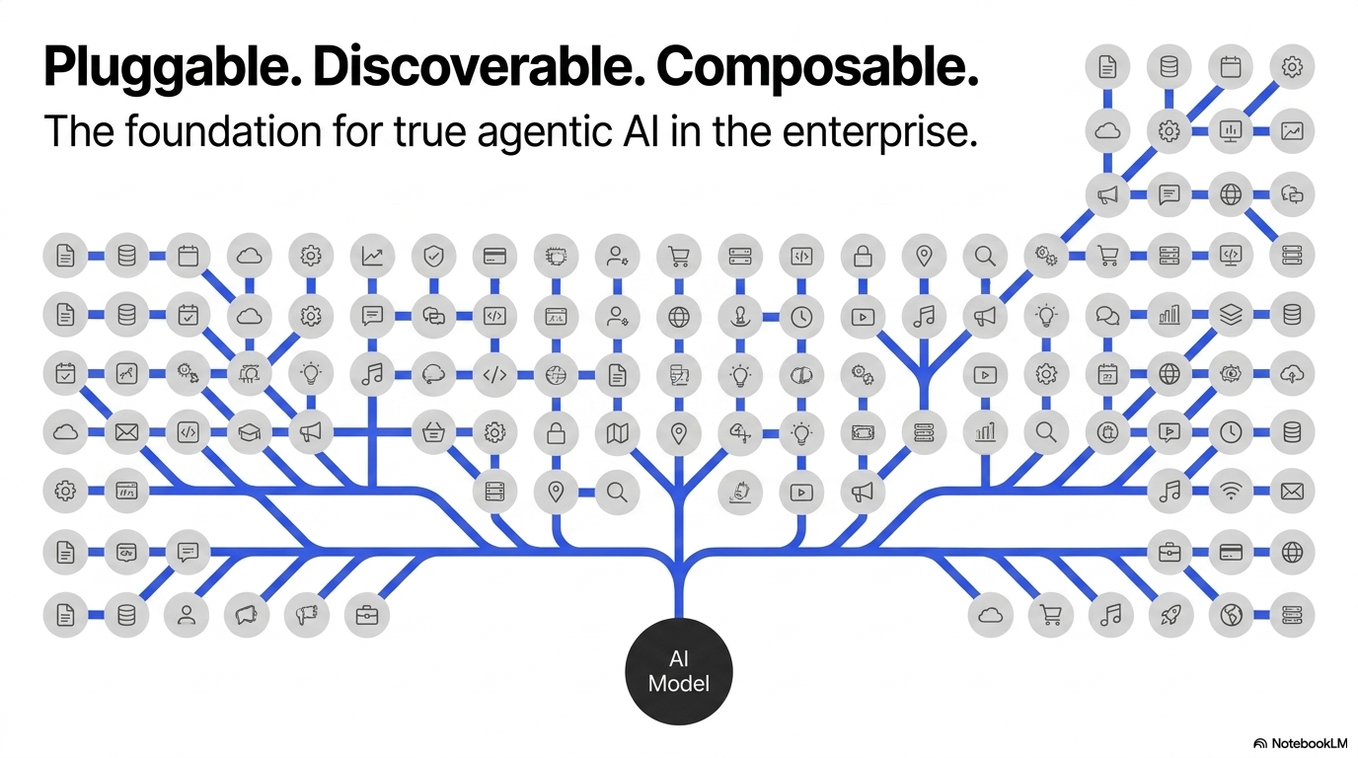

Slide 14
Enough theory.
Let's build a server.
One Python file. Two tools. A real product connected by the end of the hour.
MCP Workshop · Day 1

Slide 15
First: watch three questions fail.
Live demo — a local model, no MCP. Same root cause every time.
1 — Filesystem “What is written in the file notes.txt in my current directory?”
✕
2 — Live web data “What is the weather in Tel Aviv right now? Exact temperature.”
✕
3 — Database “Show me all products in our workshop database.”
✕
python demo_act1_failures.py
The LLM is trapped inside a box. MCP is the door.
MCP Workshop · Day 1

Slide 16
A server in two lines.
FastMCP — the framework. The name shows up in every client that connects.
from mcp.server.fastmcp import FastMCP
mcp = FastMCP("Workshop")
$ python server_starter.py
# server running — zero tools registered
Empty server. No tools. Nothing the LLM can call — yet. We're going to change that.
MCP Workshop · Day 1

Slide 17
The decorator is the whole trick.
Same function. One line on top registers it as something the LLM can call.
WITHOUT — just a function
WITH — an MCP tool
def get_weather(city: str) -> str:
return "sunny"
@mcp.tool()
def get_weather(city: str) -> str:
return "sunny"
Seen this before? Flask: @app.route('/weather') tells the framework “this function handles this URL.” MCP: @mcp.tool() tells FastMCP “this function is a tool the LLM can call.” The pattern of every tool you'll ever write: decorator on top · clear docstring · function body · return a string.
MCP Workshop · Day 1

Slide 18
Tool 1: read the machine.
Failure #1, fixed. And the docstring is not documentation — it's a prompt.
@mcp.tool()
def read_file(filename: str) -> str:
"""Read any text file from the current directory
and return its full contents."""
path = Path(__file__).parent / filename
if not path.exists():
return f"File not found: {filename}"
return path.read_text(encoding="utf-8")
The docstring IS the prompt. This is what the LLM reads to decide whether to call your tool. Vague docstring → wrong calls. Precise docstring → good decisions.
Docstrings are prompt engineering.
$ python client.py
> "What's in notes.txt?" → it works.
MCP Workshop · Day 1

Slide 19
Tool 2: reach the live world.
Failure #2, fixed. Free API, no key, no signup — and the data is from right now.
@mcp.tool()
def get_weather(city: str) -> str:
"""Get the current weather conditions and
temperature for any city in the world."""
import requests
try:
r = requests.get(f"https://wttr.in/{city}?format=3", timeout=5)
r.raise_for_status()
return r.text.strip()
except Exception as e:
return f"Weather unavailable: {e}"
Output: Tel Aviv: +28°C
Ask the room: why is import requests INSIDE the function? (Isolation — a missing package breaks one tool, not the whole server.)
MCP Workshop · Day 1

Slide 20
One file. Two transports. Zero config.
HTTP when you run it from a terminal. STDIO when a product runs it as a subprocess.
if __name__ == "__main__":
if sys.stdin.isatty():
mcp.run(transport="streamable-http") # you, in a terminal
else:
mcp.run() # STDIO — Goose / Claude Desktop
STDIO
Host launches your server as a subprocess. The desktop story.
Streamable HTTP
Server listens on a port. The remote / cloud story. (SSE is deprecated.)
MCP Workshop · Day 1

Slide 21
DO NOW — your turn (25 min)
Build a tool nobody else in the room has.
1
Pick a capability — A free API (wttr.in, Open-Meteo, Wikipedia…) or something on your machine.
2
Write the tool — @mcp.tool() · docstring that reads like a prompt · body · return a string.
3
Restart + test — python server_starter.py → python client.py — ask a question that needs YOUR tool.
4
Break it on purpose — Blank the docstring. Watch the LLM stop calling your tool. Now you believe it.
Finish early? Add a second tool that takes TWO parameters.

Slide 22
You built the door.
One Python file. The same pattern, forever:
@mcp.tool()
docstring = prompt
do one thing
return a string
Today: your model read a file and fetched live weather — the two failures from minute one, fixed by ~40 lines of Python. Tomorrow: we flip sides — you write the CLIENT, and connect real products (Goose, Claude Desktop) to the server you just built.
Remember the two corrections: the client is NOT the model (it lives inside the host) · MCP has THREE primitives — tools, resources, prompts.
MCP Workshop · Day 1

