Slide 1
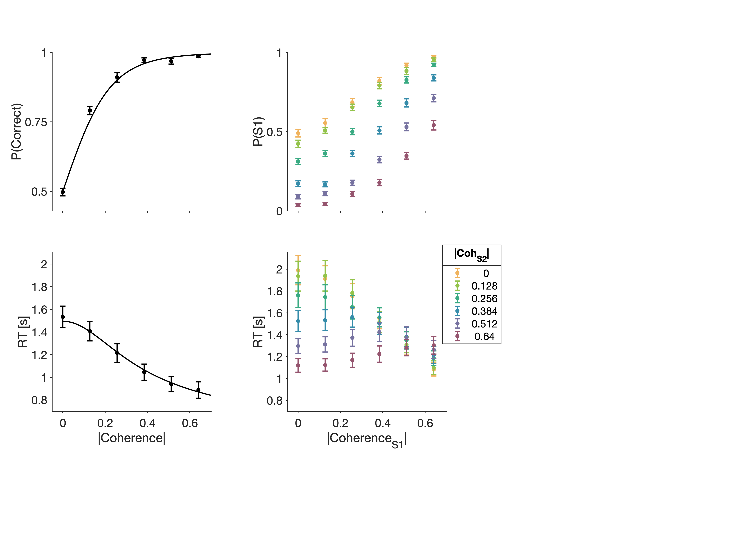



a
b
c
d
Color judgments (Training)
“What is the dominant color?”
Difficulty judgments
“Which stimulus is the easier one”?
Trial start
Trial start
S1
S2
Stimulus
Stimulus
Response
Response
L
R
Feedback
Feedback
Correct
Correct

