Slide 1
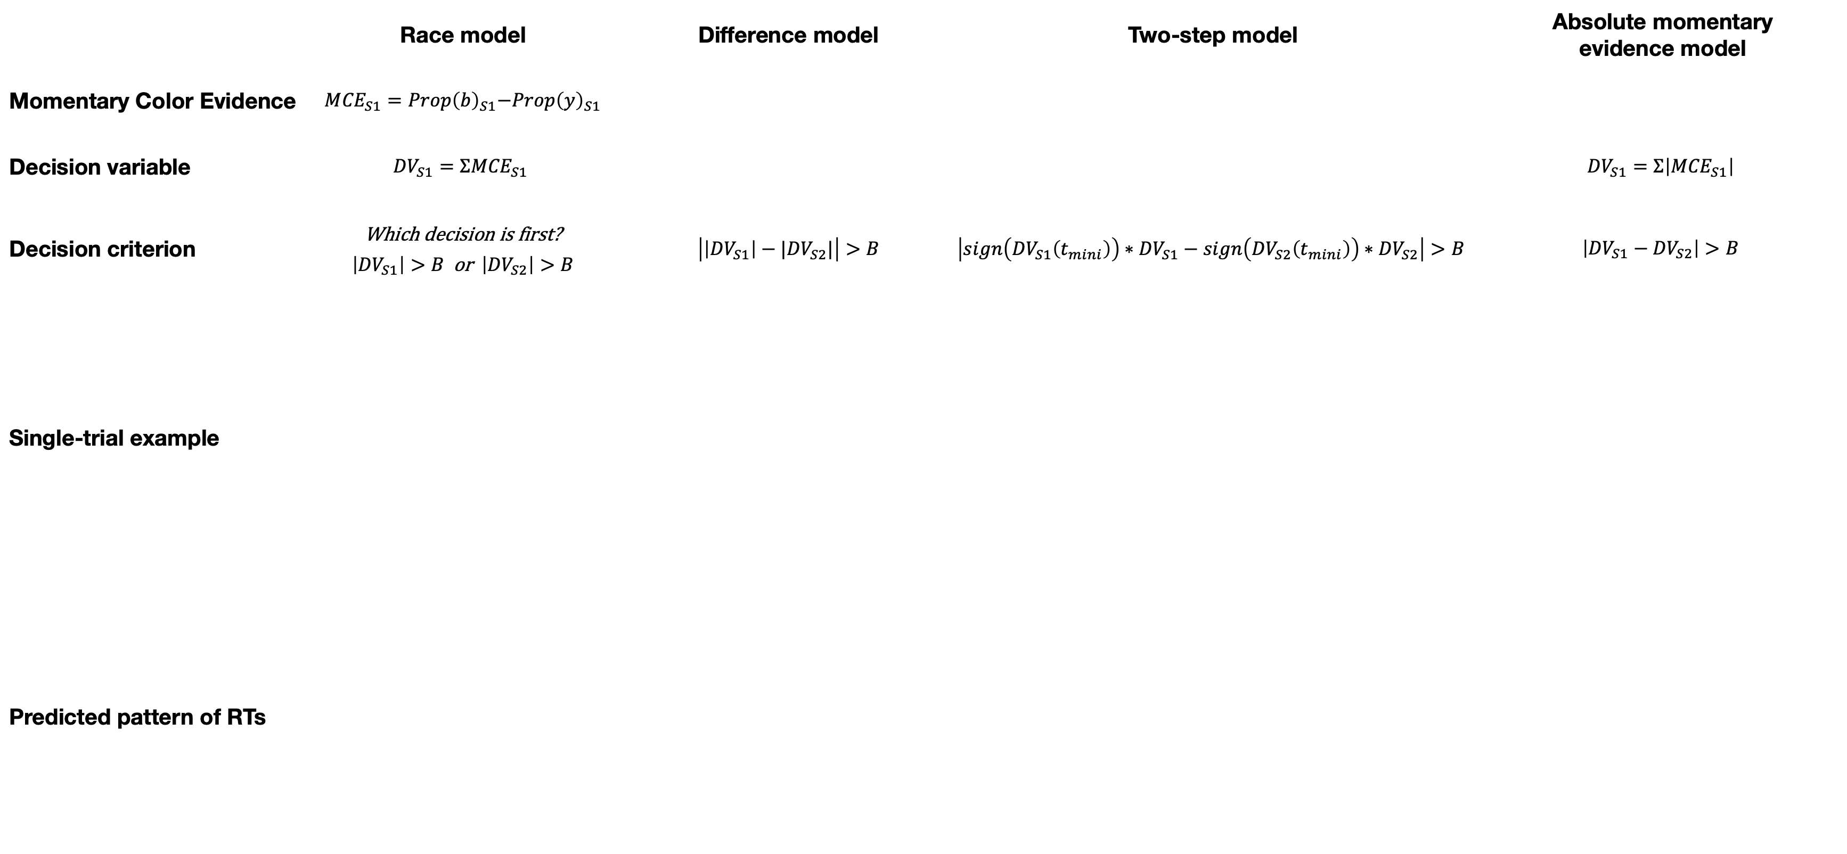
a
b
c
d
 | Race model | Difference model | Two-step model | Absolute momentary evidence model
Momentary Color Evidence | $${ {MCE}_{S1}=Prop\left(b\right)}_{S1}−{Prop\left(y\right)}_{S1}$$
Decision variable | $${DV}_{S1}={ΣMCE}_{S1}$$ |  |  | $${DV}_{S1}=Σ\left|{MCE}_{S1}\right|$$
Decision criterion | Which decision is first? $\left|{DV}_{S1}\right|>B$ or $\left|{DV}_{S2}\right|>B$ | $\left|\left|{DV}_{S1}\right|−|{DV}_{S2}|\right|>B$ | $$\left|sign\left({DV}_{S1}\left(t_{mini}\right)\right)∗{DV}_{S1}−sign\left({DV}_{S2}\left(t_{mini}\right)\right)∗{DV}_{S2}\right|>B$$ | $$\left|{DV}_{S1}−{DV}_{S2}\right|>B$$
Single-trial example
Predicted pattern of RTs
S2 easier
+B
+B
+B_{mini}
+B
+B
DV_{S2}
S1 easier
DV_{S2}
DV_{S2}
DV_{S2}
DV_{S2}
–B
–B_{mini}
–B
–B
t_{mini}
–B
+B
–B
+B
–B_{mini}
+B_{mini}
–B
+B
+B
DV_{S1}
DV_{S1}
DV_{S1}
DV_{S1}
DV_{S1}

