Slide 1
Culture Trends
Author: Xiaohan Chang (alicexhchang@gmail.com)

Slide 2
BACKGROUND
Restaurants
Compare and contrast what the city people care
Improve themselves
DESCRIPTION
By analyzing the challenge dataset, find out what makes a particular city different. We pick the review of 10 cities for comparing. For each city, do LDA analyze for them and get the corresponding topics. To each topic text, we classify them into 5 classes according to the key words. Through building the bar graph for each city and compare the results.

Slide 3
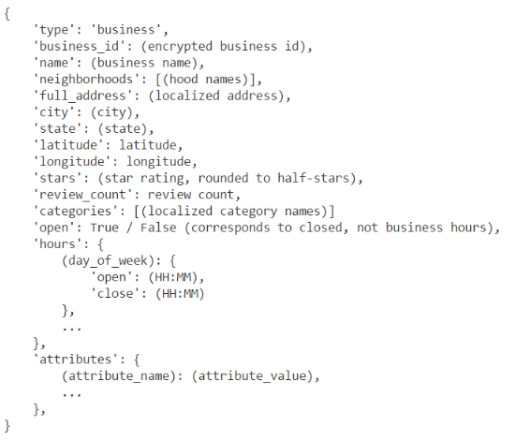
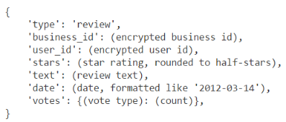
DATASET
Business
Review

Slide 4
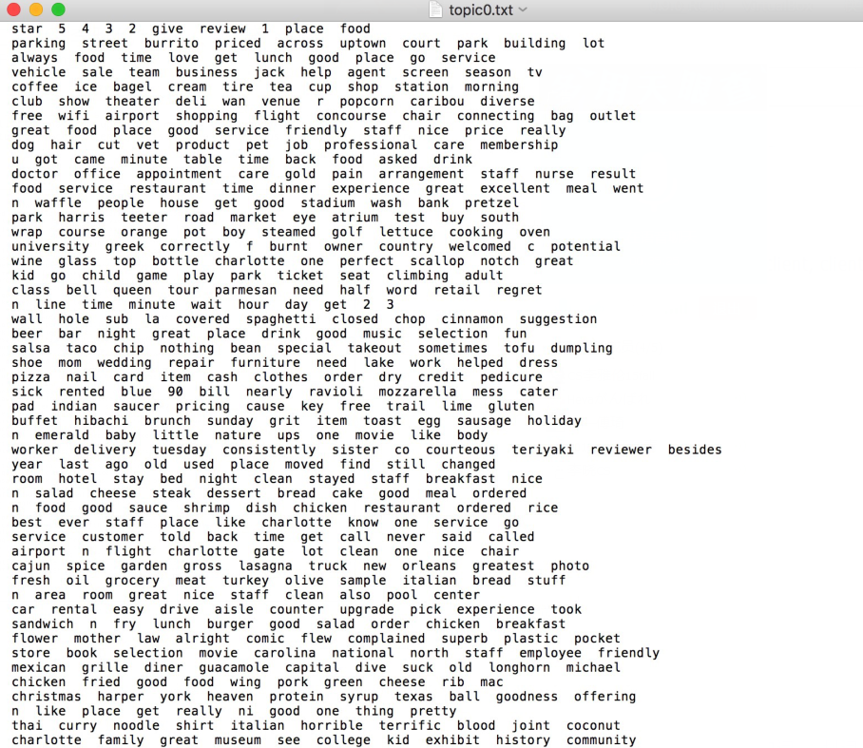
Latent Dirichlet Allocation(LDA)
Topic
Create 10 txt file, each file correspond to one city
In each topic txt file, it create 50 tuples, and in each tuple, it contains 10 key words
Classify
Feature, Service, Food, Surrounding, Price

Slide 5
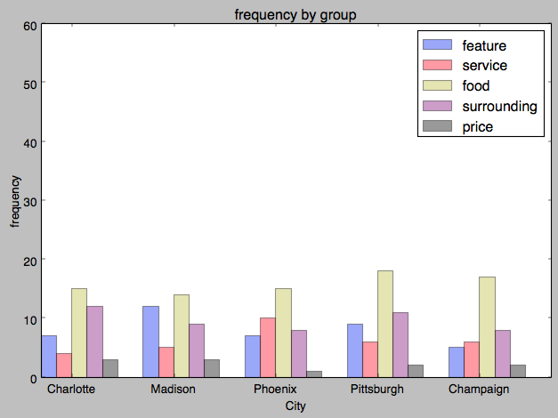
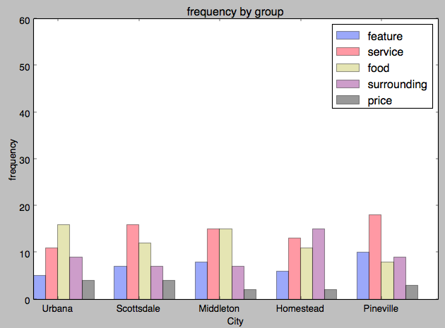
RESULT
In most of cities, people care more about food and care less about price
Take a city for analyzing, Homestead, which contains many popular tourist spot, so people may care more about the surroundings

Slide 6
Thank You

