Slide 1

1-DOF ROBOT GRIPPER
WRIST+END EFFECTOR

Slide 2
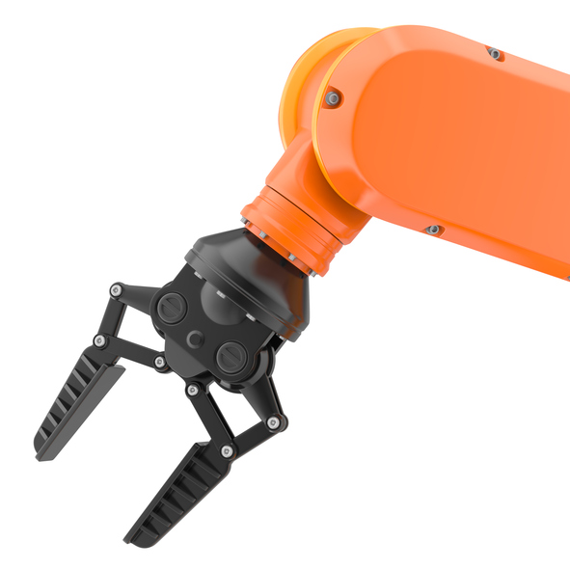
Project Overview
PROBLEM STATEMENT:
Ideate a robotic gripper and design a CAD Model. 3D print and manufacture it’s prototype.
CURRENT PROGRESS:
Ideation done
Mechanism finalized
CAD model designed
Ready for 3D printing

Slide 3
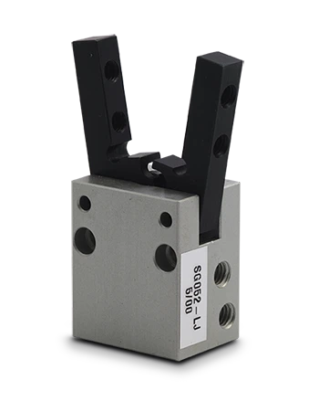
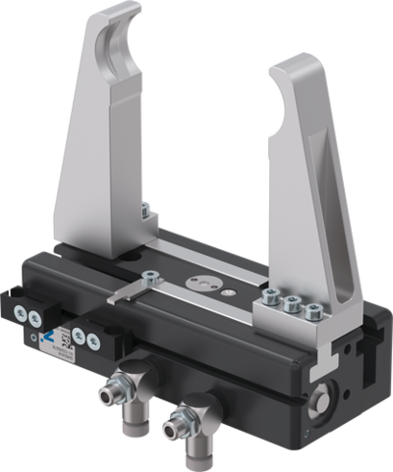
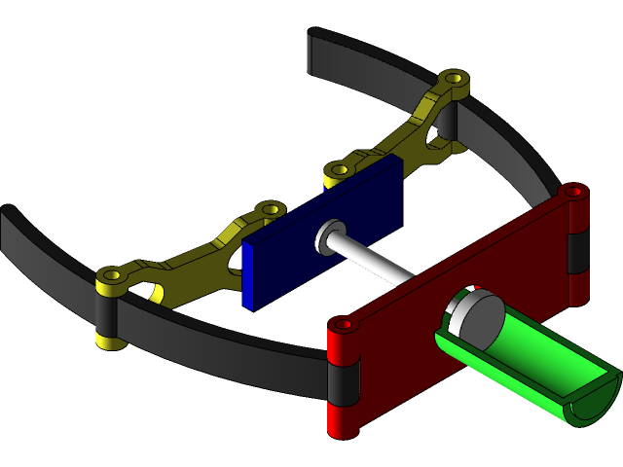
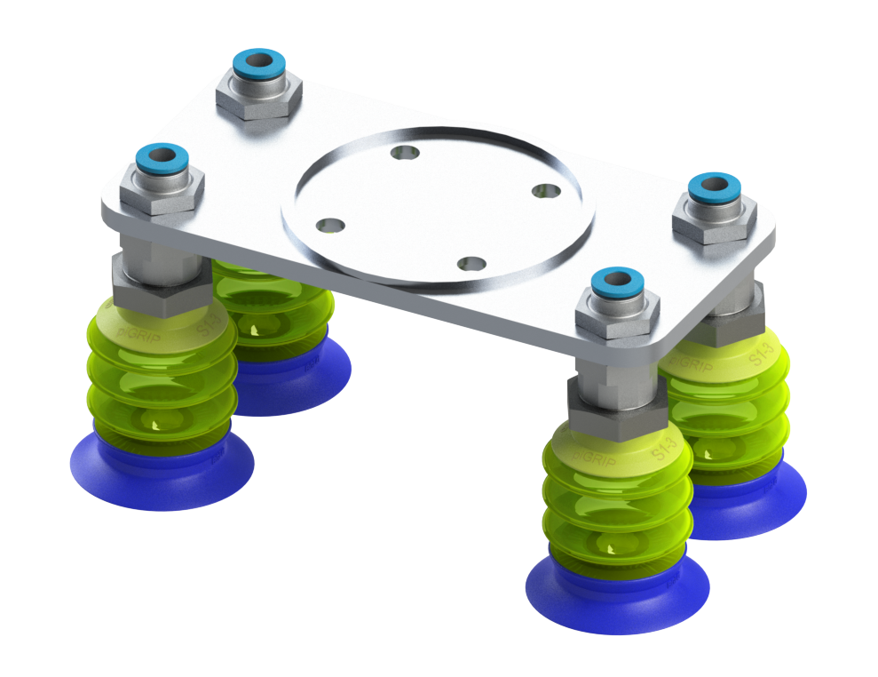
TYPES OF GRIPPERS We went through many types of magnetic grippers. We studied about them, and finalized the PARELLEL JAW GRIPPER, taking into consideration, our needs and the procedure required to make it. The types of grippers we came across are as follows
Sunction gripper
Vacuum gripper
Pneumatic gripper
Parellel gripper

Slide 4

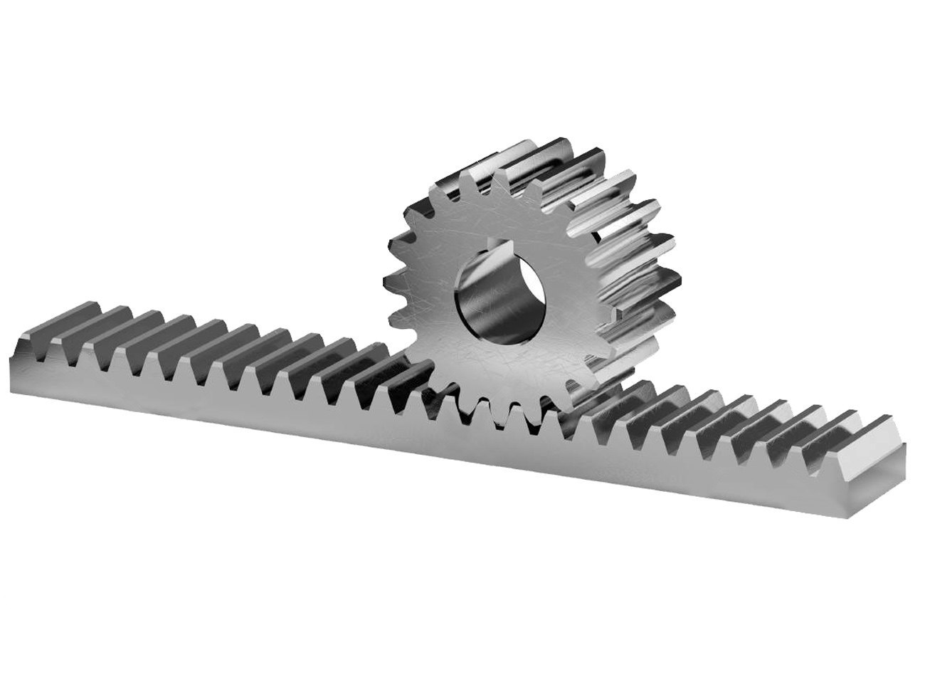
MECHANISM:RACK AND PINION
Rack: Connected to gripper arm
Pinion: Bevel gear
MG995 servo motor rotates pinion
Pinion rotation pulls rack
Jaws move closer to each other

Slide 5
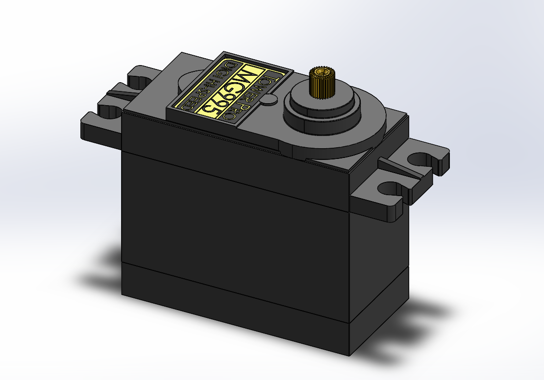
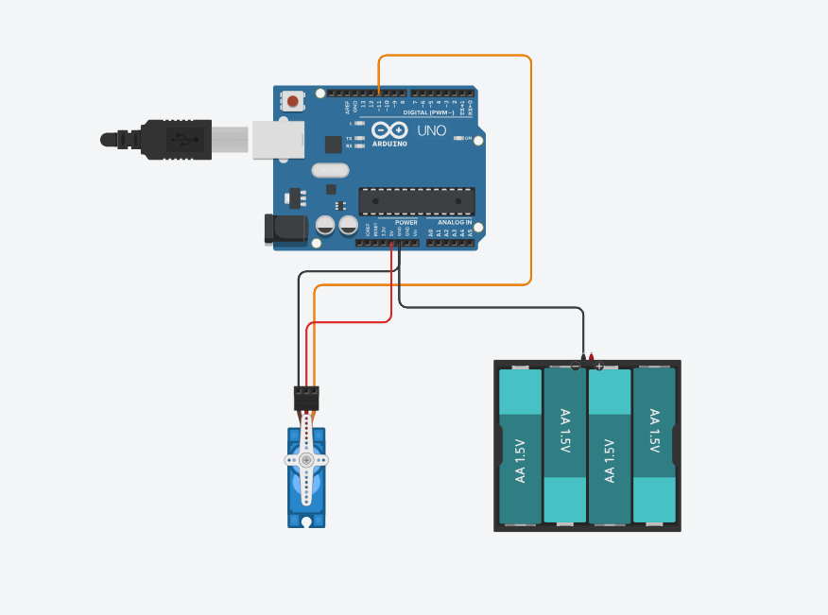
ELECTRONICS ITEMS:
Arduino UNO
Mg995 servo motor
15 jumper wires(male to male)
10 jumper wires(female to female)
Batteries
Breadboard

Slide 6
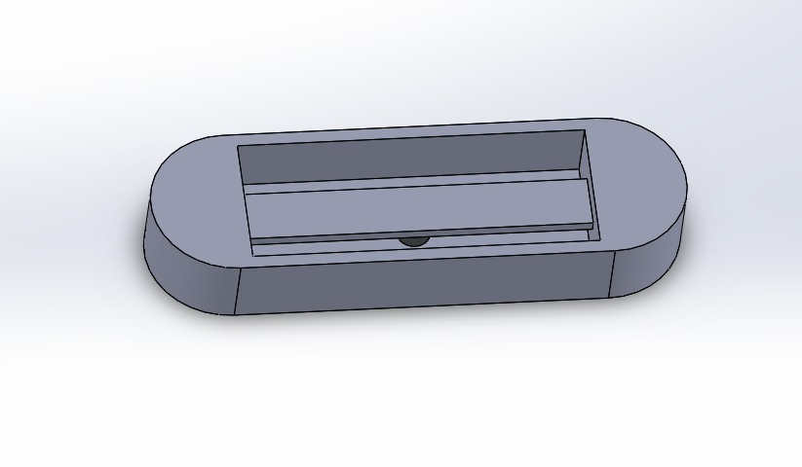
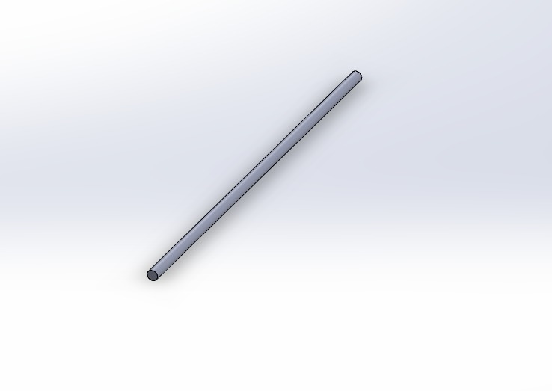
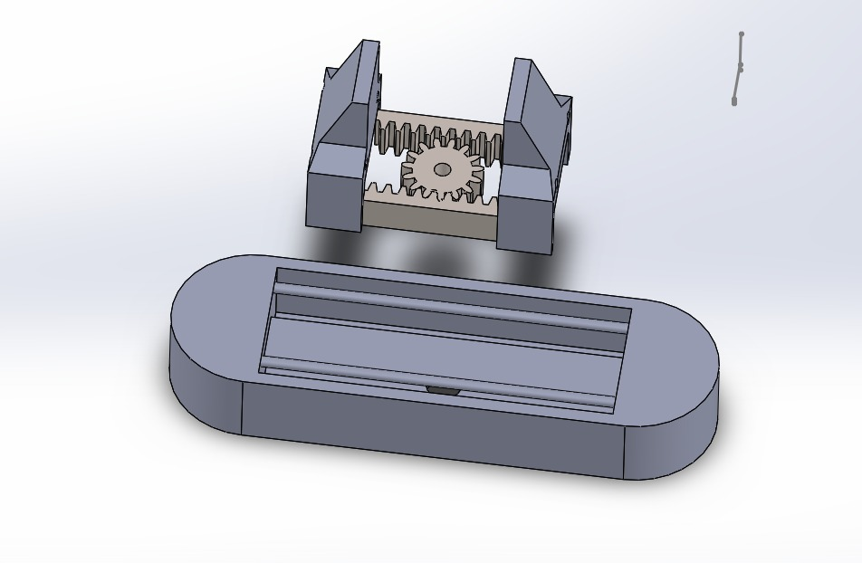
CAD COMPONENTS AND ASSEMBLY

Slide 7

OUR TEAM
Shambhavi: Participated in mechanism finalization and CAD modelling
Shivang:Participated in mechanism finalization and CAD modelling
Pronoy: Played a major role in the electronics and hardware part of the project and the final design of the gripper

Slide 8

OVERALL CONTRIBUTION AND EXPERIENCE
All the team members co-ordinated well with each other and the seniors and will continue to do so in future. We fostered a culture of open communication, and each member participated actively in the discussions and meetings.By regularly assessing our progress and approach, and through research, we gained valuable learnings. Moving forward, we will apply these learnings in the future too, ensuring continued growth.

Slide 9

REFERENCES
https://youtu.be/BzL9XSeHLVc?si=5pjTJaywO0T1a4tN
https://youtu.be/BzL9XSeHLVc?si=5pjTJaywO0T1a4tN
https://youtube.com/shorts/M8TJLqe-p8c?si=b4dI_3Nr_XtEoWcQ
https://youtu.be/2JQeXzM5KEE?si=EWx1u1rJMJ4hldtw
https://youtu.be/R7EfazP193A?feature=shared
Grabcad

Slide 10


