Slide 1
ARIES Project
Predicting life cycle of lithium ion cells
Team members -
Keshatwar Pratham Naresh
Arsh Jindal
Arav Khandelwal
Prakhar Pratap Singh

Slide 2
DATASET
For the selection of appropriate dataset having both new and used batteries we went through various available datasets such as unibo power tools NASA’s randomized battery usage, NASA’s battery datasheet but we finalized on NASA’s randomised battery data set.
This dataset satisfies our need for used battery data and is sufficiently large to apply models that we planned to do.

Slide 3
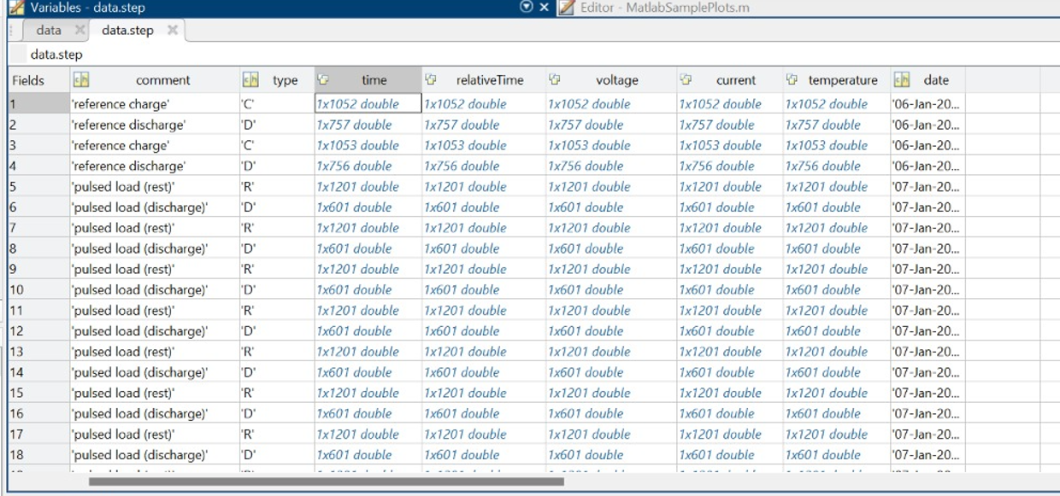
Dataset continued…

Slide 4
DATA Preprocessing
The dataset was available in Matlab and R format but for our project we are using Matlab files.
Each subset of the dataset contains 3-4 files and we have 7 such subsets.
Due to lack of RAM and large training time only limited files could be used to train our model.
The parameters available in this dataset include time, relative time, voltage, current and temperature.

Slide 5
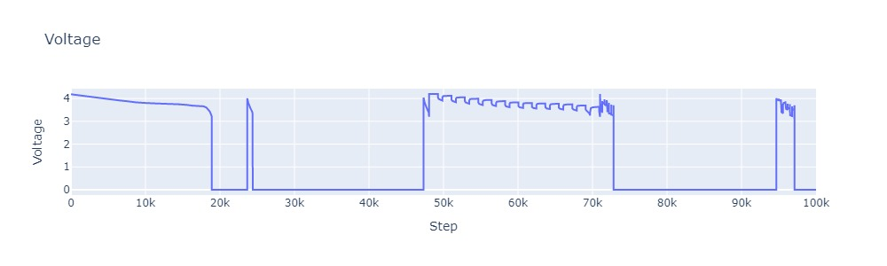
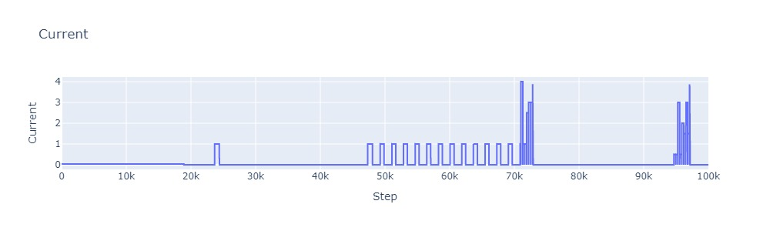
Data Visualization

Slide 6
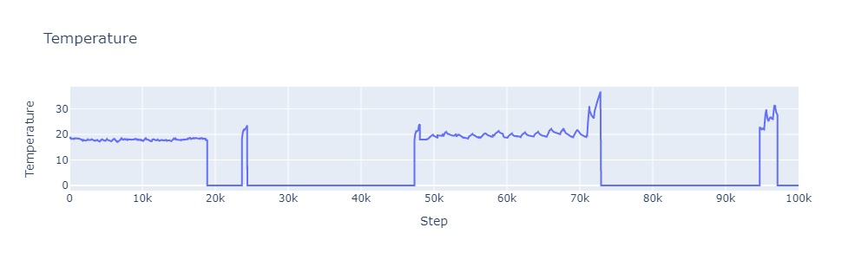
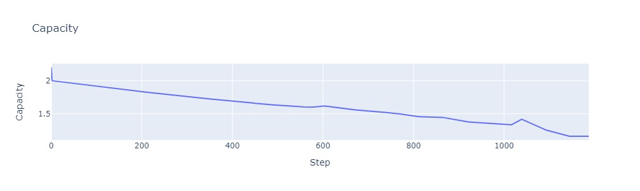
Data Visualization

Slide 7
Model Selection
The data used is in sequential form so we are applying LSTM( Long short term memory ) model.
Since it contains data in form of time series, therefore we can predict future state from past cycles of the battery.
For application of LSTM we made certain changes in dataset and after pre-processing we created the variables like train_x, train_y, battery_n, time, etc. for easy application of the respected model

Slide 8
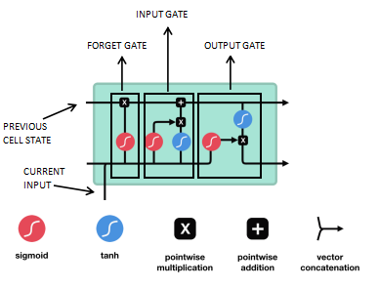
LSTM
LSTM is complex Neural Network block used for modelling complex sequential data or time-series data.
It is an improvement over RNN which has the problem of vanishing or exploding gradients causing the inability to remember longer contexts in the sequential data.

Slide 9
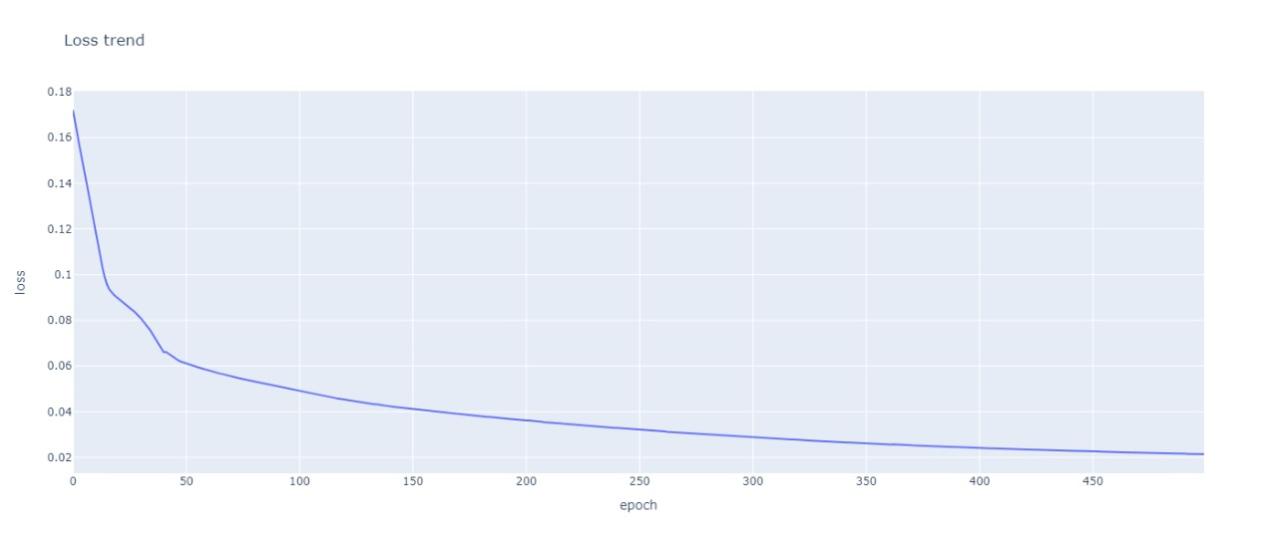
Training
We have used Google collab for training our model.
Training is done in batches of 32 with 500 epochs
After the training our loss observed is 0.0214647688.

Slide 10
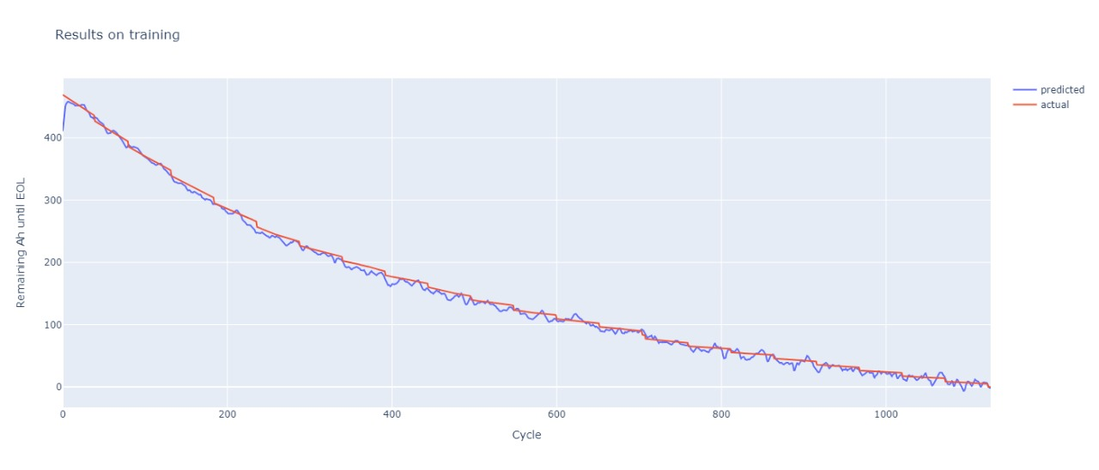
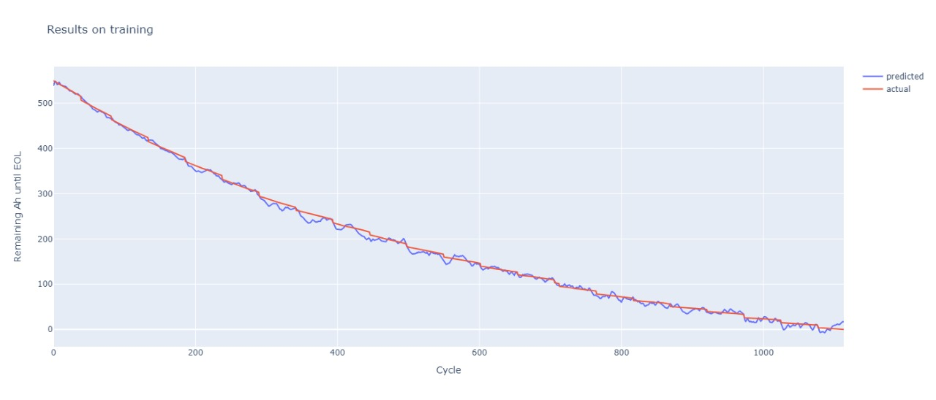
Results On Training

Slide 11
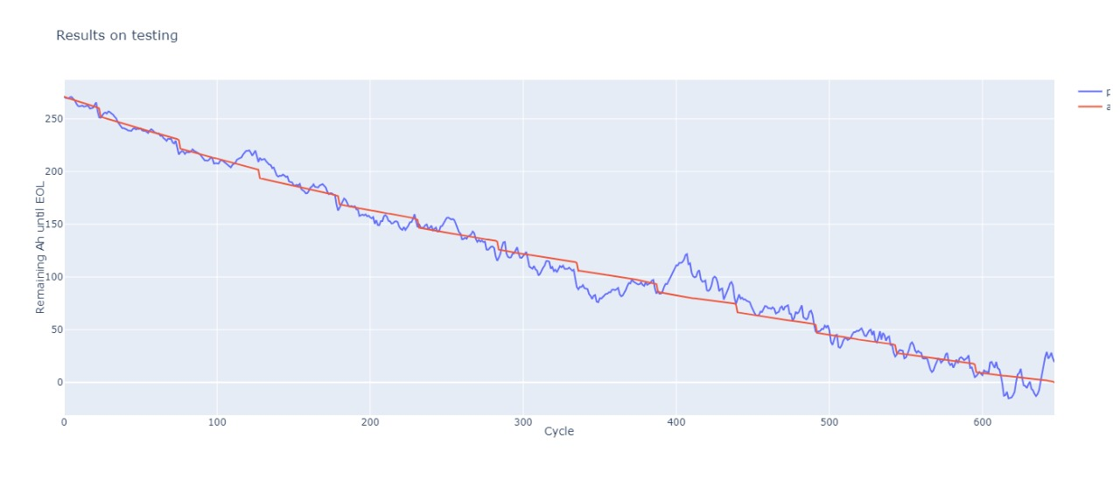
Testing Losses
Data Set | MSE | MAE | RMSE
RW-11 | 0.001268685911782086 | 0.02864351123571396 | 0.0356186181306839
RW-15 | 0.007129967678338289 | 0.06200258806347847 | 0.08443913608789444
RW-24 | 0.0021113413386046886 | 0.03405878320336342 | -0.04597912762174178
RW-28 | 0.001337920199148357 | 0.026978613808751106 | 0.03657759353518486

Slide 12
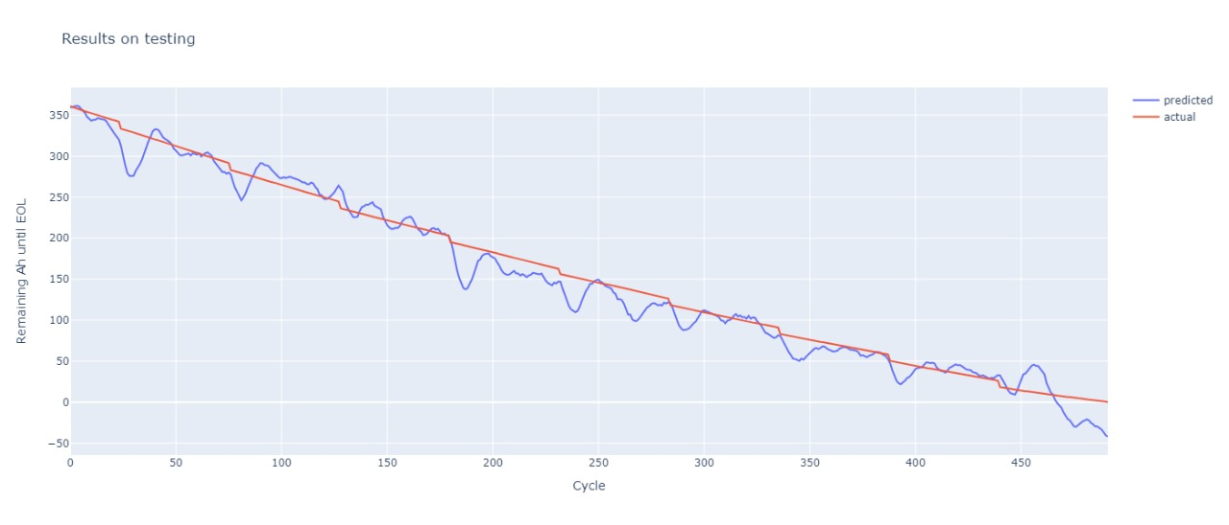
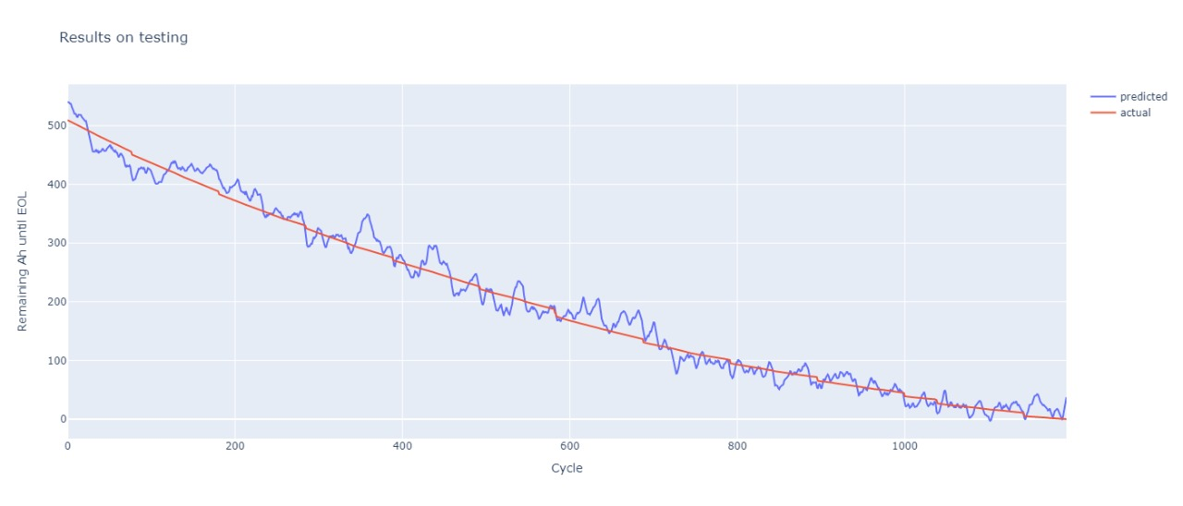
Results On Testing

Slide 13
Future Goals
We can reduce the losses by increasing the epochs (currently at 500 ) to 700 or 900.
The current limitations on epochs is due to limitations in computational power of GPU.
The efficiency might be increased by increasing the training data.
The current limitation in training data at once is due to limitations in RAM available.

Slide 14
References
https://github.com/pheonix8734/Aries_lithium_ion_project
https://www.google.com/url?sa=t&source=web&rct=j&url=https://research.google.com/pubs/archive/43905.pdf&ved=2ahUKEwiig7e8ksv3AhWUSmwGHau0D2oQFnoECAkQAQ&usg=AOvVaw0VzZo-jdF1AYyWYjyT1V8O

Slide 15
Thank You

