Slide 1

ANALYZING BANK MARKETING DATA
BDA 503
TERM PROJECT
Notes:
Hey everyone,
In this presentation, we’re going to analyze bank marketing data for our term project

Slide 2
About
Class : BDA503 - Essentials of Data Analytics
Instructor: Prof. Özgür Özlük
Group Name: NERO
Group Members:
Esra Arı
İlknur Tezgiden
Aykut Ülgenalp
Serap Konuksal
Dataset: Bank_Marketing
(https://archive.ics.uci.edu/ml/datasets/Bank+Marketing#)
Notes:
But first, Let me introduce you to our project team. Here we are; esra, ilknur…. All we are working at banking sector. 3 of us working at risk department, one of us at marketing department. Therefore, we can say dataset was similar to us. We found dataset for uci website, you can find link below.

Slide 3
Roadmap
Explore Data
Understand content of dataset
Do basic descriptive analysis
Prepare bivariate, univariate analysis
1
3
Predictive Analysis
Decide predictive modellig technique
Interpret result
Clean Data
Do variable reduction
Decide how you treat outliers
Do data transformation
4
2
Further Analysis
Clustring
Notes:
Before dig into, we want to summarize roadmap of our project. Fİrst we started to explore data. With which aim dataset is created, which variables are collected what is explation of variables. After understand overall concept of dataset, we did basic descriptive analysis. If variables were numeric, we looked at mean, min, max..etc., if they were string/factor we look at their attrbutes. We try to graph all variables to understand if there is outliers and check variables’ distrubutions are logical. In this section we did bivariate and univariate analysis. After understand data, we dedice which variable we should eliminate for predictive modelling while looking at correlation and missing analysis and also in this part we decided how we treat outlies. After prepared data, we determined which predictive technique we will use and we interpreted the results. Final but least, we tried to find what we can do more to understand and interpret data better. In this section we also used unsupervised learning algorithm to discover customer pattern in the data.

Slide 4
Explore Data /
Content of dataset
Understand variables
The data is related with direct marketing campaigns (phone calls) of a Portuguese banking institution. Dataset includes 21 variables, detailed at below:
Variable Name | Explanation
age | Customer age
job | type of job ( ‘admin.’,‘blue
marital | marital status ( ‘divorced’,‘married’,‘single’,‘unknown’; note
education | education status
default | has credit in default? (‘no’,‘yes’,‘unknown’)
housing | has housing loan? ( ‘no’,‘yes’,‘unknown’)
loan | has personal loan? ( ‘no’,‘yes’,‘unknown’)
Related with the last contact of the current | campaign:
contact | contact communication type (‘cellular’,‘telephone’)
month | last contact month of year ( ‘jan’, ‘feb’, ‘mar’, …, ‘nov’, ‘dec’)
day_of_week | last contact day of the week (‘mon’,‘tue’,‘wed’,‘thu’,‘fri’)
duration | last contact duration, in seconds (numeric).
Other attributes:
campaign | number of contacts performed during this campaign and for this client ( includes last contact)
pdays | number of days that passed by after the client was last contacted from a previous campaign ( 999 means client was not previously contacted)
previous | number of contacts performed before this campaign and for this client
poutcome | outcome of the previous marketing campaign ( ‘failure’,‘nonexistent’,‘success’)
Social and economic context attributes:
emp.var.rate | employment variation rate
cons.price.idx | consumer price index
cons.conf.idx | consumer confidence index
euribor3m | euribor 3 month rate
nr.employed | number of employees
Output variable (desired target):
y | Has the client subscribed a term deposit? (binary: ‘yes’,‘no’)
Notes:
As we mentioned our dataset is related with direct marketing campaigns (phone calls) of a Portuguese banking institution. Dataset includes 21 variables, which are age, job, marital status, educational status, default claims has credit default, housing claims has housing loans … contact information's .. Other attributes final but least social and economical variables which are employment variation rate consumer price index consumer index, euribor 3 month rate etc… Değişkenlerin tek tek üzerinden geçilebilir.

Slide 5
Explore Data /
Descriptive Summary Statistics
age job marital education default housing
Min. :17.00 admin. :10422 divorced: 4612 university.degree :12168 no :32588 no :18622
1st Qu.:32.00 blue-collar: 9254 married :24928 high.school : 9515 unknown: 8597 unknown: 990
Median :38.00 technician : 6743 single :11568 basic.9y : 6045 yes : 3 yes :21576
Mean :40.02 services : 3969 unknown : 80 professional.course: 5243
3rd Qu.:47.00 management : 2924 basic.4y : 4176
Max. :98.00 retired : 1720 basic.6y : 2292
(Other) : 6156 (Other) : 1749
loan contact month day_of_week duration campaign pdays
no :33950 cellular :26144 may :13769 fri:7827 Min. : 0.0 Min. : 1.000 Min. : 0.0
unknown: 990 telephone:15044 jul : 7174 mon:8514 1st Qu.: 102.0 1st Qu.: 1.000 1st Qu.:999.0
yes : 6248 aug : 6178 thu:8623 Median : 180.0 Median : 2.000 Median :999.0
jun : 5318 tue:8090 Mean : 258.3 Mean : 2.568 Mean :962.5
nov : 4101 wed:8134 3rd Qu.: 319.0 3rd Qu.: 3.000 3rd Qu.:999.0
apr : 2632 Max. :4918.0 Max. :56.000 Max. :999.0
(Other): 2016
previous poutcome emp.var.rate cons.price.idx cons.conf.idx euribor3m nr.employed
Min. :0.000 failure : 4252 Min. :-3.40000 Min. :92.20 Min. :-50.8 Min. :0.634 Min. :4964
1st Qu.:0.000 nonexistent:35563 1st Qu.:-1.80000 1st Qu.:93.08 1st Qu.:-42.7 1st Qu.:1.344 1st Qu.:5099
Median :0.000 success : 1373 Median : 1.10000 Median :93.75 Median :-41.8 Median :4.857 Median :5191
Mean :0.173 Mean : 0.08189 Mean :93.58 Mean :-40.5 Mean :3.621 Mean :5167
3rd Qu.:0.000 3rd Qu.: 1.40000 3rd Qu.:93.99 3rd Qu.:-36.4 3rd Qu.:4.961 3rd Qu.:5228
Max. :7.000 Max. : 1.40000 Max. :94.77 Max. :-26.9 Max. :5.045 Max. :5228
y
no :36548
yes: 4640
Notes:
After understand content of dataset and its variables. Lets look at summary statictis of all variable in the dataset. If we want to summarize findings we can see that:
Mean age of customers are 40,
In education, most of the customers are university degree,
Number customers who have housing loan is more than customers who have personel loan.
Last contact month is mainly may.
Last contact day of week varies balanced.
Mean Contact duration is 258 seconds and duration differs from 0 and 4.918 seconds. So this can be an important parameter.
All the customers have at least 1 campaign. The avarege campaing per customer ise 2,6.
Mean of pdays is 962 and mean of previous contact is 0. It is seen that these two are not useful parameters.
P outcome differs as success and failure, so this can be an important parameter while finding a strategy.
emp. var. rate and cons.price.idx, cons.conf.idx and euribor3m have minor variances but these can have an sensitivity in analysis.
In data we have 4640 customers, successfully subscribed to term deposit.

Slide 6
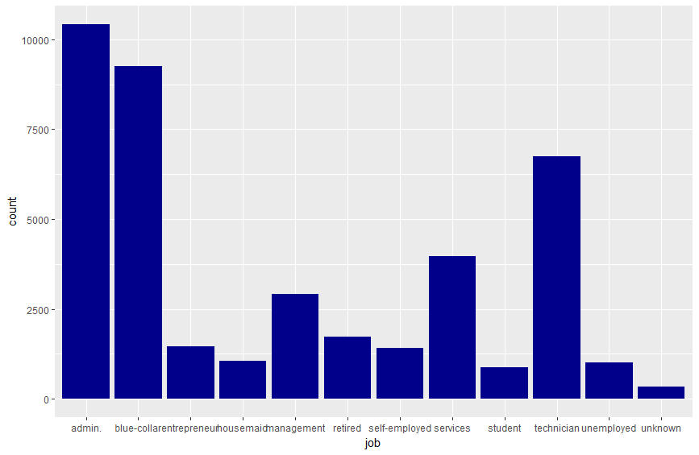
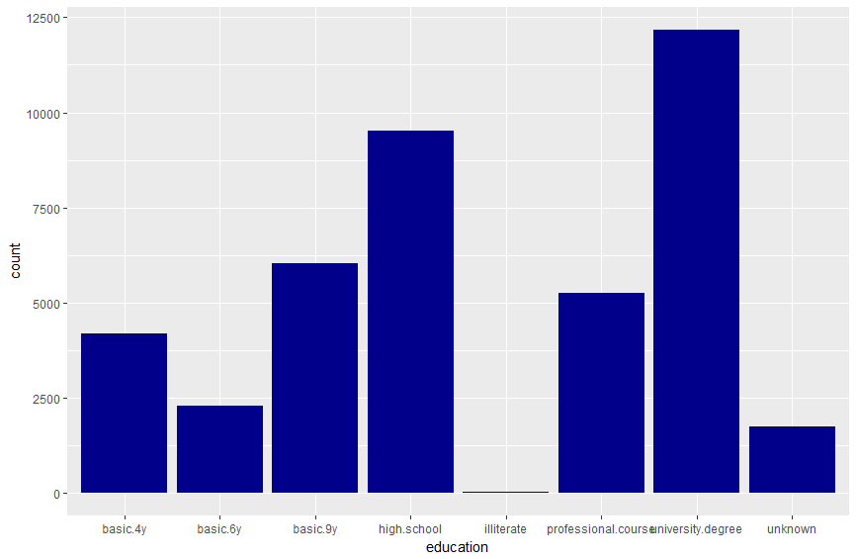
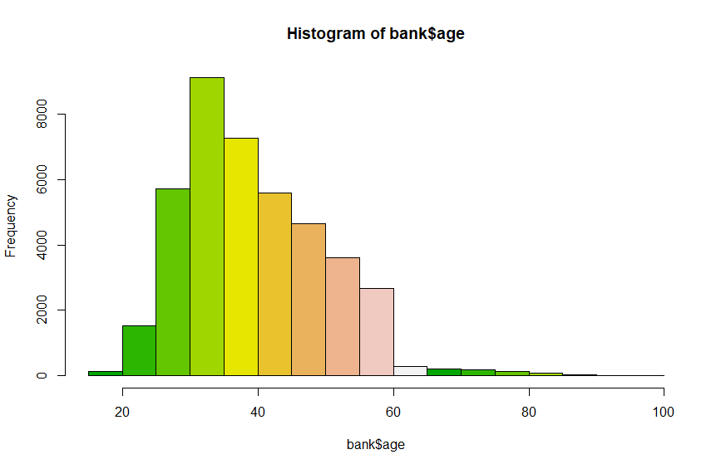
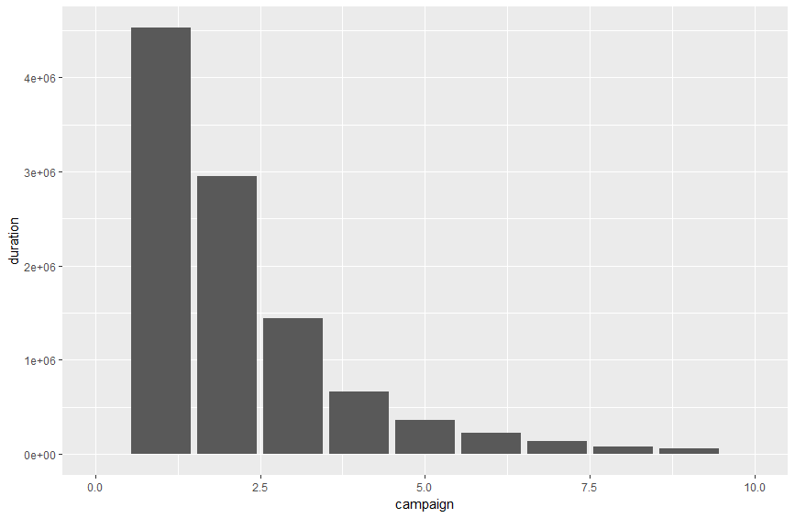
Explore Data /
Bivariate /
Univariate Analysis
Notes:
In this slide we visualized what we did previous slide. You can seen that how job, age education variables are distributed in the population. Also we look at how changes number of contacts performed during this campaign with last contact duration. İt can be seen that when number of contacts performed during this campaign increases, duration of last contact decreases.

Slide 7
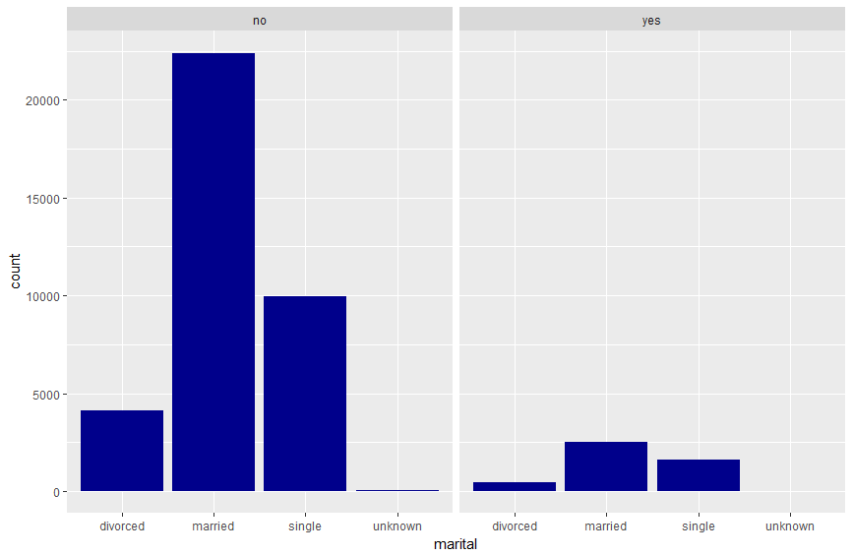
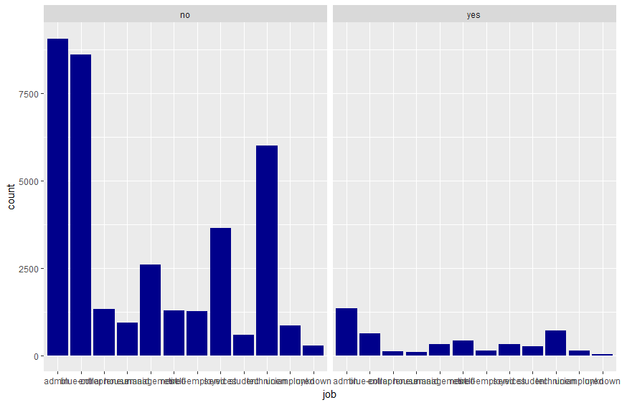
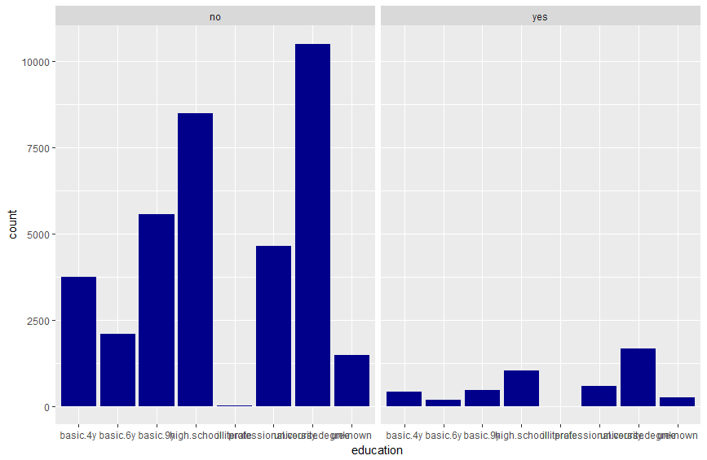
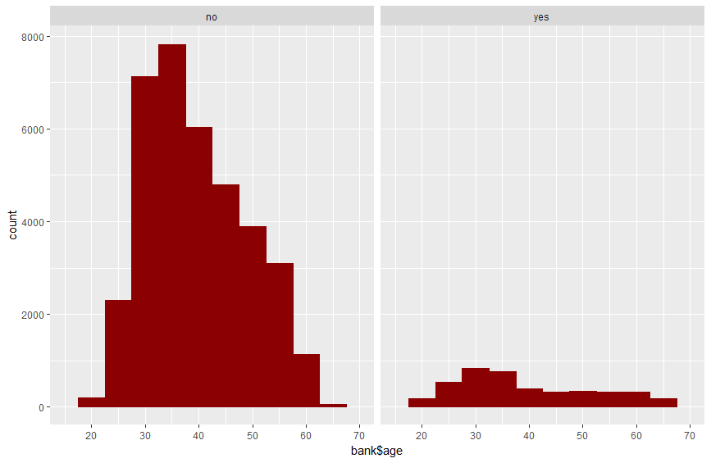
Explore Data /
Bivariate /
Univariate Analysis
Notes:
In this slide, we look at how distribution of variables changes with target implies the client subscribed a term deposit. This analysis is important to understand with which variables we can estimate target. Variables which its distrubutions differ with target, can be sign of to be good predictive.

Slide 8
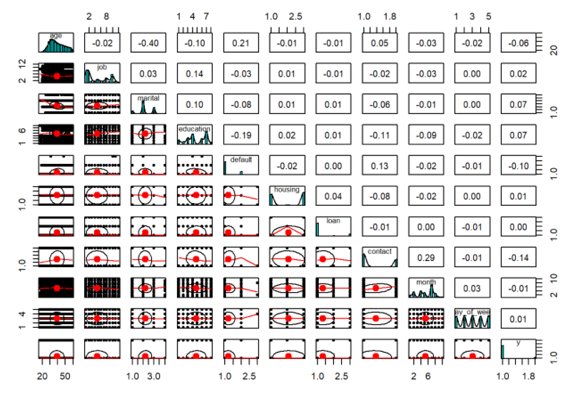
Clean Data /
Variable Reduction
With Correlation Analysis
Correlation analysis can help us decide if we can drop some columns/predictors depending upon its correlation with the outcome variable.
Notes:
Correlation analysis can help us decide if we can drop some columns/predictors depending upon its correlation with the outcome variable. From first figure, it can be seen that there is no correlation coefficent greater than 0.7; therefore, we can say that there is no correlated variables in first group of variables. Also, variables have lower correlation with the outcome variable (y) were dropped which are loan and housing.

Slide 9
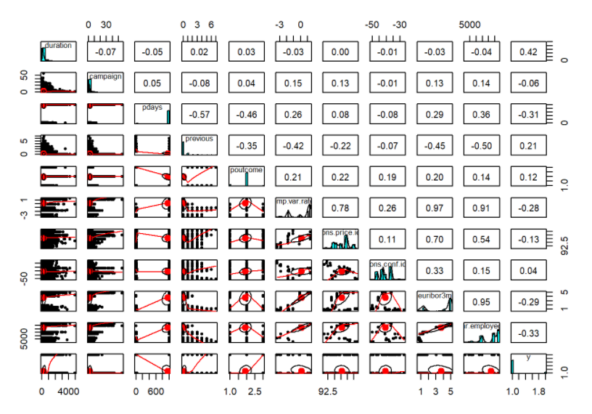
Clean Data /
Variable Reduction
With Correlation Analysis
Correlation analysis can help us decide if we can drop some columns/predictors depending upon its correlation with the outcome variable.
Notes:
When we look at second figure, emp.var.rate and cons.price.idx has 0.78 correlation coefficient which is greater than 0.7. So, we can say that these two variables are positive correlated with each other. It also makes sense with logic, because we expect that when the consumer price index is getting increased, employment variation rate(how many people are being hired or fired) increases to adapt this economic changes.
Variables which have higher correlation coefficient with each other are given in follow. We exctracted euribor3m and nr.employed because they have higher correlation with other variable
euribor3m vs emp.var.rate : 0.97 euribor3m vs cons.price.idx : 0.70 euribor3m vs nr.employed : 0.95 nr.employed vs emp.var.rate : 0.91

Slide 10
Clean Data /
Variable Reduction
With Correlation Analysis
Correlation analysis can help us decide if we can drop some columns/predictors depending upon its correlation with the outcome variable.
Notes:
When we look at second figure, emp.var.rate and cons.price.idx has 0.78 correlation coefficient which is greater than 0.7. So, we can say that these two variables are positive correlated with each other. It also makes sense with logic, because we expect that when the consumer price index is getting increased, employment variation rate(how many people are being hired or fired) increases to adapt this economic changes.
Variables which have higher correlation coefficient with each other are given in follow. We exctracted euribor3m and nr.employed because they have higher correlation with other variable
euribor3m vs emp.var.rate : 0.97 euribor3m vs cons.price.idx : 0.70 euribor3m vs nr.employed : 0.95 nr.employed vs emp.var.rate : 0.91

Slide 11
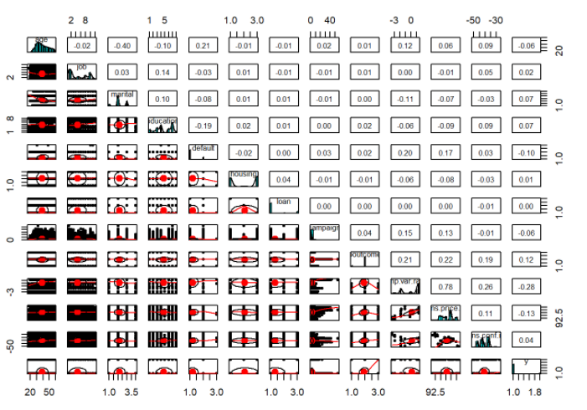
Clean Data /
Variable Reduction
With Correlation Analysis
In the final subset it can bee seen that there is no correlated variables.
Data Subset:
age
job
marital
education
default
housing
loan
campaign
poutcome
emp.var.rate
cons.price.idx
cons.conf.idx
y
Notes:
After dropped correlated variables, final correlation analysis have been done. In the final subset it can bee seen that there is no correlated variables.

Slide 12
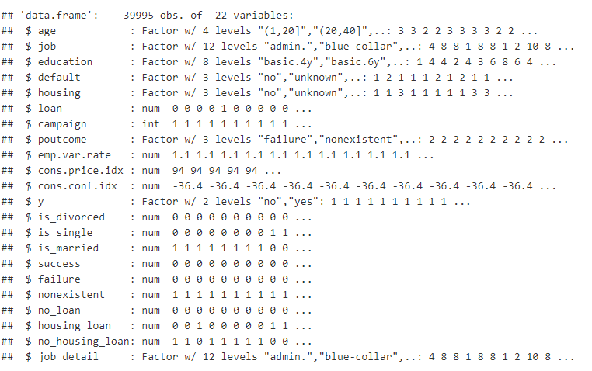
Clean Data /
Data Transformation
To prepare data for model development, basic variable transformation and attribute binning has been done. We convert the categorical variables to binary format. New prepared dataset are given below which is ready for model development.
Notes:
To prepare data for model development, basic variable transformation and attribute binning has been done. We convert the categorical variables to binary format. New prepared dataset are given below which is ready for model development. In this section we also did missing and outlier detection analysis.

Slide 13
Predictive Analysis /
Decision
Tree
Confusion Matrix and Statistics
Reference
Prediction no yes
no 10613 1033
yes 135 217
Accuracy : 0.9027
95% CI : (0.8972, 0.9079)
No Information Rate : 0.8958
P-Value [Acc > NIR] : 0.007032
Kappa : 0.2359
Mcnemar's Test P-Value : < 2.2e-16
Sensitivity : 0.9874
Specificity : 0.1736
Pos Pred Value : 0.9113
Neg Pred Value : 0.6165
Prevalence : 0.8958
Detection Rate : 0.8846
Detection Prevalence : 0.9707
Balanced Accuracy : 0.5805
'Positive' Class : no
Call:
rpart(formula = y ~ ., data = trainset)
n= 27997
CP nsplit rel error xerror xstd
1 0.07779301 0 1.000000 1.000000 0.01752091
2 0.01000000 1 0.922207 0.922207 0.01690159
Variable importance
poutcome success
50 50
Node number 1: 27997 observations, complexity param=0.07779301
predicted class=no expected loss=0.1042255 P(node) =1
class counts: 25079 2918
probabilities: 0.896 0.104
left son=2 (27180 obs) right son=3 (817 obs)
Primary splits:
poutcome splits as LLR, improve=481.2052, (0 missing)
success < 0.5 to the left, improve=481.2052, (0 missing)
emp.var.rate < -0.65 to the right, improve=385.0598, (0 missing)
cons.conf.idx < -35.45 to the left, improve=312.6642, (0 missing)
cons.price.idx < 92.868 to the right, improve=246.0858, (0 missing)
Surrogate splits:
success < 0.5 to the left, agree=1, adj=1, (0 split)
Node number 2: 27180 observations
predicted class=no expected loss=0.08815305 P(node) =0.9708183
class counts: 24784 2396
probabilities: 0.912 0.088
Node number 3: 817 observations
predicted class=yes expected loss=0.3610771 P(node) =0.0291817
class counts: 295 522
probabilities: 0.361 0.639
Notes:
To estimate the target we applied decision tree algorthim. We got 0,90 accuracy value

Slide 14
Predictive Analysis /
Random Forest
MeanDecreaseGini
age 85.33529
job 194.37801
education 234.78915
default 39.33072
housing 47.47558
loan 70.39383
campaign 236.55050
poutcome 177.88338
emp.var.rate 274.68276
cons.price.idx 265.05113
cons.conf.idx 342.26823
is_divorced 34.36353
is_single 48.43210
is_married 50.20447
success 193.44696
failure 33.81417
nonexistent 37.91295
no_loan 0.00000
housing_loan 45.20519
no_housing_loan 45.15141
job_detail 191.82201
Confusion Matrix and Statistics
Reference
Prediction no yes
no 10536 975
yes 212 275
Accuracy : 0.9011
95% CI : (0.8956, 0.9064)
No Information Rate : 0.8958
P-Value [Acc > NIR] : 0.0302
Kappa : 0.2742
Mcnemar's Test P-Value : <2e-16
Sensitivity : 0.9803
Specificity : 0.2200
Pos Pred Value : 0.9153
Neg Pred Value : 0.5647
Prevalence : 0.8958
Detection Rate : 0.8781
Detection Prevalence : 0.9594
Balanced Accuracy : 0.6001
'Positive' Class : no
Notes:
Just to do benchmarking we also applied random forest alogorthm. When we look at the variables cons.conf.idx, cons.price.idx, emp.var.rate are the most important group parameters. Education, campaign and job are the second important variable group. In confusion matrix, the prediction ratio is higher (7%) than decision tree model

Slide 15
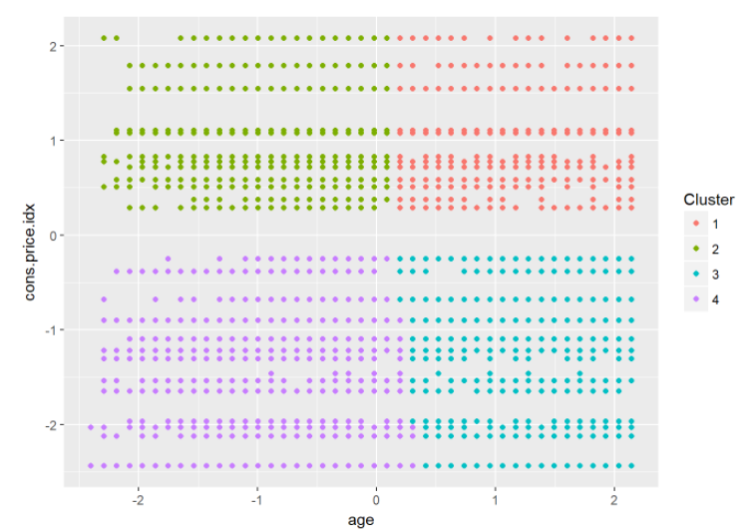
Further Analysis /
K-Means
Clustring
K-means clustering is a type of unsupervised learning. The goal of this algorithm is to find groups in the data, with the number of groups represented by the variable K. The algorithm works iteratively to assign each data point to one of K groups based on the features that are provided. Data points are clustered based on feature similarity.
In this analysis we just used age and consumer price index to cluster segments and we wanted 4 different clusters or customer segments. Analysis can be done for all variables after taking care of transformation.
Notes:
K-means clustering is a type of unsupervised learning. The goal of this algorithm is to find groups in the data, with the number of groups represented by the variable K. The algorithm works iteratively to assign each data point to one of K groups based on the features that are provided. Data points are clustered based on feature similarity.
In this analysis we just used age and consumer price index to cluster segments and we wanted 4 different clusters or customer segments. Analysis can be done for all variables after taking care of transformation.

Slide 16
Results
For the purpose to increase the number of term deposit customers, bank should take the actions below:
Outbound calls are important. The longer outbound duration, customers are become more subscriber.
Consumer price index is the one of the most important parameter. This means pricing is very effective, so the campaign should be price sensitive. They can offer discount or some fee waivers.
Outbound calls are expensive costs for banks. Outbound call target lists should be prepared consistent with job groups which are more appropriate for term deposit.
Analysing and clustering the customer segments are important, so that bank can increase the success rate of campaigns.
Notes:
For the purpose to increase the number of term deposit customers, bank should take the actions below:
Outbound calls are important. The longer outbound duration, customers are become more subscriber.
Consumer price index is the one of the most important parameter. This means pricing is very effective, so the campaign should be price sensitive. They can offer discount or some fee waivers.
Outbound calls are expensive costs for banks. Outbound call target lists should be prepared consistent with job groups which are more appropriate for term deposit.
Analysing and clustering the customer segments are important, so that bank can increase the success rate of campaigns.

