Slide 1


A Brief View of
FPSB Indonesia

Slide 2




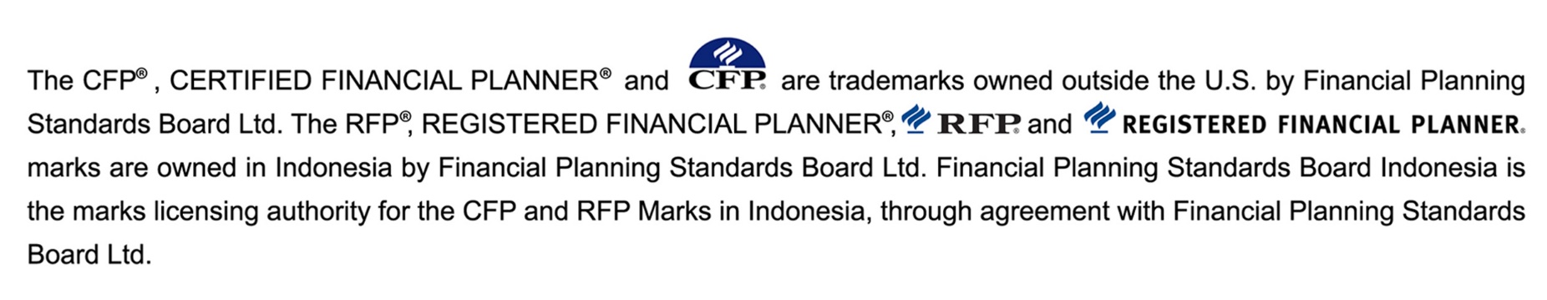

Slide 3
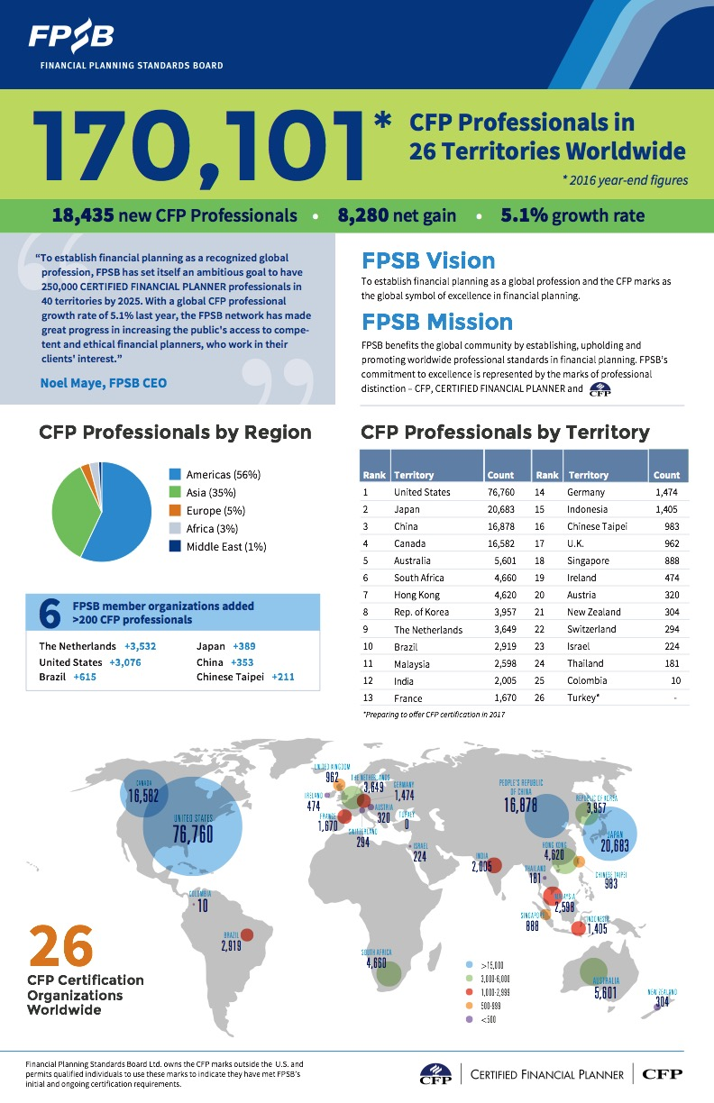
FPSB INDONESIA HAS BEEN CONDUCTING CFP AND RFP CERTIFICATION PROGRAM
SINCE 2006

Slide 4


Slide 6


FPSB Indonesia Foundation is a non profit organization approved by the Ministry of Justice and Human Rights of the Republic of Indonesia on December 20th, 2006 .
The Mission of FPSB Indonesia is to play an active role in enhancing the professional qualifications of financial services through a global financial planning certification.
FPSB Indonesia obtained a license from The National Professional Certification Board as a financial planning certification institution since 2009.
LSP FPSB Indonesia issued Certificate of Proficiency from BNSP.

Slide 7
LSP FPSB Indonesia offers 2 certification programs:
CERTIFIED FINANCIAL PLANNER®; CFP®
REGISTERED FINANCIAL PLANNER®; RFP® a path way
program to CFP Certification
RFP® – Investment: dedicated for investment professionals.
RFP® – Insurance: dedicated for Life insurance agents and bancassurance professionals.

Slide 8












98 FINANCIAL INSTITUTIONS SUPPORT FPSB INDONESIA

Slide 9








CERTIFIED FINANCIAL PLANNER EDUCATION PROVIDERS JAKARTA BANDUNG, MANADO, PALEMBANG, SURABAYA
18 Education Provider
EDUCATION PROVIDERS FPSB Indonesia is the education provider

Slide 10

8912 CERTIFICATES HAVE BEEN ISSUED
About 6832 RFP certificates have been
issued since 2009

Slide 11
THANK YOU
TERIMAKASIH
FPSB Indonesia
Eightyeight@Kasablanca 32nd Floor Unit F
Jalan Casablanca kav. 88 Jakarta.
www.fpsbindonesia.net
www.fpsb.org

