Slide 1

Java Programming Topic: Using Standard Java Package with Applet Programming.
Rashedul Islam
Roll: 200613

Slide 2
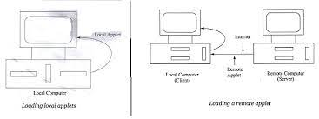
What is Applet Programming?
Applet is a special type of program that is embedded in the webpage to generate the dynamic content. It runs inside the browser and works at client side.

Slide 3
How to applets differ from Applications?
Applets don’t use the main() method for initiating the execution of the code.
Applets can not be run independently .They are run from inside a web page using a special feature known as html tag.
Applets can’t read or write to the file in the local computer.
Applets can’t run any program from the local computer.
Applets are restricted from using libraries from other languages such as c or c++.

Slide 4
Before we try to we=rite applets , we must make sure that java is installed properly and also ensure that either the
Java appletviewer or a Java-enabled browser is available.The steps involved in developing and testing in applet are:
Building an applet code (.Java file)
Creating an executable applet (.class file)
Designing a web page using HTML tags
Preparing <APPLET> tag
Incorporating <APPLET> tag into the web page.
Creating HTML file .
Testing the applet code.
Preparing to write applet code

Slide 5
Born
init()
start()
Running
Idle
stop()
paint()
start()
destroy()
Dead

Slide 6
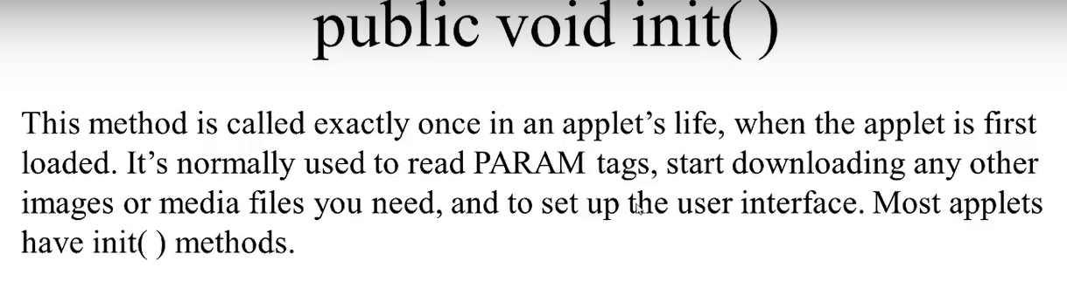
Building an Applet Code

Slide 7
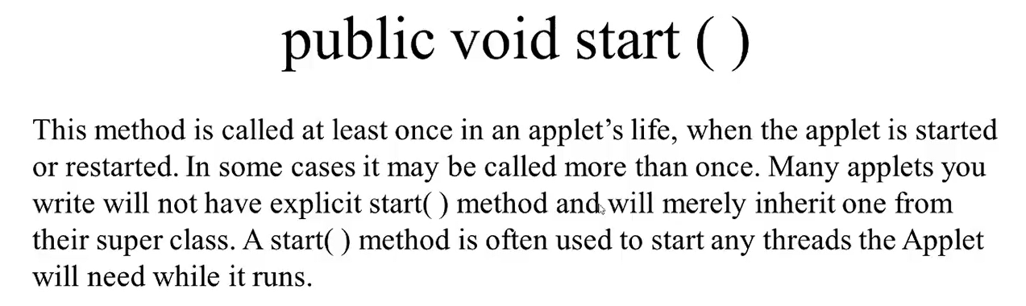
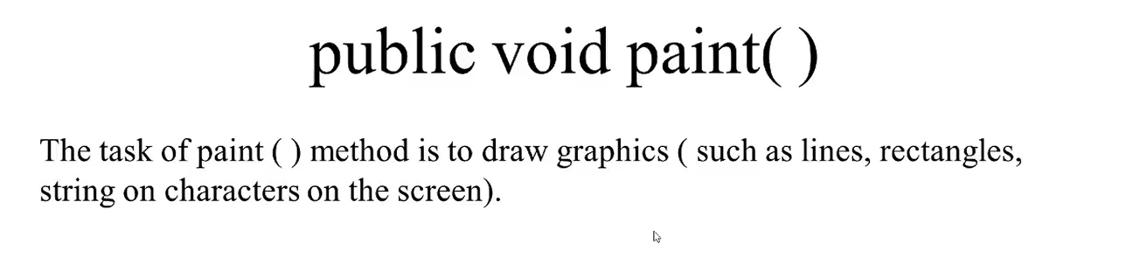

Slide 8
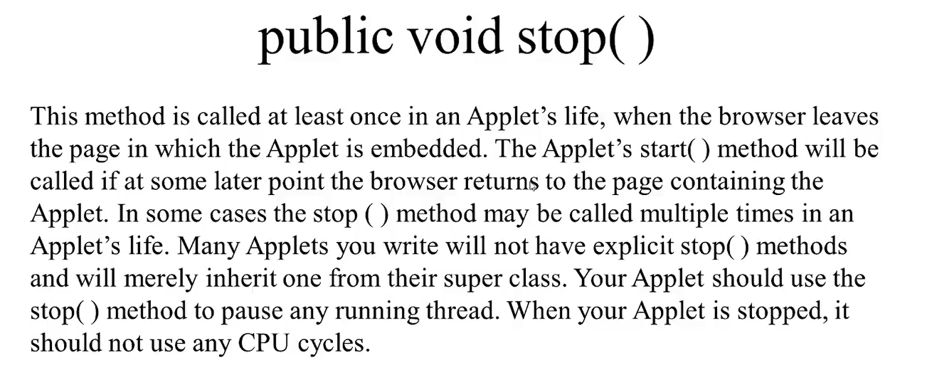
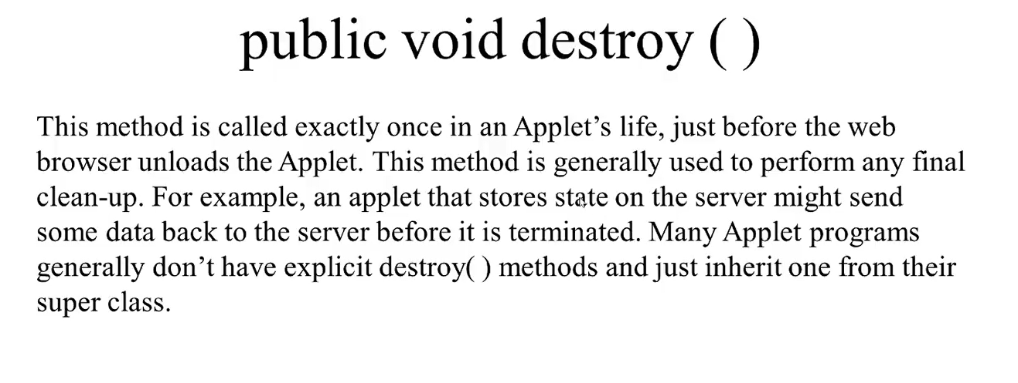

Slide 9
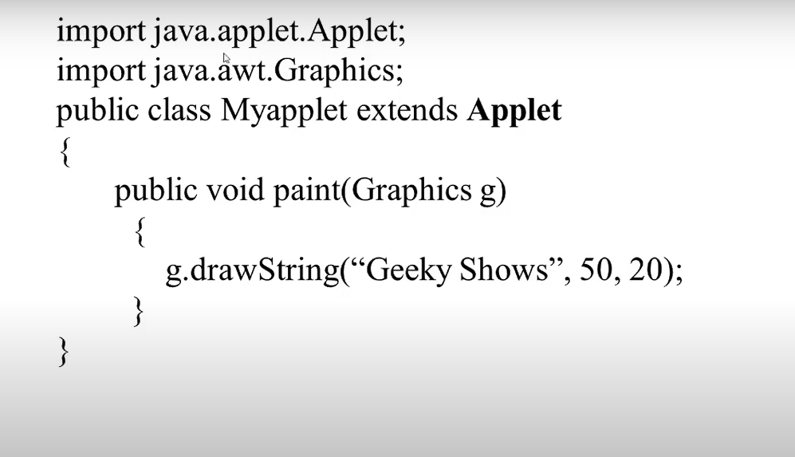
Basic Structure of Java Applets

Slide 10
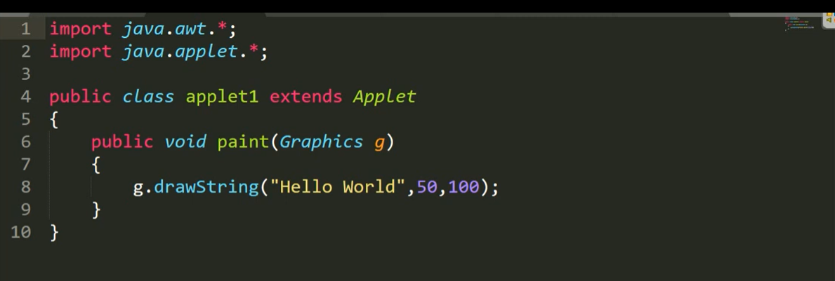
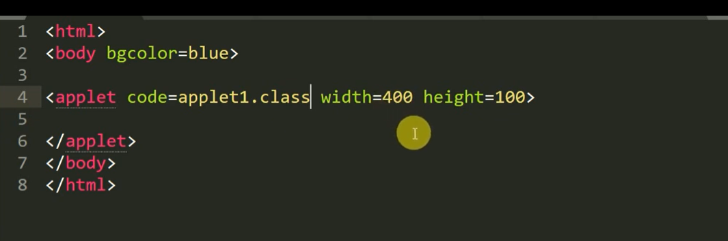

Slide 11
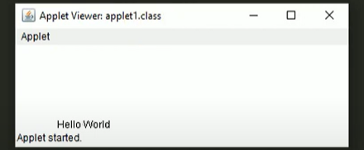

Slide 12
Graphics Programming With Java
One of the most important features of Java is its ability to draw graphics.We can write Java applets that draw lines, figures of different shapes, images,and text in different font and styles.
The Graphics Class
Java’s Graphics class includes methods for drawing many different types of shapes,from simple lines to polygons to text in a variety of fonts.
Written below the Drawing methods of the Graphics class:

Slide 13
Drawing Methods of Graphic Class
clearRect ()
copyArea ()
drawLine ()
drawOval ()
drawPolygon ()
drawRect ()
drawRoundRect ()
drawSting ()
fillOval ()
fillPolygon ()
fillRect()
fillRoundRect ()
getColor ()
getFont ()
setColor ()
setFont ()

Slide 14
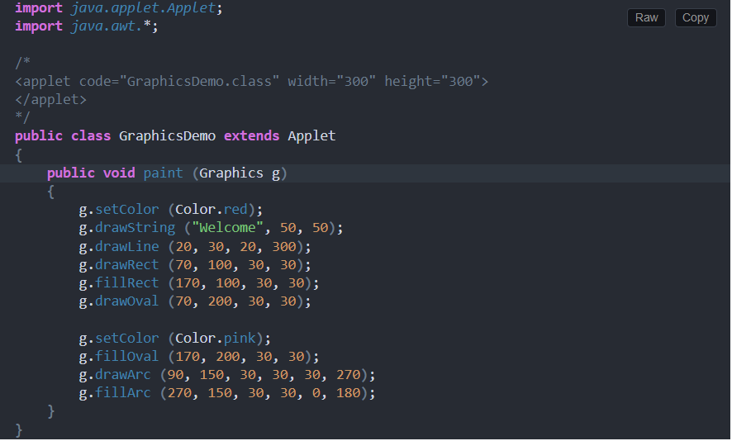
Graphics With Applet Program

Slide 15
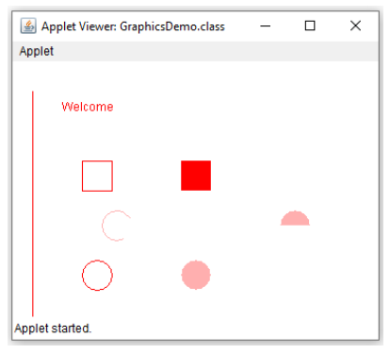

Slide 16
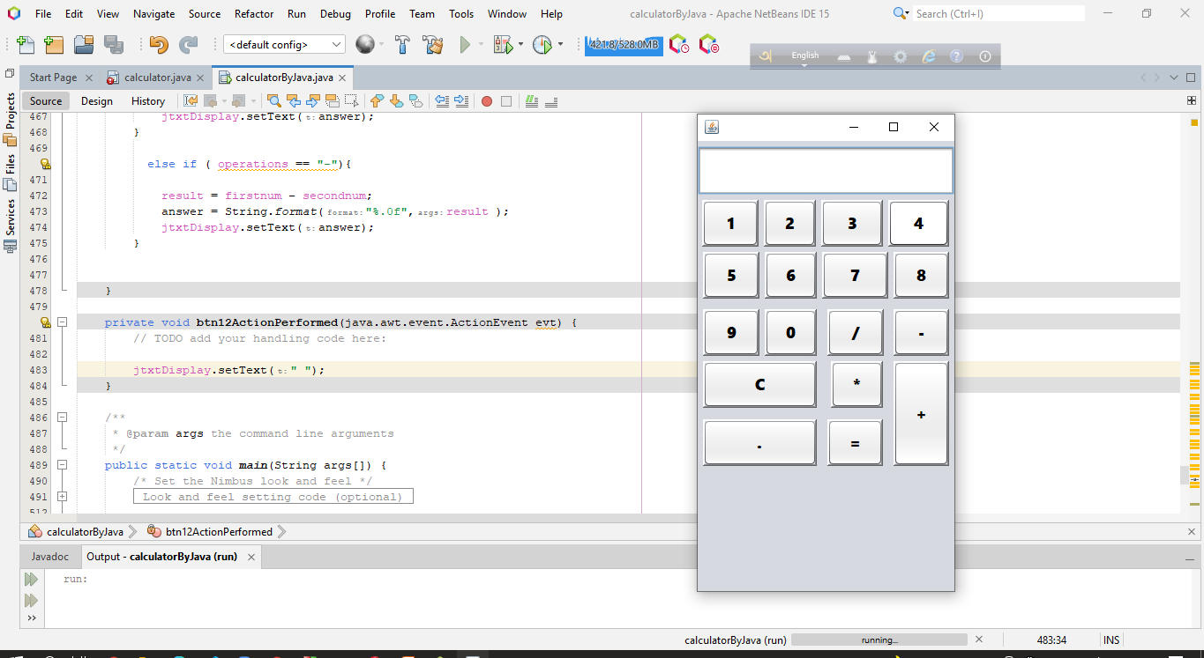
Calculator Making by Applet Program(Project)

Slide 17
Thanks To All

