Slide 1


Course title: Research Methodology Supervised by Ahsan Habib Tareq Associate Professor Dept. of ICT , MBSTU
Ali Ashadullah Arif
IT-18031
4th year 1st semester
Session 2017-18
Dept of ICT
MBSTU
Md Ahadul Haque
IT-18045
4th year 1st semester
Session 2017-18
Dept of ICT
MBSTU

Slide 2
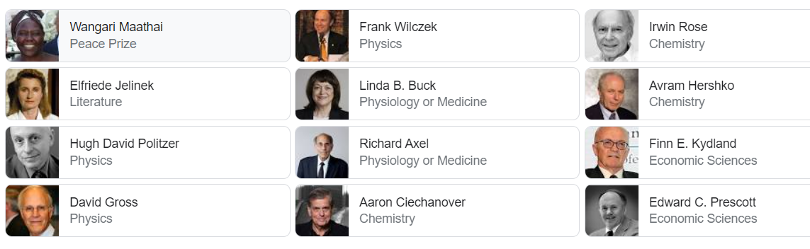
Nobel prize winners list (2004)

Slide 3

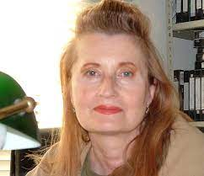
Wangari Maathai Former Member of Parliament of Kenya
Wangari Maathai (1940-2011) was the founder of the Green Belt Movement and Achieved 2004 Nobel Peace Prize.
Elfriede Jelinek
is an Austrian playwright and novelist
She is one of the most decorated authors writing in German today and was awarded the Nobel Prize in Literature in 2004 for her "musical flow of voices and counter-voices in novels.

Slide 4
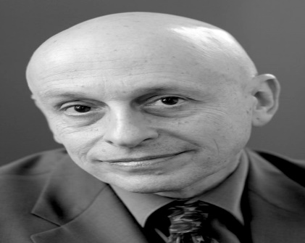
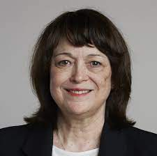
H. David Politzer The Nobel Prize in Physics 2004
Born: 31 August 1949, New York, NY, USA
Affiliation at the time of the award: California Institute of Technology (Caltech), Pasadena, CA, USAPrize motivation: "for the discovery of asymptotic freedom in the theory of the strong interaction."
Linda B. Buck
The Nobel Prize in Physiology or Medicine 2004
Born: 29 January 1947, Seattle, WA, USA
Affiliation at the time of the award: Fred Hutchinson Cancer Research Center, Seattle, WA, USAPrize motivation: "for their discoveries of odorant receptors and the organization of the olfactory system."

Slide 5
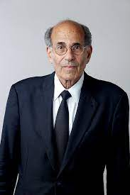
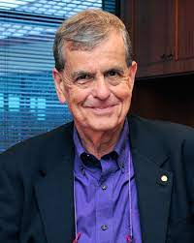
Richard Axel The Nobel Prize in Physiology 2004
Codirector Richard Axel won a Nobel Prize in 2004 for his groundbreaking work in decoding olfaction, our sense of smell. Specifically, Dr. Axel identified more than 1,000 special receptors in the nose that transmit olfactory information to the brain.
Aaron Ciechanover
The Nobel Prize in Chemistry 2004
Born: 1 October 1947, Haifa, British Protectorate of Palestine (now Israel)
Affiliation at the time of the award: Technion - Israel Institute of Technology, Haifa, Israel
Prize motivation: "for the discovery of ubiquitin-mediated protein degradation."

Slide 6
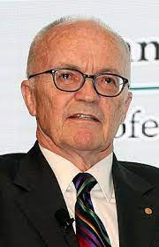
Finn E. Kydland The Nobel Prize in Economic Sciences 2004
Born: 1 December 1943, Gjesdal, Norway
Affiliation at the time of the award: Carnegie Mellon University, Pittsburgh, PA, USA, University of California, Santa Barbara, CA, USA
Prize motivation: "for their contributions to dynamic macroeconomics: the time consistency of economic policy and the driving forces behind business cycles."
Contribution: Showed that economic policies are often plagued by problems of time inconsistency. Demonstrated that society could gain from prior commitment to economic policy. Introduced new ideas about economic policy design and the driving forces behind business cycles.

