Slide 2
Windows Server Containers: What, Why, and How
Mathew John & Taylor Brown (@taylorb_msft)
Program Managers for Containers and Hyper-V
Microsoft Operating System Group
2-704

Slide 3
Here we go….
Know
Gain
Learn
enough about containers to be dangerous
insights on where you would use containers
what Microsoft
is doing with containers

Slide 4
Datacenter inflection points
Containers - DevOps
Services – IaaS, PaaS, SaaS
Infrastructure hosting – early cloud
Machine Virtualization
Physical Machines

Slide 5
Why are people doing this?
Well, money, mostly, but if you ignore that part…
Increased portability. We have been consistently standardizing on the layer before it to build tools, systems, ecosystems of systems….

Slide 6



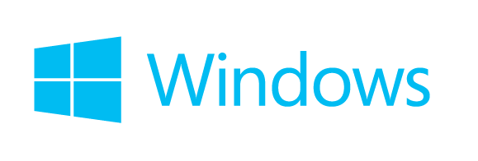
Container Ecosystem
Container Run-Time
Container Images
Image Repository
Linux

Slide 7

Demo

Slide 8



Development Process Using Containers
Central Repository
Central Repository
Local Repository
Application
Framework
Application
Framework
Application
Framework

Slide 9
Development Process Using Containers
Central Repository
Central Repository
Local Repository
Developers can easily identify application frameworks and pull them locally from central repositories
Application
Framework
Application
Framework
Application
Framework
Application
Framework

Slide 10
Development Process Using Containers
Central Repository
Central Repository
Local Repository
Developers can easily identify application frameworks and pull them locally from central repositories
Application
Framework
Application
Framework
Application
Framework
Application
Framework
Required dependencies are automatically identified and pulled locally

Slide 11

Development Process Using Containers
using System;
class Program
{
static void Main()
{
}
}
Central Repository
Central Repository
Local Repository
Developers use the same programming languages and environments they are accustomed to
Application
Framework
Application
Framework
Application
Framework
Application
Framework

Slide 12

Development Process Using Containers
using System;
class Program
{
static void Main()
{
}
}
Central Repository
Central Repository
Local Repository
Application
Framework
Application
Framework
Application
Framework
Application
Framework
Applications are compiled and assembled in the same way developers are accustomed to

Slide 13

Development Process Using Containers
using System;
class Program
{
static void Main()
{
}
}
Central Repository
Central Repository
Local Repository
Application
Framework
Application
Framework
A new container images is built containing the application written by the developer
Application
Framework
Application
Framework

Slide 14
Development Process Using Containers
using System;
class Program
{
static void Main()
{
}
}
Central Repository
Central Repository
Local Repository
Application
Framework
The new application container image can now be pushed to a central repository
Application
Framework
Application
Framework
Application
Framework

Slide 15
Development Process Using Containers
using System;
class Program
{
static void Main()
{
}
}
Central Repository
Central Repository
Local Repository
Application
Framework
The new application container image can now be pushed to a central repository
Application
Framework
Application
Framework
Application
Framework

Slide 16
Development Process Using Containers
Central Repository
Central Repository
Application
Framework
Application
Framework
Application
Framework

Slide 17

Development Process Using Containers
Used for unit testing
Central Repository
Share with other developers
Central Repository
Application
Framework
Application
Framework
Application
Framework

Slide 18

Development Process Using Containers
Used for unit testing
Central Repository
Share with other developers
Central Repository
Application
Framework
Application
Framework
Staged for integration or QA
Application
Framework

Slide 19






Dev/Ops Process with Containers
Developers update, iterate, and deploy updated containers
2
3
Operations collaborates with developers to provide app metrics and insights
Developers build and test apps in containers, using development environment i.e. Visual Studio
Operations automates deployment and monitors deployed apps from central repository
1
Central Repository
2
Containers pushed to central repository

Slide 20
Demo

Slide 21
Containers Offer
Fast Iteration
Resource Controls
Rapid Deployment
Defined State Separation
Immutability

Slide 22

Making Them Ideal For
Distributed Compute
Database
Web
$$f\left(x\right)$$
Scale Out
Tasks

Slide 23
Container Operating System Environments
Nano Server
Server Core
Highly Optimized
Highly Compatible
Born in the cloud applications
Traditional Applications

Slide 24
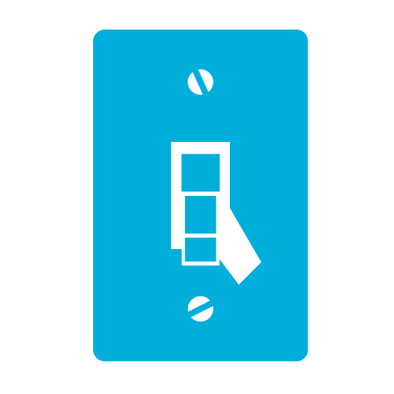





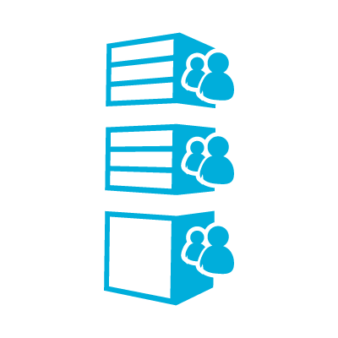

Microsoft’s Container Run-Times
Windows Server Container
EASY TO IMPLEMENT
MORE
MOBILITY
HIGHLY AUTOMATED
SECURE
SCALABLE AND ELASTIC
EFFICIENT
Hyper-V Container
SHARED HOSTING
EASY TO IMPLEMENT
MORE
MOBILITY
HIGHLY AUTOMATED
SECURE
SCALABLE AND ELASTIC
EFFICIENT
MULTI-TENANCY

Slide 25
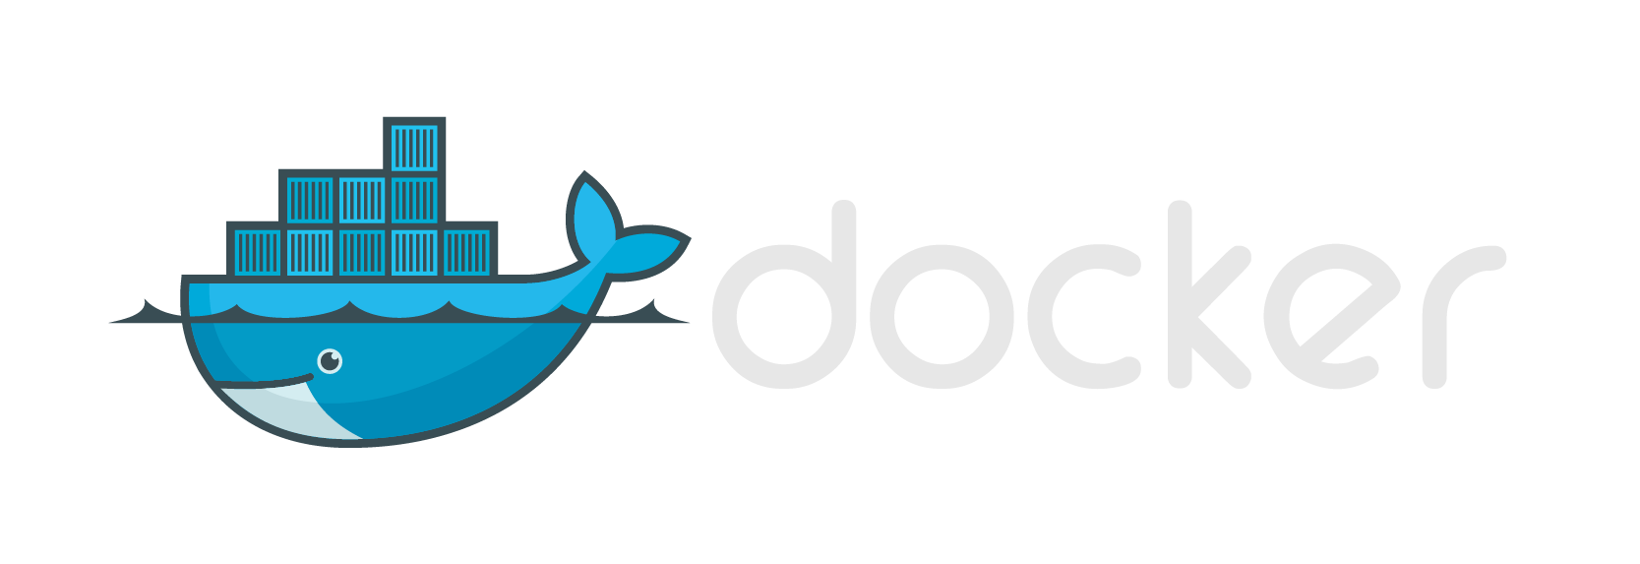


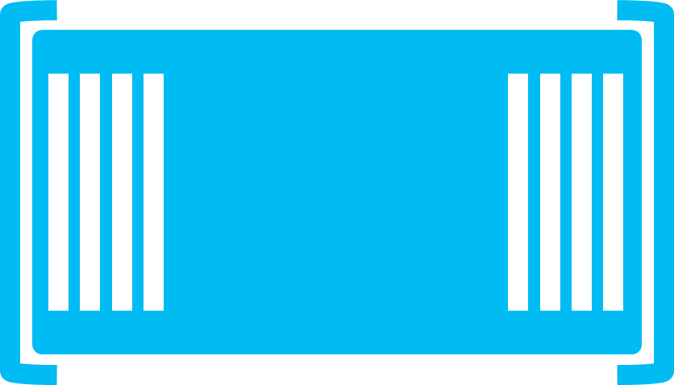

Modern App Development, Flexible Isolation
Windows Container Images
Container Run-Times
Container Management
Docker
Hyper-V Container
PowerShell
Application
Framework
Application
Framework
Others
Windows Server Container
Write once, deploy anywhere

Slide 26




Deploying Containers
Hyper-V
Container(s)
Windows Server
Container(s)
Requires Hyper-V Hypervisor
Hyper-V
Virtual Machine(s)
Physical Machine

Slide 27
Deploying Containers
Hyper-V
Container(s)
Windows Server
Container(s)
Requires Hyper-V Hypervisor
Virtual Machines
Physical Machine

Slide 28




The right
tools for you.
Container Management
PowerShell
Docker
Others
Container Technologies
Development Environments
Linux
Microsoft Cloud
Azure
On Premises
Service Provider
Others…

Slide 29
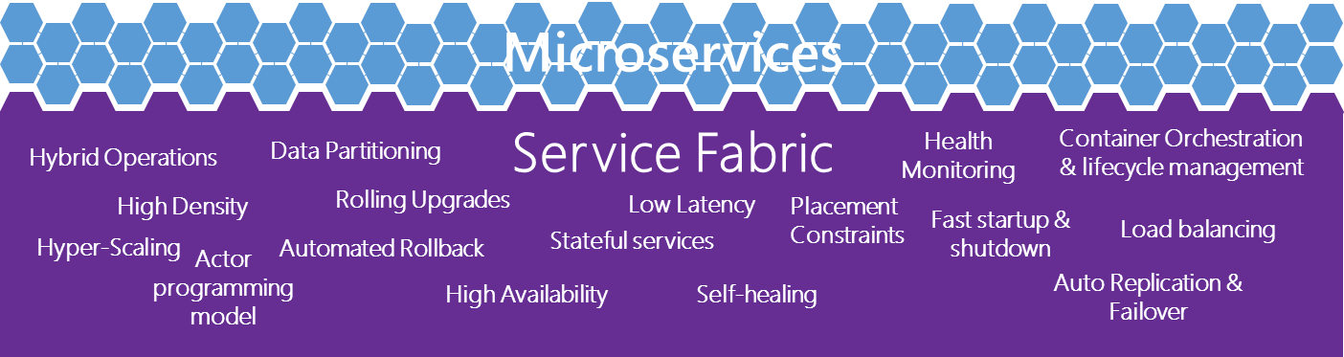
The right
tools for you.
Virtual Machines
Linux
Development Frameworks
and Languages
Service Fabric
Go
Perl
PHP
Phython
Node
JavaScript
.Net
C++
Ruby
Win32
Java
Microsoft Cloud
Container Technologies
Azure
On Premises
Service Provider
Linux

Slide 30
In conclusion
Know
Gain
Learn
enough about containers to be dangerous
insights on where you would use containers
what Microsoft
is doing with containers

Slide 31
What’s Next?
Preview of Windows Server Containers – this summer.
Preview of Hyper-V Containers – planned for this year
How can you stay up to date?
Follow taylor on Twitter @taylorb_msft
Windows Container’s site goes live on Monday
https://msdn.microsoft.com/virtualization/windowscontainers
http://aka.ms/windowscontainers

