Slide 1
Designing and Deploying Internet Scale Services
James Hamilton, https://www.usenix.org/events/lisa07/tech/full_papers/hamilton/hamilton.pdf
Part 1: Design for Scale
Part 2: Design for Availability
Partition the service
Design for Failure
Do not trust underlying components
Decouple components
Avoid single points of failure
Support geo-distribution
Instrument everything
Implement inter-service monitoring and alerting
Instrument for production testing
Configurable logging
Optimize for density

Slide 2

Build for Scale
Building Big – the scale challenge
Partitioning your application
Caching your data

Slide 3
What do we mean by large scale?
Millions of users
Hundreds of thousands of operations per second
Thousands of cores
Hundreds of databases

Slide 4

http://www.microsoft.com/en-us/news/features/2012/jun12/06-06Pottermore.aspx

Slide 5
1000
cores
500
databases
Pottermore
1B
page views
110Mdaily peak pvs

Slide 6
Decomposing Typical Social Application Workloads
Content Delivery
Site-wide content, transient state (session state)
Content Exploration
Per-user content view, per-user stateful progress
Social Graph and Content
Per-user content view (comments, likes, etc), global reach (any user can reach any other user). Loosely consistent / asynchronous updates to N consumers.
Interactive Gaming
N-user content view (game actions, session, etc), global reach (any user can reach any other user). Interactive state updates shared amongst N players.

Slide 7
The Path to Scale
Capacity
Partition application, add additional scale-out capacity to meet demand
Optimize
Improve application density through optimum resource usage
Shift
Trade durability, queryability, and consistency for throughput, latency

Slide 8
Build for Scale – Partitioning and Scale Out
Azure architecture is based on scale-out; composing multiple scale units to build large systems
Azure Compute
(Web, Worker, IaaS)
Azure Storage, Files, DocDb
Azure SQL Database

Slide 9
Evaluating Scale
Aspect | Partitioning | Capacity
Web role | Low state Automatic (via load balancer) Round-robin | Add more instances (easy)
SQL Database | High state Manual (via app code) Choose partitioning function | Add more databases

Slide 10
Horizontal Partitioning
First Name | Last Name | Email | Thumbnail | Photo
David | Alexander | davida@contoso.com | 3kb | 3MB
Jarred | Carlson | jaredc@contosco.com | 3kb | 3MB
Sue | Charles | suec@contosco.com | 3kb | 3MB
Simon | Mitchel | simonm@contoso.com | 3kb | 3MB
Richard | Zeng | richard@contosco.com | 3kb | 3MB
A
C
M
Z

Slide 11
Vertical Partitioning
First Name | Last Name | Email | Thumbnail | Photo
David | Alexander | davida@contoso.com | 3kb | 3MB
Jarred | Carlson | jaredc@contosco.com | 3kb | 3MB
Sue | Charles | suec@contosco.com | 3kb | 3MB
Simon | Mitchel | simonm@contoso.com | 3kb | 3MB
Richard | Zeng | richard@contosco.com | 3kb | 3MB
SQL Azure
Tables
BLOBs

Slide 12
Hybrid Partitioning
First Name | Last Name | Email | Thumbnail | Photo
David | Alexander | davida@contoso.com | 3kb | 3MB
Jarred | Carlson | jaredc@contosco.com | 3kb | 3MB
Sue | Charles | suec@contosco.com | 3kb | 3MB
Simon | Mitchel | simonm@contoso.com | 3kb | 3MB
Richard | Zeng | richard@contosco.com | 3kb | 3MB
A-L
M-Z

Slide 13
Understanding Partitioning for Scale
1
Select the partition key
2
Convert partition key to a partition value (optional)
3
Map partition value to a logical partition
Map logical partition to physical resource
4
Last Name
LastName.SubString(0, 2) ->
“Si”
ShardMap[“Si”] -> S
DbMap[“S”] -> “Db0123S”

Slide 14
Partitioning the Database (Range Based)
1
The user (user ID) is a natural partitioning key; all workloads are user-centric
2
Use a non-cryptographic hash to convert the user ID to an integer value
3
Map a range of integers to a logical “shard”
Map logical “shard” to physical resource (database)
4
“MaSimms”
639837447
ShardMap.FirstOrDefault(e =>
e.IsInRange(639837447))
DbMap[Shard].ConnectionString

Slide 15
Partitioning Algorithms
Range Based
Split and merge the partition range into segments
Logical Buckets
Assign data to a logical bucket, then map to a physical resource
Lookup Assignment
Lookup table to map to physical resource segment

Slide 16
Range Based Partitioning
JohnSmith
Hash
-789794523
ShardMap
Range based partitioning
Hash (MurMur3) against Upper()
5 shards, evenly distributed
Shard: 1
-1288490190:-429496730
Resource Map
UserData_001

Slide 17
Logical Bucket Based Partitioning
JohnSmith
Hash
-789794523
ShardMap (32 buckets)
Range based partitioning
Hash (MurMur3) against Upper()
5 shards, evenly distributed
Shard: 27
Resource Map
Logical buckets mapped
to physical databases
UserData_001

Slide 18
Lookup Bucket Based Partitioning
JohnSmith
Hash
-789794523
ShardMap
Lookup
Lookup records map each partition value to a logical/physical resource
Range based partitioning
Hash (MurMur3) against Upper()
5 shards, evenly distributed
Shard: 2
Resource Map
UserData_001

Slide 19
Distributed Caching

Slide 20
More capacity – now what?
Not practical to query durable store for every request
Throughput and Latency
Efficiency\COGs
Not all data needs to be immediately consistent.

Slide 21
Build for Scale – Shift to Distributed Cache
Distributed cache engines can provide high-throughput low-latency access to commonly accessed application data
Semantic: Key -> byte[]
In-memory data (not written to disk)
Scale-out architecture (client-side partitioning, explicit connections to physical resource)
Examples: memcached, Azure Caching

Slide 22
8
datacentres
Press Association
2B
Peak requests a day
50K
Peak Request per second

Slide 23
Caching Resource Data
Publishing Information Stream
One source, many subscribers
Worker role collects data, publishes to cache
Web instances feed from cache, publish to users

Slide 24
Memcached on Windows Azure
Deployment Model | Provisioned as custom code in worker role
Scale Approach | Add\Remove role instances Multiple Worker Roles
Partitioning Approach | Client Driven – some APIs have a choice of hashing algorithms
Client APIs | Many 3rd party APIs
Client Side Cache | No
Manageability | Managed as custom role Requires custom code to expose server stats
High Availabilty | No
Provisioned by running memcached within a worker role in your service
Requires custom set-up and management code
Good performance and scale*

Slide 25
Windows Azure Cache
Deployment Model | Provisioned as part of your service via SDK\Tools Distinct role or part of existing role
Scale Approach | Add\Remove Instances Multiple Roles
Partitioning Approach | Server driven
Client APIs | Microsoft provided .Net API Memcached interoperability
Client Side Cache | Yes – can work with memcached clients
Manageability | Managed as custom role Performance counters available
High Availability | Windows Azure aware High Availability options available
General Availability as part of the Windows Azure 1.8 SDK
Cache is deployed into your service as a worker role
Good Performance and Scale

Slide 26
High Availability for Windows Azure Cache
What happens when rolling out new application version, Guest OS or a Host OS upgrade?
Data moved to available nodes by upgrade domain
How does the cache behave if we add or remove instances?
Adding – ring is rebalanced data may be moved
Deleting – data is NOT moved – be careful
What about node failure
Depends on configuration

Slide 27
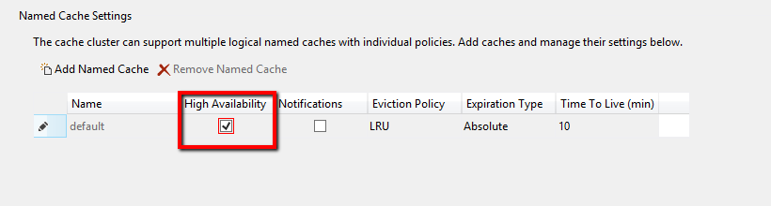
Dealing with Node Failure
Cache can be protected from node failure by keeping a secondary copy
Strong consistency model – overhead on writing

Slide 28
Cache Data Population and Refresh
On Demand
Cache Aside – client pulls data from source and caches on cache miss
Data Push
Background tasks (e.g. worker roles ) populate cache with data on a schedule
Data Pull
Async refresh triggered by client on detection of stale data – requires careful design

Slide 29
Recap and Resources
Building big:
The scale challenge
Partition your application
Optimize state management (cache)
Resources:
Best Practices for the Design of Large-Scale Services on Windows Azure Cloud Services
TODO: failsafe doc link

Slide 30
Agenda
Building Big – the availability challenge
Everything will Fail –design for failure
Get Insight – instrument everything

Slide 31
Designing and Deploying Internet Scale Services
James Hamilton, https://www.usenix.org/events/lisa07/tech/full_papers/hamilton/hamilton.pdf
Part 1: Design for Scale
Part 2: Design for Availability
Partition the service
Support geo-distribution
Design for Failure
Do not trust underlying components
Decouple components
Avoid single points of failure
Instrument everything
Implement inter-service monitoring and alerting
Instrument for production testing
Configurable logging
Optimize for density

Slide 32
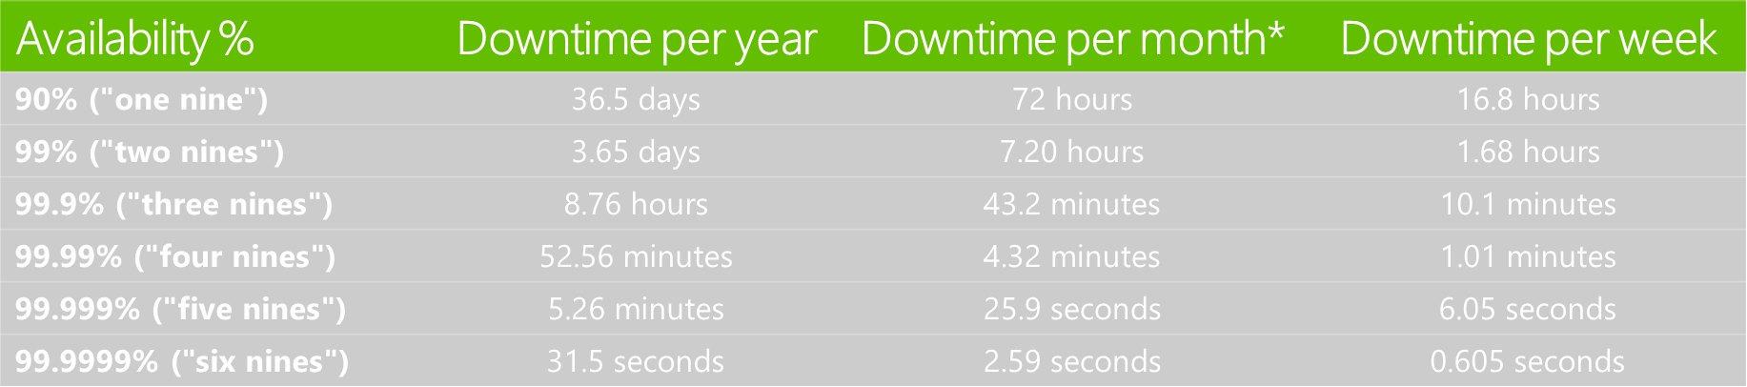
What are the 9’s?
Study Windows Azure Platform SLAs:
Compute External Connectivity: 99.95% (2 or more instances)
Compute Instance Availability: 99.9% (2 or more instances)
Storage Availability: 99.9%
SQL Azure Availability: 99.9%

Slide 33
The Hard Reality of the 9’s
Contoso API
Duwamish API
Fabrikam API
TailSpin API
Northwind API
99.99%
SLA
99.99%
SLA
99.99%
SLA
99.99%
SLA
99.99%
SLA
Composite
Composite
SLA =
99.99%
SLA
99.95%
SLA
*

Slide 34
Design for Failure
Given enough time and pressure, everything fails
How will your application behave?
Gracefully handle failure modes, continue to deliver value
Not so gracefully …
Fault types:
Transient. Temporary service interruptions, self-healing
Enduring. Require intervention.

Slide 35
Failure Scope
Region
Regions may become unavailable
Connectivity Issues, acts of nature
Service
Entire Services May Fail
Service dependencies (internal and external)
Node
Individual Nodes May Fail
Connectivity Issues (transient failures), hardware failures, configuration and code errors

Slide 36
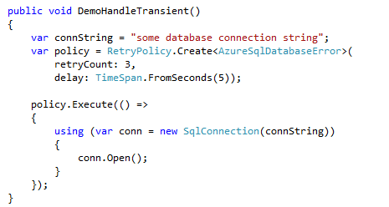
Node Failures
Use fault-handling frameworks that recognize transient errors
Appropriate retry and backoff policies

Slide 37
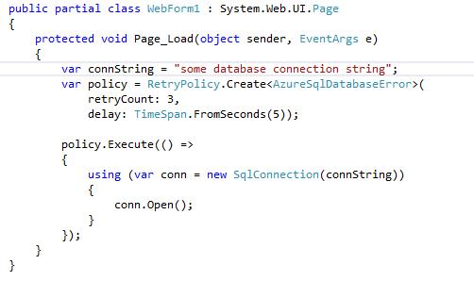
Don’t do this – why?

Slide 38
Sample Retry Policies
Platform | Context | Sample Target e2e latency max | “Fast First” | Retry Count | Delay | Backoff
SQL Database | Synchronous (e.g. render web page) | 200 ms | Yes | 3 | 50 ms | Linear
 | Asynchronous (e.g. process queue item) | 60 seconds | No | 4 | 5 s | Exponential
Azure Cache | Synchronous (e.g. render web page) | 100 ms | Yes | 3 | 10 ms | Linear
 | Asynchronous (e.g. process queue item) | 500 ms | Yes | 3 | 100 ms | Exponential

Slide 39
Decoupling Components
At some point, your request is blocking the line
Fail gracefully, and get out of the queue!
Too much retry, too much trust of downstream service

Slide 40
Decoupling Components
Leverage asynchronous I/O
Beware – not all apparently async calls are “purely” async
Ensure that all external service calls are bounded
Bound the overall call latency (including retries); beware of thread pool pressure
Beware of convoy effects on failure recovery
Trying too hard to catch up can flood newly recovered services

Slide 41
Service Level Failures
Entire Services will have outages
SQL Azure ,Windows Azure Storage – SLA < 100%
External services may be unavailable or unreachable
Application needs to workaround these
Return fail code to user (please try again later)
Queue and try later (we’ve received your order…)

Slide 42
Region Level Failure
Regional failure will occur
Load needs to be spread over multiple regions
Route around failures

Slide 43
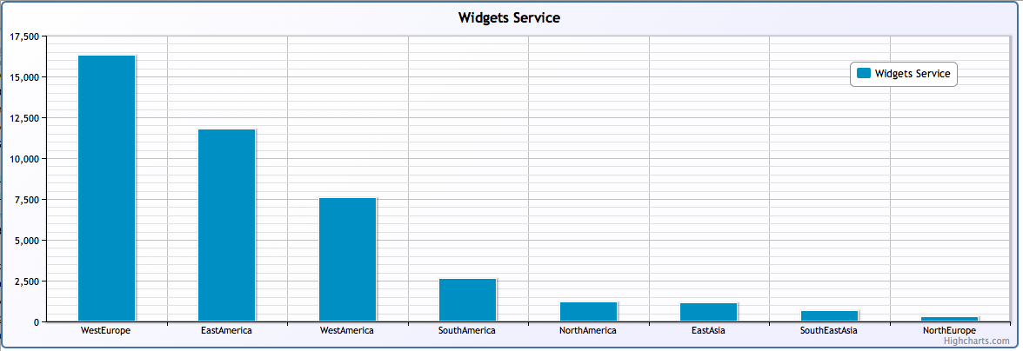
Example Distribution with Traffic Manager
Global load does not necessarily give uniform distribution

Slide 44
Information publishing
Hosted service(s) per data centre
Each service is autonomous –services independently receive or pull data from source
Azure traffic manager can direct traffic to “nearest” service
Use probing to determine service health*

Slide 45
Service Insight
Deep and detailed data needed for management, monitoring, alerting and failure diagnosis
Capture, transport, storage and analysis of this data requires careful design

Slide 46
Characterizing Insight
Inform or Act
How quickly should I react to new insight?
Automated response – real-time
Month over month trending – not so real time ☺
Type of Question
Do I know the question, or am I exploring?
Semantic of insight
KPI (window, pivot, summarize, rank), statistical, time series
Momentum and Window
How much data is required to gain insight?
Detect spike in IIS application queue (seconds/minutes)
Understand week over week user growth (months)
Partitioning / Span of Signal
How much of the source signal do I need for insight?
Local computation (aggregate local partitions)
Global computation (unique users)

Slide 47
Build and Buy (or rent)
No “one size fits all” for all perspectives at scale
Near real-time monitoring & alerting, deep diagnostics, long term trending
Mix of platform components and services
Windows Azure Diagnostics, application logging, Azure portal, 3rd party services

Slide 48
Windows Azure Diagnostics (WAD)
Azure platform service (agent) for collection and distribution of telemetry
Standard structured storage formats (perf counters, events)
Code or XML driven configuration
Partially dynamic (post updated file to blob store)

Slide 49

Windows Azure Diagnostics (WAD)
Window Azure Role Instance
Window Azure Storage Account
Diagnostic Monitor Configuration
Azure Diagnostics Monitor
Table Storage
Windows Events
Windows Events
WAD Windows Events Logs Table
Perf Counters
Perf Counters
WAD Performance Counters Table
User Application
System Diagnostics
Diag Events
WAD Logs Table
Blob Storage
IIS
IIS Log Files
Wad-iis-log files
Failed Logs
Wad-iis-failed log files
Windows
Crash Dumps
Wad-crash-dumps

Slide 50
Understanding Azure Table Store
Azure table storage is the target for performance counter and application log data
General maximum throughput is 1000 entities / partition / table
Performance Counters:
Uses part of timestamp as partition key (limits number of concurrent entity writes)
Each partition key is 60 seconds wide, and are written asynchronously in bulk
The more entities in a partition (i.e. the number of performance counter entries * the number of role instances) the slower the queries
Impact: to maintain acceptable read performance in large scale sites may need to
Increase performance counter collection period (1 minute -> 5 minutes)
Decrease the number of log records written into the activity table (by increasing the filtering level – WARN or ERROR, no INFO)

Slide 51
Managing the Deluge

Slide 52
Extending the Experience
Add high-bandwidth (chunky) logging and telemetry channels for verbose data logging
Capture tracing via core System.Diagnostics (or log4net, NLog, etc) with:
WARN/ERROR -> Table storage
VERBOSE/INFO -> Blob storage
Run-time configurable logging channels to enable selective verbose logging to table (i.e. just log database information)
Leverage the features of the core Diagnostic Monitor
Use custom directory monitoring to copy files to blob storage

