Slide 2
Thinking in Containers: Using Docker to //build/ on Azure
2-683
Tom Hauburger
Senior Program Manager, Azure Linux Compute
@thauburger

Slide 3
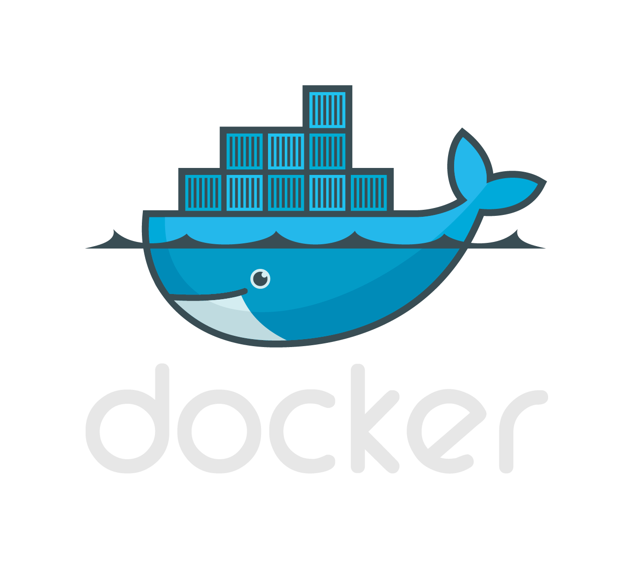
Today’s Session
10 min
Docker & the container promise
40 min
Let’s //build/ something
Wrapping Up
Code & Q+A

Slide 4
Part 1 Docker & the container promise

Slide 5
For developers, dev-ops has always been a “whale” of a problem.

Slide 6
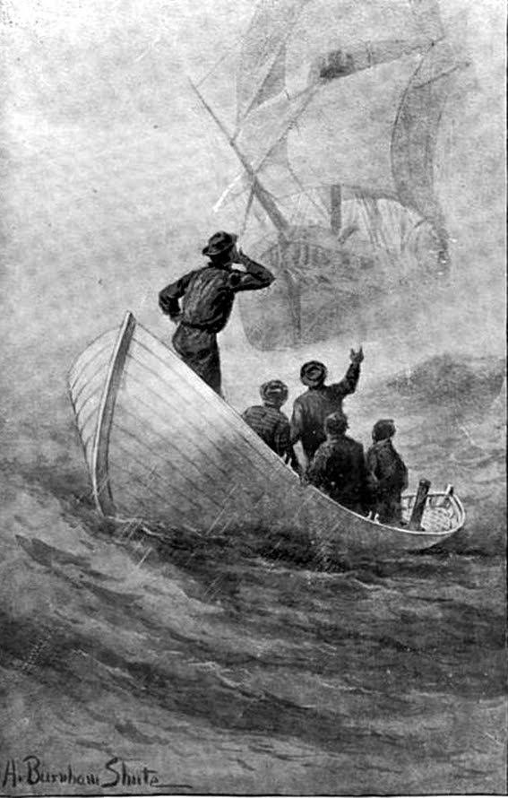
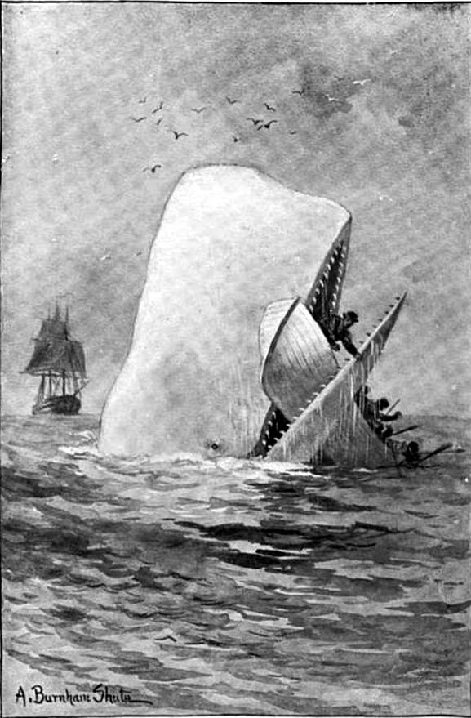
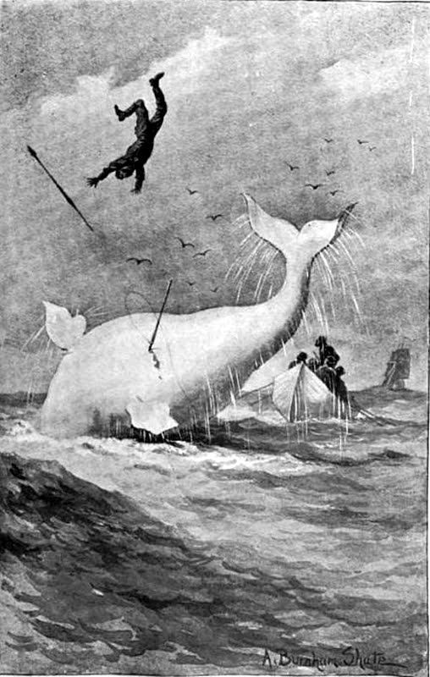
Credit: Moby Dick, Public Domain

Slide 7

Credit: Yiying Lu, http://www.whatisfailwhale.info

Slide 8
In production, VMs blow up. Networks go down. Builds break.

Slide 9
But that’s ok. As developers, we can build robust systems without a dev-ops degree.

Slide 10
Enter the newest whale on the block...

Slide 12
Docker has exploded over the last two years as as an enabler of micro-service architecture.

Slide 13
Docker let us build better applications by thinking in smaller parts.

Slide 14
The old thinking: an application is a big, single unit.

Slide 15
Virtual Machine
Start with a VM.

Slide 16
Application
Stuff our application into a single, bloated image.

Slide 17
Application
Everything’s great...

Slide 18
Application
Until the system goes down or traffic goes up.

Slide 19
Two options: scale up, or scale out

Slide 20
Two options: scale up, or scale out

Slide 21
3x Resources, (N)x Dev-ops Complexity
Application
Application
Application
Scale out

Slide 22
3x Resources, (N)x Dev-ops Complexity
Web
API
Web
API
Web
API
Scale out

Slide 23
3x Resources, (N)x Dev-ops Complexity
Web
API
API
API
What if I only need to scale parts of my app?

Slide 25
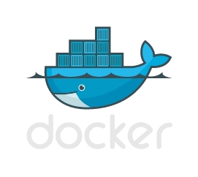
Docker Images
Web
API
1.

Slide 26
Docker Images
Create Containers
2.
Web
API
1.

Slide 27
Docker Images
Create Containers
Deploy to VMs
2.
3.
Web
API
1.

Slide 28
Containers are like light-weight VMs. Small footprint, fast boot, shared kernel.

Slide 29
Containerized apps run anywhere containers run: today, Linux. Tomorrow, Windows.

Slide 30
Images are “frozen” environments. We use images to create containers.

Slide 31
Lots of images available on Docker Hub. You can make your own, too.

Slide 32
The container promise: fast, portable and more resilient apps. Scale through components.

Slide 33
Part 2 Let’s //build/ something

Slide 34
Who’s heard of Azure News?

Slide 35
[Screen shot]

Slide 36
We’ll //build/ the “new” page of Hacker News.

Slide 37
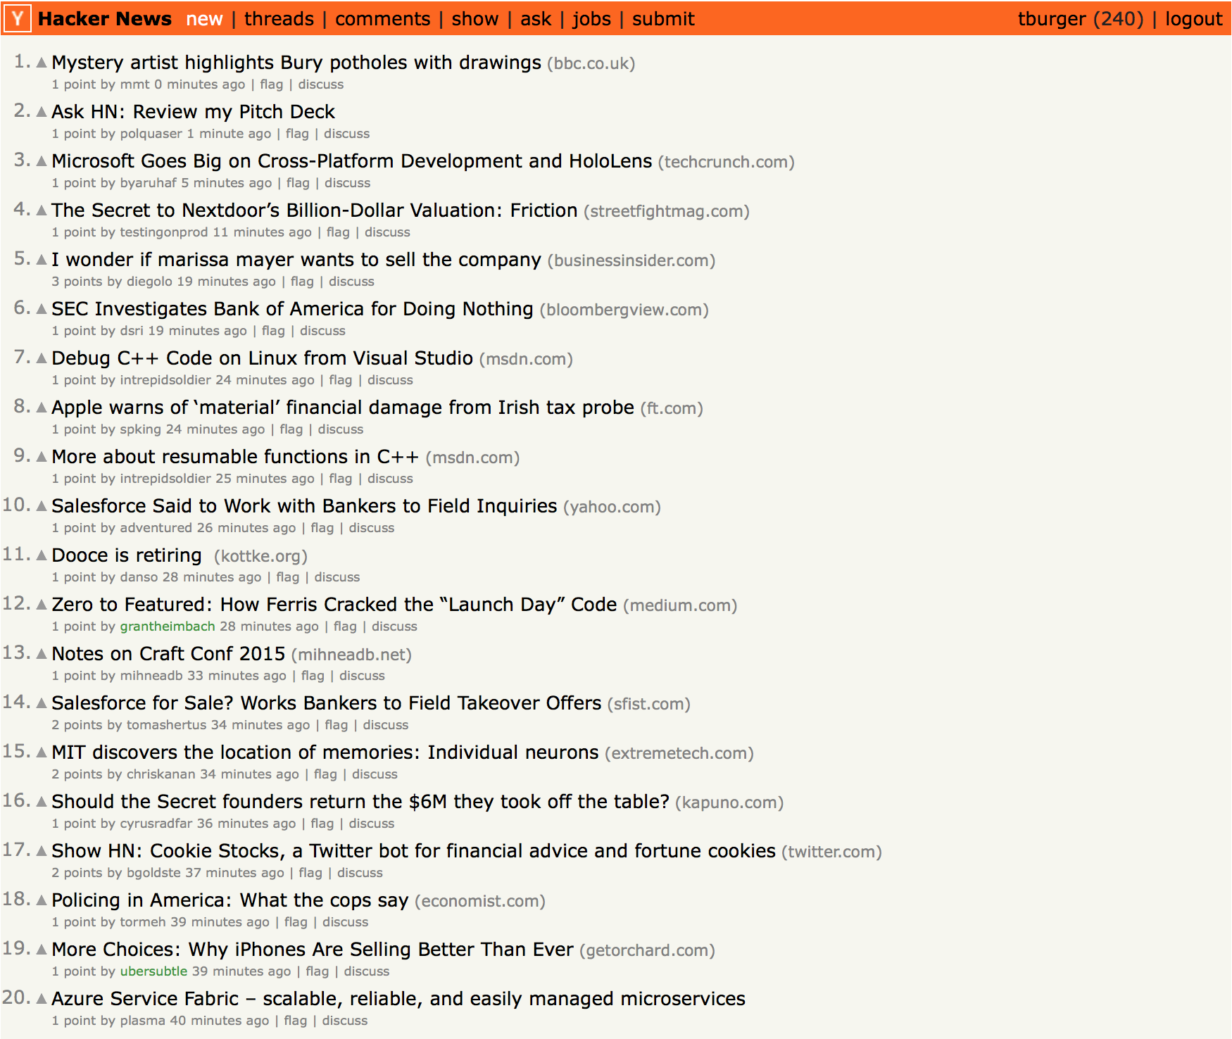

Slide 38
Azure News
Azure News will show the 30 most recent SMS posts.
Express web server
API server to handle news posts via SMS
MongoDB for persisting stories
Local cache of stories
No comments / up-voting – we only have an hour ☺

Slide 39
Cache
SMS API
DB
Web
We could stuff everything into one server...

Slide 40
C4: redis
C2: sms
C3: db
C1: web
We’ll pick functionally atomic units to turn into containers.

Slide 41
db (C3)
Read/Cache
Write
redis (C4)
sms (C2)
web (C1)
We need 4 Docker images so we can scale components independently.

Slide 42
db (C3)
db (C3)
db (C3)
Read/Cache
Write
redis (C4)
sms (C2)
web (C1)
sms (C2)
web (C1)

Slide 43
Container 1: MongoDB from Docker Hub

Slide 44
Container 2: Web: Using a Dockerfile

Slide 45
Docker File
+ Files
+ Software
+ Config
Base Image
Your Image!

Slide 46
Docker Compose Putting it all together

Slide 47
Docker Compose lets you create a YAML definition for your application and deploy it.

Slide 48
BETA Time! Send a text to (203) 802-6275
Just be careful, as MY messaging rates apply... ☺

Slide 49
Awesome, right?
Tremendous ecosystem of developers and startups emerging in this space:

Slide 50
And containers are just the start. We’re really excited to see where they’re taking us.

Slide 51
Part 3: Wrapping up

Slide 52
Check out the code: github.com/thauburger/build-docker-on-azure

Slide 53
Resources
Improve your skills by enrolling in our free cloud development courses at the Microsoft Virtual Academy.
Try Microsoft Azure for free and deploy your first cloud solution in under 5 minutes!
Easily build web and mobile apps for any platform with AzureAppService for free.

Slide 54
Thanks!! Open floor for Q+A Say hi on Twitter:@thauburger

