Slide 1
Designing and Deploying Internet Scale Services
James Hamilton, https://www.usenix.org/events/lisa07/tech/full_papers/hamilton/hamilton.pdf
Part 1: Design for Scale
Part 2: Design for Availability
Partition the service
Design for Failure
Do not trust underlying components
Decouple components
Avoid single points of failure
Support geo-distribution
Instrument everything
Implement inter-service monitoring and alerting
Instrument for production testing
Configurable logging
Optimize for density

Slide 2

Build for Scale
Building Big – the scale challenge
Partitioning your application
Caching your data

Slide 3
What do we mean by large scale?
Millions of users
Hundreds of thousands of operations per second
Thousands of cores
Hundreds of databases

Slide 4

http://www.microsoft.com/en-us/news/features/2012/jun12/06-06Pottermore.aspx

Slide 5
1000
cores
500
databases
Pottermore
1B
page views
110Mdaily peak pvs

Slide 6
Decomposing Typical Social Application Workloads
Content Delivery
Site-wide content, transient state (session state)
Content Exploration
Per-user content view, per-user stateful progress
Social Graph and Content
Per-user content view (comments, likes, etc), global reach (any user can reach any other user). Loosely consistent / asynchronous updates to N consumers.
Interactive Gaming
N-user content view (game actions, session, etc), global reach (any user can reach any other user). Interactive state updates shared amongst N players.

Slide 7
The Path to Scale
Capacity
Partition application, add additional scale-out capacity to meet demand
Optimize
Improve application density through optimum resource usage
Shift
Trade durability, queryability, and consistency for throughput, latency

Slide 8
Build for Scale – Partitioning and Scale Out
Azure architecture is based on scale-out; composing multiple scale units to build large systems
Azure Compute
(Web, Worker, IaaS)
Azure Storage, Files, DocDb
Azure SQL Database

Slide 9
Horizontal Partitioning
First Name | Last Name | Email | Thumbnail | Photo
David | Alexander | davida@contoso.com | 3kb | 3MB
Jarred | Carlson | jaredc@contosco.com | 3kb | 3MB
Sue | Charles | suec@contosco.com | 3kb | 3MB
Simon | Mitchel | simonm@contoso.com | 3kb | 3MB
Richard | Zeng | richard@contosco.com | 3kb | 3MB
A
C
M
Z

Slide 10
Vertical Partitioning
First Name | Last Name | Email | Thumbnail | Photo
David | Alexander | davida@contoso.com | 3kb | 3MB
Jarred | Carlson | jaredc@contosco.com | 3kb | 3MB
Sue | Charles | suec@contosco.com | 3kb | 3MB
Simon | Mitchel | simonm@contoso.com | 3kb | 3MB
Richard | Zeng | richard@contosco.com | 3kb | 3MB
SQL Azure
Tables
BLOBs

Slide 11
Hybrid Partitioning
First Name | Last Name | Email | Thumbnail | Photo
David | Alexander | davida@contoso.com | 3kb | 3MB
Jarred | Carlson | jaredc@contosco.com | 3kb | 3MB
Sue | Charles | suec@contosco.com | 3kb | 3MB
Simon | Mitchel | simonm@contoso.com | 3kb | 3MB
Richard | Zeng | richard@contosco.com | 3kb | 3MB
A-L
M-Z

Slide 12
Understanding Partitioning for Scale
1
Select the partition key
2
Convert partition key to a partition value (optional)
3
Map partition value to a logical partition
Map logical partition to physical resource
4
Last Name
LastName.SubString(0, 2) ->
“Si”
ShardMap[“Si”] -> S
DbMap[“S”] -> “Db0123S”

Slide 13
Partitioning the Database (Range Based)
1
The user (user ID) is a natural partitioning key; all workloads are user-centric
2
Use a non-cryptographic hash to convert the user ID to an integer value
3
Map a range of integers to a logical “shard”
Map logical “shard” to physical resource (database)
4
“MaSimms”
639837447
ShardMap.FirstOrDefault(e =>
e.IsInRange(639837447))
DbMap[Shard].ConnectionString

Slide 14
Partitioning Algorithms
Range Based
Split and merge the partition range into segments
Logical Buckets
Assign data to a logical bucket, then map to a physical resource
Lookup Assignment
Lookup table to map to physical resource segment

Slide 15
Distributed Caching

Slide 16
More capacity – now what?
Not practical to query durable store for every request
Throughput and Latency
Efficiency\COGs
Not all data needs to be immediately consistent.

Slide 17
Build for Scale – Shift to Distributed Cache
Distributed cache engines can provide high-throughput low-latency access to commonly accessed application data
Semantic: Key -> byte[]
In-memory data (not written to disk)
Scale-out architecture (client-side partitioning, explicit connections to physical resource)
Examples: memcached, redis

Slide 18
8
datacentres
Press Association
2B
Peak requests a day
50K
Peak Request per second

Slide 19
Caching Resource Data
Publishing Information Stream
One source, many subscribers
Worker role collects data, publishes to cache
Web instances feed from cache, publish to users

Slide 20
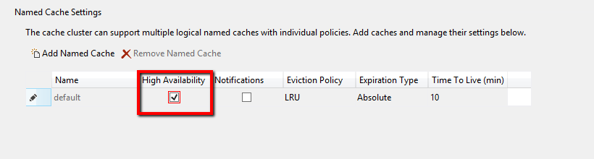
Dealing with Node Failure
Cache can be protected from node failure by keeping a secondary copy
Strong consistency model – overhead on writing

Slide 21
Cache Data Population and Refresh
On Demand
Cache Aside – client pulls data from source and caches on cache miss
Data Push
Background tasks (e.g. worker roles ) populate cache with data on a schedule
Data Pull
Async refresh triggered by client on detection of stale data – requires careful design

Slide 22
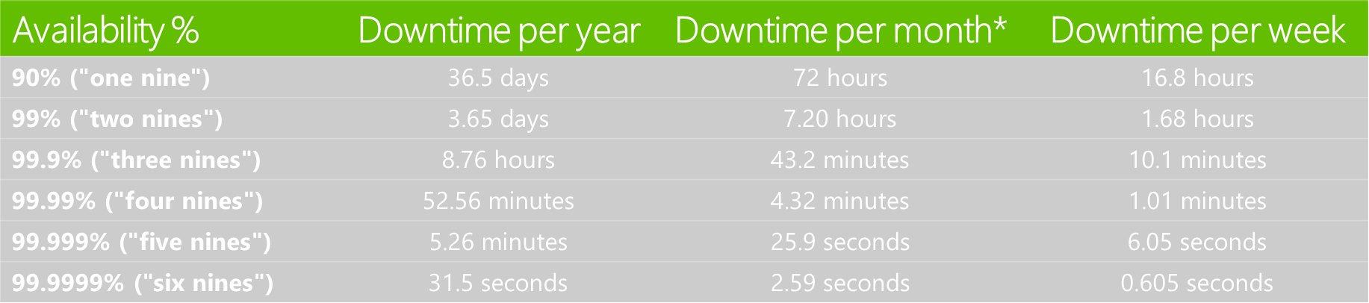
What are the 9’s?

Slide 23
The Hard Reality of the 9’s
Contoso API
Duwamish API
Fabrikam API
TailSpin API
Northwind API
99.99%
SLA
99.99%
SLA
99.99%
SLA
99.99%
SLA
99.99%
SLA
Composite
Composite
SLA =
99.99%
SLA
99.95%
SLA
*

Slide 24
Design for Failure
Given enough time and pressure, everything fails
How will your application behave?
Gracefully handle failure modes, continue to deliver value
Not so gracefully …
Fault types:
Transient. Temporary service interruptions, self-healing
Enduring. Require intervention.

Slide 25
Failure Scope
Region
Regions may become unavailable
Connectivity Issues, acts of nature
Service
Entire Services May Fail
Service dependencies (internal and external)
Node
Individual Nodes May Fail
Connectivity Issues (transient failures), hardware failures, configuration and code errors

Slide 26
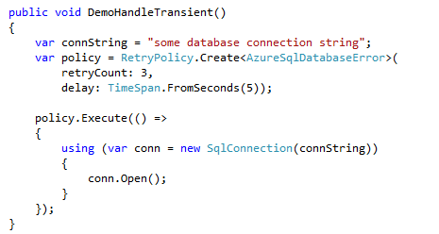
Node Failures
Use fault-handling frameworks that recognize transient errors
Appropriate retry and backoff policies

Slide 27
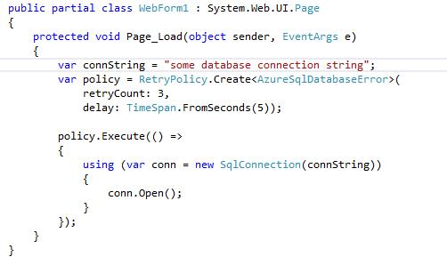
Don’t do this – why?

Slide 28
Sample Retry Policies
Platform | Context | Sample Target e2e latency max | “Fast First” | Retry Count | Delay | Backoff
SQL Database | Synchronous (e.g. render web page) | 200 ms | Yes | 3 | 50 ms | Linear
 | Asynchronous (e.g. process queue item) | 60 seconds | No | 4 | 5 s | Exponential
Azure Cache | Synchronous (e.g. render web page) | 100 ms | Yes | 3 | 10 ms | Linear
 | Asynchronous (e.g. process queue item) | 500 ms | Yes | 3 | 100 ms | Exponential

Slide 29
Decoupling Components
At some point, your request is blocking the line
Fail gracefully, and get out of the queue!
Too much retry, too much trust of downstream service

Slide 30
Decoupling Components
Leverage asynchronous I/O
Beware – not all apparently async calls are “purely” async
Ensure that all external service calls are bounded
Bound the overall call latency (including retries); beware of thread pool pressure
Beware of convoy effects on failure recovery
Trying too hard to catch up can flood newly recovered services

Slide 31
Service Level Failures
Entire Services will have outages
SQL Azure ,Windows Azure Storage – SLA < 100%
External services may be unavailable or unreachable
Application needs to workaround these
Return fail code to user (please try again later)
Queue and try later (we’ve received your order…)

Slide 32
Region Level Failure
Regional failure will occur
Load needs to be spread over multiple regions
Route around failures

Slide 33
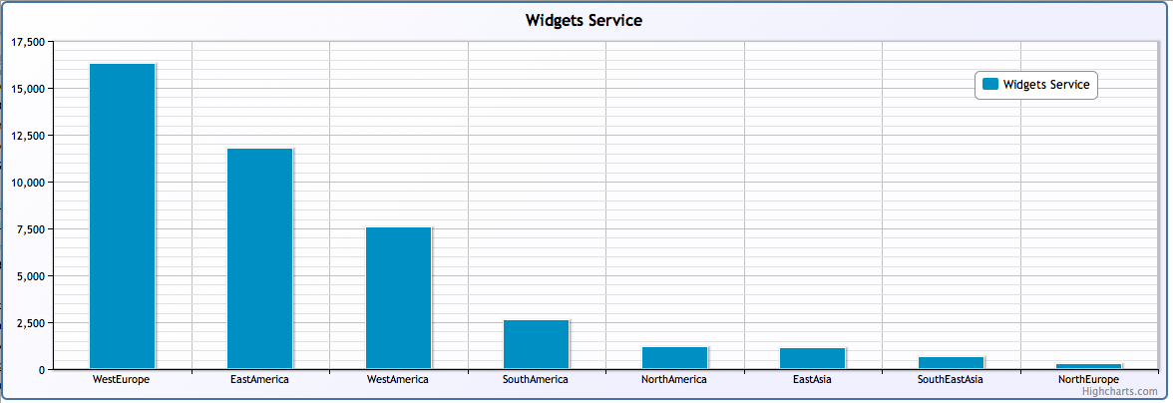
Example Distribution with Traffic Manager
Global load does not necessarily give uniform distribution

Slide 34
Information publishing
Hosted service(s) per data centre
Each service is autonomous –services independently receive or pull data from source
Azure traffic manager can direct traffic to “nearest” service
Use probing to determine service health*

Slide 35
Service Insight
Deep and detailed data needed for management, monitoring, alerting and failure diagnosis
Capture, transport, storage and analysis of this data requires careful design

Slide 36
Characterizing Insight
Inform or Act
How quickly should I react to new insight?
Automated response – real-time
Month over month trending – not so real time ☺
Type of Question
Do I know the question, or am I exploring?
Semantic of insight
KPI (window, pivot, summarize, rank), statistical, time series
Momentum and Window
How much data is required to gain insight?
Detect spike in IIS application queue (seconds/minutes)
Understand week over week user growth (months)
Partitioning / Span of Signal
How much of the source signal do I need for insight?
Local computation (aggregate local partitions)
Global computation (unique users)

Slide 37
Build and Buy (or rent)
No “one size fits all” for all perspectives at scale
Near real-time monitoring & alerting, deep diagnostics, long term trending
Mix of platform components and services
Windows Azure Diagnostics, application logging, Azure portal, 3rd party services

Slide 38
Managing the Deluge

