Slide 1
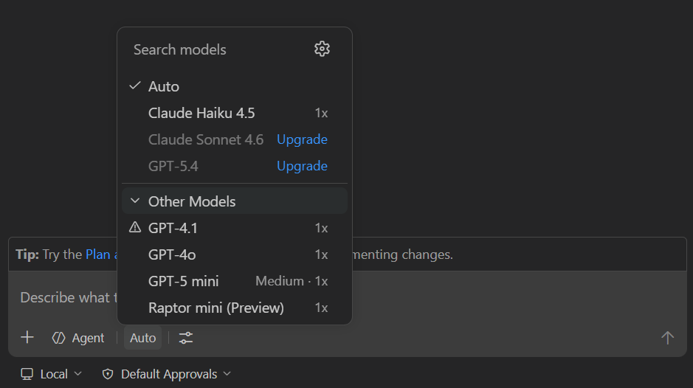
VS CODE MODEL SURFACE
New AI models enter VS Code through a managed model layer.
The practical choice is not "Copilot or custom". It is whether a team can configure a provider in the Language Models editor, or needs to ship a provider extension that owns discovery, credentials, streaming, and token counting.
01
Built-in provider
Azure, Anthropic, Gemini, OpenAI, and others
02
Custom endpoint
Chat Completions, Responses, or Messages API
03
Provider extension
Marketplace or internal extension contributes models
Screenshot: official VS Code docs
Source: code.visualstudio.com/docs/agent-customization/language-models
01

Slide 2
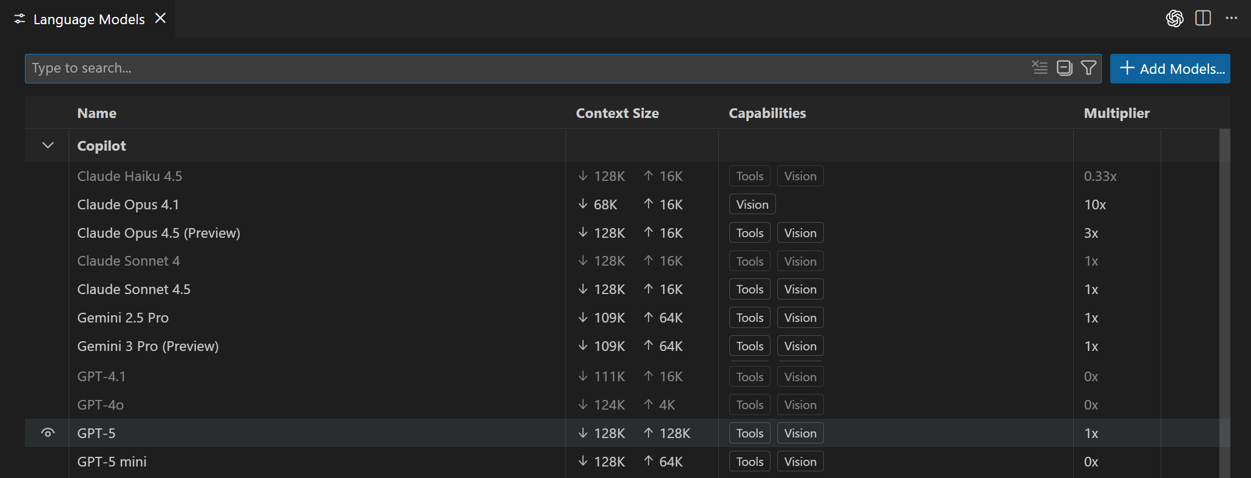
CONFIGURATION PATH
Most teams add a model first through Manage Language Models.
VS Code exposes a Language Models editor where users can view providers, hide/show picker entries, pin favorites, and add models from built-in providers, custom endpoints, or provider extensions.
1
Open
Chat: Manage Language Models
2
Add
Select Add Models
3
Configure
Key, endpoint, API type, metadata
4
Select
Choose the model in chat
Source: VS Code docs, Language Models editor
02

Slide 3
BYOK MODEL METADATA
A configured model is a named endpoint plus declared capabilities.
VS Code stores BYOK model details in chatLanguageModels.json when extra configuration is required. Capabilities decide which surfaces can use the model.
[
{
"name": "Acme Models",
"vendor": "customendpoint",
"apiKey": "YOUR_API_KEY",
"apiType": "responses",
"models": [
{
"id": "acme-reasoner-2",
"name": "Acme Reasoner 2",
"url": "https://models.acme.com/v1/responses",
"toolCalling": true,
"vision": true,
"maxInputTokens": 200000,
"maxOutputTokens": 64000
}
]
}
]
apiType
Chat Completions, Responses, or Messages
toolCalling
Required for agent model picker visibility
vision
Allows image input where supported
token limits
Drive prompt sizing and safe defaults
Source: VS Code docs, Model configuration reference
03

Slide 4
PROVIDER EXTENSION PATH
Ship a provider extension when model access is a product boundary.
The Language Model Chat Provider API lets an extension contribute one provider with many models, then own model discovery, requests, and token counting.
VS Code Language Models editor
Provider extension
Model service or local runtime
User opens model picker
model info
stream response
token count
Use this when
API keys, tenant routing, local model startup, dynamic model discovery, or custom billing details need a packaged UX.
Avoid this when
A built-in provider or custom endpoint can already expose the model with static metadata.
Source: VS Code Language Model Chat Provider API
04

Slide 5
API CONTRACT
VS Code discovers model metadata before it sends a single token.
The provider contribution point names the vendor; activation registers the provider; the provider returns model info; only then does VS Code route chat requests to a selected model.
package.json
activate()
information
response
contributes.languageModelChatProviders
lm.registerLanguageModelChatProvider
id, name, family, version, token limits, capabilities
stream fragments, count tokens, honor cancellation
Implementation rule
Do not hardcode a single model into a chat participant. Use the model the user selected, or select by vendor/id/family and handle the empty-list case.
Source: VS Code Provider API and Language Model API
05

Slide 6
SURFACE FIT
Capabilities decide where the added model can actually appear.
Adding a model is not the same as enabling every AI feature. VS Code distinguishes chat, agent/tool use, image input, utility tasks, and Copilot-dependent completions/embeddings.
Surface
Gate
What to tell users
Chat
Model picker
BYOK and provider extensions can appear here.
Agents
toolCalling
Models without tool calling are hidden for agent use.
Vision
vision / imageInput
Only show image flows when the model declares support.
Utility tasks
chat.utilityModel
Titles, commit messages, intent detection can be overridden.
Inline suggestions
Copilot service or extension API
Local BYOK chat models do not automatically power completions.
Source: VS Code docs, language model capabilities and FAQ
06

Slide 7
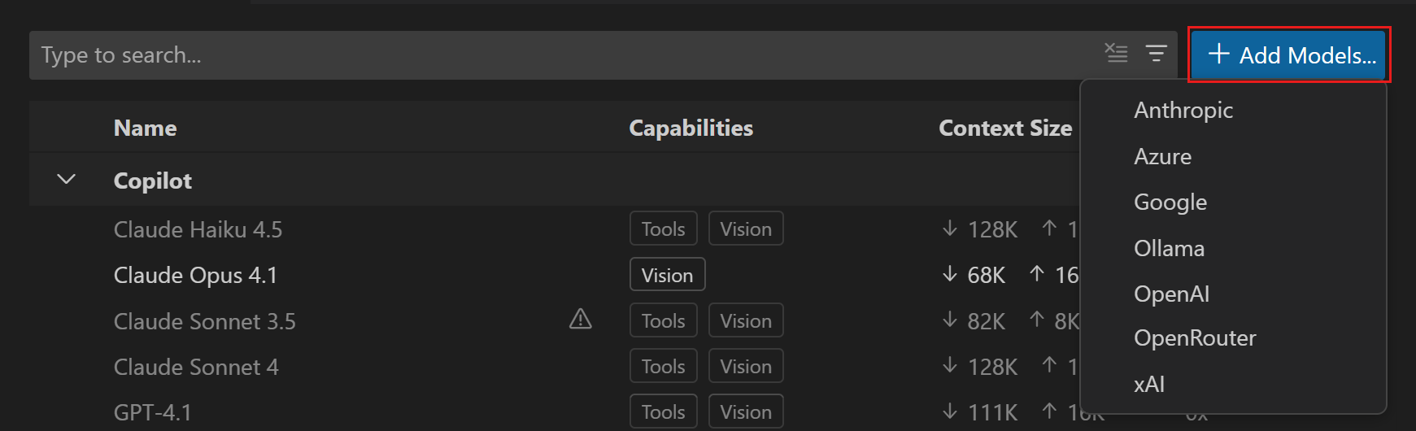
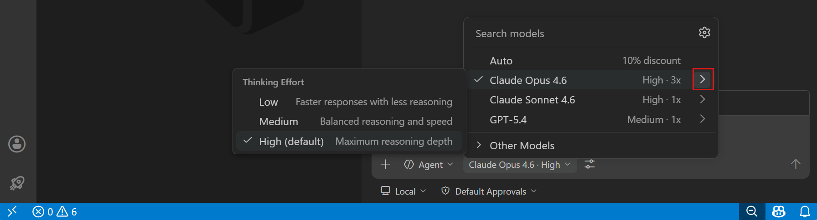
ROLLOUT CHECKLIST
A production rollout needs more than a model ID.
Treat the model as a managed dependency: define access policy, capability claims, fallback behavior, and user-visible support before publishing broadly.
Access
API key storage | Enterprise BYOK policy | No secrets in workspace
Capability truth
Tool calling | Vision | Token limits | Thinking effort
Fallback
Empty model list | Provider outage | Restart/reload guidance
Scope
Chat vs utility tasks | Inline suggestion limits | Offline expectations
Source: VS Code docs, BYOK and model picker behavior
07

Slide 8
DECISION TREE
Choose the smallest integration that owns the real problem.
The clean implementation path is: configure when possible, extend when necessary, and only build a chat participant when the value is a domain assistant rather than a raw model.
Is the provider already listed?
Does your endpoint speak a supported API?
Need packaged auth, discovery, local runtime, or billing UX?
Use built-in provider + key
Use Custom Endpoint
Build provider extension
Separate concern: build a Chat Participant when you are adding a domain assistant invoked with @mention, not merely exposing a new model.
Sources: VS Code Language Models, Provider API, Language Model API, Chat Participant API
08

