Slide 1
Fundamentals of Backend Communications and Protocols
husseinnasser
Understand what’s behind the backend

Slide 2
Introduction
husseinnasser

Slide 3
Introduction
husseinnasser
Welcome
Who this course is for?
Course Outline

Slide 4
Backend Communication Design Patterns
husseinnasser
There are handful of ways backends communicate

Slide 5
Request - Response
husseinnasser
Classic, Simple and Everywhere

Slide 6

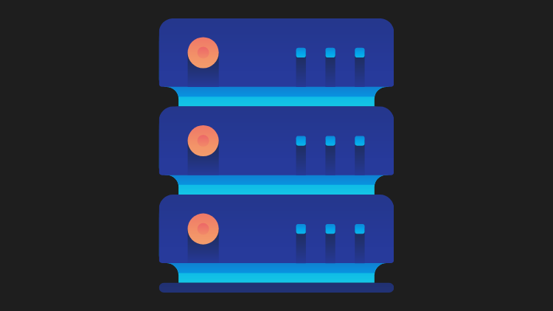
Request Response Model
Client sends a Request
Server parses the Request
Server processes the Request
Server sends a Response
Client parses the Response and consume

Slide 7
Where it is used?
Web, HTTP, DNS, SSH
RPC (remote procedure call)
SQL and Database Protocols
APIs (REST/SOAP/GraphQL)
Implemented in variations

Slide 8
Anatomy of a Request / Response
A request structure is defined by both client and server
Request has a boundary
Defined by a protocol and message format
Same for the response
E.g. HTTP Request
GET / HTTP/1.1
Headers
<CRLF>
BODY

Slide 9

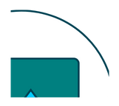
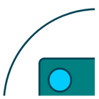


Building an upload image service with request response
Send large request with the image (simple)
Chunk image and send a request per chunk (resumable)

Slide 10
Doesn’t work everywhere
Notification service
Chatting application
Very Long requests
What if client disconnects?
We will talk about alternatives

Slide 11
Request/Response
t0
t2
t30
t32
Request
Request processing
time
Response

Slide 12
Demo Curl
husseinnasser
–trace
Notes:
We are going to show curl –trace on http://google.com and describe the request and response paths

Slide 13
Synchronous vs Asynchronous
husseinnasser
Can I do work while waiting?

Slide 14
Synchronous I/O
Caller sends a request and blocks
Caller cannot execute any code meanwhile
Receiver responds, Caller unblocks
Caller and Receiver are in “sync”

Slide 15
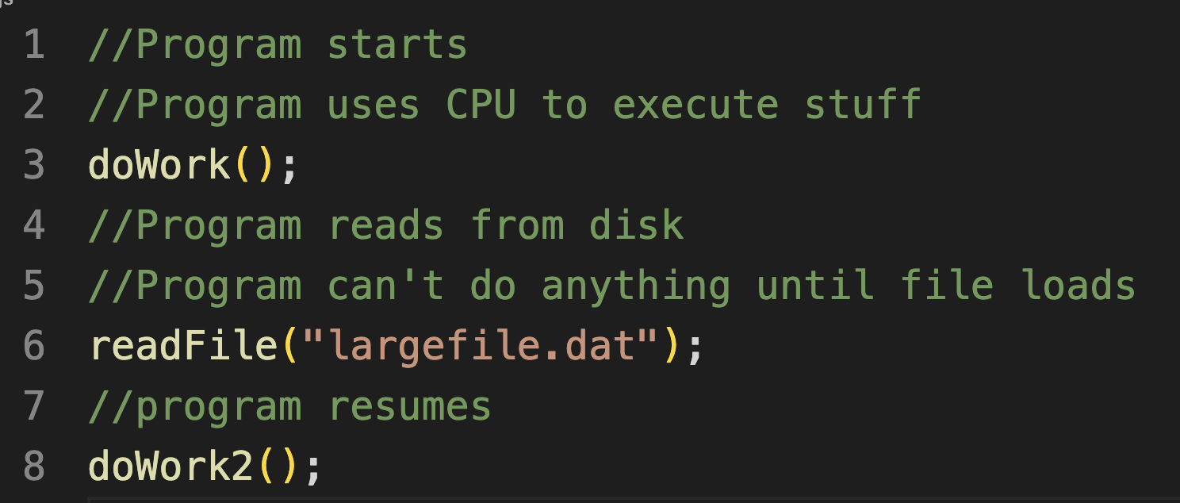
Example of an OS synchronous I/O
Program asks OS to read from disk
Program main thread is taken off of the CPU
Read completes, program can resume execution

Slide 16
Asynchronous I/O
Caller sends a request
Caller can work until it gets a response
Caller either:
  Checks if the response is ready (epoll)
  Receiver calls back when it's done (io_uring)
  Spins up a new thread that blocks
Caller and receiver are not necessary in sync

Slide 17
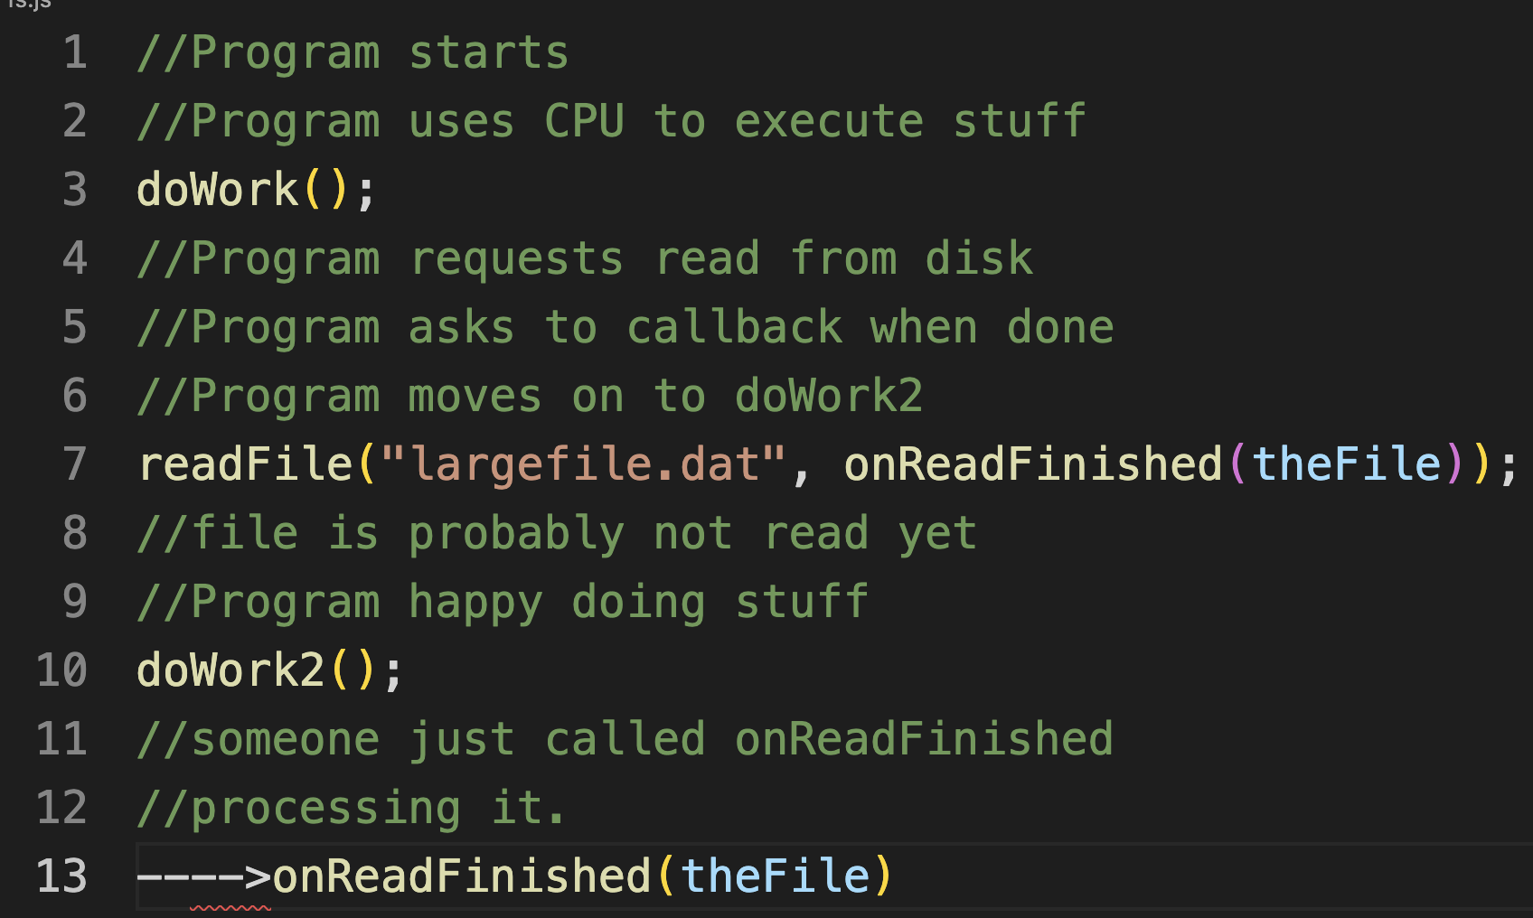
Example of an OS asynchronous call (NodeJS)
Program spins up a secondary thread
Secondary thread reads from disk, OS blocks it
Main program still running and executing code
Thread finish reading and calls back main thread

Slide 18
Synchronous vs Asynchronous in Request Response
Synchronicity is a client property
Most modern client libraries are asynchronous
E.g. Clients send an HTTP request and do work
Executes
code
locally….

Slide 19
Synchronous vs Asynchronous in real life
Just in case it is still confusing
In Synchronous communication the caller waits for a response from receiver
  E.g. Asking someone a question in a meeting
Asynchronous communication the response can come whenever. Caller and receiver can do anything meanwhile
  email

Slide 20
Asynchronous workload is everywhere
Asynchronous Programming (promises/futures)
Asynchronous backend processing
Asynchronous commits in postgres
Asynchronous IO in Linux (epoll, io_uring)
Asynchronous replication
Asynchronous OS fsync (fs cache)

Slide 21
Push
husseinnasser
I want it as soon as possible

Slide 22
Request/response isn’t always ideal
Client wants real time notification from backend
  A user just logged in
  A message is just received
Push model is good for certain cases

Slide 23
What is Push?
Client connects to a server
Server sends data to the client
Client doesn’t have to request anything
Protocol must be bidirectional
Used by RabbitMQ

Slide 24
Push
Bidirectional connection
*Backend gets message*
New message 1
New message 2

Slide 25
Demo NodeJS
husseinnasser
Blocking call (loop) and fetch
Notes:
Call readFileSync
console(“more code ”)
Vs
Call readFile()
console.log(“more code”)

Slide 26
Push Pros and Cons
Pros
  Real time
Cons
  Clients must be online
  Clients might not be able to handle
  Requires a bidirectional protocol
  Polling is preferred for light clients

Slide 27
Demo WebSockets
husseinnasser
Push notification (users login)
Notes:
Build a websocket server, have two clients connect, client one sends a message client two gets the message pushed

Slide 28
Short Polling
husseinnasser
Request is taking a while, I’ll check with you later

Slide 29
Where request/response isn’t ideal
A request takes long time to process
  Upload a youtube video
The backend want to sends notification
  A user just logged in
Polling is a good communication style

Slide 30
What is Short Polling?
Client sends a request
Server responds immediately with a handle
Server continues to process the request
Client uses that handle to check for status
Multiple “short” request response as polls

Slide 31
Short Polling
Request
RequestID X
Is X ready?
No
Is X ready?
No
Is X ready?
Response

Slide 32
Short Polling Pros and Cons
Pros
  Simple
  Good for long running requests
  Client can disconnect
Cons
  Too chatty
  Network bandwidth
  Wasted Backend resources

Slide 33
Demo Job Status
husseinnasser
Check if a job is done with progress
Notes:
Build an Express server.. /submitJob
/checkstatus)

Slide 34
Long Polling
husseinnasser
Request is taking long, I’ll check with you later
But talk to me only when it's ready

Slide 35
Where request/response & polling isn’t ideal
A request takes long time to process
  Upload a youtube video
The backend want to sends notification
  A user just logged in
Short Polling is a good but chatty
Meet Long polling (Kafka uses it)

Slide 36
What is Long Polling?
Client sends a request
Server responds immediately with a handle
Server continues to process the request
Client uses that handle to check for status
Server DOES not reply until it has the response
So we got a handle, we can disconnect and we are less chatty
Some variation has timeouts too

Slide 37
Long Polling
Request
RequestID X
Is X ready?
Response

Slide 38
Long Polling Pros and Cons
Pros
  Less chatty and backend friendly
  Client can still disconnect
Cons
  Not real time

Slide 39
Demo Job Status
husseinnasser
Check if a job is done
Notes:
Build an Express server.. /submitJob
Checkstatus will block until we get a response, timer to check

Slide 40
Server Sent Events
husseinnasser
One Request, a very very long response

Slide 41
Limitations of Request/Response
Vanilla Request/response isn’t ideal for notification backend
Client wants real time notification from backend
  A user just logged in
  A message is just received
Push works but restrictive
Server Sent Events work with Request/response
Designed for HTTP

Slide 42
What is Server Sent Events?
A response has start and end
Client sends a request
Server sends logical events as part of response
Server never writes the end of the response
It is still a request but an unending response
Client parses the streams data looking for events
Works with request/response (HTTP)

Slide 43
SSE
Bidirectional connection
Request
*Backend gets message*
event1
event2

Slide 44
Server Sent Events Pros and Cons
Pros
  Real time
  Compatible with Request/response
Cons
  Clients must be online
  Clients might not be able to handle
  Polling is preferred for light clients
  HTTP/1.1 problem (6 connections)

Slide 45
Demo Job Status
husseinnasser
Check if a job is done with progress using SSE
Notes:
Build an Express server.. /submitJob
/checkstatus and let the server stream progress)

Slide 46
Publish Subscribe
husseinnasser
One publisher many readers

Slide 47

Request Response
GET /
content..
Web Server

Slide 48

Where it breaks
Upload
Service
Compress
Service
Format
Service
Notification
Service
Copyright
Service

Slide 49
Request/Response pros and cons
Pros
Cons
Elegant and Simple
Bad for multiple receivers
Scalable
High Coupling
Client/Server have to be running
Chaining, circuit breaking

Slide 50

Pub/Sub
Raw mp4 videos
Compressed video
Compress
Service
480p video
1080p video
Uploaded!
Upload
Service
4k video
Format
Service
Message Queue
topics/channels
Notification
Service

Slide 51
Pub/Sub pros and cons
Pros
Scales w/ multiple receivers
Great for microservices
Loose Coupling
Works while clients not running
Cons
Message delivery issues (Two generals problem)
Complexity
Network saturation

Slide 52
RabbitMQ Demo
husseinnasser
Publish a job and have worker pick them up
Notes:
Spin up a rabbitmq server -> submit a job to a queue, and pull and

Slide 53
Multiplexing vs Demultiplexing
husseinnasser
HTTP/2, QUIC,
Connection Pool, MPTCP

Slide 54
Multiplexing vs Demultiplexing

Slide 55


Multiplexing example HTTP/2
HTTP request 1
3 HTTP/1.1 Connections
HTTP/1.1 server
HTTP request 2
HTTP request 3
HTTP request 1
1 HTTP/2 Connection
HTTP/2 server
HTTP request 2
HTTP request 3

Slide 56
Multiplexing HTTP/2 on the Backend
Proxy
(e.g. ENVOY)
h1 frontend h2 backend
3 HTTP/1.1 Connections
1 HTTP/2 Connection
HTTP/2 server
More throughput
High backend resources (CPU for h2)

Slide 57
Demultiplexing HTTP/1.1 on the Backend
Proxy
(e.g. ENVOY)
h2 frontend h1 backend
1 HTTP/2 Connection
3 HTTP/1.1 Connections
HTTP/1.1 server
less throughput
low backend resources (simple h1)

Slide 58

Connection Pooling
Backend Server
Database Server
4 Database Connections

Slide 59
Browser demultiplexing in HTTP/1.1
6 HTTP/1.1 Connections
HTTP/1.1 server
HTTP request 1
HTTP request 2
HTTP request 3
Note: Chromes allows up to 6 connections per domain, user’s requests are demultiplexed in the 6 connections

Slide 60
Browser connection pool Demo
husseinnasser
Up to 6 connections in HTTP/1.1
After that we are blocked
Notes:
Spin up an express server that takes 5 seconds to /GET response
In hte client, make 10 fetch requests each fetch will from the GET request, notice how network tab will block the 7th request.

Slide 61
Stateless vs Stateful
husseinnasser
Is state stored in the backend?

Slide 62
Stateful vs Stateless backend
Stateful
  Stores state about clients in its memory
  Depends on the information being there
Stateless
  Client is responsible to “transfer the state” with every request
  May store but can safely lose it

Slide 63
Stateless Backends
Stateless backends can still store data somewhere else
Can you restart the backend during idle time while the client workflow continues to work?

Slide 64
What makes a backend stateless?
Stateless backends can store state somewhere else (database)
The backend remain stateless but the system is stateful
Can you restart the backend during idle time and the client workflow continue to work?

Slide 65
Stateful backend
Generate session S1, return to user and store locally
/verify user&pass
/login user&pass
S1
/profile
cookie=S1
Check if S1 is in memory to authenticate and return.

Slide 66

Stateful backend where it breaks
/profile
Cookie =S1
/login
Backend restarted
Sessions are empty

Slide 67
Stateless backend
Generate session S1, return to user and store in DB
/verify user&pass
/login user&pass
Store S1
S1
S1?
/profile
cookie=S1
Check if S1 is in the DB
Backend App is stateless but entire system still stateful (database dies we lose everything)

Slide 68
Stateless vs Stateful protocols
The Protocols can be designed to store state
TCP is stateful
  Sequences, Connection file descriptor
UDP is stateless
  DNS send queryID in UDP to identify queries
  QUIC sends connectionID to identify connection

Slide 69
Stateless vs Stateful protocols
You can build a stateless protocol on top of a stateful one and vise versa
HTTP on top of TCP
If TCP breaks, HTTP blindly create another one
QUIC on top UDP

Slide 70
Complete Stateless System
Stateless Systems are rare
State is carried with every request
A backend service that relies completely on the input
  Check if input param is a prime number
JWT (JSON Web Token)
Definitions go nowhere

Slide 71
HTTP vs TCP Demo
husseinnasser
Restart a TCP server vs Restart an HTTP Server
Notes:
Spin up an express http server and visit it from browser,
Spin up a tcp server http

Slide 72
Sidecar Pattern
husseinnasser
Thick clients, Thicker backends

Slide 73

Every protocol requires a library
HTTP/1.1 Server
HTTP/1.1 Client
HTTP/1.1
Library
HTTP/1.1
Library
HTTP/2 Server
HTTP/2 Client
HTTP/2
+
HTTP/1.1
Library
HTTP/2
+
HTTP/1.1
Library

Slide 74
Every protocol requires a library
TLS Server
TLS Client
TLS
Library (openSSL)
TLS
Library (rustSSL)
gRPC Server
gRPC Client
gRPC
Library
gRPC
Library

Slide 75
Changing the library is hard
Once you use the library your app is entrenched
App & Library “should” be same language
Changing the library require retesting
Breaking changes Backward compatibility
Adding features to the library is hard
Microservices suffer

Slide 76

When if we delegate communication?
Proxy communicate instead
Proxy has the rich library
Client has thin library (e.g. h1)
Meet Sidecar pattern
Each client must have a sidecar proxy

Slide 77

Sidecar Design Pattern
Client sidecar
Proxy
Server sidecar
Reverse Proxy
HTTP/1.1 client
HTTP/2 + Secure
http/1.1 Server
HTTP/2+TLS
Library
HTTP/2+TLS
Library

Slide 78
Sidecar Design Pattern - Upgrade to HTTP/3!
HTTP/1.1 client
http/1.1 Server
HTTP/3 + Secure
HTTP/3+QUIC
Library
HTTP/3+QUIC
Library
No change in both client and server code, just the proxies
But introduces an extra hop

Slide 79
Sidecar Examples
Service Mesh Proxies
  Linkerd, Istio, Envoy
Sidecar Proxy Container
Must be Layer 7 Proxy

Slide 80
Pros & Cons of Sidecar proxy
Pros
Language agnostic (polyglot)
Protocol upgrade
Security
Tracing and Monitoring
Service Discovery
Caching
Cons
Complexity
Latency

Slide 81
Protocols
husseinnasser
How the client and backend communicate

Slide 82
Protocol Properties
husseinnasser
What to take into account when designing a protocol?

Slide 83
What is a protocol?
A system that allows two parties to communicate
A protocol is designed with a set of properties
Depending on the purpose of the protocol
TCP, UDP, HTTP, gRPC, FTP

Slide 84
Protocol properties
Data format
  Text based (plain text, JSON, XML)
  Binary (protobuf, RESP, h2, h3)
Transfer mode
  Message based (UDP, HTTP)
  Stream (TCP, WebRTC)
Addressing system
  DNS name, IP, MAC
Directionality
  Bidirectional (TCP)
  Unidirectional (HTTP)
  Full/Half duplex

Slide 85
Protocol properties
State
  Stateful (TCP, gRPC, apache thrift)
  Stateless (UDP, HTTP)
Routing
  Proxies, Gateways
Flow & Congestion control
  TCP (Flow & Congestion)
  UDP (No control)
Error management
  Error code
  Retries and timeouts

Slide 86
OSI Model
husseinnasser
Open Systems Interconnection model

Slide 87
Why do we need a communication model?
husseinnasser
Agnostic applications
  App doesn’t need to to know network medium
  Otherwise we need an App for WIFI, ethernet vs LTE vs fiber
Network Equipment Management
  Without a standard model, upgrading network equipments becomes difficult
Decoupled Innovation
  Innovations can be done in each layer separately without affecting the rest of the models

Slide 88
What is the OSI Model?
husseinnasser
7 Layers each describe a specific networking component
Layer 7 - Application - HTTP/FTP/gRPC
Layer 6 - Presentation - Encoding, Serialization
Layer 5 - Session - Connection establishment, TLS
Layer 4 - Transport - UDP/TCP
Layer 3 - Network - IP
Layer 2 - Data link - Frames, Mac address Ethernet
Layer 1 - Physical - Electric signals, fiber or radio waves

Slide 89
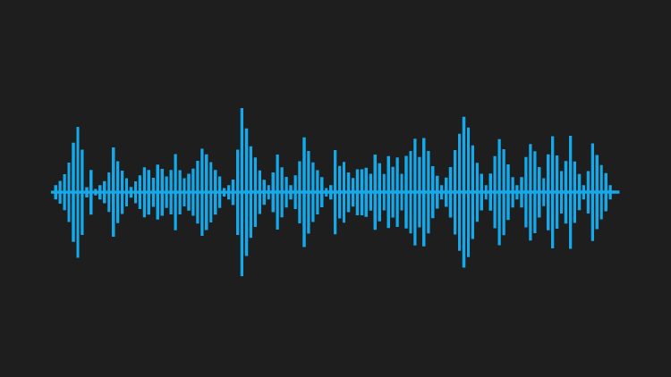
Client sends an HTTPS POST request
Client
Server
Application
Application
Presentation
Presentation
Session
Session
Transport
Segment
Transport
Network
Packet
Network
Data Link
Frame
Data Link
Physical
Physical

Slide 90
Client
Server
SPORT
DPORT
SPORT
DPORT
SIP
DIP
SIP
DIP
SMAC
DMAC
SMAC
DMAC

Slide 91
Across networks
Client
Server
Application
Application
Presentation
Presentation
Session
Session
Transport
Router
Transport
Network
Switch
Network
Network
Data Link
Data Link
Data Link
Data Link
Physical
Physical
Physical
Physical

Slide 92
Across networks
Layer 7 Load Balancer/CDN
Client
Backend Server
Application
Application
Application
Presentation
Presentation
Presentation
Layer 4 Proxy, Firewall
Session
Session
Session
Transport
Transport
Transport
Transport
Network
Network
Network
Network
Data Link
Data Link
Data Link
Data Link
Physical
Physical
Physical
Physical

Slide 93
The shortcomings of the OSI Model
husseinnasser
OSI Model has too many layers which can be hard to comprehend
Hard to argue about which layer does what
Simpler to deal with Layers 5-6-7 as just one layer, application
TCP/IP Model does just that

Slide 94
TCP/IP Model
husseinnasser
Much simpler than OSI just 4 layers
Application (Layer 5, 6 and 7)
Transport (Layer 4)
Internet (Layer 3)
Data link (Layer 2)
Physical layer is not officially covered in the model

Slide 95
OSI Model Summary
husseinnasser
Why do we need a communication model?
What is the OSI Model?
Example
Each device in the network doesn’t have to map the entire 7 layers
TCP/IP is simpler model

Slide 96
UDP
husseinnasser
User Datagram Protocol

Slide 97
UDP
husseinnasser
Stands for User Datagram Protocol
Message Based Layer 4 protocol
Ability to address processes in a host using ports
Simple protocol to send and receive messages
Prior communication not required (double edge sword)
Stateless no knowledge is stored on the host
8 byte header Datagram

Slide 98
UDP Use cases
husseinnasser
Video streaming
VPN
DNS
WebRTC
A
B

Slide 99
Multiplexing and demultiplexing
husseinnasser
IP target hosts only
Hosts run many apps each with different requirements
Ports now identify the “app” or “process”
Sender multiplexes all its apps into UDP
Receiver demultiplex UDP datagrams to each app
App1-port 5555
App2-port 7712
App3-port 2222
AppX-port 53
AppY-port 68
AppZ-port 6978
10.0.0.1
10.0.0.2

Slide 100
Source and Destination Port
husseinnasser
App1 on 10.0.0.1 sends data to AppX on 10.0.0.2
Destination Port = 53
AppX responds back to App1
We need Source Port so we know how to send back data
Source Port = 5555
10.0.0.1
5555
53
10.0.0.2
App1-port 5555
App2-port 7712
App3-port 2222
AppX-port 53
AppY-port 68
AppZ-port 6978
10.0.0.1
10.0.0.2
53
5555
10.0.0.1
10.0.0.2

Slide 101
UDP Pros
husseinnasser
Simple protocol
Header size is small so datagrams are small
Uses less bandwidth
Stateless
Consumes less memory (no state stored in the server/client)
Low latency - no handshake , order, retransmission or guaranteed delivery

Slide 102
UDP Cons
husseinnasser
No acknowledgement
No guarantee delivery
Connection-less - anyone can send data without prior knowledge
No flow control
No congestion control
No ordered packets
Security - can be easily spoofed

Slide 103
Summary
husseinnasser
UDP is a simple message based layer 4 protocol
Uses ports to address processes
Stateless
Pros & Cons

Slide 104
TCP
husseinnasser
Transmission Control Protocol

Slide 105
TCP
husseinnasser
Stands for Transmission Control Protocol
Stream based Layer 4 protocol
Ability to address processes in a host using ports
“Controls” the transmission unlike UDP which is a firehose
Connection
Requires handshake
20 bytes headers Segment (can go to 60)
Stateful

Slide 106
TCP Use cases
husseinnasser
Reliable communication
Remote shell
Database connections
Web communications
Any bidirectional communication
A
B

Slide 107
TCP Connection
husseinnasser
Connection is a Layer 5 (session)
Connection is an agreement between client and server
Must create a connection to send data
Connection is identified by 4 properties
  SourceIP-SourcePort
  DestinationIP-DestinationPort

Slide 108
TCP Connection
husseinnasser
Can’t send data outside of a connection
Sometimes called socket or file descriptor
Requires a 3-way TCP handshake
Segments are sequenced and ordered
Segments are acknowledged
Lost segments are retransmitted

Slide 109
Multiplexing and demultiplexing
husseinnasser
IP target hosts only
Hosts run many apps each with different requirements
Ports now identify the “app” or “process”
Sender multiplexes all its apps into TCP connections
Receiver demultiplex TCP segments to each app based on connection pairs
App1-port 5555
App2-port 7712
App3-port 2222
AppX-port 53
AppY-port 68
AppZ-port 6978
10.0.0.1
10.0.0.2

Slide 110
Connection Establishment
husseinnasser
App1 on 10.0.0.1 want to send data to AppX on 10.0.0.2
App1 sends SYN to AppX to synchronous sequence numbers
AppX sends SYN/ACK to synchronous its sequence number
App1 ACKs AppX SYN.
Three way handshake
10.0.0.1
5555
SYN
22
10.0.0.2
AppX-port 22
AppY-port 443
AppZ-port 80
App1-port 5555
App2-port 7712
App3-port 2222
10.0.0.2
22
SYN/ACK
5555
10.0.0.1
10.0.0.1
10.0.0.2
10.0.0.1:5555:10.0.0.2:22
10.0.0.1:5555:10.0.0.2:22
10.0.0.1
5555
ACK
22
10.0.0.2
File descriptor
File descriptor

Slide 111
Sending data
husseinnasser
App1 sends data to AppX
App1 encapsulate the data in a segment and send it
AppX acknowledges the segment
Hint: Can App1 send new segment before ack of old segment arrives?
10.0.0.1
5555
ls
22
10.0.0.2
AppX-port 22
AppY-port 443
AppZ-port 80
App1-port 5555
App2-port 7712
App3-port 2222
10.0.0.2
22
ACK
5555
10.0.0.1
10.0.0.1
10.0.0.2
10.0.0.1:5555:10.0.0.2:22
10.0.0.1:5555:10.0.0.2:22
File descriptor
File descriptor

Slide 112
Acknowledgment
husseinnasser
App1 sends segment 1,2 and 3 to AppX
AppX acknowledge all of them with a single ACK 3
10.0.0.1
5555
seq1
22
10.0.0.2
AppX-port 22
AppY-port 443
AppZ-port 80
App1-port 5555
App2-port 7712
App3-port 2222
10.0.0.1
5555
seq2
22
10.0.0.2
10.0.0.1
10.0.0.1
5555
seq3
22
10.0.0.2
10.0.0.1:5555:10.0.0.2:22
10.0.0.2
10.0.0.1:5555:10.0.0.2:22
File descriptor
File descriptor
10.0.0.2
22
ACK3
5555
10.0.0.1

Slide 113
Lost data
husseinnasser
App1 sends segment 1,2 and 3 to AppX
Seg 3 is lost, AppX acknowledge 3
App1 resend Seq 3
10.0.0.1
5555
seq1
22
10.0.0.2
AppX-port 22
AppY-port 443
AppZ-port 80
App1-port 5555
App2-port 7712
App3-port 2222
10.0.0.1
5555
seq2
22
10.0.0.2
10.0.0.1
10.0.0.1
5555
seq3
22
10.0.0.2
10.0.0.1:5555:10.0.0.2:22
10.0.0.2
10.0.0.1:5555:10.0.0.2:22
10.0.0.2
22
ACK2
5555
10.0.0.1
File descriptor
File descriptor
10.0.0.1
5555
seq3
22
10.0.0.2
10.0.0.2
22
ACK3
5555
10.0.0.1

Slide 114
Closing Connection
husseinnasser
App1 wants to close the connection
App1 sends FIN, AppX ACK
AppX sends FIN, App1 ACK
Four way handshake
10.0.0.1
5555
FIN
22
10.0.0.2
AppX-port 22
AppY-port 443
AppZ-port 80
App1-port 5555
App2-port 7712
App3-port 2222
10.0.0.2
22
ACK
5555
10.0.0.1
10.0.0.1
10.0.0.2
10.0.0.1:5555:10.0.0.2:22
10.0.0.1:5555:10.0.0.2:22
10.0.0.2
22
FIN
5555
10.0.0.1
File descriptor
File descriptor
10.0.0.1
5555
ACK
22
10.0.0.2

Slide 115
TCP Pros
husseinnasser
Guarantee delivery
No one can send data without prior knowledge
Flow Control and Congestion Control
Ordered Packets no corruption or app level work
Secure and can’t be easily spoofed

Slide 116
TCP Cons
husseinnasser
Large header overhead compared to UDP
More bandwidth
Stateful - consumes memory on server and client
Considered high latency for certain workloads (Slow start/ congestion/ acks)
Does too much at a low level (hence QUIC)
  Single connection to send multiple streams of data (HTTP requests)
  Stream 1 has nothing to do with Stream 2
  Both Stream 1 and Stream 2 packets must arrive
TCP Meltdown
  Not a good candidate for VPN

Slide 117
Summary
husseinnasser
Stands for Transmission Control Protocol
Layer 4 protocol
“Controls” the transmission unlike UDP which is a firehose
Introduces Connection concept
Retransmission, acknowledgement, guaranteed delivery
Stateful, connection has a state
Pros & Cons

Slide 118
TLS
husseinnasser
Transport Layer Security

Slide 119
TLS
Vanilla HTTP
HTTPS
TLS 1.2 Handshake
Diffie Hellman
TLS 1.3 Improvements

Slide 120
HTTP
open
close
80
GET /
Headers+ index.html
<html>...
….

Slide 121


HTTPS
open
close
443
Handshake
GET /
Headers+ index.html
<html>...
….

Slide 122
Why TLS
We encrypt with symmetric key algorithms
We need to exchange the symmetric key
Key exchange uses asymmetric key (PKI)
Authenticate the server
Extensions (SNI, preshared, 0RTT)

Slide 123


TLS1.2
open
close
RSA Public key
RSA Private key
Client hello
Server hello (cert)
Change cipher, fin
Change cipher, fin
GET /
Headers+ index.html
<html>...
….

Slide 124

Diffie Hellman
Private x
+
=
Public g,n
Symmetric key
+
Private y

Slide 125
Diffie Hellman
Public/
Unbreakable
/can be shared
g^x % n
+
Public/
Unbreakable
/can be shared
g^y % n
+
(g^x % n)^y = g^xy % n
(g^y % n)^x = g^xy % n

Slide 126
TLS Extensions
SNI
  Server Name Indication
ALPN
  Application Layer Protocol Negotiation
Pre-shared key
  0RTT
ECH
  Encrypted Client Hello

Slide 127
TLS1.3
open
close
client hello / key /fin
server hello/ change cipher/ fin
GET /
Headers+ index.html
<html>...
….
(g^x % n)^y = g^xy % n
(g^y % n)^x = g^xy % n

Slide 128
TLS Summary
Vanilla HTTP
HTTPS
TLS 1.2 Handshake (two round trips)
Diffie Hellman
TLS 1.3 Improvements (one round trip can be zero)

Slide 129
HTTP/1.1
husseinnasser
Simple web protocol lasts decades

Slide 130
Client / Server
(Client) Browser, python or javascript app, or any app that makes HTTP request
(Server) HTTP Web Server, e.g. IIS, Apache Tomcat, NodeJS, Python Tornado

Slide 131
HTTP Request
Method
PATH
Protocol
Headers
Body

Slide 132
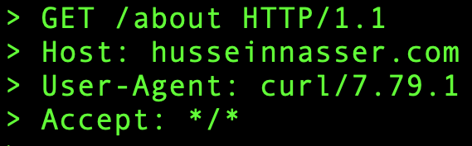
HTTP Request

Slide 133
HTTP Response
Protocol
Code
Code Text
Headers
Body

Slide 134
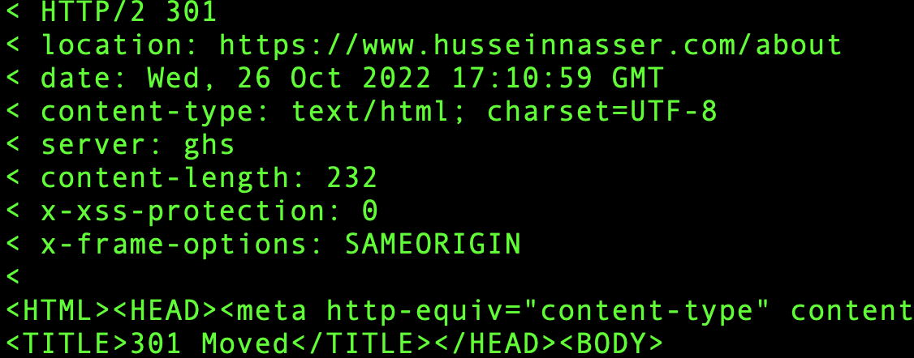
HTTP Response

Slide 135
HTTP
open
close
80
GET /
Headers+ index.html
<html>...
….

Slide 136
HTTPS
open
close
443
Handshake
GET /
Headers+ index.html
<html>...
….

Slide 137
HTTP 1.0
open
close
80
GET /index.html
GET /img1.jpg
GET /img2.jpg
….

Slide 138
HTTP 1.0
New TCP connection with each request
Slow
Buffering (transfer-encoding:chunked didn’t exist)
No multi-homed websites (HOST header)

Slide 139
HTTP 1.1
open
close
80
GET /index.html
GET /img1.jpg
GET /img2.jpg
….

Slide 140
HTTP 1.1
Pipelining
open
close
80
GET /index.html
GET /img1.jpg
GET /img2.jpg
….

Slide 141
HTTP 1.1
Persisted TCP Connection
Low Latency & Low CPU Usage
Streaming with Chunked transfer
Pipelining (disabled by default)
Proxying & Multiple websites on single IP

Slide 142
HTTP/2
SPDY
Compression
Multiplexing
Server Push
Secure by default
Protocol Negotiation during TLS (NPN/ALPN)

Slide 143
HTTP over QUIC (HTTP/3)
Replaces TCP with QUIC (UDP with Congestion control)
All HTTP/2 features
Without HOL

Slide 144
Summary
HTTP Anatomy
HTTP/1.0 over TCP
HTTP/1.1 over TCP
HTTP/2 over TCP
HTTP over QUIC (HTTP/3)

Slide 145
WebSockets
husseinnasser
Bidirectional communications on the web

Slide 146
Agenda
HTTP
WebSockets
WebSockets Handshake
WebSockets use cases
WebSockets Example
WebSockets Pros and Cons

Slide 147
HTTP 1.0
open
close
80
GET /index.html
GET /img1.jpg
GET /img2.jpg
….

Slide 148
HTTP 1.1
open
close
80
GET /index.html
GET /img1.jpg
GET /img2.jpg
….

Slide 149
WebSockets
open
close
80
Websocket handshake
….

Slide 150
WebSockets Handshake ws:// or wss://
open
close
80
GET 1.1 UPGRADE
101 - Switching Protocols
….

Slide 151
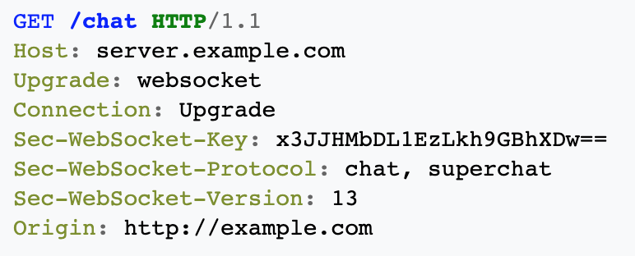
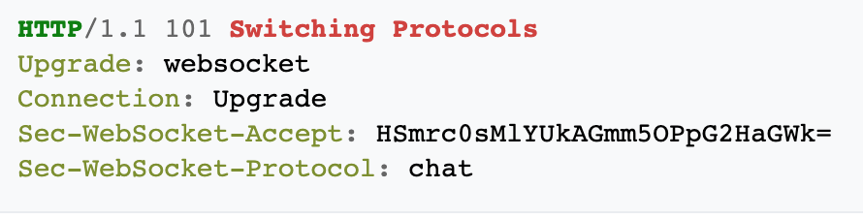
WebSocket Handshake
Client
Server

Slide 152
WebSockets use cases
Chatting
Live Feed
Multiplayer gaming
Showing client progress/logging

Slide 153
WebSockets Pros and Cons
Pros
Cons
Full-duplex (no polling)
Proxying is tricky
HTTP compatible
L7 LB challenging (timeouts)
Firewall friendly (standard)
Stateful, difficult to horizontally scale

Slide 154
Do you have to use WebSockets?
No
Rule of thumb - do you absolutely need bidirectional communication?
Long polling
Server Sent Events

Slide 155
Summary
HTTP
WebSockets
WebSockets Handshake
WebSockets use cases
WebSockets Example
WebSockets Pros and Cons

Slide 156
HTTP/2
husseinnasser
Improving HTTP/1.1

Slide 157
Agenda
How HTTP 1.1 Works?
How HTTP/2 Works?
HTTP/2 Pros & Cons
H1 vs H2 performance test!

Slide 158
HTTP 1.1
GET /index.html
200 ok Html document
….

Slide 159
HTTP 1.1
GET /main.js
Content type javascript, main.js
/index.html ✅
/main.js
/main.css
/img1.jpg
….

Slide 160
HTTP 1.1
GET /main.css
Content type css, main.js
/index.html ✅
/main.js ✅
/main.css
/img1.jpg
….

Slide 161
HTTP 1.1 (Browsers use 6 connections)
GET /main.js
GET /main.css
GET /img1.jpg

Slide 162
HTTP/2
GET /main.js (stream1)
GET /main.css (stream3)
GET /img1.jpg (stream5)
GET /img2.jpg (stream7)

Slide 163
HTTP/2 with Push
GET /index.html (stream1)
Index.html (stream1)
Main.css (stream 2)
Main.js (stream 4)
Img.jpg (stream 6)
….

Slide 164
HTTP/2 Pros
Multiplexing over Single Connection (save resources)
Compression (Headers & Data)
Server Push
Secure by default
Protocol Negotiation during TLS (ALPN)

Slide 165
HTTP/2 Cons
TCP head of line blocking
Server Push never picked up
High CPU usage

Slide 166
Summary
How HTTP 1.1 Works?
How HTTP/2 Works?
HTTP/2 Pros & Cons
H1 vs H2 performance test

Slide 167
HTTP/3
husseinnasser
HTTP over QUIC
Multiplexed streams

Slide 168
Agenda
How HTTP 1.1 Works?
How HTTP/2 Works?
HTTP/2 Cons
How HTTP/3 & QUIC saves the day
HTTP/3 & QUIC Pros & Cons

Slide 169
HTTP 1.1
GET /index.html
200 ok Html document
….

Slide 170
HTTP 1.1
GET /main.js
Content type javascript, main.js
/index.html ✅
/main.js
/main.css
/img1.jpg
….

Slide 171
HTTP 1.1
GET /main.css
Content type css, main.js
/index.html ✅
/main.js ✅
/main.css
/img1.jpg
….

Slide 172
HTTP 1.1 (Browsers use 6 connections)
GET /main.js
GET /main.css
GET /img1.jpg

Slide 173
HTTP/2
GET /main.js (stream1)
GET /main.css (stream3)
GET /img1.jpg (stream5)
GET /img2.jpg (stream7)

Slide 174
TCP head of line blocking
TCP segments must be delivered in order
But streams don’t have to
Blocking requests

Slide 175

HTTP/2 TCP HOL
GET /main.js (stream1)
GET /main.css (stream2)
GET /img1.jpg (stream3)
GET /img2.jpg (stream4)
8
7
6
5
4
3
2
1
2
1
GET /main.js (stream1)
4
3
GET /main.css (stream2)
6
5
GET /img1.jpg (stream3)
8
7
GET /img2.jpg (stream4)

Slide 176

HTTP/2 TCP HOL
GET /main.js (stream1)
GET /main.css (stream2)
GET /img1.jpg (stream3)
GET /img2.jpg (stream4)
8
7
6
5
4
3
2
1
2
1
GET /main.js (stream1)
4
GET /main.css (stream2)
6
5
GET /img1.jpg (stream3)
8
7
GET /img2.jpg (stream4)

Slide 177
HTTP/3 & QUIC
HTTP/3 uses QUIC
Like HTTP/2, QUIC has streams
But QUIC use UDP instead
Application decides the boundary

Slide 178
HTTP/3 Streams
GET /main.js (stream1)
GET /main.css (stream2)
GET /img1.jpg (stream3)
GET /img2.jpg (stream4)
8
7
6
5
4
3
2
1
2
1
GET /main.js (stream1)
4
GET /main.css (stream2)
6
5
GET /img1.jpg (stream3)
8
7
GET /img2.jpg (stream4)

Slide 179
HTTP/3 & QUIC Pros
QUIC has many other benefits
Merges Connection setup + TLS in one handshake
Has congestion control at stream level
Connection migration (connectionID)
Why not HTTP/2 over QUIC?
  Header compression algorithm

Slide 180
HTTP/3 & QUIC Cons
Takes a lot of CPU (parsing logic)
UDP could be blocked
IP Fragmentations is the enemy

Slide 181
Summary
How HTTP 1.1 Works?
How HTTP/2 Works?
HTTP/2 Cons
How HTTP/3 & QUIC saves the day
HTTP/3 & QUIC Pros & Cons

Slide 182
gRPC
husseinnasser
Taking HTTP/2 to the next level

Slide 183
Agenda
Motivation
  Client/Server Communication
  Problem with Client Libraries
  Why gRPC was invented?
gRPC
  Unary gRPC
  Server Streaming
  Client Streaming
  Bidirectional
Coding!
gRPC Pros & Cons
I’m tired of new protocols
Summary

Slide 184
Client Server Communication
SOAP, REST, GraphQL
SSE, WebSockets
Raw TCP

Slide 185
The Problem with Client Libraries
Any communication protocol needs client library for the language of choice
  SOAP Library
  HTTP Client Library
Hard to maintain and patch client libraries
  HTTP/1.1 HTTP/2, new features, security etc.

Slide 186
Why gRPC was invented?
Client Library: One library for popular languages
Protocol: HTTP/2 (hidden implementation)
Message Format: Protocol buffers as format

Slide 187
gRPC modes
Unary RPC
Server streaming RPC
Client streaming RPC
Bidirectional streaming RPC

Slide 188

gRPC modes
Unary RPC
Server streaming RPC
Client streaming RPC
Bidirectional streaming RPC

Slide 189
gRPC modes
Unary RPC
Server streaming RPC
Client streaming RPC
Bidirectional streaming RPC

Slide 190
gRPC modes
Unary RPC
Server streaming RPC
Client streaming RPC
Bidirectional streaming RPC

Slide 191
Coding time!
Todo application (server, client) with gRPC
createTodo ( )
readTodos ( ) //synchronous
readTodos ( ) //server stream

Slide 192
gRPC Pros & Cons
Pros
Cons
Fast & Compact
One Client Library
Progress Feedback (upload)
Cancel Request (H2)
H2/Protobuf
Schema
Thick Client
Proxies
Error handling
No native browser support
Timeouts (pub/sub)

Slide 193
Can I write my own protocol too?
Yes, you can, Spotify did (Hermes) but guess what
Only you will be using it so…
Spotify moved to gRPC not because of limitation of Hermes but because they are isolated.

Slide 194
Summary
Motivation
  Client/Server Communication
  Problem with Client Libraries
  Why gRPC was invented?
gRPC
  Unary gRPC
  Server Streaming
  Client Streaming
  Bidirectional
Coding!
gRPC Pros & Cons
I’m tired of new protocols
Summary

Slide 195
WebRTC
husseinnasser
Realtime communication on the web

Slide 196
Agenda
WebRTC Overview
WebRTC Demystified
  NAT, STUN, TURN, ICE, SDP, Signaling the SDP
Demo
WebRTC Pros & Cons
More WebRTC content beyond this content

Slide 197
WebRTC Overview
Stands for Web Real-Time Communication
Find a peer to peer path to exchange video and audio in an efficient and low latency manner
Standardized API
Enables rich communications browsers, mobile, IOT devices

Slide 198
WebRTC Overview
A wants to connect to B
A finds out all possible ways the public can connect to it
B finds out all possible ways the public can connect to it
A and B signal this session information via other means
  WhatsApp, QR, Tweet, WebSockets, HTTP Fetch..
A connects to B via the most optimal path
A & B also exchanges their supported media and security

Slide 199

WebRTC Overview
How can people reach me? (A1, A2, A3) are candidates
Security Parameters
Media options
How can people reach me?
B1, B2, B3 are candidates
Security Parameters
Media options
A1
B1
A2
B2
A
B
A3
B3

Slide 200
WebRTC Overview
Looks like B2 is the available and optimal path
Looks like A1 is the available and optimal path
A1
B1
A2
B2
A
B
A3
B3

Slide 201
WebRTC Demystified
NAT
STUN, TURN
ICE
SDP
Signaling the SDP

Slide 202

Network Address Translation
10.0.0.1
5.5.5.5
10.0.0.2
8992
10.0.0.2
GET/
4.4.4.4
80
4.4.4.4:80
8992
10.0.0.2
GET/
4.4.4.4
80
3333
5.5.5.5
GET/
4.4.4.4
80
3333
5.5.5.5
GET/
4.4.4.4
80
Internal IP | Internal Port | External IP | Ext. Port | Dest IP | Dest Port
10.0.0.2 | 8992 | 5.5.5.5 | 3333 | 4.4.4.4 | 80

Slide 203
Network Address Translation
10.0.0.1
5.5.5.5
10.0.0.2
80
4.4.4.4
200 OK
5.5.5.5
3333
80
4.4.4.4
200 OK
10.0.0.2
8992
4.4.4.4:80
80
4.4.4.4
200 OK
10.0.0.2
8992
80
4.4.4.4
200 OK
5.5.5.5
3333
Internal IP | Internal Port | Ext IP | Ext Port | Dest IP | Dest Port
10.0.0.2 | 8992 | 5.5.5.5 | 3333 | 4.4.4.4 | 80

Slide 204
NAT Translations Method
One to One NAT (Full-cone NAT)
Address restricted NAT
Port restricted NAT
Symmetric NAT

Slide 205
One to One NAT (Full cone NAT)
Packets to external IP:port on the router always maps to internal IP:port without exceptions
Internal IP | Internal Port | Ext IP | Ext Port | Dest IP | Dest Port
10.0.0.2 | 8992 | 5.5.5.5 | 3333 | 4.4.4.4 | 80

Slide 206

One to One NAT
80
4.4.4.4
200 OK
5.5.5.5
3333
22
3.3.3.3
200 OK
5.5.5.5
3333
10.0.0.1
5.5.5.5
8080
3.3.3.3
200 OK
5.5.5.5
3333
10.0.0.2
23
9.8.1.2
200 OK
5.5.5.5
3333
Internal IP | Internal Port | Ext IP | Ext Port | Dest IP | Dest Port
10.0.0.2 | 8992 | 5.5.5.5 | 3333 | 4.4.4.4 | 80
10.0.0.2 | 9999 | 5.5.5.5 | 4444 | 3.3.3.3 | 80

Slide 207
Address Restricted NAT
Packets to external IP:port on the router always maps to internal IP:port as long as source address from packet matches the table (regardless of port)
Allow if we communicated with this host before
Internal IP | Internal Port | Ext IP | Ext Port | Dest IP | Dest Port
10.0.0.2 | 8992 | 5.5.5.5 | 3333 | 4.4.4.4 | 80

Slide 208

Address Restricted NAT
80
4.4.4.4
200 OK
5.5.5.5
3333
22
3.3.3.3
200 OK
5.5.5.5
3333
10.0.0.1
5.5.5.5
8080
3.3.3.3
200 OK
5.5.5.5
3333
10.0.0.2
23
9.8.1.2
200 OK
5.5.5.5
3333
Internal IP | Internal Port | Ext IP | Ext Port | Dest IP | Dest Port
10.0.0.2 | 8992 | 5.5.5.5 | 3333 | 4.4.4.4 | 80
10.0.0.2 | 9999 | 5.5.5.5 | 4444 | 3.3.3.3 | 80

Slide 209
Port Restricted NAT
Packets to external IP:port on the router always maps to internal IP:port as long as source address and port from packet matches the table
Allow if we communicated with this host:port before
Internal IP | Internal Port | Ext IP | Ext Port | Dest IP | Dest Port
10.0.0.2 | 8992 | 5.5.5.5 | 3333 | 4.4.4.4 | 80

Slide 210
Port Restricted NAT
80
4.4.4.4
200 OK
5.5.5.5
3333
22
3.3.3.3
200 OK
5.5.5.5
3333
10.0.0.1
5.5.5.5
8080
3.3.3.3
200 OK
5.5.5.5
3333
10.0.0.2
23
9.8.1.2
200 OK
5.5.5.5
3333
Internal IP | Internal Port | Ext IP | Ext Port | Dest IP | Dest Port
10.0.0.2 | 8992 | 5.5.5.5 | 3333 | 4.4.4.4 | 80
10.0.0.2 | 9999 | 5.5.5.5 | 4444 | 3.3.3.3 | 80
10.0.0.2 | 8888 | 5.5.5.5 | 2222 | 3.3.3.3 | 8080

Slide 211
Symmetric NAT
Packets to external IP:port on the router always maps to internal IP:port as long as source address and port from packet matches the table
Only Allow if the full pair match
Internal IP | Internal Port | Ext IP | Ext Port | Dest IP | Dest Port
10.0.0.2 | 8992 | 5.5.5.5 | 3333 | 4.4.4.4 | 80

Slide 212
Symmetric NAT
80
4.4.4.4
200 OK
5.5.5.5
3333
22
3.3.3.3
200 OK
5.5.5.5
3333
10.0.0.1
5.5.5.5
8080
3.3.3.3
200 OK
5.5.5.5
3333
10.0.0.2
23
9.8.1.2
200 OK
5.5.5.5
3333
Internal IP | Internal Port | Ext IP | Ext Port | Dest IP | Dest Port
10.0.0.2 | 8992 | 5.5.5.5 | 3333 | 4.4.4.4 | 80
10.0.0.2 | 9999 | 5.5.5.5 | 4444 | 3.3.3.3 | 80
10.0.0.2 | 8888 | 5.5.5.5 | 2222 | 3.3.3.3 | 8080

Slide 213
STUN
Session Traversal Utilities for NAT
Tell me my public ip address/port through NAT
Works for Full-cone, Port/Address restricted NAT
Doesn’t work for symmetric NAT
STUN server port 3478, 5349 for TLS
Cheap to maintain

Slide 214

STUN Request
10.0.0.1
5.5.5.5
8992
10.0.0.2
STN
9.9.9.9
3478
9.9.9.9:3478
(STUN Sever)
10.0.0.2
3333
5.5.5.5
STN
9.9.9.9
3478
3333
5.5.5.5
STN
9.9.9.9
3478
8992
10.0.0.2
STN
9.9.9.9
3478
Internal IP | Internal Port | Ext IP | Ext Port | Dest IP | Dest Port
10.0.0.2 | 8992 | 5.5.5.5 | 3333 | 9.9.9.9 | 3478

Slide 215
STUN Response
10.0.0.1
5.5.5.5
9.9.9.9:3478
(STUN Sever)
3478
9.9.9.9
RSP
5.5.5.5
3333
10.0.0.2
You are 5.5.5.5:3333
3478
9.9.9.9
RSP
10.0.0.2
8992
3478
9.9.9.9
RSP
10.0.0.2
8992
You are 5.5.5.5:3333
3478
9.9.9.9
RSP
5.5.5.5
3333
Internal IP | Internal Port | Ext IP | Ext Port | Dest IP | Dest Port
10.0.0.2 | 8992 | 5.5.5.5 | 3333 | 9.9.9.9 | 3478

Slide 216
STUN when it works!
Who am i?
Who am i?
You are 5.5.5.5:3333
You are 7.7.7.7:4444
Hey 7.7.7.7:4444 I’m 5.5.5.5:3333 lets connect
10.0.0.2
Behind full cone NAT
Sure! 5.5.5.5:3333!
192.168.1.2
Behind full cone NAT
Shortest path! With lowest latency

Slide 217
STUN when it doesn’t!
Who am i?
Who am i?
You are 5.5.5.5:3333
You are 7.7.7.7:4444
Hey 7.7.7.7:4444 I’m 5.5.5.5:3333 lets connect
10.0.0.2
Behind full cone NAT
NOPE!
192.168.1.2
Behind symmetric NAT

Slide 218
TURN
Traversal Using Relays around NAT
In case of Symmetric NAT we use TURN
It's just a server that relays packets
TURN default server port 3478, 5349 for TLS
Expensive to maintain and run

Slide 219
TURN
5.5.5.5:3333 sent “hello” to you
Send hello 7.7.7.7:4444
7.7.7.7:4444 says HI
Sure, tell 5.5.5.5:3333 I said Hi
10.0.0.2
(5.5.5.5:3333)
Behind symmetric NAT
192.168.1.2
(7.7.7.7:4444)
Behind symmetric NAT

Slide 220
ICE
Interactive Connectivity Establishment
ICE collects all available candidates (local IP addresses, reflexive addresses – STUN ones and relayed addresses – TURN ones)
Called ice candidates
All the collected addresses are then sent to the remote peer via SDP

Slide 221
SDP
Session Description Protocol
A format that describes ice candidates, networking options, media options, security options and other stuff
Not really a protocol its a format
Most important concept in WebRTC
The goal is to take the SDP generated by a user and send it “somehow” to the other party

Slide 222
SDP Example
v=0
o=- 9148204791819634656 3 IN IP4 127.0.0.1
s=-
t=0 0
a=group:BUNDLE audio video data
a=msid-semantic: WMS kyaiqbOs7S2h3EoSHabQ3JlBqZ67cFqZmWFN
m=audio 50853 RTP/SAVPF 111 103 104 0 8 107 106 105 13 126
c=IN IP4 192.168.1.64
a=rtcp:50853 IN IP4 192.168.1.64
a=candidate:3460887983 1 udp 2113937151 192.168.1.64 50853 typ host generation 0
a=candidate:3460887983 2 udp 2113937151 192.168.1.64 50853 typ host generation 0
...

Slide 223
Signaling
SDP Signaling
Send the SDP that we just generated somehow to the other party we wish to communicate with
Signaling can be done via a tweet, QR code, Whatsapp, WebSockets, HTTP request DOESN’T MATTER! Just get that large string to the other party

Slide 224
WebRTC Demystified
A wants to connect to B
A creates an “offer”, it finds all ICE candidates, security options, audio/video options and generates SDP, the offer is basically the SDP
A signals the offer somehow to B (whatsapp)
B creates the “answer” after setting A’s offer
B signals the “answer” to A
Connection is created

Slide 225
WebRTC Demo
We will connect two browsers (Browser A & Browser B)
A will create an offer (sdp) and set it as local description
B will get the offer and set it as remote description
B creates an answer sets it as its local description and signal the answer (sdp) to A
A sets the answer as its remote description
Connection established, exchange data channel

Slide 226
WebRTC Pros & Cons
Pros
  P2p is great ! low latency for high bandwidth content
  Standardized API I don’t have to build my own
Cons
  Maintaining STUN & TURN servers
  Peer 2 Peer falls apart in case of multiple participants (discord case)

Slide 227
More WebRTC stuff!
So more to discuss beyond this content

Slide 228
Media API
getUserMedia to access microphone, video camera
RTCPConnection.addTrack(stream)
https://www.html5rocks.com/en/tutorials/webrtc/basics/

Slide 229
onIceCandidate and addIceCandidate
To maintain the connection as new candidates come and go
onIceCandidate tells user there is a new candidate after the SDP has already been created
The candidate is signaled and sent to the other party
The other party uses addiceCandidate to add it to its SDP

Slide 230
Set custom TURN and STUN Servers
const iceConfiguration = {
iceServers: [{
urls: 'turn:turnserver.company.com:3478',
username: 'optional-username',
credentials: 'auth-token'},
{ urls: "stun:stun.services.mozilla.com",
username: "test@mozilla.com",
credential: "webrtcdemo"}
]
}
const pc = new RTCPeerConnection(configuration);

Slide 231
Create your own STUN & TURN server
COTURN open source project
https://github.com/coturn/coturn

Slide 232
Public STUN servers
stun1.l.google.com:19302
stun2.l.google.com:19302
stun3.l.google.com:19302
stun4.l.google.com:19302
stun.stunprotocol.org:3478

Slide 233
Many ways to HTTPS
husseinnasser
And how each affect latency

Slide 234
HTTPS Communication Basics
Establish Connection
Establish Encryption
Send Data
Close Connection (when absolutely done)

Slide 235
HTTPs communications
HTTPS over TCP with TLS 1.2
HTTPS over TCP with TLS 1.3
HTTPS over QUIC
HTTPS over TCP fast Open
HTTPS over TCP with TLS 1.3 0RTT
HTTPS over QUIC with 0RTT

Slide 236
HTTPS over TCP
With TLS 1.2
husseinnasser

Slide 237
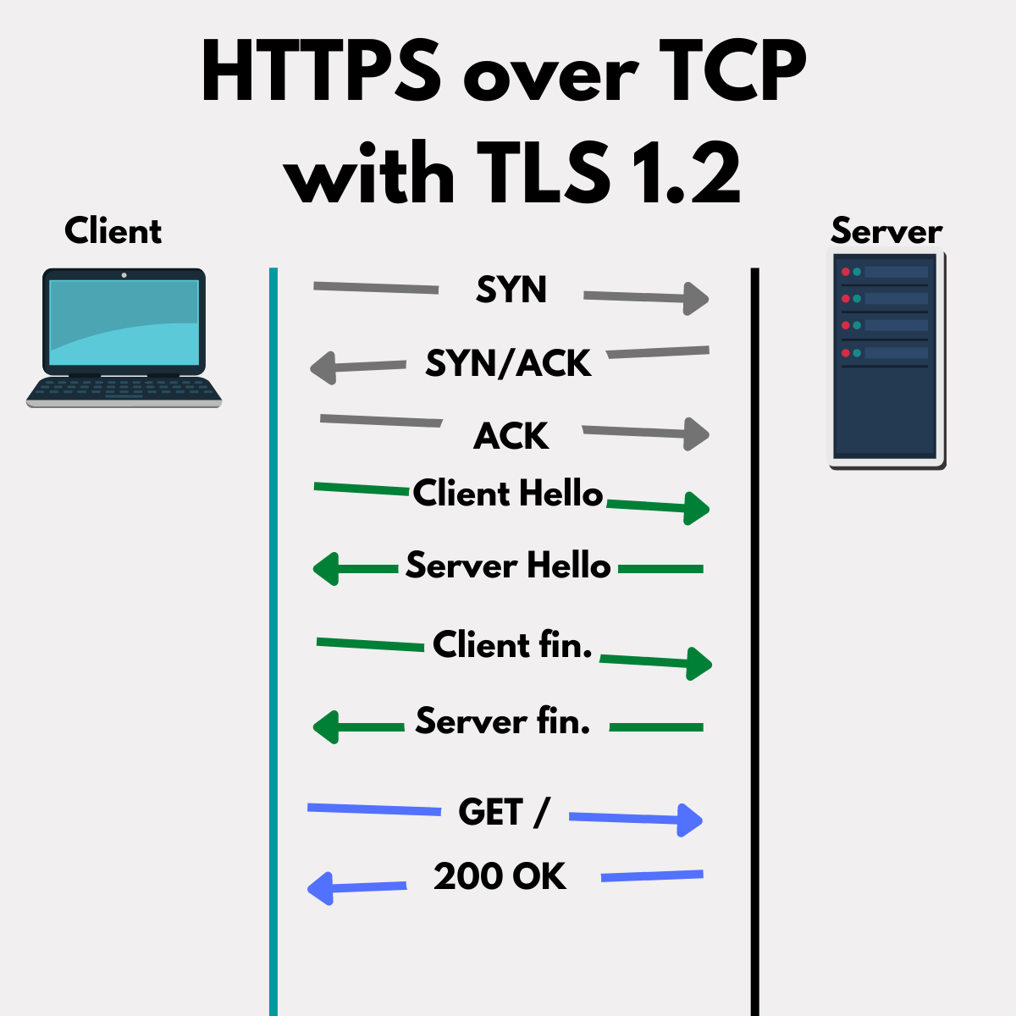
Notes:
Curl –trace https://nginx.org

Slide 238
HTTPS over TCP
With TLS 1.3
husseinnasser

Slide 239
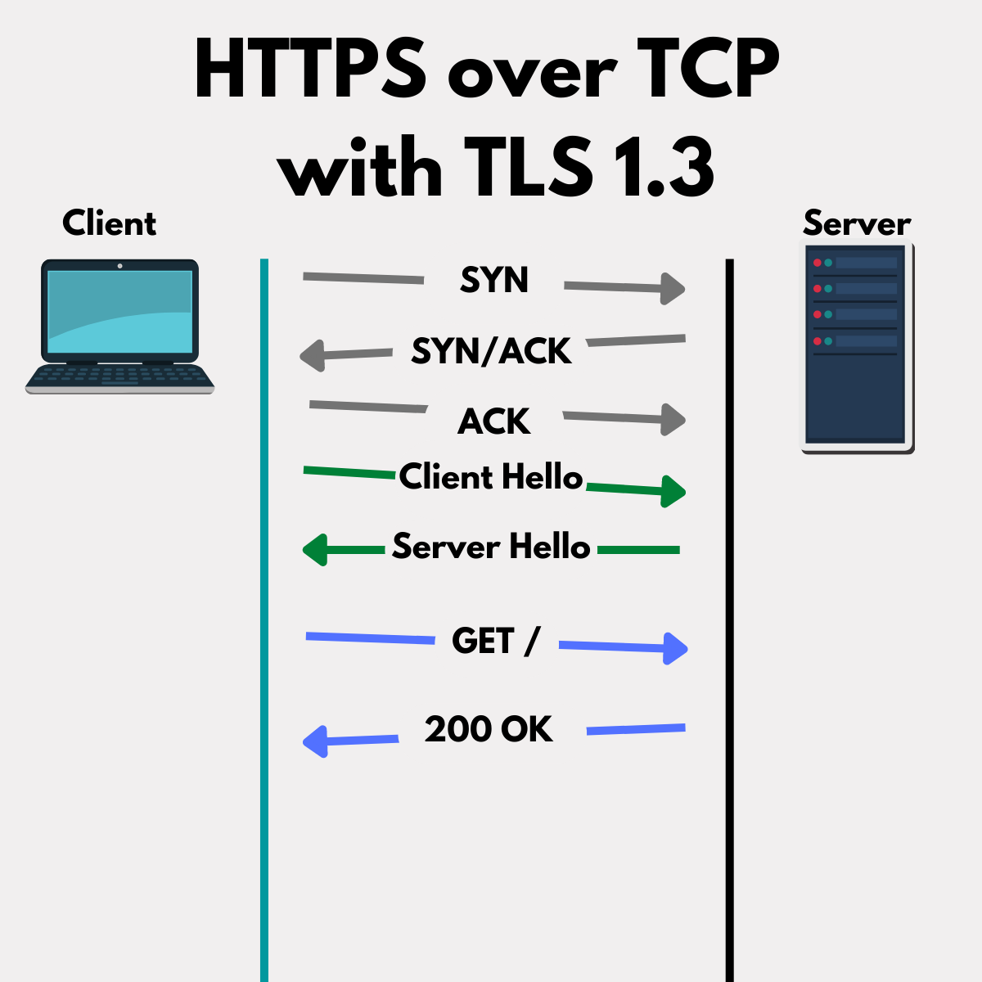
Notes:
Curl –trace https://google.com

Slide 240
HTTPS over QUIC
(HTTP/3)
husseinnasser

Slide 241
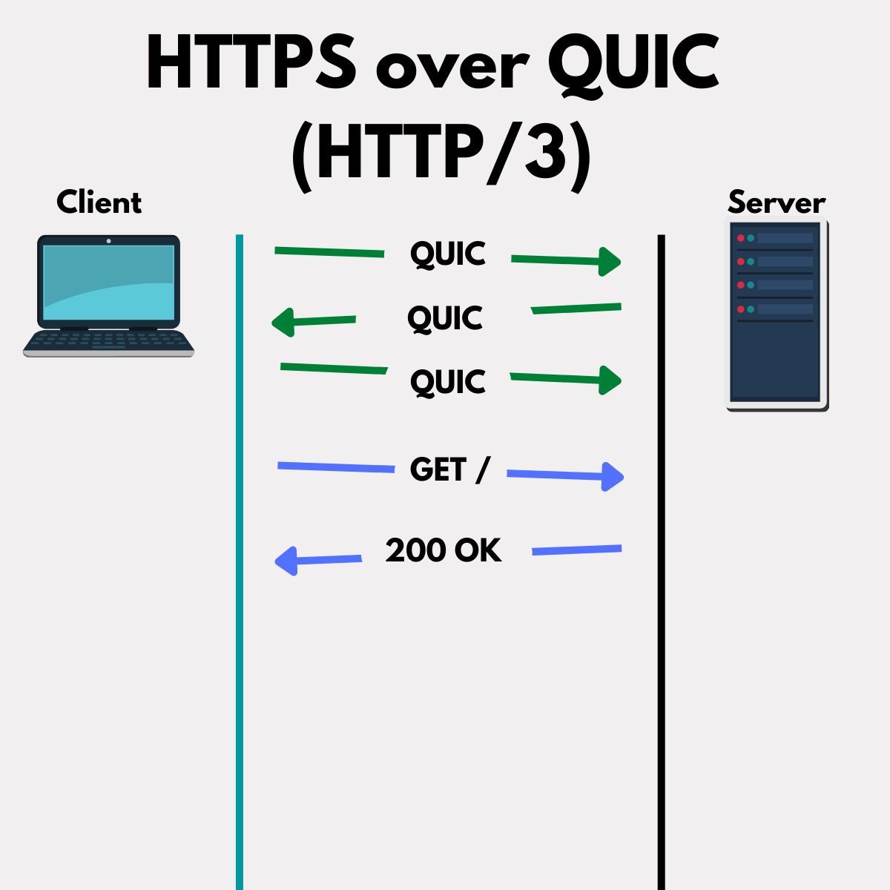

Slide 242
HTTPS over TFO
with TLS 1.3
husseinnasser

Slide 243
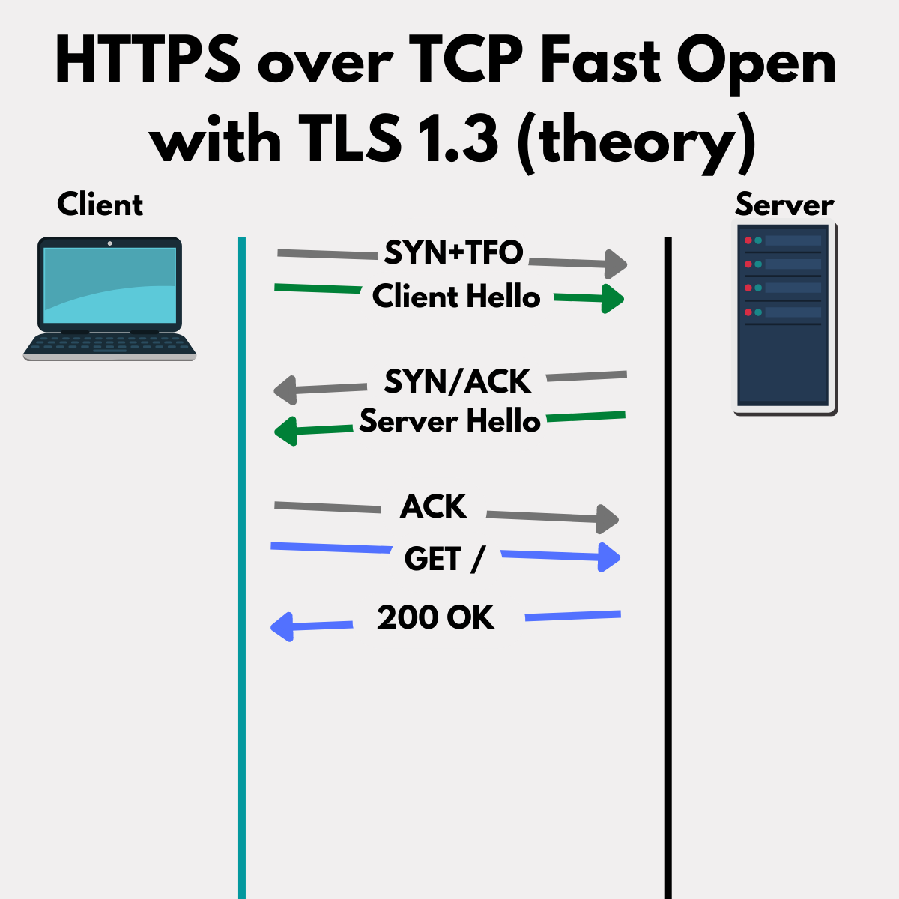

Slide 244
HTTPS over TFO
with TLS 1.3 0RTT
husseinnasser

Slide 245
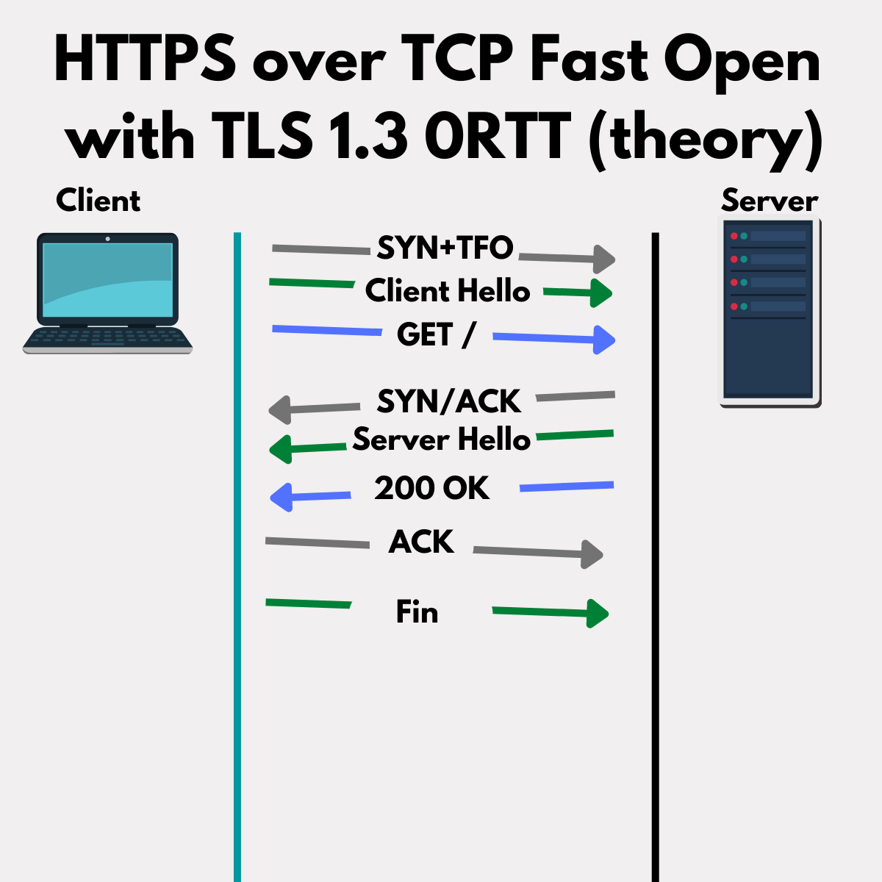

Slide 246
HTTPS over TCP with TLS1.3 0RTT
husseinnasser

Slide 247
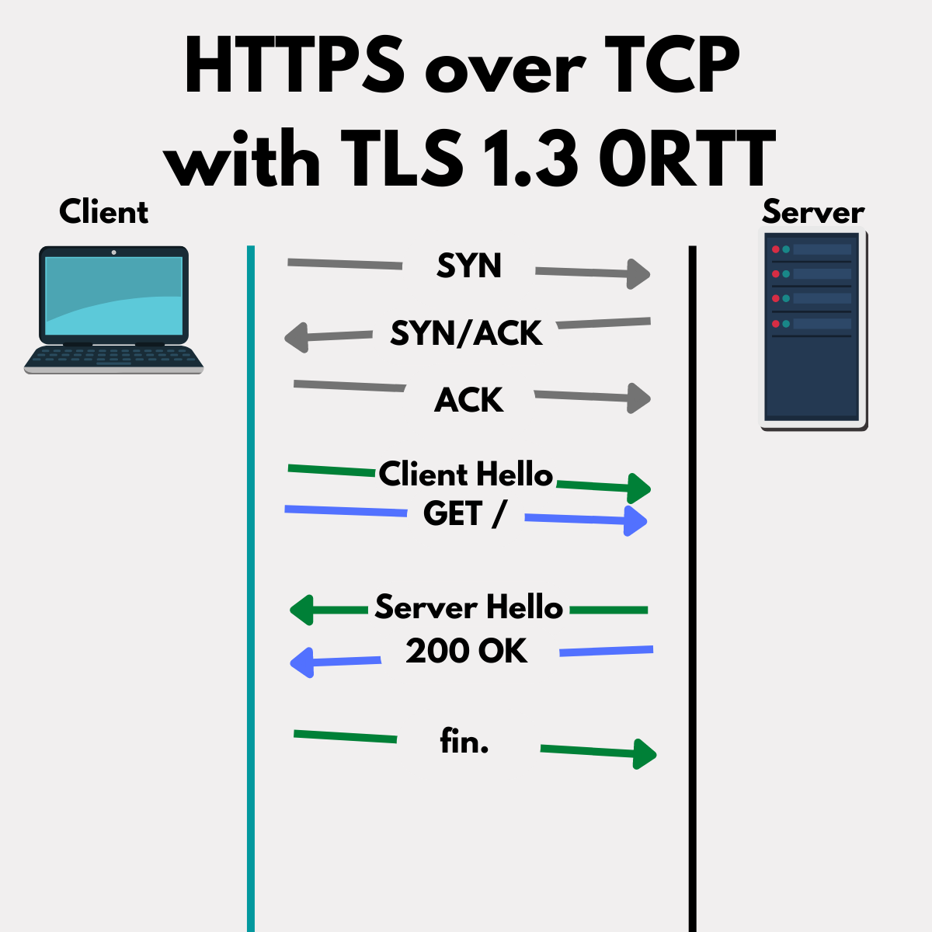

Slide 248
HTTPS over QUIC
0RTT
husseinnasser

Slide 249
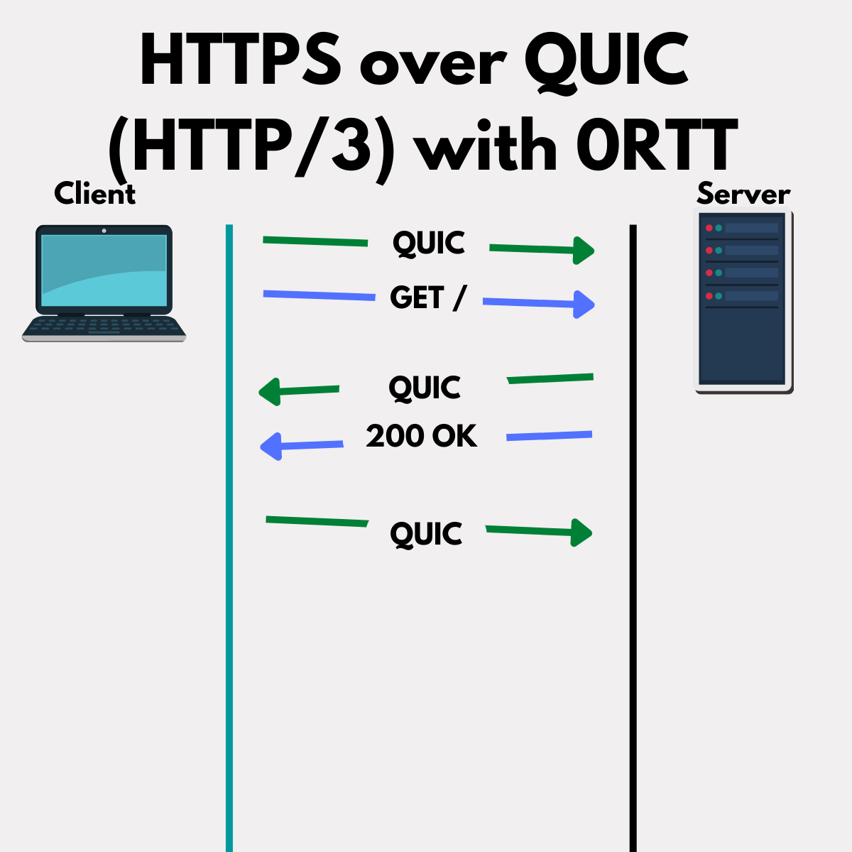

Slide 250
Backend Execution Patterns
husseinnasser
How Backends accept, dispatch and execute requests
Notes:
Process vs Threads
Connection Establishement
Reading and Sending data on the socket
Multiple patterns to dispatch work
Idempotency

Slide 251
Process vs Thread
husseinnasser
What is the difference?

Slide 252
What is a Process?
PID
A set of instructions
Has an isolated memory
Has a PID
Scheduled in the CPU

Slide 253
What is a Thread?
PID
Light weight Process (LWP)
A set of instructions
Shares memory with parent process
Has a ID
Scheduled in the CPU
LWP
LWP
LWP

Slide 254
Single Threaded Process
PID
One Process with a single thread
Simple
Examples NodeJS

Slide 255
Multi-Processes
PID
PID
App has multiple processes
Each has its own Memory
Examples NGINX/Postgres
Take advantage of multi-cores
More memory but isolated
Redis backup routine (COW)
PID
PID

Slide 256
Multi-Threaded
PID
One Process, multiple threads
Shared Memory (compete)
Take advantage of multi-cores
Require less memory
Race conditions
Locks and Latches (SQL Server)
Examples Apache, Envoy
LWP
LWP
LWP

Slide 257

How many is too many?
PID1
Too many processes/threads
CPU context switch
Multiple Cores help
Rule of thumb -> # Cores = # Processes
PID3
PID2

Slide 258
How Connections are Established
husseinnasser
SYN/Accept Queues

Slide 259
Connection Establishment
TCP Three way handshake
SYN/SYN-ACK/ACK
But what happens on the backend?
SYN
SYN/ACK
ACK

Slide 260
Connection Establishment
Server Listens on an address:port
Client connects
Kernel does the handshake creating a connection
Backend process “Accepts” the connection

Slide 261
Connection Establishment
Kernel creates a socket & two queues SYN and Accept
Client sends a SYN
Kernels adds to SYN queue, replies with SYN/ACK
Client replies with ACK
Kernel finish the connection
Kernel removes SYN from SYN queue
Kernel adds full connection to Accept queue
Backend accepts a connection, removed from accept queue
A file descriptor is created for the connection

Slide 262
Connection Establishment
SYN
SYN Queue
SYN/ACK
ACK
Accept Queue
accept()
copy
PID

Slide 263
Problems with accepting connections
Backend doesn’t accept fast enough
Clients who don’t ACK
Small backlog

Slide 264
Reading and Sending Data
husseinnasser
Receive vs Send buffers

Slide 265
Send and receive buffers
Client sends data on a connection
Kernel puts data in receive queue
Kernel ACKs (may delay) and update window
App calls read to copy data

Slide 266
Receive buffers
data
Receive buffer
ACK
read()
Copy
PID

Slide 267
Send buffers
data
Send buffer
ACK
send()
Copy
PID

Slide 268
Problems with reading and sending
Backend doesn’t read fast enough
Receive queue is full
Client slows down

Slide 269
Socket Programming Patterns
husseinnasser

Slide 270
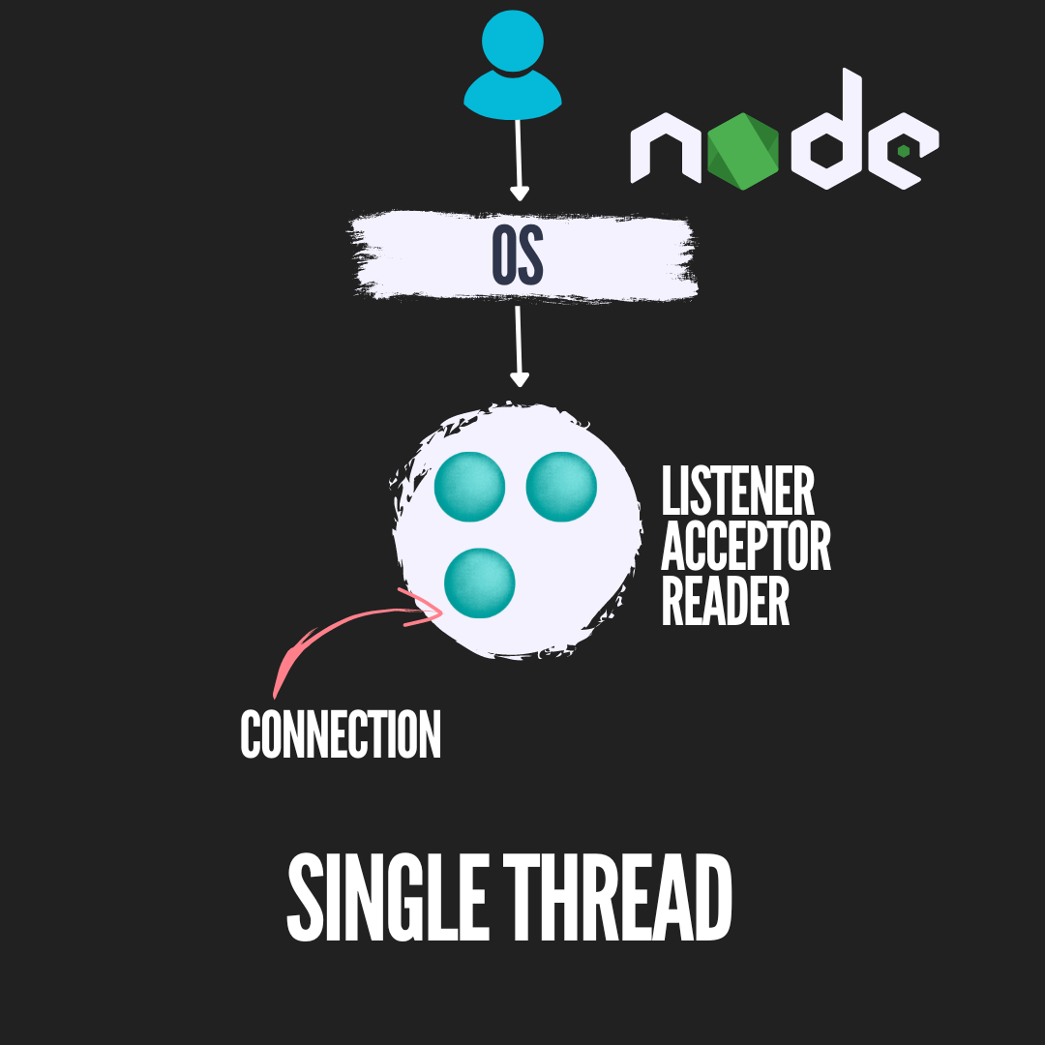
Single Listener/Single Worker Thread

Slide 271
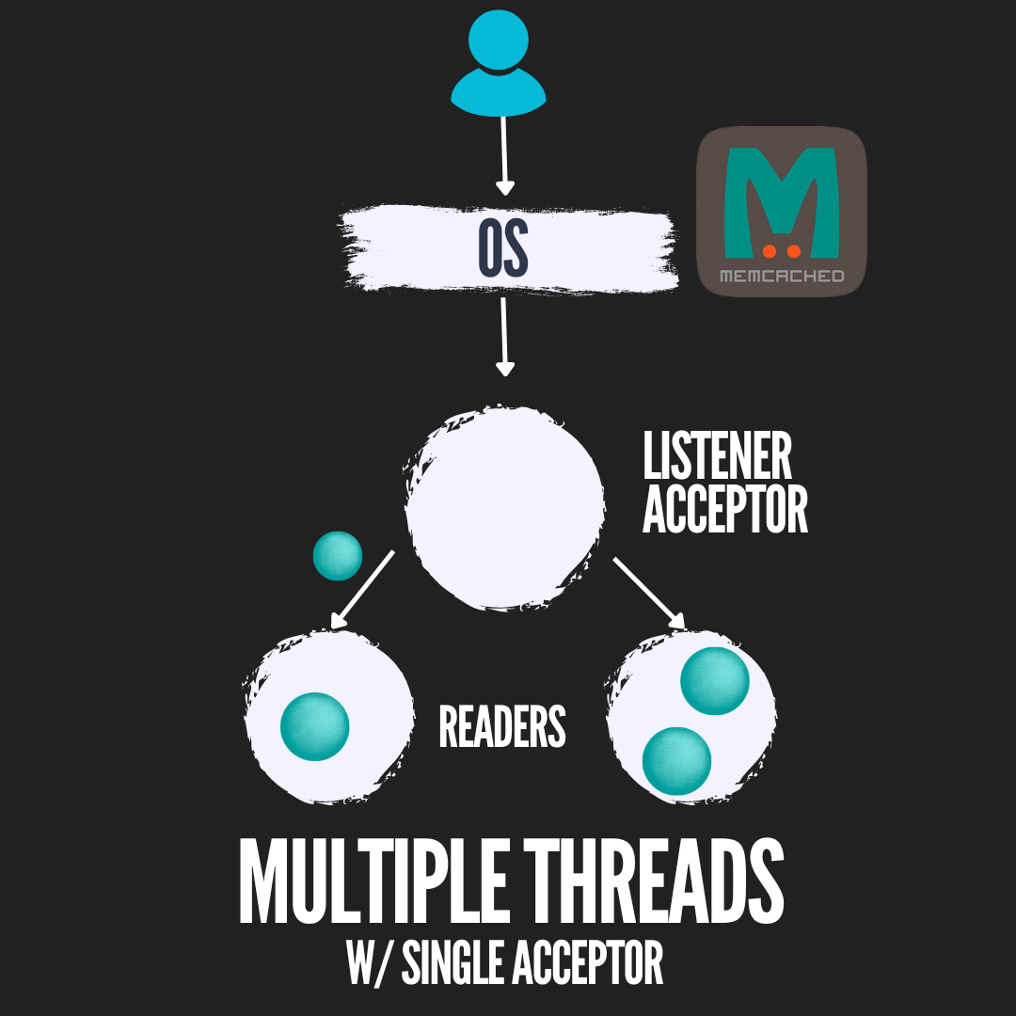
Single Listener/Multiple Worker threads

Slide 272
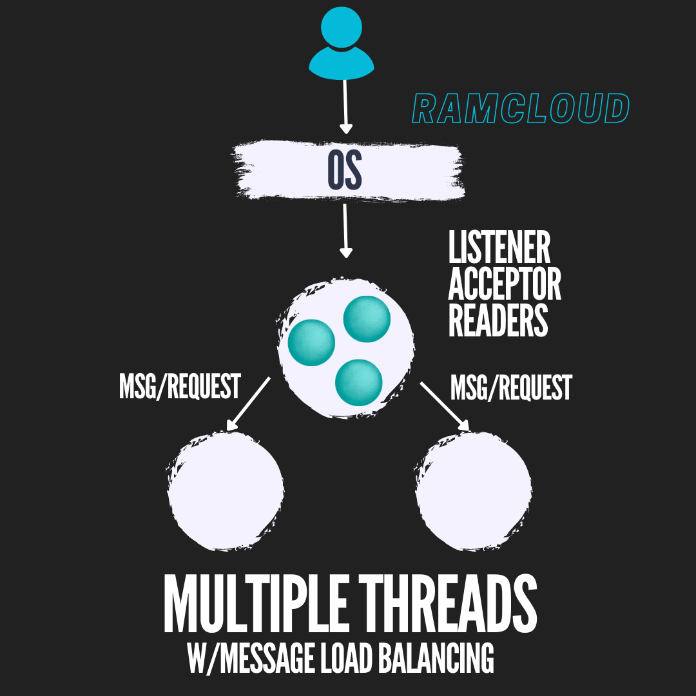
Single Listener/Multiple Worker threads with load balancing

Slide 273
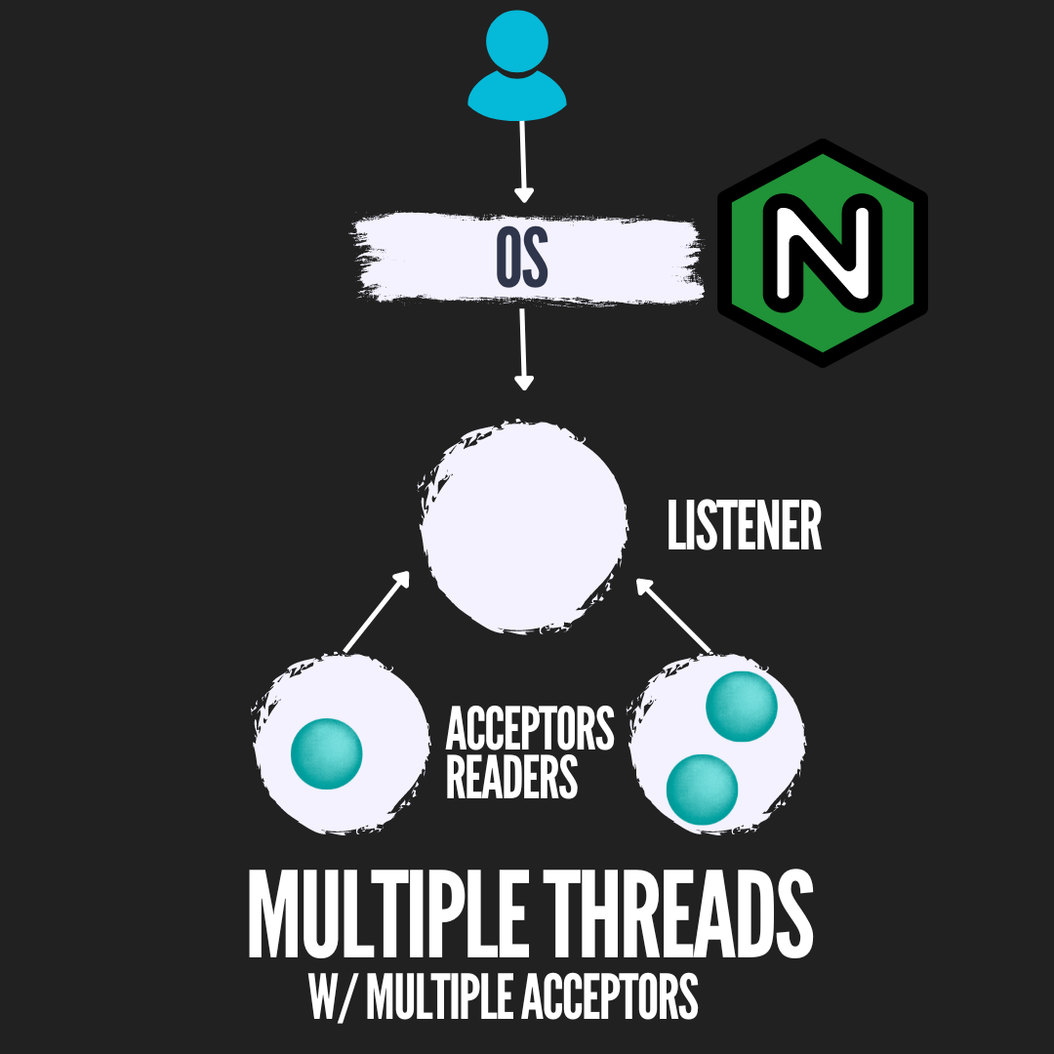
Multiple Acceptor Threads single Socket

Slide 274
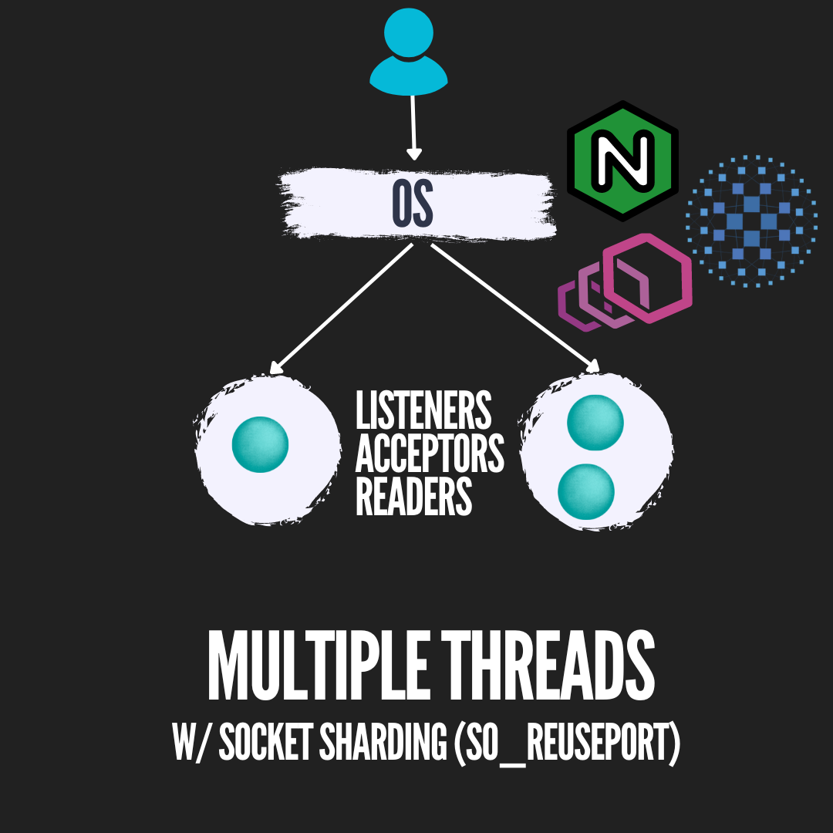
Multiple Listeners on the same port

Slide 275
Idempotency
husseinnasser
Resending the Request without affecting backend

Slide 276
What is idempotency?
API /postcomment
Takes comment and appends it to table
What if the user/proxy retries it?
You will have duplicate comments
Very bad for financial systems

Slide 277
What is idempotency?
Idempotent request can be retried without affecting backend
Easy implementation send a requestId
If requestId has been processed return
Also known as idempotency token

Slide 278
In HTTP
GET is idempotent
POST isn’t, but we can make it
Browsers and proxies treat GET as idempotent
Make sure your GETs are

Slide 279
Proxying & Load Balancing
husseinnasser
Core of backend engineering

Slide 280
Proxy vs Reverse Proxy
A fundamental component of backend networking

Slide 281
Layer 4 vs Layer 7
Load balancers
A fundamental component of backend networking

Slide 282
Agenda
Layer 4 vs Layer 7
Load Balancer
Layer 4 Load Balancer (pros and cons)
Layer 7 Load Balancer (pros and cons)

Slide 283
Layer 7 Application
Application
Layer 6 Presentation
Presentation
Layer 5 Session
Session
Layer 4 Transport
Transport
Layer 3 Network
Network
Layer 2 Data Link
Data Link
Layer 1 Physical
Physical

Slide 284
Load Balancer (aka fault tolerant)
Backend server 1
Load Balancer
Backend server 2

Slide 285
Layer 4 Load Balancer
TCP Connection
SYN
SYN/ACK
ACK
Backend server 1
44.1.1.3
TCP Connection
SYN
SYN/ACK
ACK
44.1.1.1
L4 Load Balancer
44.1.1.2
Backend server 2
44.1.1.4

Slide 286
Layer 4 Load Balancer
Backend server 1
44.1.1.3
TCP Connection
SYN
SYN/ACK
ACK
44.1.1.1
L4 Load Balancer
44.1.1.2
When a client connects to the L4 load balancer, the LB chooses one server and all segments for that connections go to that server
Backend server 2
44.1.1.4

Slide 287
Layer 4 Load Balancer
44.1.1.3
Data
44.1.1.2
Backend server 1
44.1.1.3
44.1.1.1
Data
44.1.1.2
44.1.1.1
L4 Load Balancer
44.1.1.2
Backend server 2
44.1.1.4

Slide 288
Layer 4 Load Balancer
44.1.1.2
RES
44.1.1.3
Backend server 1
44.1.1.3
44.1.1.2
RES
44.1.1.1
44.1.1.1
L4 Load Balancer
44.1.1.2
Backend server 2
44.1.1.4

Slide 289
Layer 4 Load Balancer
3
2
1
Backend server 1
44.1.1.3
HTTP GET /1
1
2
3
44.1.1.1
L4 Load Balancer
44.1.1.2
Backend server 2
44.1.1.4

Slide 290
Layer 4 Load Balancer
7
6
5
Backend server 1
44.1.1.3
HTTP GET /2
5
6
7
44.1.1.1
L4 Load Balancer
44.1.1.2
Backend server 2
44.1.1.4

Slide 291
Layer 4 Load Balancer
Backend server 1
44.1.1.3
44.1.1.1
1
2
1
2
3
L4 Load Balancer
44.1.1.2
3
(New connection)
HTTP GET /3
Backend server 2
44.1.1.4

Slide 292
Layer 4 Load Balancer (Pros and Cons)
Pros
Cons
Simpler load balancing
Efficient (no data lookup)
More secure
Works with any protocol
One TCP connection (NAT)
No smart load balancing
NA microservices
Sticky per connection
No caching
Protocol unaware (can be dangerous) bypass rules

Slide 293
Layer 7 Load Balancer
TCP Connection
SYN
SYN/ACK
ACK
Backend server 1
44.1.1.3
TCP Connection
SYN
SYN/ACK
ACK
44.1.1.1
L7 Load Balancer
44.1.1.2
Backend server 2
44.1.1.4

Slide 294
Layer 7 Load Balancer
Backend server 1
44.1.1.3
TCP Connection
SYN
SYN/ACK
ACK
44.1.1.1
L7 Load Balancer
44.1.1.2
When a client connects to the L7 load balancer, it becomes protocol specific. Any logical “request” will be forwarded to a new backend server. This could be one or more segments
Backend server 2
44.1.1.4

Slide 295
Layer 7 Load Balancer
44.1.1.3
Data
44.1.1.2
Backend server 1
44.1.1.3
44.1.1.1
Data
44.1.1.2
44.1.1.1
L7 Load Balancer
44.1.1.2
Backend server 2
44.1.1.4

Slide 296
Layer 7 Load Balancer
44.1.1.2
RES
44.1.1.3
Backend server 1
44.1.1.3
44.1.1.2
RES
44.1.1.1
44.1.1.1
L7 Load Balancer
44.1.1.2
Backend server 2
44.1.1.4

Slide 297
Layer 7 Load Balancer
LB parsers and understand the segments
3
2
1
2
3
1
Backend server 1
44.1.1.3
HTTP GET /1
1
2
3
44.1.1.1
L7 Load Balancer
44.1.1.2
Backend server 2
44.1.1.4

Slide 298
Layer 7 Load Balancer
Backend server 1
44.1.1.3
HTTP GET /2
5
6
7
44.1.1.1
5
L7 Load Balancer
44.1.1.2
6
7
Backend server 2
44.1.1.4

Slide 299
Layer 7 Load Balancer
3
2
1
Backend server 1
44.1.1.3
44.1.1.1
1
2
3
L7 Load Balancer
44.1.1.2
(New connection)
HTTP GET /3
Backend server 2
44.1.1.4

Slide 300
Layer 7 Load Balancer (Pros and Cons)
Pros
Cons
Smart load balancing
Caching
Great for microservices
API Gateway logic
Authentication
Expensive (looks at data)
Decrypts (terminates TLS)
Two TCP Connections
Must share TLS certificate
Needs to buffer
Needs to understand protocol

Slide 301
Summary
Layer 4 vs Layer 7
Load Balancer
Layer 4 Load Balancer (pros and cons)
Layer 7 Load Balancer (pros and cons)

Slide 302
WebSockets Proxying
How WebSockets are proxied

Slide 303
Agenda
Quick Introduction to WebSockets
Layer 4 vs Layer 7 WebSocket Proxying
Spin up a WebSocket Server without NGINX
Configure NGINX as a Layer 4 WebSocket Proxy/Load Balancer
Configure NGINX as a Layer 7 WebSocket Proxy/Load Balancer
Summary

Slide 304
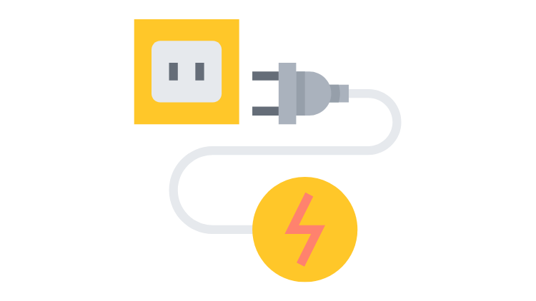
Introduction to WebSockets

Slide 305

HTTP 1.0
open
close
80
GET /index.html
GET /img1.jpg
GET /img2.jpg
….

Slide 306
HTTP 1.1
open
close
80
GET /index.html
GET /img1.jpg
GET /img2.jpg
….

Slide 307
WebSockets
open
close
80
Websocket handshake
….

Slide 308
WebSockets Handshake ws:// or wss://
open
close
80
GET / HTTP/1.1 Connection:Upgrade
101 - Switching Protocols
….

Slide 309
WebSocket Handshake
Client
Server

Slide 310
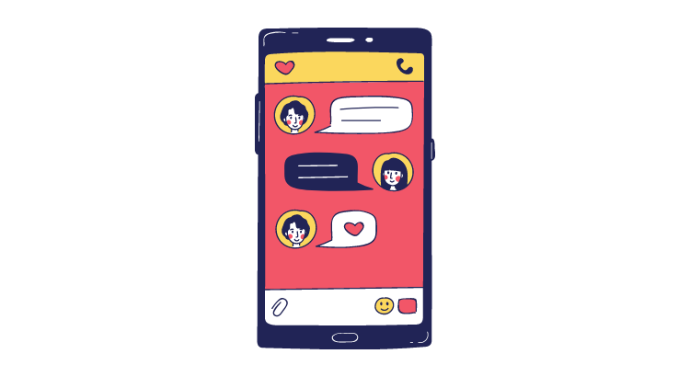



WebSockets use cases
Chatting
Live Feed
Multiplayer gaming
Showing client progress/logging

Slide 311

Layer 4 vs Layer 7
WebSockets
Proxying

Slide 312
Layer 4 vs Layer 7 WebSocket Proxying
In Layer 4 OSI model we see TCP/IP content
  Connections, Ports, IP addresses.
  Content remains encrypted (if unencrypted it is not inspected)
In Layer 7 OSI Model we see all what's below
  Layer 4 + Application layer content
  Content is decrypted (TLS termination)
  We can read headers, paths, urls etc.

Slide 313
Layer 4 vs Layer 7 WebSocket Proxying
Layer 4 Proxying on WebSockets is done as a tunnel
NGINX intercepts the SYN for a connection and creates another connection on the backend
Any data sent on the frontend connection is tunneled to the backend connection
The backend connection remains private and dedicated to this client.

Slide 314


Layer 4 Proxying on WebSocket
open
open
close
close
TLS Handshake
TLS Handshake
TLS Handshake Fn.
TLS Handshake Fn.
443
UPGRADE
UPGRADE
101 - Switching Protocols
101 - Switching Protocols

Slide 315

Layer 7 Proxying on WebSocket
open
open
close
close
TLS Handshake
TLS Handshake
TLS Handshake Fn.
TLS Handshake Fn.
443
UPGRADE
UPGRADE
101 - Switching Protocols
101 - Switching Protocols

Slide 316
Layer 7 Load Balancing (Normal HTTP requests)
TLS Handshake
TLS Handshake
TLS Handshake

Slide 317
Layer 7 Load Balancing (WebSocket)
TLS Handshake
TLS Handshake

Slide 318
Layer 4 Proxying
Listening on port 80
Any TCP connection request is a tunnel and always goes to the websocket app
Paths don’t matter (layer 7)
  ws://localhost/ -> websocket app
  ws://localhost/blahblah -> websocket app
Layer 4 proxying blindly tunnels everything to the backend
Any connection request to port 80 will be tunneled to the websocket app backend

Slide 319
Layer 7 Proxying
Intercept the path and “route” appropriately
http://localhost/ -> open main html page
ws://localhost/wsapp -> websocket app
ws://localhost/chat -> another websocket app for chatting
Can’t do that in Layer 4 since port 80 is blindly tunnels

Slide 320
Summary
Quick Introduction to WebSockets
Layer 4 vs Layer 7 WebSocket Proxying
Spin up a WebSocket Server without NGINX
Deploy NGINX as a Layer 4 WebSocket Load Balancer
Deploy NGINX as a Layer 7 WebSocket Load Balancer

Slide 321







PROXY VS
REVERSE PROXY
By Hussein Nasser

Slide 322


What is a Proxy?
I want to go to google.com through
proxy: my-proxy.com
my-proxy.com
google.com
I just know that I received a request from my-proxy

Slide 323




PROXY USE CASES
Caching
Anonymity
Logging
Block Sites
Microservices

Slide 324
What is a Reverse Proxy?
google-server1
I want to go to google.com
google.com
google-server2

Slide 325



REVERSE PROXY USE CASES
Caching
Load Balancing
Ingress
Canary Deployment
Microservices

Slide 326

MOST COMMON QUESTIONS
Can Proxy & Reverse Proxy used in the same time?
Can I use Proxy instead of VPN for anonymity?
Is Proxy just for HTTP traffic?

