Slide 1
Data Analysis for FreeRadius (vAAA)
Md Arif Hossen earihos@mail.uni-paderborn.de
Notes:
Everyone introduce themselves?

Slide 2
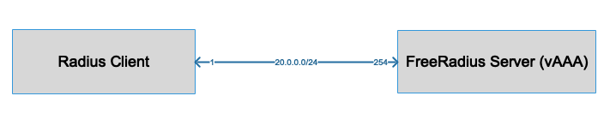
FreeRadius Experiment Network

Slide 3
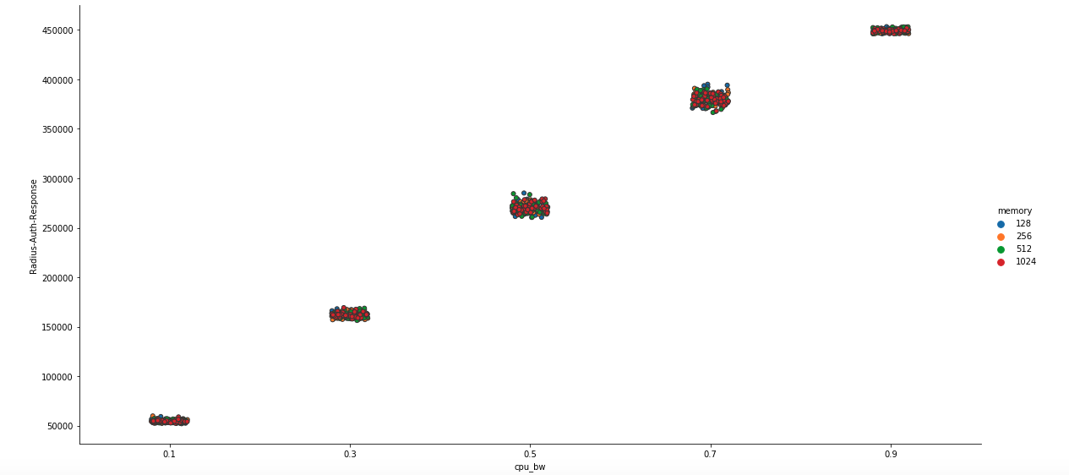
Authentication Request

Slide 4
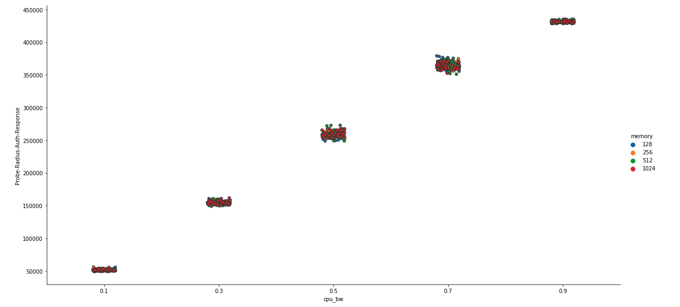
Authentication Response

