Slide 1
Data Analysis for OpenIMSCore
Md Arif Hossen earihos@mail.uni-paderborn.de
Notes:
Everyone introduce themselves?

Slide 2
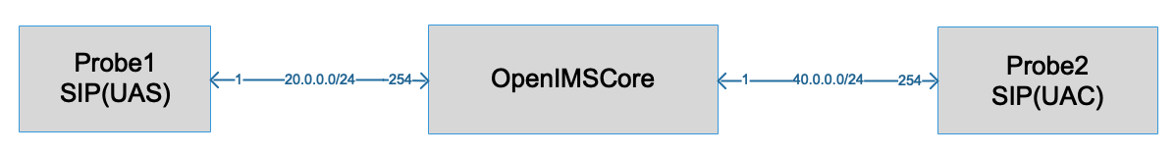
OpenIMSCore Network Setup

Slide 3
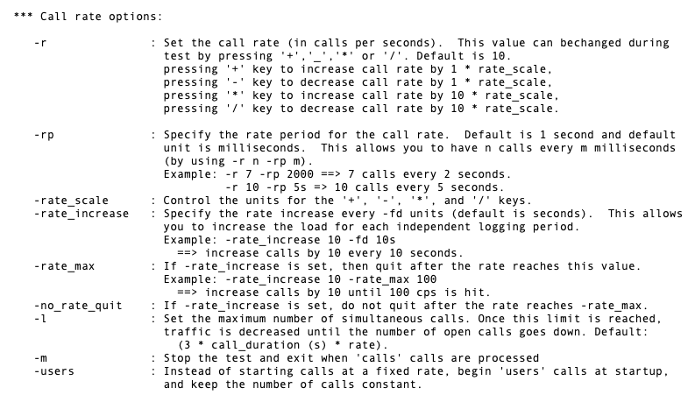
Parameter for the experiment

Slide 4
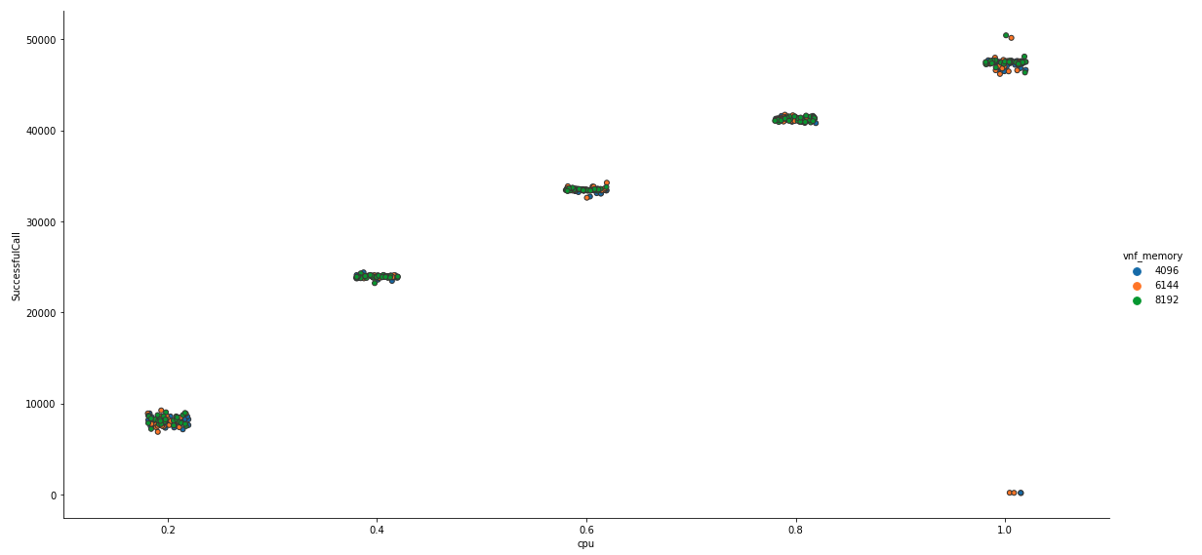
Successful Call

Slide 5
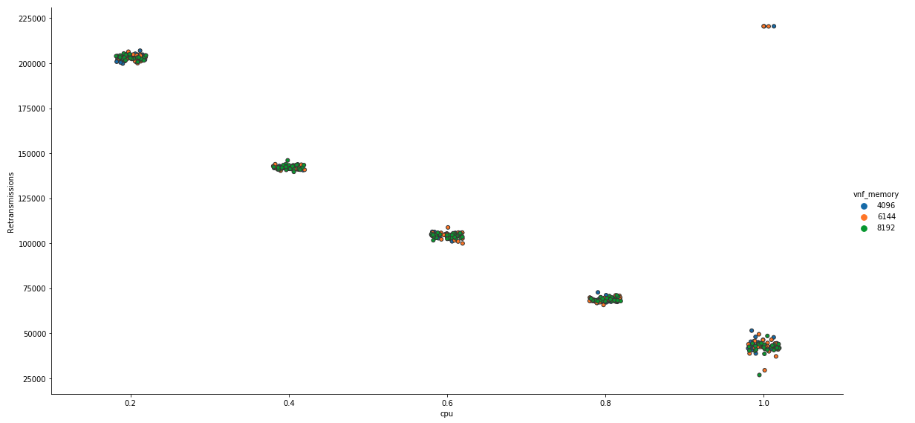
Retransmissions of Call

Slide 6
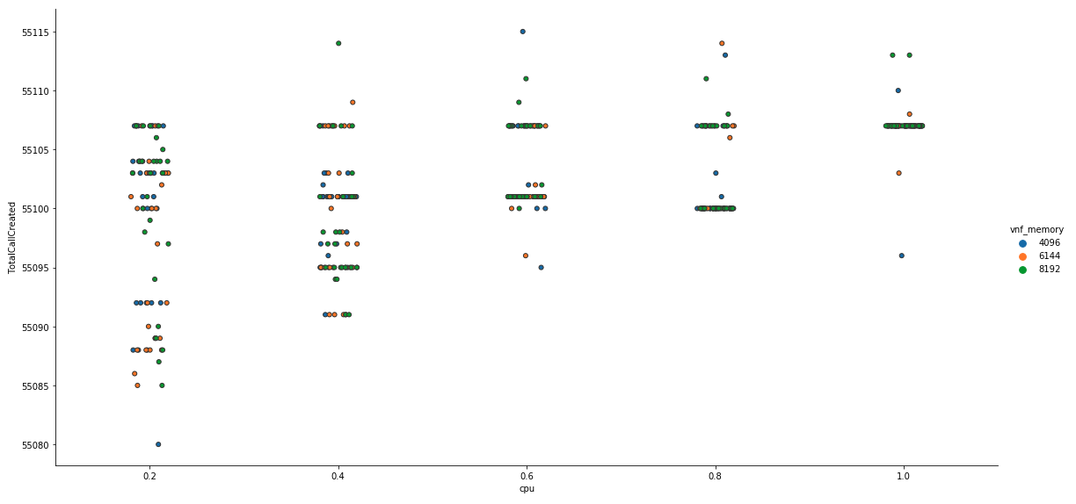
Total Call Created

Slide 7
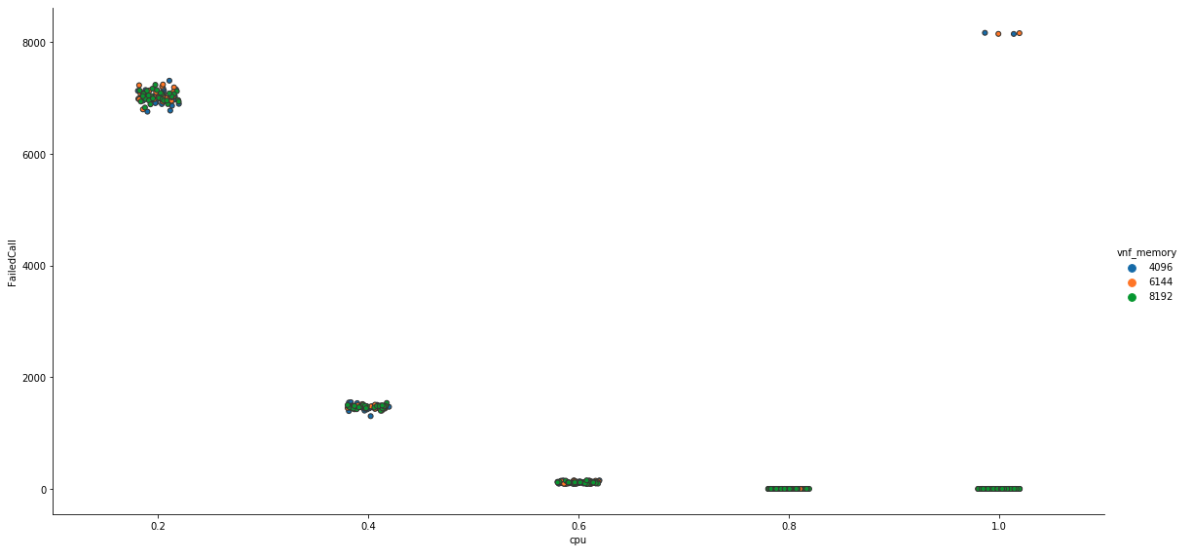
Failed Call

