Slide 1
Clean Code by Uncle Bob Lesson 1
Arif Burak Demiray - 250201022
Furkan Şahin - 25020142
https://www.youtube.com/watch?v=7EmboKQH8lM

Slide 2


Slide 3
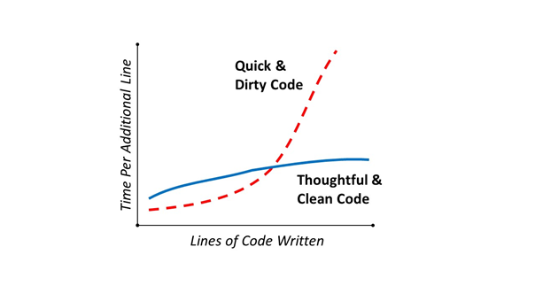
Why are programmers slow ?
A fragile premise : Good code matters.
Kent Beck

Slide 4
What is clean code ?
Elegance : "I like my code to be elegant and efficient... Clean code does one thing well."
Grady Booch : "Clean code reads like well-written prose."
Michael Feathers : "Clean code always looks like it was written by someone who cares."

Slide 5
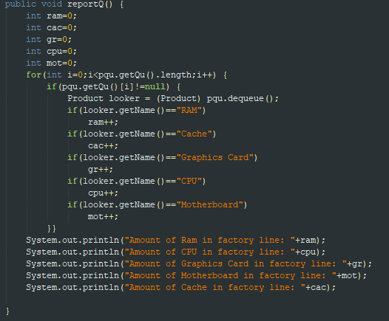

Clean Code Details
- Function should do one thing
The Rules of Functions:
1- They should be small
2- They should be smaller than that.
EXTRACT, EXTRACT, EXTRACT
UNTIL YOU CANNOT EXTRACT ANYMORE.

Slide 6
- No more than 3 arguments as function parameters
- Same level of abstraction in the function body
- Have no side effects in functions
Clean Code Details (Continue..)

Slide 7
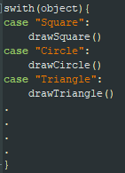
- Avoid switch statements
Clean Code Details ( Continue.. )

Slide 8
- Use Open Closed Principle in your system
- Use try catch block for just error processing
- Don't Repeat Yourself to aim reducing repetition in your code
- Test every line of your code to ensure it works correctly
Clean Code Details ( Continue.. )

Slide 9
THANKS

