Slide 1
Paper Id – 1098 Paper Title – A Convolutional Neural Network Model for Screening COVID-19 Patients Based on CT Scan Images Authors
International Conference on Big Data IoT and Machine Learning (BIM 2021)
Md. Fazle Rabbi
Dept. of CSE, BAIUST.
S. M. Mahedy Hasan
Dept. of CSE, RUET.
Arifa Islam Champa
Dept. of CSE, BAIUST.
Md. Rifat Hossain
Dept. of CSE, BAIUST.
Md. Asif Zaman
North South University.

Slide 2
Outlines
Introduction
Problem Statement
Related Works
Objectives
Methodology
Experimental Results
Conclusion
Future Works
References

Slide 3
Introduction
Coronavirus disease 2019 (COVID-19)
contagious disease caused by SARS-CoV-2
originated from Wuhan, Hubei Province, China, in December 2019 [1]
224 million affected, 4.6 million died

Slide 4
Problem Statement
COVID-19 spread all over the world within a few months and turned into a pandemic.
Early diagnosis - isolate the affected cases from healthy ones for refraining it from further spreading.
At present, RT-PCR is used for screening coronavirus cases, however, WHO stated that it suffers from low sensitivity and low specificity in the early-stage patients. [3]
Deep learning approaches combined with CT images could be useful for the precise diagnosis of positive coronavirus patients.

Slide 5
Related Works
Li et al. [4]
Model: COVNET
Classification Type: Binary (COVID-19, Pneumonia)
Dataset: 4356 CT images
Result: 87% sensitivity, 92% specificity
Harrison X. Bai et al. [5]
Model: Efficient Net B4 architecture
Classification Type: Binary (COVID-19, Pneumonia)
Dataset: 521 patients were COVID-19 positive, and 665 non-COVID pneumonia patients
Result: 87% accuracy, 89% sensitivity, 86% specificity

Slide 6
Related Works (Cont’d)
Ardakani et al. [6]
Model: compared ten different CNN architectures
Classification Type: Binary (COVID-19, Viral Pneumonia)
Dataset: CT images of 108 COVID-19 positive patients and 86 viral pneumonia patients
Result: ResNet-101 achieved the highest accuracy of 99.51%.
Kang et al. [7]
Model: multi-view representation learning framework
Classification Type: Binary (COVID-19, Pneumonia)
Dataset: 2522 chest CT images
Result: 95.5% accuracy

Slide 7
Related Works (Cont’d)
Xu et al. [8]
Model: ResNet-18
Classification Type: Ternary (COVID-19, Pneumonia, Normal)
Dataset: 618 CT samples
Result: 86.7% accuracy
Butt et al. [9]
Model: ResNet-18 and ResNet-23
Classification Type: Binary (COVID-19, Non-COVID-19)
Dataset: 618 CT samples
Result: 98.2% sensitivity, 92.2% specificity

Slide 8
Objectives
To build a deep learning based CNN model to identify the Covid-19 patients from the healthy and pulmonary cases using CT scan images.

Slide 9
Outcomes and Impacts
Generalized predictive model for classifying both of binary (COVID-19, Other pulmonary cases) and ternary cases (COVID-19, Other pulmonary cases, Healthy.
This proposed CNN model can be efficient for screening COVID-19 cases and giving test results in a minute so that the affected patients can be isolated more quickly, and community spread can be prevented.

Slide 10
Dataset Description
In this study, publicly available CT scan images are collected from Kaggle and China National Center for Bio information for the detection of COVID-19 cases [10][11].
This dataset comprises 3791 chest CT scan images that were accumulated from a public hospital of Sao Paolo, Brazil, and (CC-CCII) the China Consortium of Chest CT Image Investigation.
Among those images, 1252 chest CT scan images are of positive COVID-19 cases, 1230 chest CT scan images are of other pulmonic diseases, and the rest of the 1309 chest CT scan images are healthy patients.

Slide 11
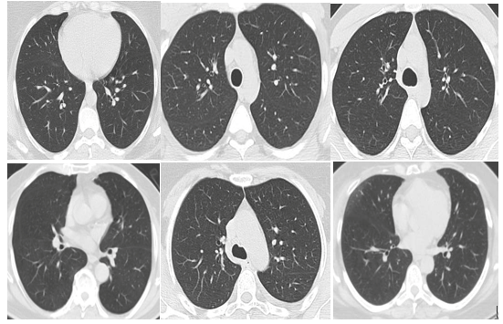
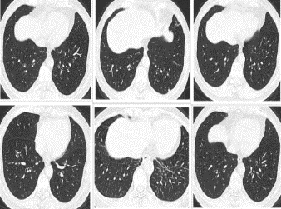
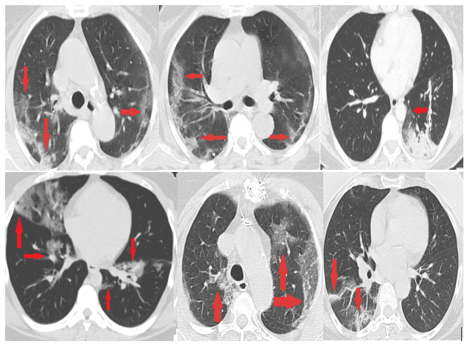
Dataset Description (Cont’d)
Some samples of CT images from this dataset are displayed in Figure 1.
(a) Healthy cases (b) COVID-19 cases (c) Pulmonary cases
Fig.1. Samples of CT scan images of the dataset.

Slide 12
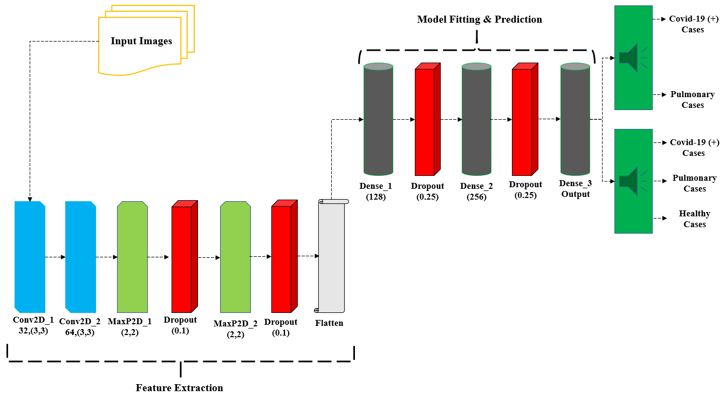
Methodology
In Figure 2, the structure of the proposed CNN model is delineated
Fig. 2. The structure of proposed CNN model.

Slide 13
Experimental Setup
To conduct the experiment, we used a cloud-based application development service named Google Collaboratory provided by google.
We utilized Scikit learn service of Python 3 programming language, and virtual tensor Processing Unit (TPU) for processing purposes pledged by google Collaboratory.
Furthermore, we applied ten-fold cross-validation method and 80:20 ratio in the dataset to create the training and testing set during model building.

Slide 14
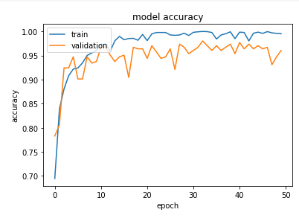
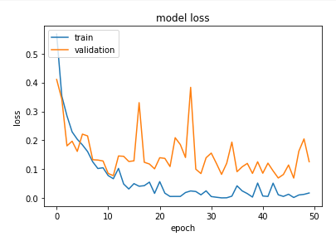
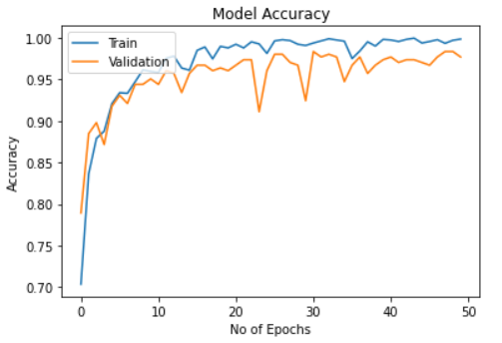
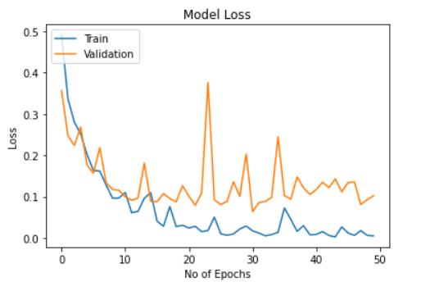
Experimental Result
Fig 3. Model accuracy and loss curve of ternary classification.
Fig 4. Model accuracy and loss curve of binary classification.

Slide 15
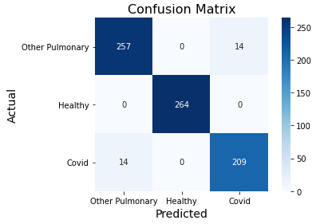
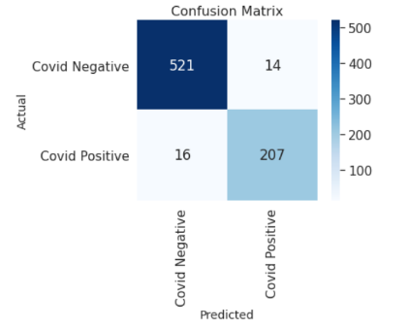
Experimental Result (Cont’d)
Table 1. Accuracy of the proposed model
Classification Type | Training | Validation | Testing
Ternary | 99.22% | 96.05% | 96.00%
Binary | 99.85% | 97.70% | 96.00%
Fig 5. Confusion Matrix

Slide 16
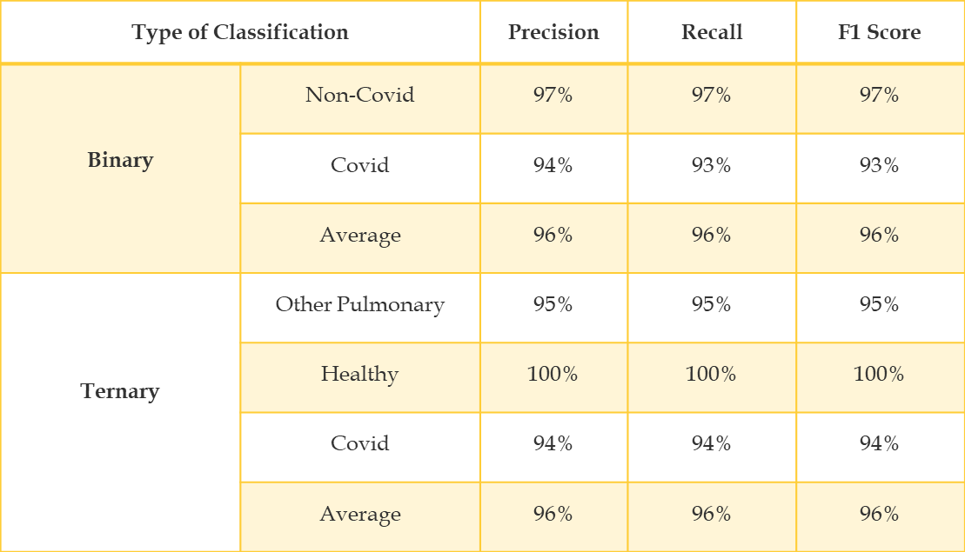
Experimental Result (Cont’d)
Table 2. Class wise Performance

Slide 17
Conclusion
RT-PCR has been used as yet to detect the coronavirus, which regularly engenders false-negative results.
Therefore, chest CT images can play an active role to combat this problem.
Here, a model is developed employing CNN on chest CT images to detect and classify coronavirus cases from the healthy and other pulmonary diseases.
However, our Proposed CNN model has produced superior accuracy, accounted for 96% for both binary and ternary classification.
This model can be applied as a substitutive tool, even an assistive tool along with RT-PCR, in distant areas where there has been lacking of test kits and a shortage or no experienced physicians at all.

Slide 18
Future Works
Since the large dataset of COVID-19 is not easily accessible, therefore, we have used a new publicly available dataset.
If the size of the dataset was even bigger, then we could create a more accurate and precise model to classify COVID-19 cases.
In the future, we intend to accumulate chest CT images of real COVID-19 patients from local hospitals in Bangladesh and assess them with our developed model.
This model can be preserved in the cloud so that the disease can be detected even more quickly, and the patient can be isolated immediately.

Slide 19
References
[1] "In Hunt for Covid-19 Origin, Patient Zero Points to Second Wuhan Market" [Online]. Available: https://www.wsj.com/articles/in-hunt-for-covid-19-origin-patient-zero-points-to-second-wuhan-market-11614335404. Accessed: 11-September-2021
[2] "COVID Live Update" [Online]. Available: https://www.worldometers.info/coronavirus/?utm_campaign=homeAdvegas1?. Accessed: 11-September-2021
[3] Bleve G, Rizzotti L, Dellaglio F, Torriani S. Development of reverse transcription (RT)-PCR
and real-time RT-PCR assays for rapid detection and quantification of viable yeasts and molds
contaminating yogurts and pasteurized food products. Appl Environ Microbiol.
2003;69(7):4116‐4122. doi:10.1128/aem.69.7.4116-4122.2003

Slide 20
References
[4] Li, Lin and Qin, Lixin and Xu, Zeguo and Yin, Youbing and Wang, Xin and Kong, Bin and Bai, Junjie and Lu, Yi and Fang, Zhenghan and Song, Qi and Cao, Kunlin and Liu, Daliang and Wang, Guisheng and Xu, Qizhong and Fang, Xisheng and Zhang, Shiqin and Xia, Juan and Xia, Jun, “Artificial Intelligence Distinguishes COVID-19 from Community”, Radiology, vol. 0, no. 0, pp. 200905, 2020, https://doi.org/10.1148/radiol.2020200905.
[5] Bai, Harrison X. and Wang, Robin and Xiong, Zeng and Hsieh, Ben and Chang, Ken and Halsey, Kasey and Tran, Thi My Linh and Choi, Ji Whae and Wang, Dong-Cui and Shi, Lin-Bo and Mei, Ji and Jiang, Xiao-Long and Pan, Ian and Zeng, Qiu-Hua and Hu, Ping-Feng and Li, Yi-Hui and Fu, Fei-Xian and Huang, Raymond Y. and Sebro, Ronnie and Yu, Qi-Zhi and Atalay, Michael K. and Liao, Wei-Hua, "AI Augmentation of Radiologist Performance in Distinguishing COVID-19 from Pneumonia of Other Etiology on Chest CT," Radiology, vol. 0, no. 0, pp. 201491, 2020. 10.1148/radiol.2020201491.
[6] Ali AbbasianArdakani,Alireza RajabzadehKanafi, U. Rajendra Acharya, Nazanin Khadem, AfshinMohammadi,"Application of deep learning technique to manage COVID-19 in routine clinical practice using CT images: Results of 10 convolutional neural networks, "Computers in Biology and Medicine, vol. 121, pp. 103795, 2020. https://doi.org/10.1016/j.compbiomed.2020.103795.

Slide 21
References
[7] Kang H, Xia L, Yan F, et al. Diagnosis of Coronavirus Disease 2019 (COVID-19) with Structured Latent Multi-View Representation Learning [published online ahead of print, 2020 May 5]. IEEE Trans Med Imaging. 2020;10.1109/TMI.2020.2992546. doi:10.1109/TMI.2020.2992546.
[8] X. Xu, X. Jiang, C. Ma, P. Du, X. Li, S. Lv, L. Yu, Y. Chen, J. Su, G. Lang et al., “Deep learning system to screen coronavirus disease 2019 pneumonia,” arXiv preprint arXiv:2002.09334, 2020.
[9] Butt, C., Gill, J., Chun, D., & Babu, B. A. (2020). Deep learning system to screen coronavirus disease 2019 pneumonia. Applied Intelligence, 1–7. Advance online publication. https://doi.org/10.1007/s10489-020-01714-3.

Slide 22
References
[10] Eduardo Soares and PlamenAngelov, “SARS-COV-2 Ct-Scan Dataset.” Kaggle, doi: 10.34740/KAGGLE/DSV/1100240.
[11] “China National Center for Bioinformation: National Genomics Data Center,” [Online]. Available: https://bigd.big.ac.cn/. [Accessed: 28-March-2021].

Slide 23
Thank You!

