Slide 1

2nd International Conference on
ADVANCED INFORMATION AND COMMUNICATION TECHNOLOGY
Paper Id: 124
Title: Prediction of Liver Disorders using Machine Learning Algorithms: A Comparative Study
Authors
Md. Fazle Rabbi
Dept. of CSE, IUT, Gazipur.
Arifa Islam Champa
Dept. of CSE, BAIUST, Comilla.
Md. Kamrul Hasan
Dept. of CSE, IUT, Gazipur
S. M. Mahedy Hasan
Dept. of CSE, RUET, Rajshahi.
Md. Asif Zaman
North South University, Dhaka.
Supervised By
Sadia Zaman Mishu
Lecturer
Dept. of CSE
RUET
Notes:
Give a brief overview of the presentation. Describe the major focus of the presentation and why it is important.
Introduce each of the major topics.
To provide a road map for the audience, you can repeat this Overview slide throughout the presentation, highlighting the particular topic you will discuss next.

Slide 2

Overview
Introduction
Motivation
Methodology
Classification
Comparison
Conclusion
Notes:
What will the audience be able to do after this training is complete? Briefly describe each objective how the audience will benefit from this presentation.

Slide 3
Introduction
Liver:
Most prominent interior organ
Only regenerative visceral organ of vertebrates[1]
Plays significant role in
Removal of toxic substances
Synthesis of proteins
Production of bile and albumin
Metabolization of bilirubin, carbohydrates, fat
Digestion of food effectively
Hepatitis, fatty liver disease, liver cancer, liver failure, gilbert's syndrome, and hemochromatosis, etc.
Notes:
What will the audience be able to do after this training is complete? Briefly describe each objective how the audience will benefit from this presentation.

Slide 4
Motivation
Around 50 million people suffer from liver disorders [2]
2 million people are dying per year worldwide [3]
Early diagnosis is compulsory to reduce the risk
Detection of liver disorders requires a lot of time and experienced physicians
Machine Learning
Plays an important role in disease diagnosis
Extracts valuable information from medical datasets and build a model to identify the patients
Notes:
What will the audience be able to do after this training is complete? Briefly describe each objective how the audience will benefit from this presentation.

Slide 5
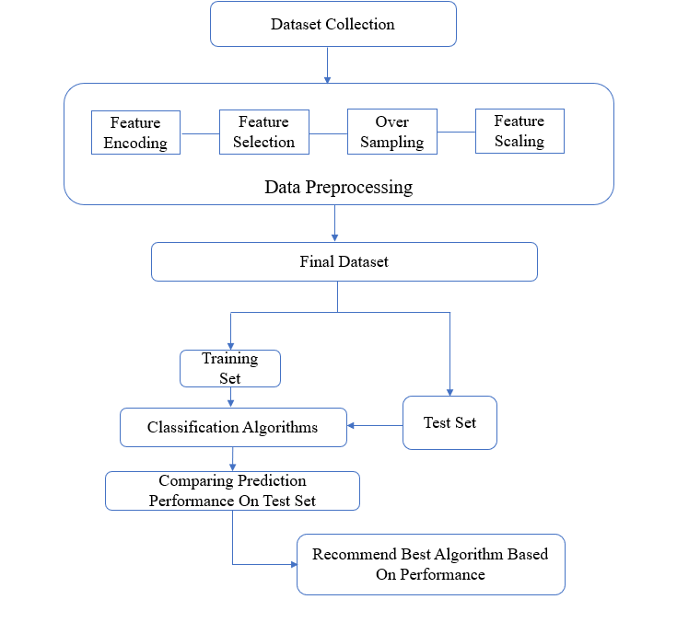
Methodology
Figure 1: Workflow of Our Research Methodology
Notes:
What will the audience be able to do after this training is complete? Briefly describe each objective how the audience will benefit from this presentation.

Slide 6
Dataset Description
Indian Liver Patient Dataset (ILPD)[4]
Table 1 : Attributes of ILPD dataset
Serial No. | Attribute Name | Attribute Description
1 | Age | Age in Years
2 | Sex | Gender of Patient
3 | TB | Total Bilirubin
4 | DB | Direct Bilirubin
5 | Alkphos | Alkaline Phosphotase
6 | Sgpt | Alamine Aminotransferase
7 | Sgot | Aspartate Aminotransferase
8 | TP | Total Protiens
9 | ALB | Albumin
10 | A/G | Ratio Albumin and Globulin Ratio
11 | Class | 1 for Positive and 0 for Negative
Notes:
What will the audience be able to do after this training is complete? Briefly describe each objective how the audience will benefit from this presentation.

Slide 7
Data Preprocessing
Feature Encoding:
Transforms a categorical variable into a continuous variable
Attribute Gender: Male and Female
Label Encoding:
Converts categorical values into numerical labels
1 for Male and 0 for Female
Notes:
What will the audience be able to do after this training is complete? Briefly describe each objective how the audience will benefit from this presentation.

Slide 8
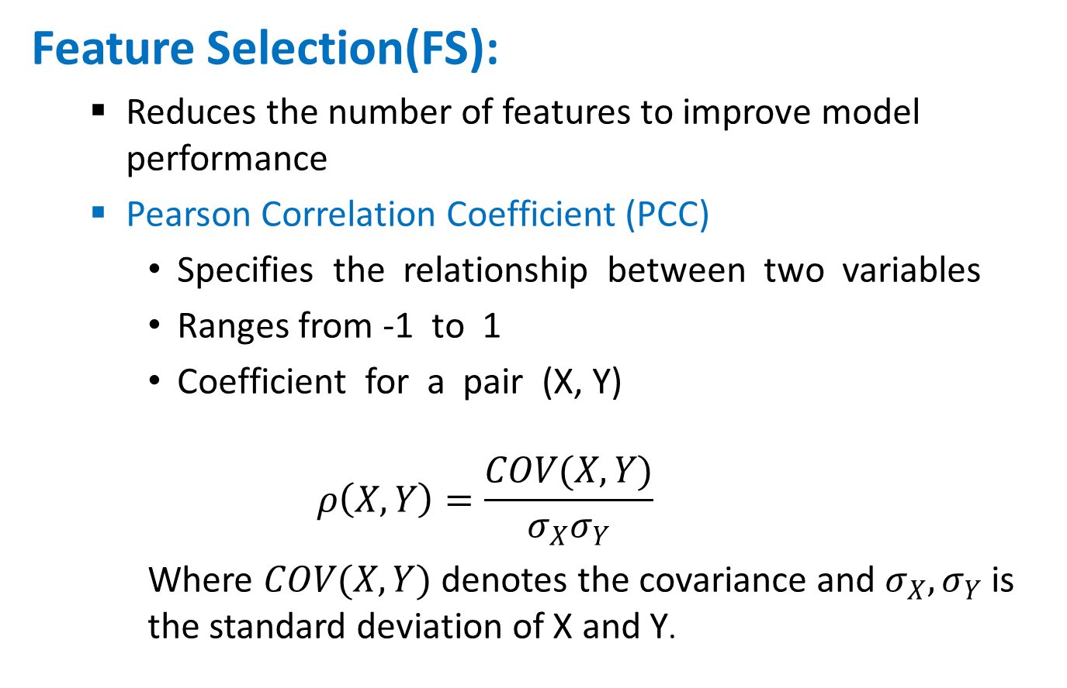
Data Preprocessing
Feature Selection(FS):
Reduces the number of features to improve model performance
Pearson Correlation Coefficient (PCC)
Specifies the relationship between two variables
Ranges from -1 to 1
Coefficient for a pair (X, Y)
$$ρ\left(X,Y\right)=\frac{COV(X,Y)}{σ_{X}σ_{Y}}$$
Where $COV(X,Y)$ denotes the covariance and $σ_{X},σ_{Y}$ is the standard deviation of X and Y.
Notes:
What will the audience be able to do after this training is complete? Briefly describe each objective how the audience will benefit from this presentation.

Slide 9
Data Preprocessing
Oversampling:
Duplicates samples from the minority class
ILPD
167 negative samples and 416 positive samples
Suffers from class imbalance issue
Random Over Sampler
Randomly selects samples from the minority class
with replacement
Adds them to the training dataset
Notes:
What will the audience be able to do after this training is complete? Briefly describe each objective how the audience will benefit from this presentation.

Slide 10
Data Preprocessing
Feature Scaling:
Normalizes the feature values in a specified range
Reduces the training time
Helps to achieve faster convergence
Robust Scaling
Uses the Inter Quartile range to handle the outliers
Removes the median
Scales the data according to the quartile range
Notes:
What will the audience be able to do after this training is complete? Briefly describe each objective how the audience will benefit from this presentation.

Slide 11
Classification
Logistic Regression (LR):
Predictive algorithm based on the notion of probability
Utilizes the Logistic function to compress the output between 0 and 1
Decision Tree (DT):
Flowchart-like tree structure
Comprises of internal node (feature), the branch (decision rule), and leaf node (outcome)
Attribute selection measures
Information gain
Gini index
Notes:
What will the audience be able to do after this training is complete? Briefly describe each objective how the audience will benefit from this presentation.

Slide 12
Classification
Random Forest (RF):
Consists of a large number of individual DTs
Each individual tree spits out a class prediction
The class with the most votes becomes the model’s prediction
Extra Tree (ET):
Ensemble machine learning classifier
Creates multiple unpruned trees
Calculates majority votes in case of classification.
Notes:
What will the audience be able to do after this training is complete? Briefly describe each objective how the audience will benefit from this presentation.

Slide 13
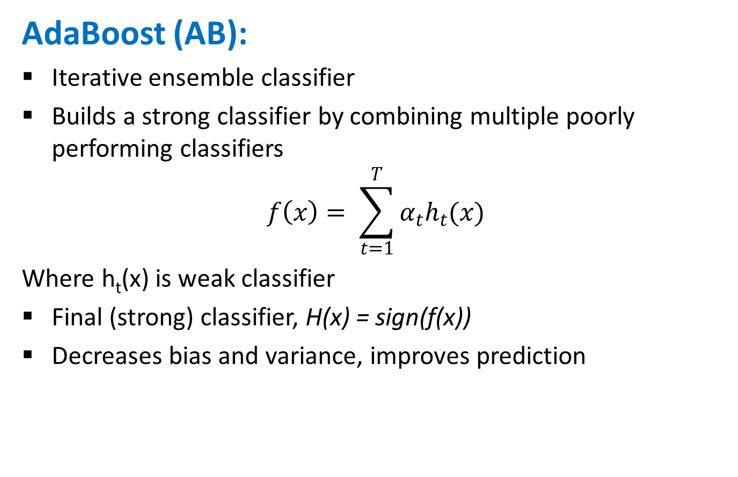
Classification
AdaBoost (AB):
Iterative ensemble classifier
Builds a strong classifier by combining multiple poorly performing classifiers
$$f\left(x\right)= \sum_{t=1}^{T}{α_{t}h_{t}(x)}$$
Where h_{t}(x) is weak classifier
Final (strong) classifier, H(x) = sign(f(x))
Decreases bias and variance, improves prediction
Notes:
What will the audience be able to do after this training is complete? Briefly describe each objective how the audience will benefit from this presentation.

Slide 14
I
Evaluation Measures
10-fold cross validation
Technique to evaluate predictive models
Training set divided into 10 equal sized sets
9 subsets training
1 subset validating test performance
From Confusion Matrix
Accuracy
F1-Score
Recall
Precision
Notes:
What will the audience be able to do after this training is complete? Briefly describe each objective how the audience will benefit from this presentation.

Slide 15
Results
Table 2: Classification Performance using All Features
Evaluation Measure |  | Accuracy | ROC | F1-Score | Precision | Recall
Machine Learning Algorithm | LR | 68.75 | 75.01 | 71.83 | 64.97 | 81.58
 | DT | 84.86 | 84.94 | 85.25 | 80.08 | 93.23
 | RF | 86.9 | 98.23 | 87.9 | 80.62 | 96.62
 | ET | 90.76 | 98.07 | 90.78 | 87.9 | 94.47
AdaBoost Algorithm | LR | 69.71 | 75.22 | 72.83 | 65.43 | 80.47
 | DT | 85.81 | 83.73 | 86.88 | 75.53 | 94.69
 | RF | 87.13 | 98.08 | 88.72 | 80.62 | 96.38
 | ET | 91.48 | 97.88 | 91.08 | 88.71 | 93.5
Notes:
What will the audience be able to do after this training is complete? Briefly describe each objective how the audience will benefit from this presentation.

Slide 16
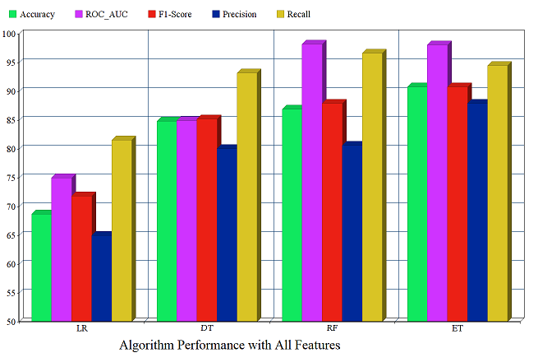
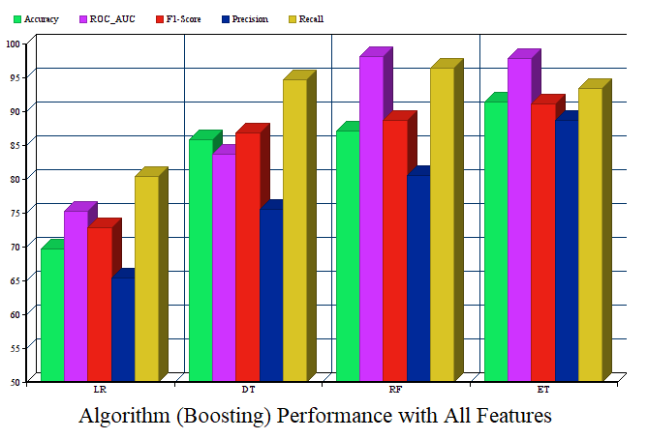
Results
Figure 2: Performance Analysis of All Features
Notes:
What will the audience be able to do after this training is complete? Briefly describe each objective how the audience will benefit from this presentation.

Slide 17
Results
Table 3: Classification Performance using PCC-FS
Evaluation Measure |  | Accuracy | ROC | F1-Score | Precision | Recall
Machine Learning Algorithm | LR | 70.07 | 73.87 | 73.75 | 65.89 | 83.89
 | DT | 87.14 | 86.41 | 88.35 | 81.97 | 95.88
 | RF | 87.38 | 97.7 | 88.32 | 81.87 | 96.38
 | ET | 91.7 | 98.07 | 89.81 | 88.5 | 92.18
AdaBoost Classifier | LR | 70.68 | 74.48 | 73.96 | 66.52 | 83.4
 | DT | 87.26 | 87 | 87.65 | 81.49 | 95.64
 | RF | 87.86 | 97.84 | 88.7 | 81.51 | 96.62
 | ET | 92.19 | 97.74 | 91.78 | 87.09 | 93.37
Notes:
What will the audience be able to do after this training is complete? Briefly describe each objective how the audience will benefit from this presentation.

Slide 18
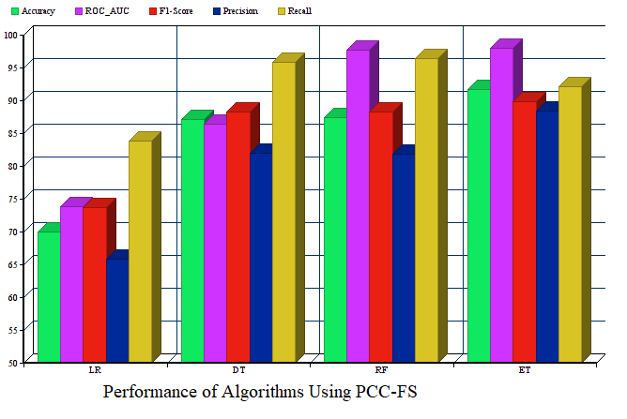
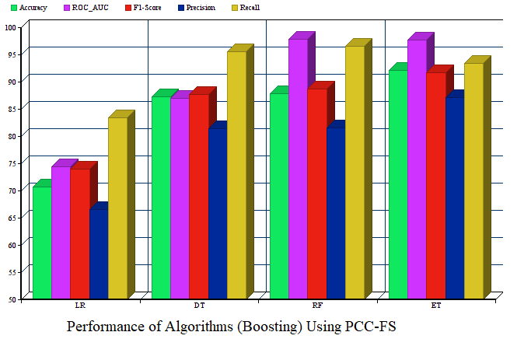
Results
Figure 3: Performance Analysis Using PCC-FS
Notes:
What will the audience be able to do after this training is complete? Briefly describe each objective how the audience will benefit from this presentation.

Slide 19
Comparison
Table 4: Comparison of Accuracy with Earlier Studies
Author (year) | Methods | Accuracy
Ramana et al. (2019) [5] | Bagging | 69.3%
Anagaw et al. (2019) [6] | CNB | 71.36%
Rahman et al. (2019) [7] | LR | 75%
Veena et al. (2018) [8] | C5.0 Boosting | 75.19%
Auxilia et al. (2018) [9] | PCC + DT | 81%
Kuzhippallil et al. (2020) [10] | GA + RF | 88%
Ramesh et al. (2019) [11] | PCA + SVM | 89.1%
Our model | PCC + AdaBoost (ET) | 92.19%
Notes:
What will the audience be able to do after this training is complete? Briefly describe each objective how the audience will benefit from this presentation.

Slide 20
Conclusion
AB with PCC-FS increases the overall performance of ML algorithms
ET as a base estimator of the AdaBoost algorithm has achieved the highest accuracy
In future, apply different deep learning algorithms with various feature selection techniques
Notes:
What will the audience be able to do after this training is complete? Briefly describe each objective how the audience will benefit from this presentation.

Slide 21
References
[1] | “Regeneration,” [Online]. Available: https://www.medicalnewstoday.com/articles/305075#regeneration. [Accessed: 11-May-2020].
[2] | Global Burden of Liver Disease, S.K. Sarin MD, DM and Rakhi Maiwall MD, DM, www.worldgastroenterology.org.
[3] | Asrani SK, Devarbhavi H, Eaton J, Kamath PS, “Burden of liver diseases in the world,” Journal of hepatology, vol. 70, no. 1, pp. 151-171, Jan 2019.
[4] | “UCI machine learning repository,” [Online]. Available: https://archive.ics.uci.edu/ml/datasets/ILPD+(Indian+Liver+Patient+Dataset). [Accessed: 11-May-2020].
[5] | B. V. Ramana and R. S. Kumar Boddu, “Performance Comparison of Classification Algorithms on Medical Datasets,” 2019 IEEE 9th Annual Computing and Communication Workshop and Conference (CCWC), Las Vegas, NV, USA, 2019, pp. 0140-0145
[6] | A. Anagaw, Y.L. Chang, “A new complement naïve Bayesian approach for biomedical data classification,” Journal of Ambient Intelligence and Humanized Computing, vol. 10, pp. 3889- 3897, 2019.
Notes:
What will the audience be able to do after this training is complete? Briefly describe each objective how the audience will benefit from this presentation.

Slide 22
References
[7] | Rahman, A. K. M. & Shamrat, F.M. & Tasnim, Zarrin & Roy, Joy & Hossain, Syed, “A Comparative Study On Liver Disease Prediction Using Supervised Machine Learning Algorithms,” International Journal of Scientific & Technology Research, vol. 8, pp. 419-422, 2019
[8] | Veena, G. & Sneha, D & Basavaraju, Deepti & Tanvi, Tripti, “Effective Analysis and Diagnosis of Liver Disorder,” International Conference on Communication and Signal Processing, April 3-5, 2018, pp. 86-90.
[9] | L. A. Auxilia, "Accuracy Prediction Using Machine Learning Techniques for Indian Patient Liver Disease," 2018 2nd International Conference on Trends in Electronics and Informatics (ICOEI), Tirunelveli, 2018, pp. 45-50.
[10] | M. A. Kuzhippallil, C. Joseph and K. A, "Comparative Analysis of Machine Learning Techniques for Indian Liver Disease Patients," 2020 6th International Conference on Advanced Computing and Communication Systems (ICACCS), Coimbatore, India, 2020, pp. 778-782.
[11] | [12] Ramesh, D., Katheria, Y.S, “Ensemble method based predictive model for analyzing disease datasets: a predictive analysis approach,” Health and Technology, vol. 9, no. 4, pp. 533- 545, 2019.
Notes:
What will the audience be able to do after this training is complete? Briefly describe each objective how the audience will benefit from this presentation.

