Slide 1
Paper Id – 91 Paper Title – A Machine Learning Based Model for Early Stage Detection of Diabetes Authors
23rd International Conference on Computer and Information technology (ICCIT), 19-21 December, 2020.
S. M. Mahedy Hasan
Dept. of CSE, RUET.
Md. Fazle Rabbi
Dept. of CSE, IUT.
Arifa Islam Champa
Dept. of CSE, IUT.
Md. Asif Zaman
North South University.

Slide 2
Outlines
Introduction
Literature Review
Materials & Methods
Results & Discussion
Conclusion & Future Work

Slide 3
Introduction
Diabetes
Generally, it is known as chronic disease.
It occurs when the blood sugar level rises too high [1].
It weakens the human body's immune system and increases the chances of other serious diseases [2].

Slide 4
Introduction (Cont’d)
Machine Learning
Branch of artificial intelligence (AI).
Ability to automatically learn and improve through experience without being explicitly programmed.
Plays an important role in medical disease diagnosis.
Extracts valuable information from medical datasets and helps in effective decision making.

Slide 5
Literature Review
Agarwal et al. [3] utilized 738 patient's record and compared the performance of Convolutional Neural Network (CNN), K-Nearest Neighbors (KNN), Support Vector Machine (SVM)+Linear Discriminant Analysis (LDA), SVM, Naive Bayes (NB), Iterative Dichotomiser 3(ID3), C4.5 and CART to predict diabetes.
Findings: Combined (SVM+LDA) provided highest accuracy of 88.10%.
Limitations: Effective preprocessing of data.

Slide 6
Literature Review (Cont’d)
Wang et al. [4] developed a prediction model named DMP_MI using RF for classifying PIDD.
Findings: RF achieved an accuracy of 87.1%.
Limitations: Effective preprocessing of data.
Roopa et al. [5] utilized the PIDD dataset to build a statistical model to predict diabetes. They applied Principal Component Analysis (PCA) to extract features, and finally, those extracted features were fed into the Linear Regression Model (LRM) for classifying diabetes patients.
Findings: LRM delivered 82.1% accuracy.
Limitations: Effective preprocessing of data.

Slide 7
Literature Review (Cont’d)
Kannadasan et al. [6] utilized the Pima Indians Diabetes Dataset (PIDD) comprising 768 instances; each instance has eight attributes. Using stacked autoencoders, they presented a framework based on DNN to predict type 2 diabetes precisely.
Findings: Proposed framework achieved an accuracy of 86.26%.
Limitations: Effective preprocessing of data.
Sisodia et al. [7] compared the performances of Decision Tree (DT), Support Vector Machine (SVM), and Naïve Bayes (NB) for classifying diabetes patients.
Findings: NB delivered highest accuracy of 76.30%.
Limitations: Effective preprocessing of data.

Slide 8







Materials & Methods
Diabetes Dataset Collection
Data Preprocessing
Apply FT Methods
Apply 6 Classifiers into Transformed Dataset
Select Best (FT + Classifier)
Performance Analysis
Performance Analysis & Recommend Best Model
Apply 3 Different FST’s
Figure 1. Pipeline of the research to classify diabetic patients

Slide 9
Dataset Description
This dataset was collected from the University of California, Irvine (UCI) machine learning repository [8].
It was created through a direct questionnaire among diabetic and non-diabetic patients from the Diabetes Hospital of Sylhet, Bangladesh.
This dataset consists of 520 records and 17 attributes. Among them, 320 records are positive, and 200 records are negative.

Slide 10
Dataset Description (Cont’d)
A brief description of the dataset is represented in Table I.
Table I. Attributes of Diabetes Dataset
S. I. | Name of Attribute | Attribute Description
1. | Age | Continuous
2. | Sex | Categorical
3. | Polyuria | Categorical
4. | Polydipsia | Categorical
5. | Sudden weight loss | Categorical
6. | Weakness | Categorical
7. | Polyphagia | Categorical
8. | Genital thrush | Categorical
9. | Visual blurring | Categorical
10. | Itching | Categorical
11. | Irritability | Categorical
12. | Delayed healing | Categorical
13. | Partial paresis | Categorical
14. | Muscle stiffness | Categorical
15. | Alopecia | Categorical
16. | Obesity | Categorical
17. | Class | Target Variable (1 for Positive, and 0 for Negative)

Slide 11
Data Preprocessing
Feature Encoding
Transforms the categorical variables into their corresponding continuous values.
Oversampling
The dataset has imbalanced class distribution problem (320 class values are positive, and 200 class values are negative).
To combat this problem, Random Over Sampler is applied.

Slide 12
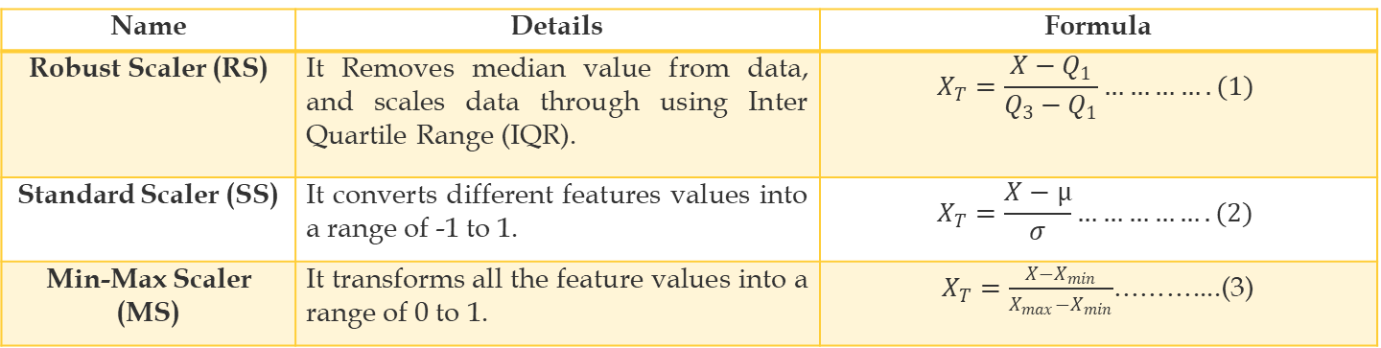
Data Preprocessing (Cont’d)
Feature Transformation (FT)
Standardize the feature values in a specified range.
This research utilized three different FT techniques.
The following Table 2 describes the different FT methods.
Table 2. Description of FT Methods
Name | Details | Formula
Robust Scaler (RS) | It Removes median value from data, and scales data through using Inter Quartile Range (IQR). | $$X_{T}=\frac{X−Q_{1}}{Q_{3}−Q_{1}}………….(1)$$
Standard Scaler (SS) | It converts different features values into a range of -1 to 1. | $$X_{T}=\frac{X−µ}{σ}…………….(2)$$
Min-Max Scaler (MS) | It transforms all the feature values into a range of 0 to 1. | $X_{T}=\frac{X−X_{min}}{X_{max}−X_{min}}$………....(3)

Slide 13
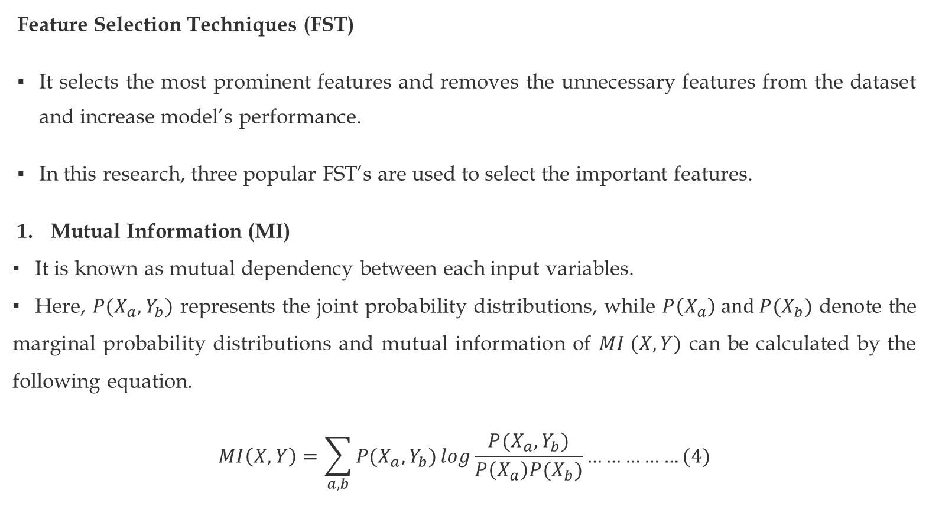
Data Preprocessing (Cont’d)
Feature Selection Techniques (FST)
It selects the most prominent features and removes the unnecessary features from the dataset and increase model’s performance.
In this research, three popular FST’s are used to select the important features.
Mutual Information (MI)
It is known as mutual dependency between each input variables.
Here, $P(X_{a}, Y_{b})$ represents the joint probability distributions, while $P\left(X_{a}\right) and P(X_{b})$ denote the marginal probability distributions and mutual information of $MI (X, Y)$ can be calculated by the following equation.
$$MI\left(X, Y\right)=\sum_{a, b}{P(X_{a}, Y_{b})}log\frac{P(X_{a}, Y_{b})}{P\left(X_{a}\right)P(X_{b})}……………(4)$$

Slide 14
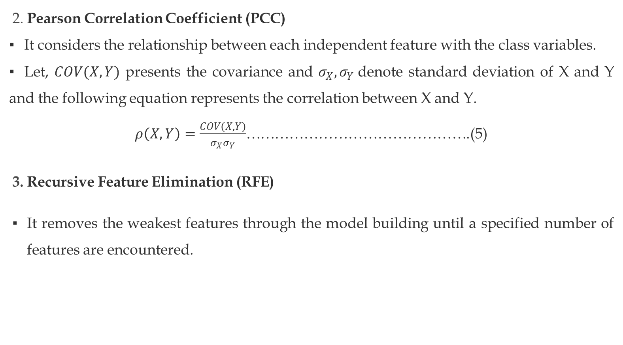
Data Preprocessing (Cont’d)
2. Pearson Correlation Coefficient (PCC)
It considers the relationship between each independent feature with the class variables.
Let, $COV(X,Y)$ presents the covariance and $σ_{X},σ_{Y}$denote standard deviation of X and Y and the following equation represents the correlation between X and Y.
$ρ\left(X,Y\right)=\frac{COV(X,Y)}{σ_{X}σ_{Y}}$……………………………………….(5)
3. Recursive Feature Elimination (RFE)
It removes the weakest features through the model building until a specified number of features are encountered.

Slide 15
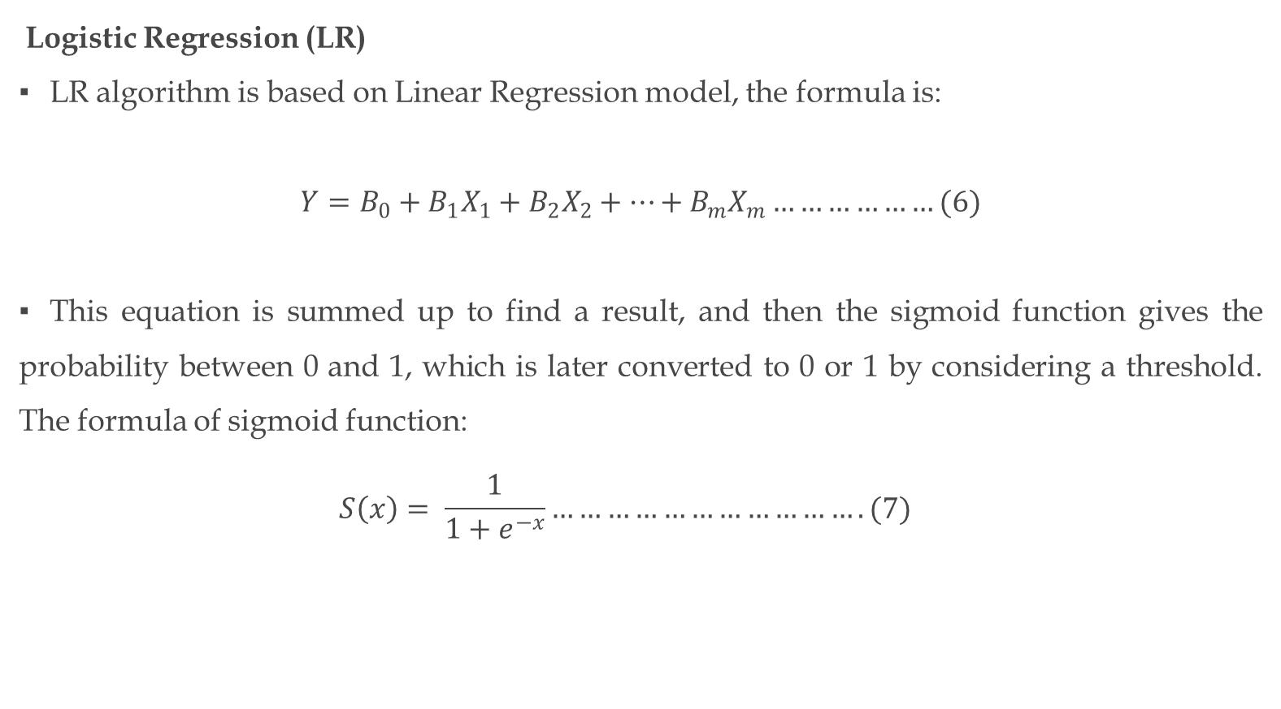
Classification Methods
Logistic Regression (LR)
LR algorithm is based on Linear Regression model, the formula is:
$$Y=B_{0}+B_{1}X_{1}+B_{2}X_{2}+…+B_{m}X_{m}………………(6)$$
This equation is summed up to find a result, and then the sigmoid function gives the probability between 0 and 1, which is later converted to 0 or 1 by considering a threshold. The formula of sigmoid function:
$$S\left(x\right)= \frac{1}{1+e^{−x}}…………………………….(7)$$

Slide 16
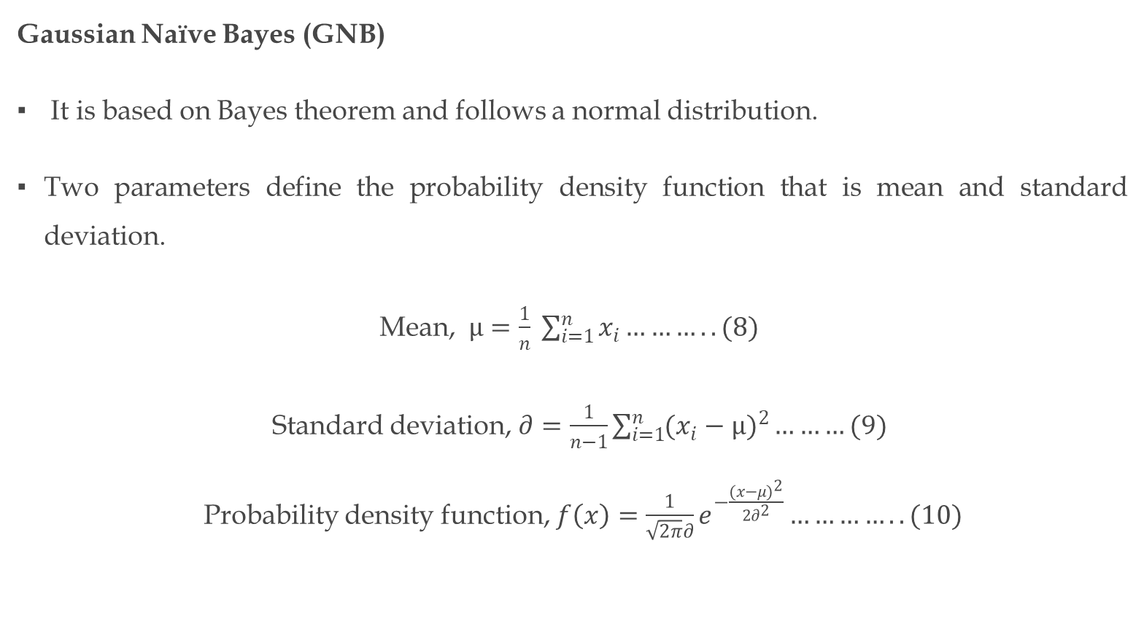
Classification Methods (Cont’d)
Gaussian Naïve Bayes (GNB)
It is based on Bayes theorem and follows a normal distribution.
Two parameters define the probability density function that is mean and standard deviation.
Mean, $µ=\frac{1}{n} \sum_{i=1}^{n}{x_{i}………..(8)}$
Standard deviation, $∂=\frac{1}{n−1}\sum_{i=1}^{n}{{(x_{i}−µ)}^{2}}………(9)$
Probability density function, $f\left(x\right)=\frac{1}{\sqrt{2π}∂}e^{−\frac{{(x−μ)}^{2}}{2∂^{2}}}…………..(10)$

Slide 17
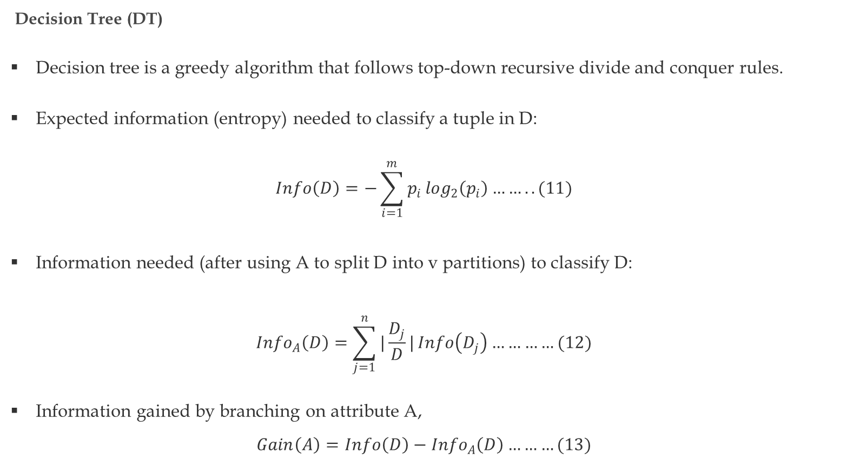
Classification Methods (Cont’d)
Decision Tree (DT)
Decision tree is a greedy algorithm that follows top-down recursive divide and conquer rules.
Expected information (entropy) needed to classify a tuple in D:
$$Info\left(D\right)=−\sum_{i=1}^{m}{p_{i}}\log_{2}\left(p_{i}\right)……..(11)$$
Information needed (after using A to split D into v partitions) to classify D:
$${Info}_{A}\left(D\right)=\sum_{j=1}^{n}{|\frac{D_{j}}{D}|}Info\left(D_{j}\right)…………(12)$$
Information gained by branching on attribute A,
$$Gain\left(A\right)=Info\left(D\right)−{Info}_{A}\left(D\right)………(13)$$

Slide 18
Classification Methods (Cont’d)
Random Forest (RF)
Random Forest (RF) algorithm is an ensemble classification technique that classifies by creating multiple decision trees during training [9].
RF trains numerous trees, and each tree produces different results.
The highest number of votes received through voting was considered as final.

Slide 19
Classification Methods (Cont’d)
Extra Trees (ET)
Ensemble machine learning classifier.
It choses the random features instead of best features for splitting the tree nodes.
After creating multiple unpruned trees, ET predicts by averaging all the tree outcomes in by calculating majority votes in case of classification.

Slide 20
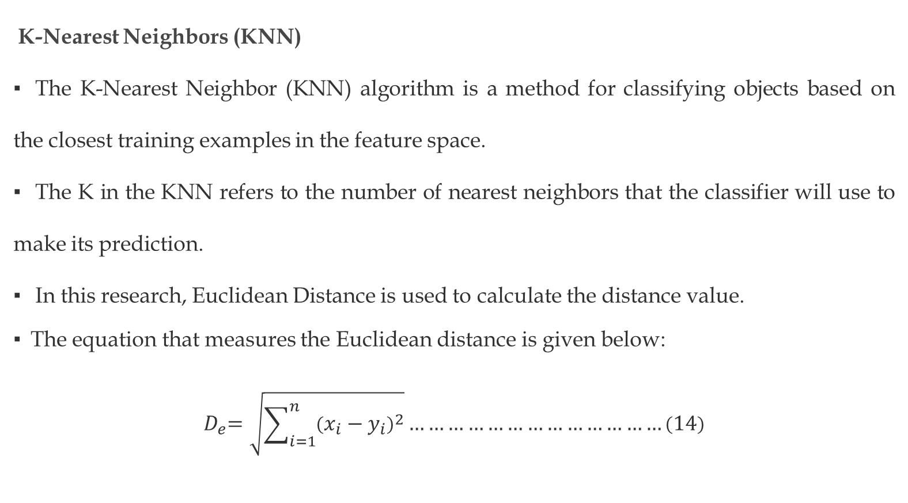
Classification Methods (Cont’d)
K-Nearest Neighbors (KNN)
The K-Nearest Neighbor (KNN) algorithm is a method for classifying objects based on the closest training examples in the feature space.
The K in the KNN refers to the number of nearest neighbors that the classifier will use to make its prediction.
In this research, Euclidean Distance is used to calculate the distance value.
The equation that measures the Euclidean distance is given below:
$${ D}_{e}=\sqrt{\sum_{i=1}^{n}{{\left(x_{i}−y_{i}\right)}^{2}}}…………………………………\left(14\right)$$

Slide 21
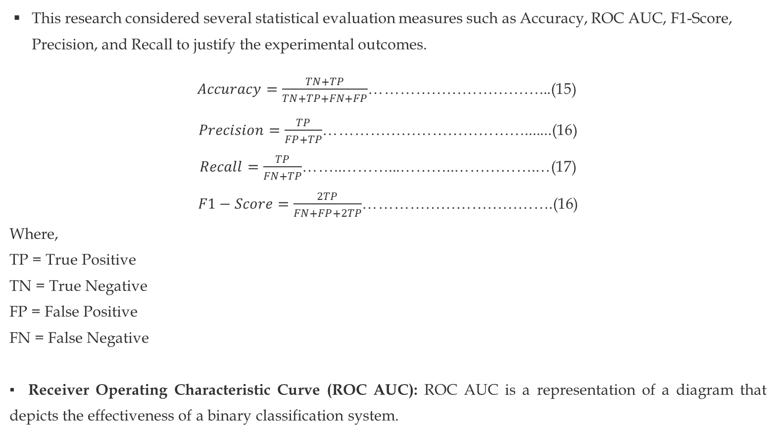
Evaluation Measures
This research considered several statistical evaluation measures such as Accuracy, ROC AUC, F1-Score, Precision, and Recall to justify the experimental outcomes.
$Accuracy=\frac{TN+TP}{TN+TP+FN+FP}$……………………………...(15)
$Precision=\frac{TP}{FP+TP}$………………………………….......(16)
$Recall=\frac{TP}{FN+TP}$……..………...………..…………….…(17)
$F1−Score=\frac{2TP}{FN+FP+2TP}$……………………………….(16)
Where,
TP = True Positive
TN = True Negative
FP = False Positive
FN = False Negative
Receiver Operating Characteristic Curve (ROC AUC): ROC AUC is a representation of a diagram that depicts the effectiveness of a binary classification system.

Slide 22
Experimental Setup
To conduct the experiment, we used a cloud-based application development service named Google Collaboratory provided by google [10].
We utilized Scikit learn service of Python 3 programming language, and virtual tensor Processing Unit (TPU) for processing purposes pledged by google Collaboratory.
Furthermore, we applied ten-fold cross-validation method and 80:20 ratio in the dataset to create the training and testing set during model building.

Slide 23
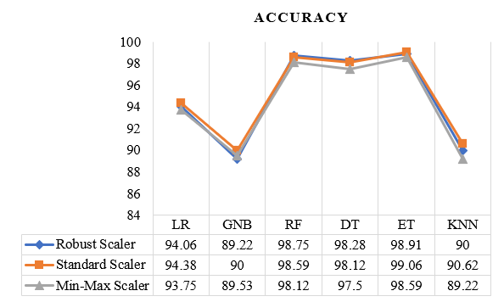
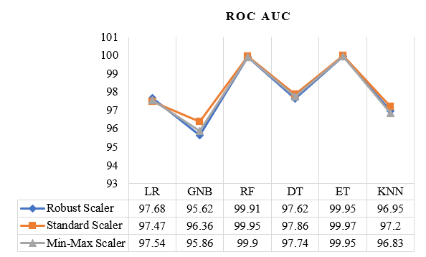
Results & Discussion
Figure 2. Accuracy of classifiers on FT transformed datasets
Figure 3. ROC AUC of classifiers on FT transformed datasets

Slide 24
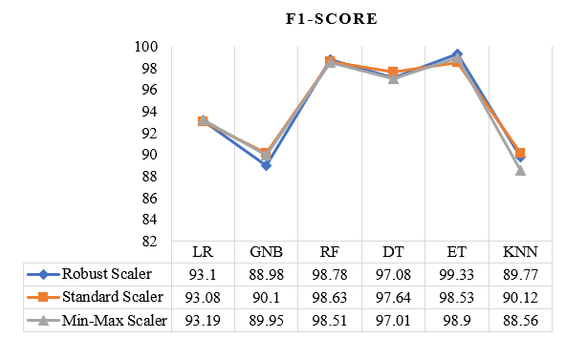
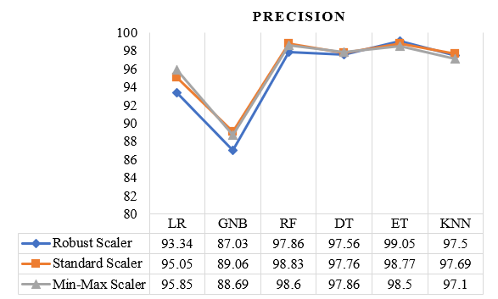
Results & Discussion (Cont’d)
Figure 4. F1-Score of classifiers on FT transformed datasets
Figure 5. Precision of classifiers on FT transformed datasets

Slide 25
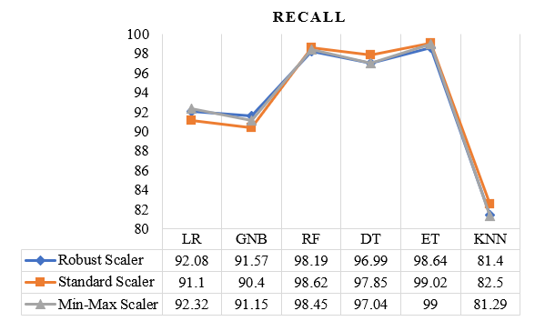
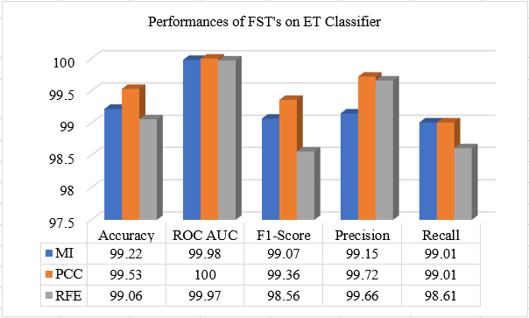
Results & Discussion (Cont’d)
Figure 6. Recall of classifiers on FT transformed datasets
Figure 7. Performances of ET classifier on FST’s datasets

Slide 26
Conclusion & Future Work
This research focuses on how feature transformation and feature selection techniques affect the performance of different classification algorithms.
Standard Scaler feature transformation method outperformed the other techniques to form a high quality diabetes dataset.
In terms of classifying diabetes data, ET classifier performed better.
PCC showed better performance to identify the most prominent features for diagnosing diabetic patients.
In future, we want to collect more data related to diabetes from different diabetic hospitals in Bangladesh and build a diabetes prediction model server on cloud storage to identify diabetic patients in real-time by taking individual patient's records related to diabetes and classify as diabetes positive or not.

Slide 27
References
“Diabetes,” [Online]. Available: https://www.who.int/newsroom/fact-sheets/detail/diabetes. [Accessed: 06-May-2020].
“Diabeets Daily,” [Online]. Available: https://www.diabetesdaily.com/learn-about-diabetes/what-is diabetes/how-manypeople-have-diabetes/. [ Accessed: 06-May-2020].
Agrawal, P., Dewangan, A.: A brief survey on the techniques used for the diagnosis of diabetesmellitus. Int. Res. J. Eng. Technol. (IRJET).02(03) (2015). e-ISSN: 2395-0056; p-ISSN: 2395-0072.
Q. Wang, W. Cao, J. Guo, J. Ren, Y. Cheng and D. N. Davis, "DMP_MI: An Effective Diabetes Mellitus Classification Algorithm on Imbalanced Data With Missing Values," in IEEE Access, vol. 7, pp. 102232-102238, 2019.

Slide 28
References
5. H. Roopa and T. Asha, "A Linear Model Based on Principal Component Analysis for Disease Prediction," in IEEE Access, vol. 7, pp. 105314-105318, 2019.
6. K Kannadasan, Damodar Reddy Edla, Venkatanareshbabu Kuppili, “Type 2 diabetes data classification using stacked autoencoders in deep neural networks,” Clinical Epidemiology and Global Health, vol. 7, no. 4, pp. 530-535, 2019.
7. Deepti Sisodia, Dilip Singh Sisodia, “Prediction of Diabetes using Classification Algorithms,” Procedia Computer Science, vol. 132, pp. 1578-158, 2018.
8. “Early stage diabetes risk prediction dataset. Data Set,” [Online]. Available: https://archive.ics.uci.edu/ml/datasets/Early+stage+diabetes+risk+prediction+dataset. [Accessed: 28-Aug-2020].

Slide 29
References
9. S. M. M. Hasan, M. A. Mamun, M. P. Uddin and M. A. Hossain, "Comparative Analysis of Classification Approaches for Heart Disease Prediction," 2018 International Conference on Computer, Communication, Chemical, Material and Electronic Engineering (IC4ME2), Rajshahi, 2018, pp. 1-4.
10. "Google Colaboratory," [Online]. Available: colab.research.google.com. [Accessed: 28-Aug-2020].

Slide 30
Thank You!

