Slide 1
Software Requirement Specification
Sky View (Air Ways)
Prepared by :
Abul Hossain
Id : 1246643
Round : 39

Slide 2
Sky View (Air Ways)
Used Technology :
Java Jsf,Primefaces,Hibernate,
JDBC,Mysql

Slide 3
We offer comfort, reliability and value for money air travel across our network in 50 countries….
Requirement:

Slide 4
Requirement Analysis
User list.
Customer list.
Customer Registration.
Proper service.
Paid Bill.
Annual Summary.

Slide 5
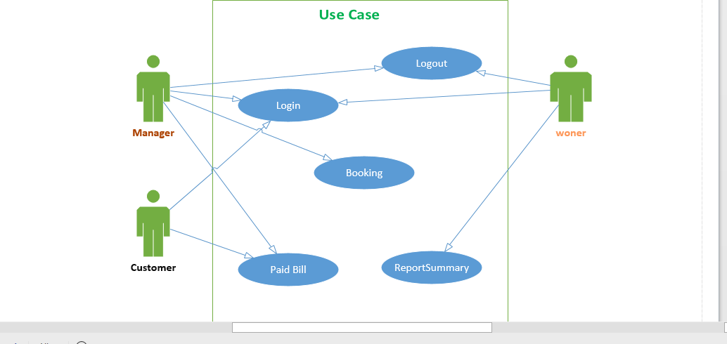
Use Case Diagram.

Slide 6
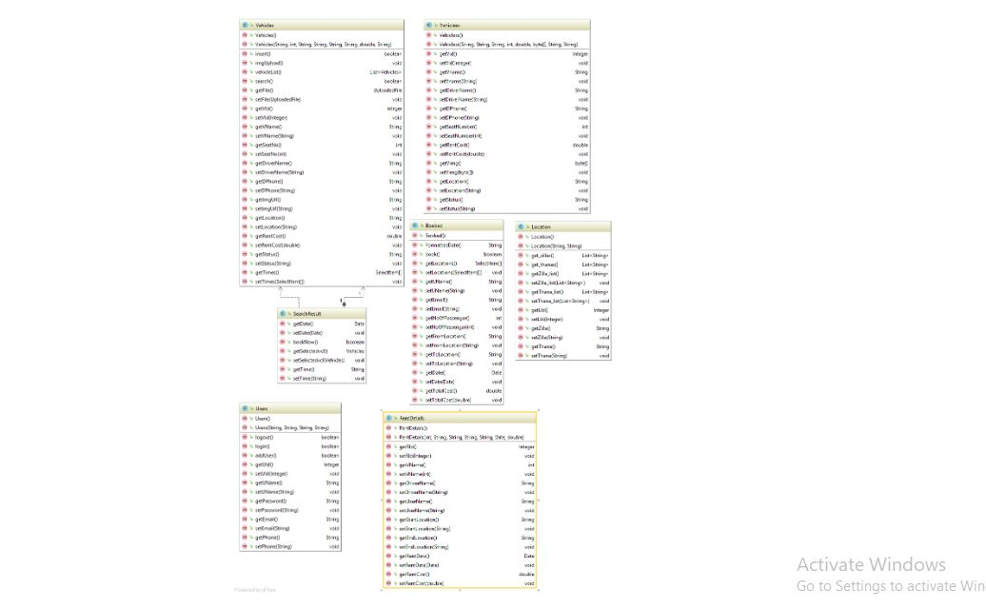
Class Diagram

Slide 7
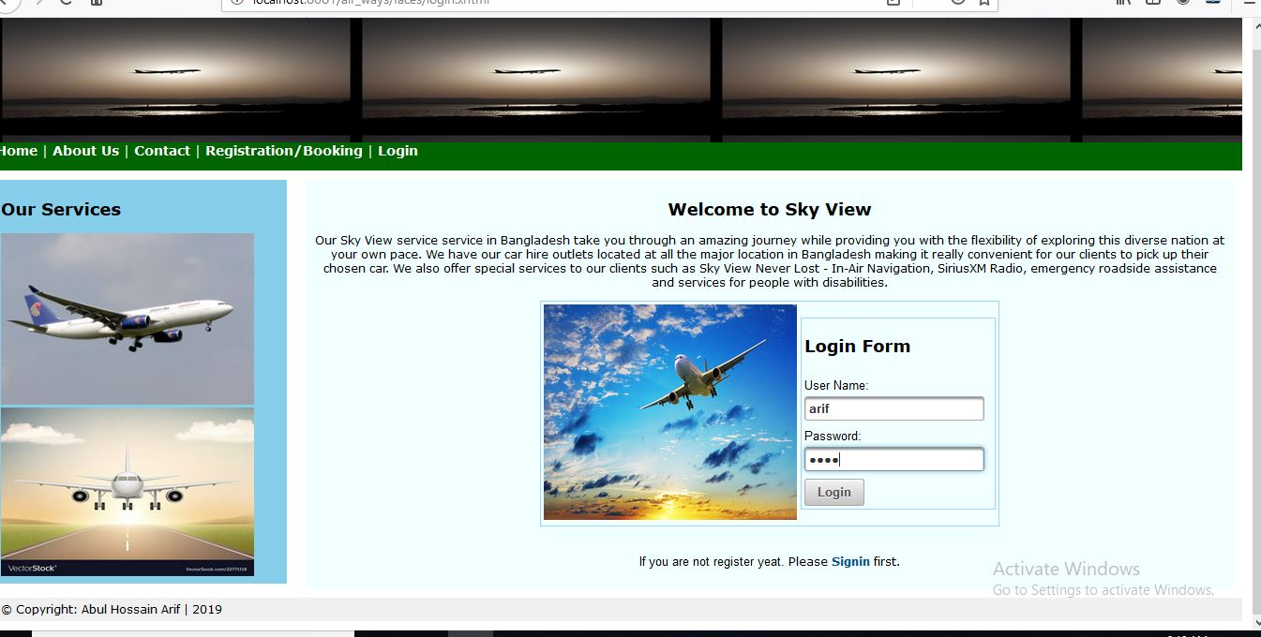
Login Input

Slide 8
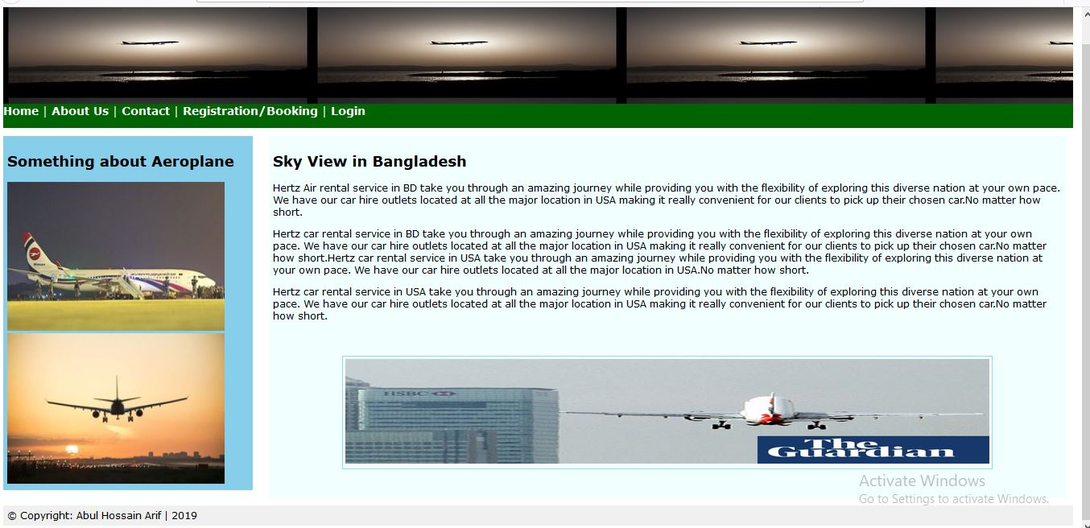
About Page

Slide 9
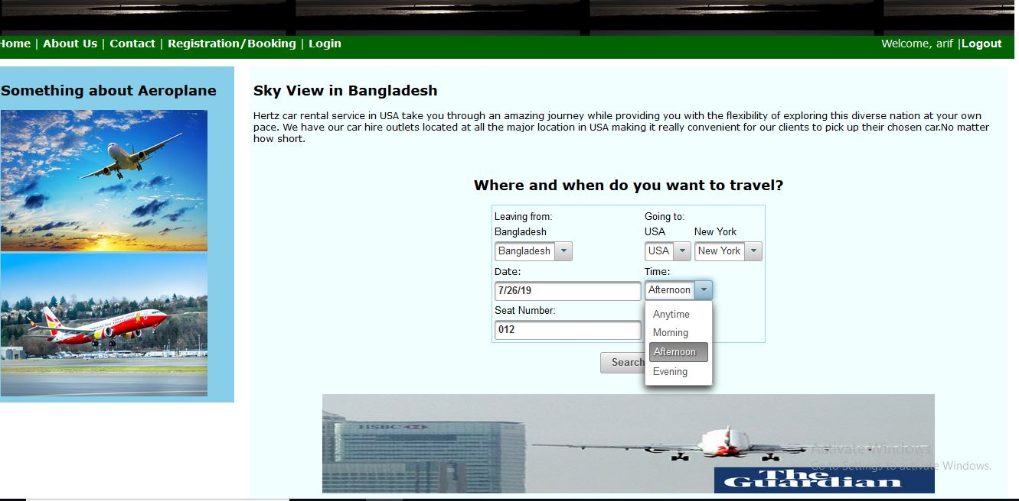
Home Page

Slide 10
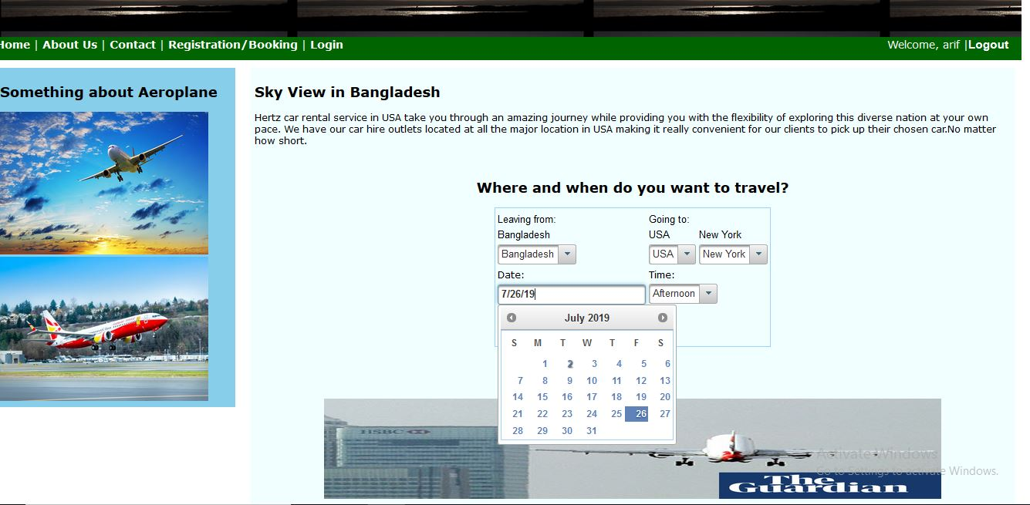
Show Data

Slide 11
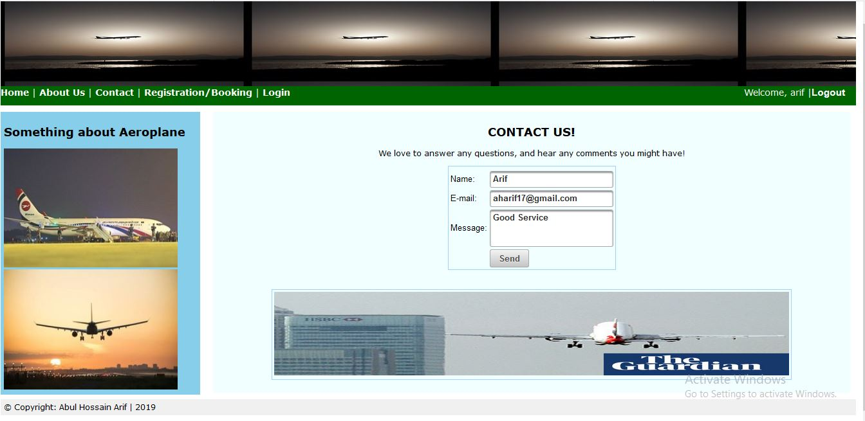
Contact

Slide 12
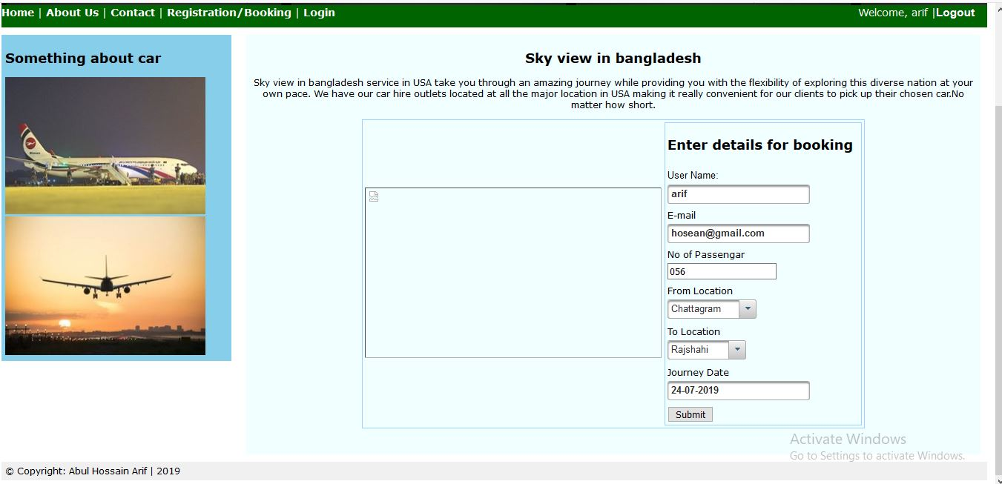
Booking

Slide 13
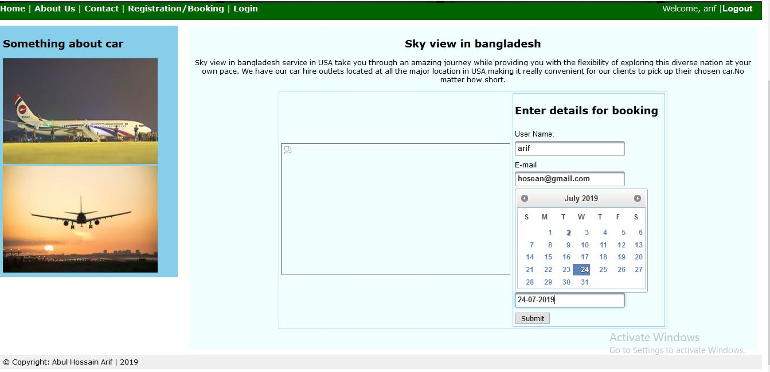
Sow Data

Slide 14
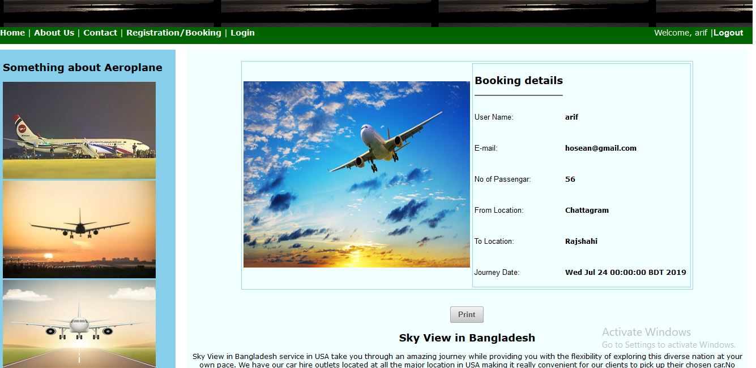
Show Data

Slide 15
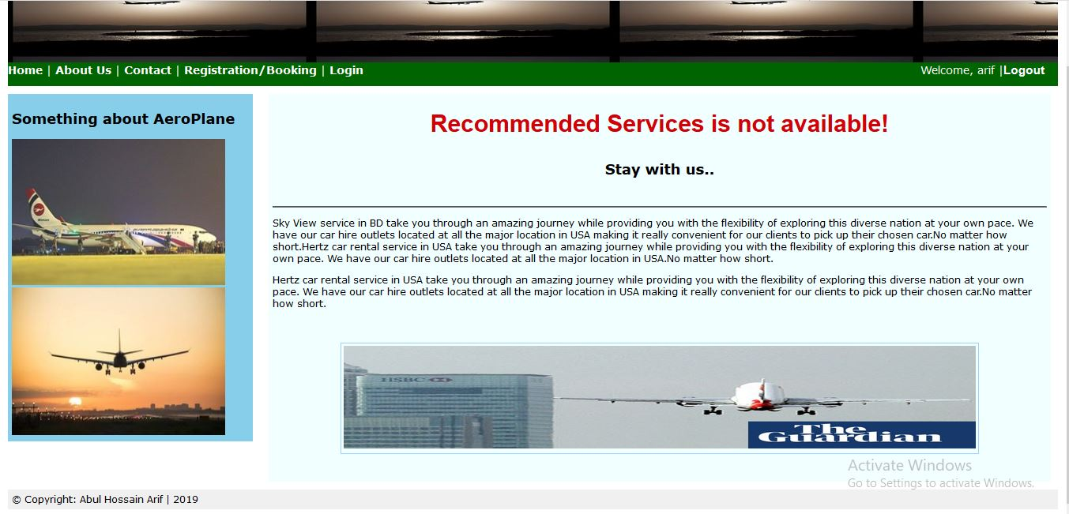
Error Page

Slide 16
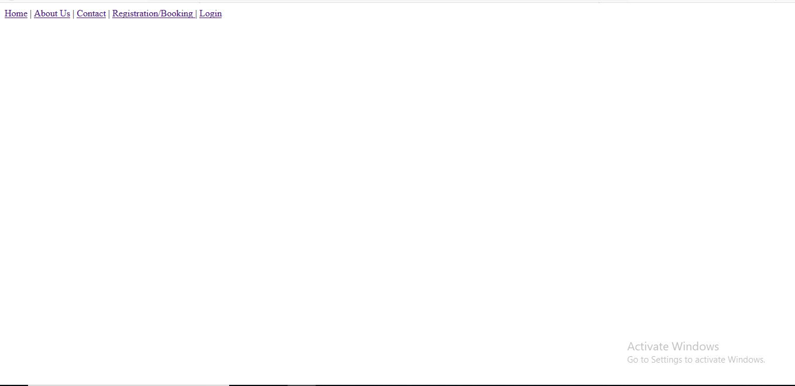
Menu

Slide 17
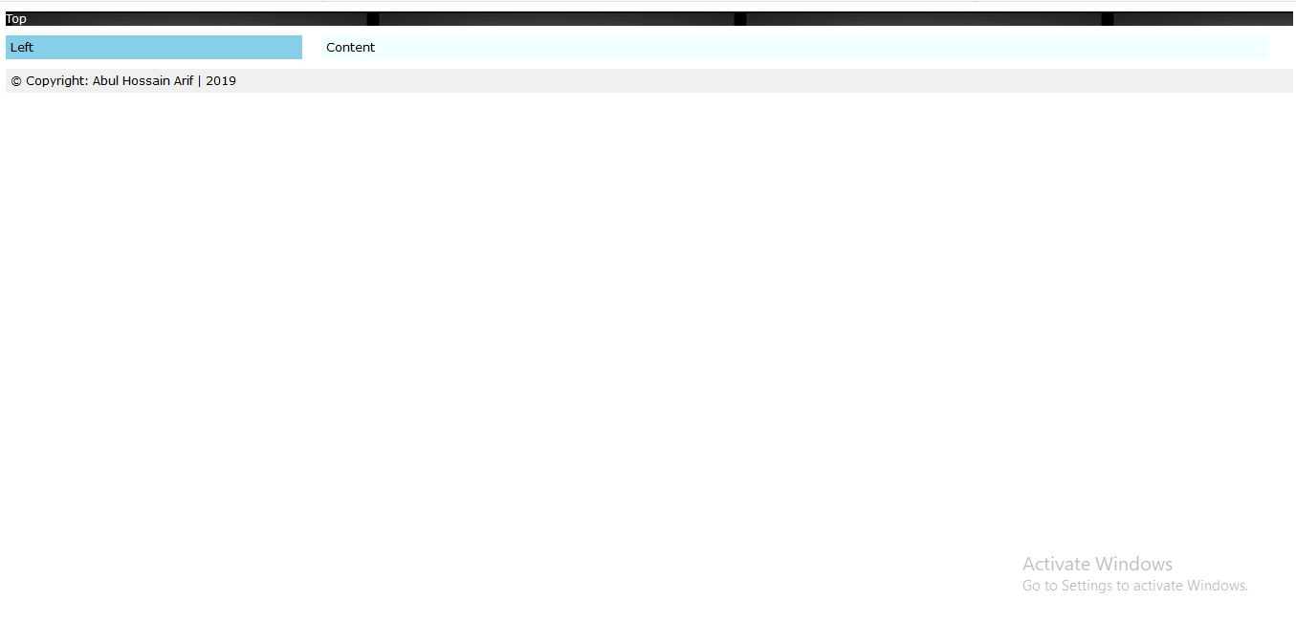
Template

Slide 18
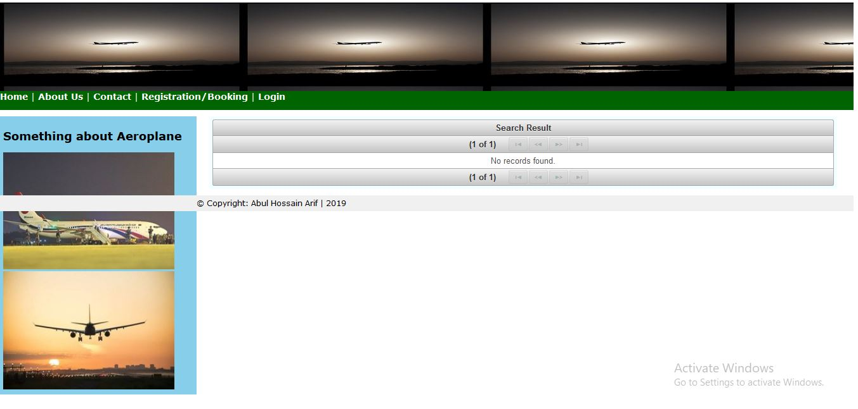
Result

Slide 19
Thanks

