Slide 1
DebtFree Coach App
App to help user to understand their finance situation and
Raise awareness about consumptive behavior

Slide 2
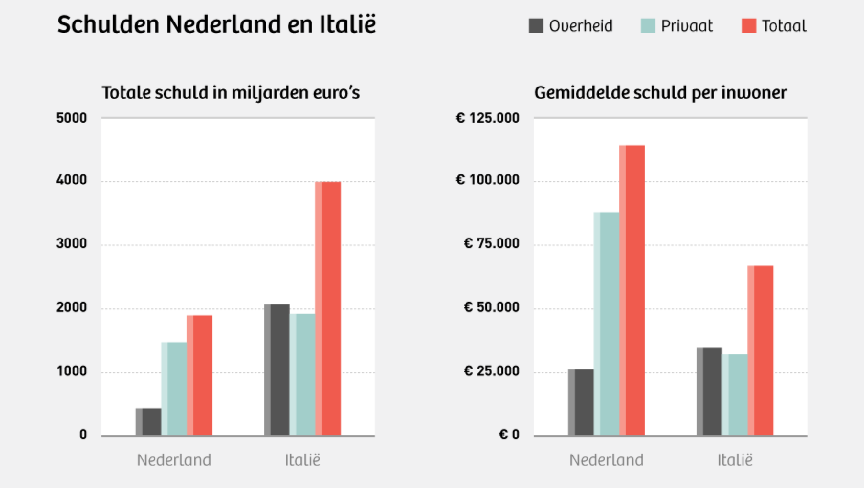
Type of Debt

Slide 3
Debt vs Loan (private)

Slide 4

How many?

Slide 5
How bad?

Slide 6
How much?

Slide 7
Solution?
Credit
GKB
Help (from local municipality)

Slide 8
Does it work?
Credit
GKB
Help (from local municipality)
Free from debt

Slide 9
Is there any alternative solution?
Credit
GKB
Help (from local municipality)
Free from debt
DebtFree Coach

Slide 10
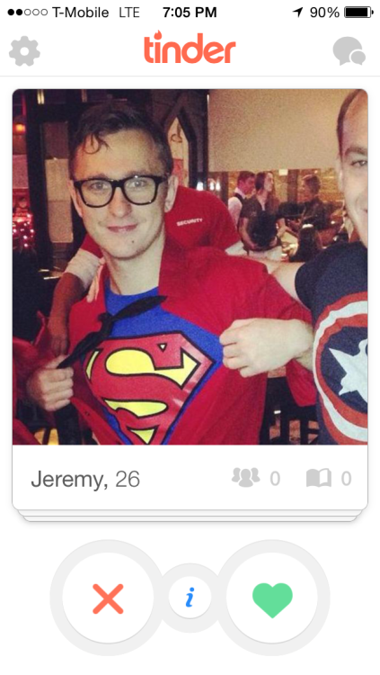
What is debtfree_coach?
$ +

Slide 11
Why debtfree_coach?
Building user financial awareness (how much do they spent, where their money goes, why did they paid some amount, etc)
Give user understanding about how to manage their finance (tips to reduce consumptive behavior, find help nearby the area for addictive consuming behavior, share experience with other users)
Give sticker rewards to appreciate users will and their hard work
To help people overcome their financial challenge, especially the one in debt

Slide 12
How does it work?
Do you have any debt?
yes
How much?
no
break
Monthly expenses
Any income?
Weekly expenses
Daily expenses

Slide 13
source
http://www.nu.nl/geldzaken/4203372/nederlanders-relatief-tevreden-spaargeld-en-schulden.html
http://www.nu.nl/geldzaken/4172898/nederlanders-hebben-meer-onhoudbare-schulden-dan-gedacht.html
http://www.destaatsschuldmeter.nl/
http://content1d.omroep.nl/urishieldv2/l27m799f28875f8c2dbf00575950d3000000.37dccad2cc099c9adfcfabb9ff68d027/nos/docs/281115_schulden.pdf
https://decorrespondent.nl/2421/Factcheck-Nederland-heeft-evenveel-schulden-als-Italie/267616436967-a21b7130
http://www.bnr.nl/nieuws/10304382/de-gemiddelde-schuld-van-nederlanders-in-de-schuldhulpverlening-stijgt-hard

Slide 14
Link to app
http://nycda.zone/arif67/debtfree_coach/

