Slide 1




GREEN DESTINATIONS
HR Employee Attrition Analysis
A Tableau-driven investigation into workforce turnover and its key drivers
Name
Arif Bin Mushtaq – B.Sc Hons Statistics
Email
loneasuu123@gmail.com,arifbinmushtaqq@stats.du.ac.in
Institution
Ramanujan College, University of Delhi

Slide 2

Objective
Green Destinations is experiencing increased employee attrition.
THE HR DIRECTOR WANTS TO:
Determine the attrition rate — The percentage of employees who have left.
1
Identify whether factors like age, years at the company, and income influence attrition.
2
Goal: Provide insights and predictive analysis to help reduce future attrition.

Slide 3


Tech Stack
Tableau
Excel
Dashboard creation & interactive visualization
Data wrangling, cleaning, and sourcing

Slide 4
Key Terms
Definitions used throughout this analysis
Attrition
The loss of employees over time — when people leave a company voluntarily or involuntarily and are not replaced. Also called employee turnover.
Example: If someone resigns or retires and their role isn't filled, that's attrition.
Attrition Count
The number of employees who have left the organization during a given period.
Example: Out of 1,000 employees, if 200 have left, the attrition count is 200.
Attrition Rate
The percentage of employees who have left, out of the total workforce.
Example: 1,000 total, 200 left → (200 / 1,000) × 100 = 20%

Slide 5

What Are KPIs?
KPI stands for Key Performance Indicator — a measurable value that shows how effectively an individual, team, or organization is achieving specific objectives.
WHY THEY MATTER
Help monitor performance
Guide decision-making
Align teams with company goals

Slide 6
Our KPIs
The six metrics tracked in the Green Destination dashboard
Education-wise Attrition
Department-wise Attrition
1
2
Job Satisfaction
Attrition by Gender
3
4
Attrition Rate and Attrition Count
Employee Count and Active Employees
5
6

Slide 7
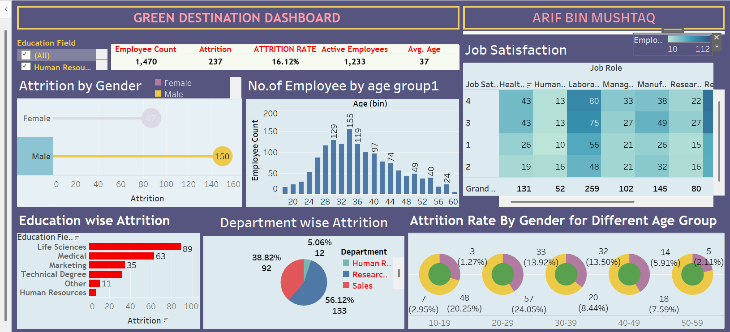
DATA ANALYSIS
Green Destination Dashboard
Built in Tableau — live and interactive
View live: public.tableau.com/views/GREENDESTINATIONHRDEPARTMENT/Dashboard1

Slide 8
Key Findings
1. Department-Wise Attrition
Research & Development (R&D)
Has the highest attrition count — 133 employees (56.1% of all departures).
Human Resources
Has the lowest attrition count — just 12 employees (5.1% of all departures).

Slide 9
Key Findings
2. Education-Wise Attrition Rate
Life Sciences shows the highest attrition (89 employees).
Medical (63) and Marketing (35) also show significant attrition — marketing's pressure and targets may explain the higher turnover.
Technical Degree shows moderate attrition (32).
Other and Human Resources show the lowest attrition (11 and 7) — possibly smaller teams or higher satisfaction.

Slide 10


Key Findings
3. Job Satisfaction
Job Satisfaction | Employees
4 · High | 459
3 | 442
2 | 280
1 · Low | 289
High Satisfaction (Level 4)
Sales Executives (112) and R&D staff (95) report the most top-tier satisfaction.
Laboratory Technicians (80) and Healthcare Representatives (43) also show strong satisfaction.
Total workforce: 1,470 across 9 job roles. Satisfaction is fairly evenly spread, with slightly more employees at the top (Level 4) than the bottom (Level 1).
Low Satisfaction (Levels 1–2)
Sales Exec: 69 at Level 1, 54 at Level 2.
R&D: 54 at Level 1, 53 at Level 2 — the same two teams dominate both extremes.

Slide 11
Key Findings
4. Attrition by Age Group
Peak Age Group
Age 34 has the highest employee count (155) — the core of the workforce is early-to-mid 30s.
Growth Phase (18–34)
Headcount rises steadily from 17 (age 18) to 155 (age 34), indicating active hiring/retention of younger staff.
Decline Phase (35+)
Steady drop from 155 (age 34) to 5 (age 60) — consistent with retirement and natural attrition.

Slide 12

Key Findings
5. Attrition by Gender
150
male employees left the company
87
female employees left the company

Slide 13

SUMMARY
6 · KPI Overview
1,470
237
16.12%
1,233
Employee Count
Attrition
Attrition Rate
Active Employees
Short Insight: Out of 1,470 employees, 237 have left, resulting in an attrition rate of 16.12%, leaving 1,233 active employees.
Decision: Implement retention strategies such as employee engagement programs and career development initiatives, especially in departments or age groups showing higher attrition.

Slide 14
RECOMMENDATIONS
Overall Metrics — Insights & Actions
Insight
Action
More males are leaving than females — possible gender-based engagement or satisfaction differences.
Conduct exit interviews or surveys focused on gender-related concerns.
Insight
Action
Majority of the workforce is aged 28–36 — a relatively young, mid-career employee base.
Focus retention strategies and career development on this age group.
Insight
Action
Employees with Life Sciences & Medical backgrounds are more likely to leave.
Investigate job satisfaction, pay parity, and growth paths in these fields.
Insight
Action
Sales shows alarmingly high attrition — possible stress, weak incentives, or poor work-life balance.
Reassess sales targets, commissions, support systems, and wellness programs.

Slide 15
Recommendations
Key Data-Driven Decisions
Insight: Younger females and mid-career males are at the highest risk of leaving; older employees tend to stay longer.
Action: Offer flexible work, mentorship, and promotion paths for early-career women; address burnout and stagnation among mid-career men.
Prioritize retention in the Sales department — redesign KPIs, improve support.
Tailor HR strategies by gender and age group (mentorship for young women, career mobility for mid-career men).
Target employee engagement programs to Life Sciences and Medical degree holders.
Enhance satisfaction in high-attrition roles, especially Sales and Healthcare.
Maintain and replicate practices from R&D and HR, where attrition is lowest.

Slide 16
THANK YOU!
Green Destinations — HR Employee Attrition Analysis
Arif Bin Mushtaq · Ramanujan College, University of Delhi · loneasuu123@gmail.com

