Slide 1
Scalable Web Application Architecture and Tools
Scalable Web Application Architecture
Distributed Computation
Redis (in-memory data structure store)
Apache Ignite (In-Memory Computing Platform )
Mongo DB (Distributed Document DB)
Object Storage (Distributed Storage) Azure Blob, Distributed Cloud Storage
Docker Container, Compose, Swarm and Kubernetes
Microservices
DevOps and Tools
DevOps
Continuous Delivery (Azure DevOps, Jenkins, Bamboo)
Code as Infrastructure(Chef, SaltStack, Ansible)
Code Quality and Unit Testing
Azure Cloud
Cloud Basics XaaS IaaS, PaaS, SaaS, DBaaS,… etc
Azure Compute Azure VM, Availability Sets, Connections, Load Balancer, Application Gateway
Azure Network Virtual, Network, Public IP, Load balancers, App Gateway
Azure Databases SQL Server, MySQL, Maria DB, SQL Elastic Pools, Cosmos DB
Programming Language
Python
Django
Go
Web Assembly and Blazor
Nodejs
Code Quality and Unit Testing

Slide 2
Description
Unit tests are typically automated tests written and run by software developers to ensure that a section of an application (known as the "unit") meets its design and behaves as intended.
In object-oriented programming, a unit is often an entire interface, such as a class, but could be an individual method. By writing tests first for the smallest testable units, then the compound behaviors between those, one can build up comprehensive tests for complex applications.
To isolate issues that may arise, each test case should be tested independently. Substitutes such as method stubs, mock objects, fakes, and test harnesses can be used to assist testing a module in isolation.
https://www.wikizeroo.org/index.php?q=aHR0cHM6Ly9lbi53aWtpcGVkaWEub3JnL3dpa2kvVW5pdF90ZXN0aW5n

Slide 3
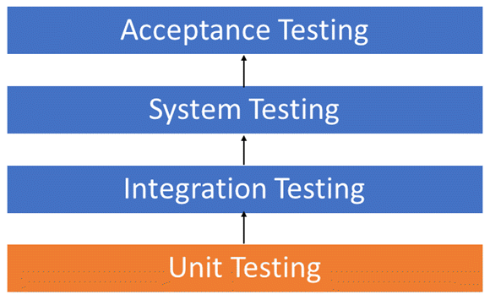
System Under Test (SUT)
In SDLC, STLC, V Model, Unit testing is first level of testing done before integration testing. Unit testing is a WhiteBox testing technique that is usually performed by the developer. Though, in a practical world due to time crunch or reluctance of developers to tests, QA engineers also do unit testing.
https://www.guru99.com/unit-testing-guide.html

Slide 4
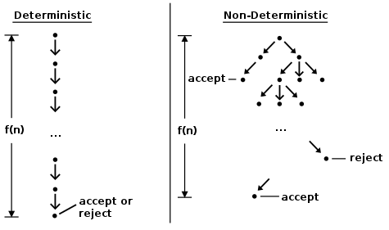
Deterministic Stochastic Probabilistic
Deterministik sistem matematik ve fizikte, deterministik bir sistem, sistemin gelecekteki durumlarının gelişmesinde rastgelelik bulunmayan bir sistemdir.
Belirli bir model bu nedenle her zaman belirli bir başlangıç ​​koşulundan veya başlangıç ​​durumundan aynı çıktı üretir.
Stokastik ve olasılıksal aynı anlama gelebilir. Ancak Stokastik zaman bağımlı iken olasılıksal zaman bağımsız olay veya durumları ifade eder.

Slide 5
Advantages
Unit testing finds problems early in the development cycle. Since the unit tests alert the development team of the problem before handing the code off to testers or clients, potential problems are caught early in the development process.
Unit testing allows the programmer to refactor code or upgrade system libraries at a later date, and make sure the module still works correctly (e.g., in regression testing).
Unit testing may reduce uncertainty in the units themselves and can be used in a bottom-up testing style approach. By testing the parts of a program first and then testing the sum of its parts, integration testing becomes much easier.
Unit testing provides a sort of living documentation of the system. Developers looking to learn what functionality is provided by a unit, and how to use it, can look at the unit tests to gain a basic understanding of the unit's interface
When software is developed using a test-driven approach, the combination of writing the unit test to specify the interface plus the refactoring activities performed after the test has passed, may take the place of formal design. Each unit test can be seen as a design element specifying classes, methods, and observable behavior.
Benefits of Unit Testing
Unit tests prove that your code actually works
You get a low-level regression-test suite
You can improve the design without breaking it
It's more fun to code with them than without
They demonstrate concrete progress
Unit tests are a form of sample code
It forces you to plan before you code
It reduces the cost of bugs
It's even better than code inspections
Unit tests make better designs
https://www.wikizeroo.org/index.php?q=aHR0cHM6Ly9lbi53aWtpcGVkaWEub3JnL3dpa2kvVW5pdF90ZXN0aW5n
https://dzone.com/articles/unit-testing-guidelines-what-to-test-and-what-not

Slide 6
Limitations and Disadvantages
Testing will not catch every error in the program, because it cannot evaluate every execution path in any but the most trivial programs.
An elaborate hierarchy of unit tests does not equal integration testing. Integration with peripheral units should be included in integration tests, but not in unit tests.
Software testing is a combinatorial problem. For example, every Boolean decision statement requires at least two tests: one with an outcome of "true" and one with an outcome of "false". As a result, for every line of code written, programmers often need 3 to 5 lines of test code. This obviously takes time and its investment may not be worth the effort.
Another challenge related to writing the unit tests is the difficulty of setting up realistic and useful tests. It is necessary to create relevant initial conditions so the part of the application being tested behaves like part of the complete system. If these initial conditions are not set correctly, the test will not be exercising the code in a realistic context, which diminishes the value and accuracy of unit test results.
https://www.wikizeroo.org/index.php?q=aHR0cHM6Ly9lbi53aWtpcGVkaWEub3JnL3dpa2kvVW5pdF90ZXN0aW5n

Slide 7
Code Coverage

Slide 8
Code Coverage
Code coverage is a measure which describes the degree of which the source code of the program has been tested.
Code Coverage Methods
Following are major code coverage methods
Statement Coverage
Decision Coverage
Branch Coverage
Toggle Coverage
FSM Coverage
https://www.guru99.com/code-coverage.html

Slide 9
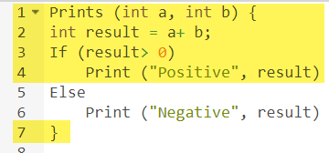
Code Coverage Methods Statement Coverage
The statements marked in yellow color are those which are executed as per the scenario
Number of executed statements = 5, Total number of statements = 7
Statement Coverage: 5/7 = 71%
https://www.guru99.com/code-coverage.html

Slide 10

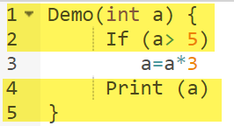
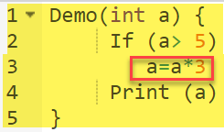
Decision coverage reports the true or false outcomes of each Boolean expression. In this coverage, expressions can sometimes get complicated. Therefore, it is very hard to achieve 100% coverage.
Code Coverage Methods Decision Coverage
Test Case | Value of A | Output | Decision Coverage
1 | 2 | 2 | 50%
2 | 6 | 18 | 50%
https://www.guru99.com/code-coverage.html

Slide 11

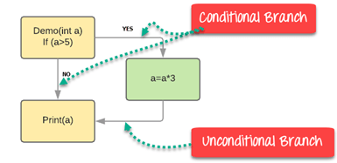
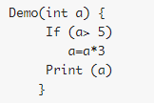
In the branch coverage, every outcome from a code module is tested. For example, if the outcomes are binary, you need to test both True and False outcomes.
It helps you to ensure that every possible branch from each decision condition is executed at least a single time.
Code Coverage Methods Branch Coverage
Test Case | Value of A | Output | Decision Coverage | Branch Coverage
1 | 2 | 2 | 50% | 33%
2 | 6 | 18 | 50% | 67%
https://www.guru99.com/code-coverage.html

Slide 12

Conditional coverage or expression coverage will reveal how the variables or subexpressions in the conditional statement are evaluated. In this coverage expressions with logical operands are only considered.
For example, if an expression has Boolean operations like AND, OR, XOR, which indicated total possibilities.
Conditional coverage offers better sensitivity to the control flow than decision coverage. Condition coverage does not give a guarantee about full decision coverage
Code Coverage Methods Condition Coverage
we have 4 possible combinations
TT – FF – TF - FT
X=3 Y=4 | (x<y) | TRUE | Condition Coverage is ¼ = 25%
A=3 B=4 | (a>b) | FALSE
https://www.guru99.com/code-coverage.html

Slide 13
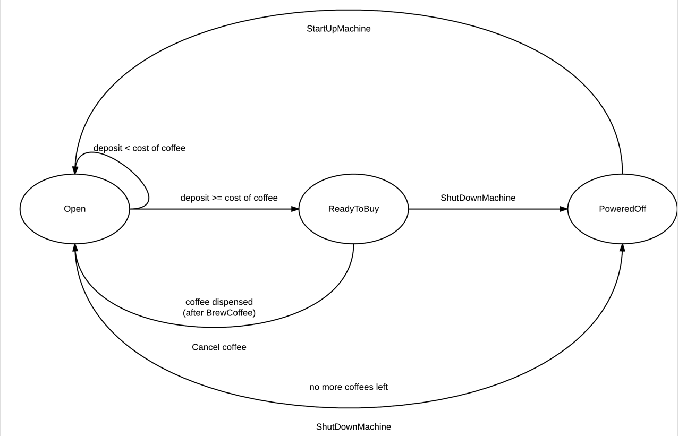
Finite state machine coverage is certainly the most complex type of code coverage method. This is because it works on the behavior of the design. In this coverage method, you need to look for how many time-specific states are visited, transited. It also checks how many sequences are included in a finite state machine.
Code Coverage Methods Finite State Machine Coverage
https://www.guru99.com/code-coverage.html

Slide 14
Code Coverage vs. Functional Coverage
Code Coverage | Functional Coverage
Code coverage tells you how well the source code has been exercised by your test bench. | Functional coverage measures how well the functionality of the design has been covered by your test bench.
Never use a design specification | Use design specification
Done by developers | Done by Testers
Code Coverage Methods
https://www.guru99.com/code-coverage.html

Slide 15
What needs to be tested ?
Code used from a lot of modules
Repeatedly changed code
Code that is expected to generate a lot of bugs
https://dreamix.eu/blog/java/what-needs-to-be-unit-tested-how-much-code-coverage-is-needed https://www.jrebel.com/blog/unit-testing-in-java

Slide 16
What you should assume is working correctly and does not need to be tested ?
External libraries and frameworks
Trivial code like getters and setters
Code that works only with the UI
Database
Code that has non deterministic results (Think Thread order or random numbers)
Constructors or properties (if they just return variables). Test them only if they contain validations.
Configurations like constants, readonly fields, configs, enumerations, etc.
Facades of just wrapping other frameworks or libraries
Container service registrations
Exception messages (mesaj değil exception nın throw olup olmadığı test edilmeli)
POCO classes — models, etc.
.NET Core/Framework logic- like default parameters
Private methods directly
Complex SQL Queries (more than 3 joins or grouping, etc.). Better to test it with manual or some kind of system test against real DB.
ASPNET.Core controller methods (API controller eğer BL olarak yazıldıysa test edilmeli )
Complex multi-threading code (it is better to be tested with integration tests)
Methods that call another public method
https://dreamix.eu/blog/java/what-needs-to-be-unit-tested-how-much-code-coverage-is-needed https://www.jrebel.com/blog/unit-testing-in-java
https://dzone.com/articles/unit-testing-guidelines-what-to-test-and-what-not

Slide 17
Priority

Slide 18
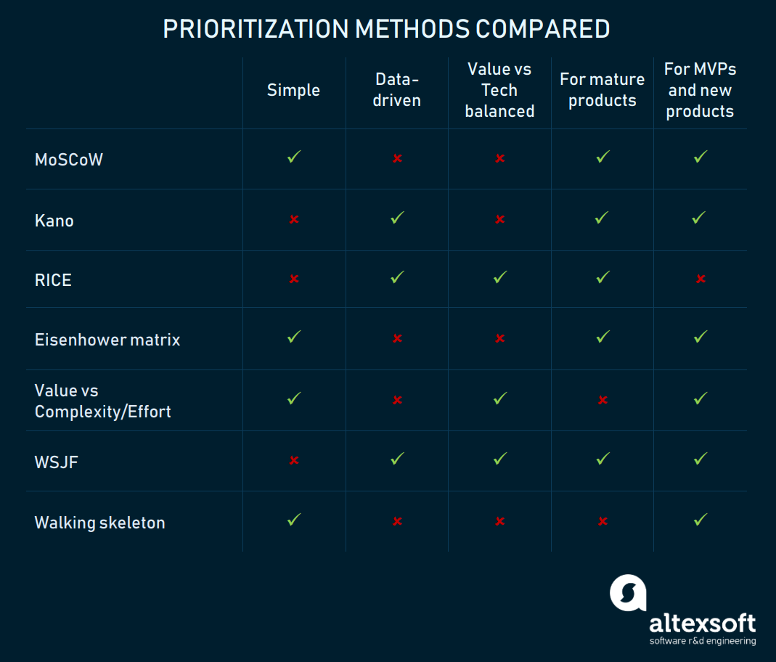
https://www.altexsoft.com/blog/business/most-popular-prioritization-techniques-and-methods-moscow-rice-kano-model-walking-skeleton-and-others/

Slide 19
Prioritization and Risk Assessment Matrix
A risk is the probability of occurrence of an uncertain event. It could be events that have occurred in the past or current events or something that could happen in the future. These unpredictable events can have an impact on the cost, business, technical, and quality targets of a project.
Based on the calculated risk rating, we can decide how many unit tests we will write, with the higher the priority, the higher the test coverage should be. Please review the types of code coverage.
Risk assessment matrix is the probability impact matrix. It provides the project team with a quick view of the risks and the priority with which each of these risks needs to be addressed.
moscow analysis vs Eisenhower vs Risk Assesment Matrix
Risk rating = Probability x Severity (şiddet)
https://dzone.com/articles/unit-testing-guidelines-what-to-test-and-what-not

Slide 20
This can be classified as Frequent(A), Probable(B), Occasional(C), Remote(D), Improbable(E), Eliminated(F)
Frequent — It is expected to occur several times in most circumstances (91 - 100%)
Probable — Likely to occur several times in most circumstances (61 - 90%)
Occasional — Might occur sometime (41 - 60%)
Remote — Unlikely to occur /could occur sometime ( 11 - 40%)
Improbable — May occur in rare and exceptional circumstances (0 -10%)
Eliminate — Impossible to occur (0%)
Probability
Risk rating = Probability x Severity (şiddet)
https://dzone.com/articles/unit-testing-guidelines-what-to-test-and-what-not

Slide 21
Severity is the degree of impact of damage or loss caused due to the uncertain event. Scored 1 to 4 and can be classified as Catastrophic=1, Critical=2, Marginal=3, Negligible=4
Catastrophic — Harsh Consequences that make the project wholly unproductive and could even lead to project shut down. This must be a top priority during risk management.
Critical — Large consequences, which can lead to a great amount of loss. The project is severely threatened.
Marginal — Short-term damage still reversible through restoration activities.
Negligible — Little or minimal damage or loss. This can be monitored and managed by routine procedures.
Severity
Risk rating = Probability x Severity (şiddet)
https://dzone.com/articles/unit-testing-guidelines-what-to-test-and-what-not

Slide 22
The priority is classified into four categories, which are mapped against the severity and probability of the risk, as shown in below image.
Serious — The risks that fall in this category are marked in the Amber color. The activity must be stopped, and immediate action must be taken to isolate the risk. Effective controls must be identified and implemented. Further, the activity must not proceed unless the risk is reduced to a low or medium level.
High —The risks that fall in this category are marked in Red color ate action or risk management strategies. Immediate action must be taken to isolate, eliminate, and substitute the risk and to implement effective risk controls. If these issues cannot be resolved immediately, strict timelines must be defined to address these issues.
Medium — The risks that fall in this category are marked in Yellow color. Reasonable and practical steps must be taken to minimize the risks.
Low — The risks that fall in this category are marked in the green color; they can be marked ignored as they usually do not pose any significant problem. A periodical review is a must to ensure the controls remain effective.
Priority
Categories
https://dzone.com/articles/unit-testing-guidelines-what-to-test-and-what-not

Slide 23
Uygulama 1 Introduction

Slide 24
Terms and Definitions

Slide 25
TDD / ATDD / BDD
Parameters | TDD | BDD | ATDD
Definition | TDD is a development technique that focuses more on the implementation of a feature | BDD is a development technique that focuses on the system’s behavior | ATDD is a technique similar to BDD focusing more on capturing the requirements
Participants | Developer | Developers, Customer, QAs | Developers, Customers, QAs
Language used | Written in a language similar to the one used for feature development (Eg. Java, Python, etc) | Simple English, (Gherkin) | Simple English, Gherkin
Main Focus | Unit Tests | Understanding Requirements | Writing Acceptance Tests
UI Test (Manual or Automated Testing)
Acceptance Test (BDD / ATDD)
Unit Test (TDD)
Test Driven Development
Acceptance Driven Development
Behavioral Driven Devlopment
https://www.browserstack.com/guide/tdd-vs-bdd-vs-atdd
https://en.wikipedia.org/wiki/Acceptance_test%E2%80%93driven_development

Slide 26
Validation Rule vs Business Rule,
Exception vs Validation,
Specification
https://martinfowler.com/articles/replaceThrowWithNotification.html
https://www.codeproject.com/Tips/790758/Specification-and-Notification-Patterns

Slide 27
Stub - an object that provides predefined answers to method calls. (fake database)
A stub replaces a class with a small substitute that implements the same interface. To use stubs, you have to design your application so that each component depends only on interfaces, and not on other components. (By "component" we mean a class or group of classes that are designed and updated together and typically contained in an assembly.)
Moles - Shim (dolgu): A shim modifies the compiled code of your application at run time so that instead of making a specified method call, it runs the shim code that your test provides. Shims can be used to replace calls to assemblies that you cannot modify, such .NET assemblies.
Mock - an object on which you set expectations.
Fake - an object with limited capabilities (for the purposes of testing), e.g. a fake web service.
https://stackoverflow.com/questions/346372/whats-the-difference-between-faking-mocking-and-stubbing/5180286#5180286

Slide 28
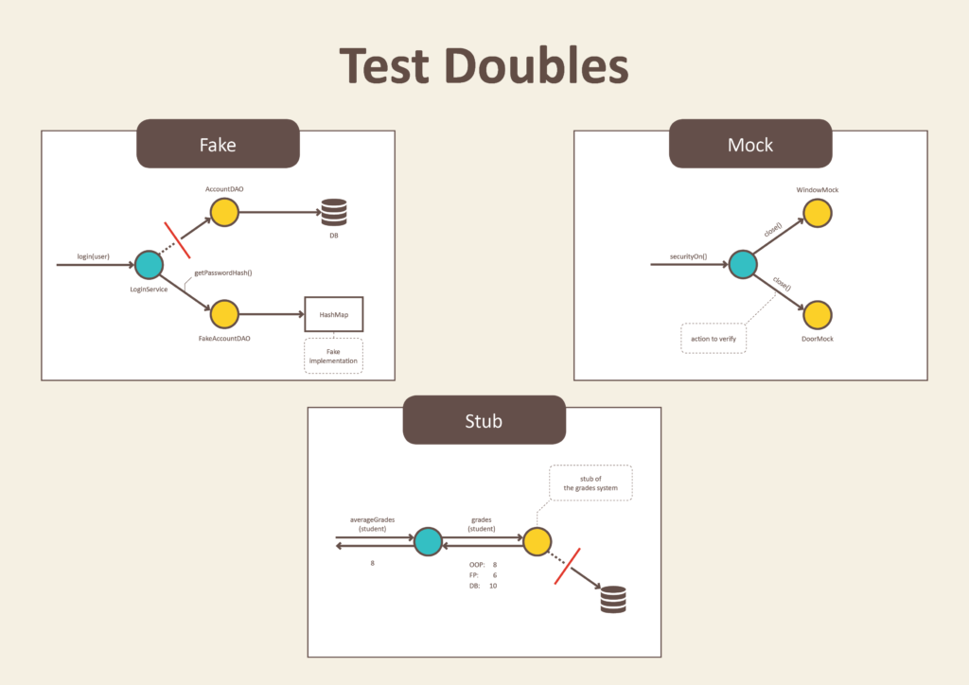

Slide 29
Fact and Theory
Facts are tests which are always true. They test invariant conditions.
Theories are tests which are only true for a particular set of data (Parameterized unit testing, Data-Driven Testing).
using Xunit;
namespace MyFirstUnitTests
{
public class Class1
{
[Fact]
public void PassingTest()
{
Assert.Equal(4, Add(2, 2));
}
[Fact]
public void FailingTest()
{
Assert.Equal(5, Add(2, 2));
}
int Add(int x, int y)
{
return x + y;
}
}
}
[Theory]
[InlineData(3)]
[InlineData(5)]
[InlineData(6)]
public void MyFirstTheory(int value)
{
Assert.True(IsOdd(value));
}
bool IsOdd(int value)
{
return value % 2 == 1;
}
Terms
https://xunit.net/docs/getting-started/netfx/visual-studio
https://docs.microsoft.com/en-us/visualstudio/test/intellitest-manual/getting-started?view=vs-2019
https://docs.microsoft.com/en-us/visualstudio/test/how-to-create-a-data-driven-unit-test?view=vs-2019
https://docs.microsoft.com/en-us/visualstudio/test/intellitest-manual/test-generation?view=vs-2019

Slide 30
Arrange, Act and Assert - AAA
Arrange – setup the testing objects and prepare the prerequisites for your test.
Act – perform the actual work of the test.
Assert – verify the result.
[Fact]
public void Withdraw_ValidAmount_ChangesBalance()
{
// arrange
double currentBalance = 10.0;
double withdrawal = 1.0;
double expected = 9.0;
var account = new CheckingAccount("JohnDoe", currentBalance);
// act
account.Withdraw(withdrawal);
// assert
Assert.AreEqual(expected, account.Balance);
}
[Fact]
public void Withdraw_AmountMoreThanBalance_Throws()
{
// arrange
var account = new CheckingAccount("John Doe", 10.0);
// act and assert
Assert.ThrowsException<System.ArgumentException>(() => account.Withdraw(20.0));
}
Terms

Slide 31
Why Did we Build xUnit 1.0?
James Newkirk (creator of xunit and nunit)
https://xunit.net/docs/why-did-we-build-xunit-1.0.html
Xunit vs Nunit vs MsTest
 | Nunit | XUnit | MSTest
Execution Isolation Level | Per test class | Per test method | Per test class
Extensible Test Attributes | No (Test and TestCase attributes are sealed) | YES (Theory and Fact attributes are extensible) | No
https://xunit.net/docs/comparisons
https://xunit.net/docs/why-did-we-build-xunit-1.0.html
https://devblogs.microsoft.com/visualstudio/test-experience-improvements/
https://dingyuliang.me/unit-testing-frameworks-xunit-vs-nunit-vs-mstest-net-net-core/
https://dev.to/hatsrumandcode/net-core-2-why-xunit-and-not-nunit-or-mstest--aei
https://visualstudiomagazine.com/articles/2018/11/01/net-core-testing.aspx
https://www.davidyardy.com/blog/xunit%E2%80%93what-is-it-and-why-another-unit-testing-framework/
https://www.clariontech.com/blog/why-should-you-use-xunit-a-unit-testing-framework-for-.net

Slide 32
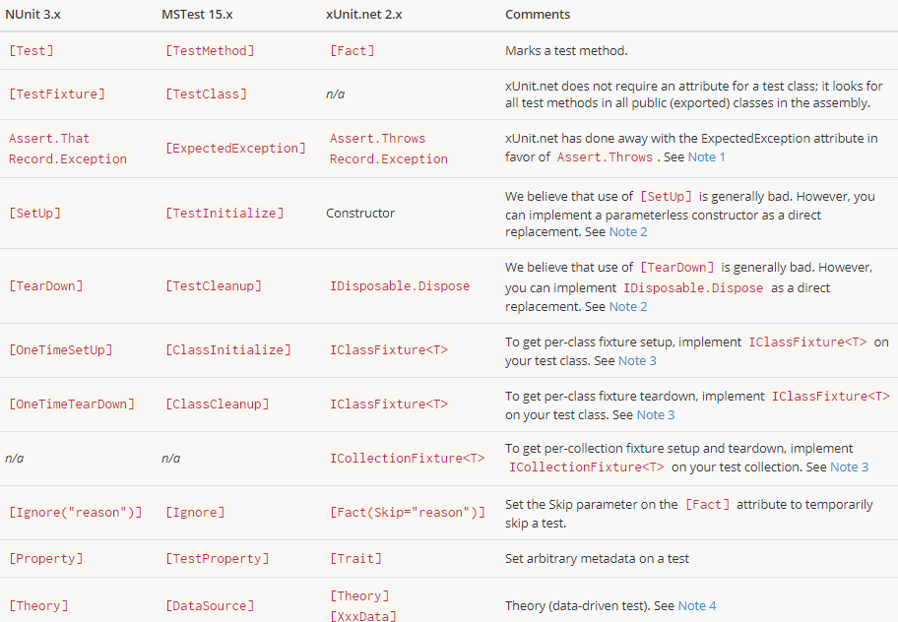
Attributes
Xunit vs Nunit vs MsTest
https://xunit.net/docs/comparisons
https://dingyuliang.me/unit-testing-frameworks-xunit-vs-nunit-vs-mstest-net-net-core/

Slide 33
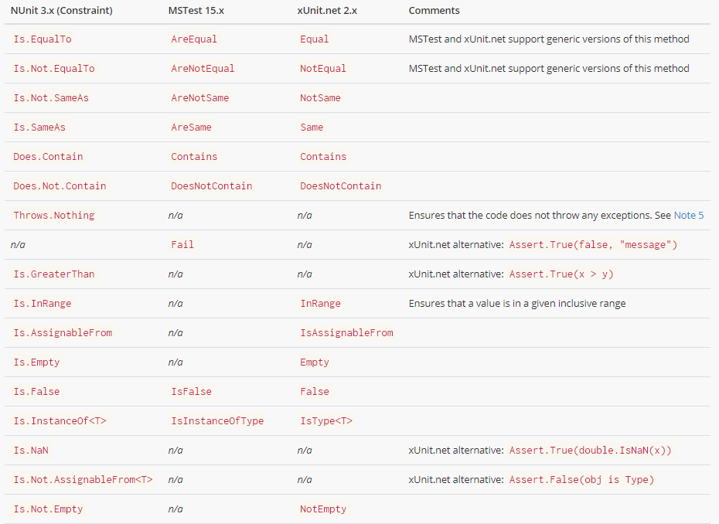
Assertions
Xunit vs Nunit vs MsTest
https://xunit.net/docs/comparisons
https://dingyuliang.me/unit-testing-frameworks-xunit-vs-nunit-vs-mstest-net-net-core/

Slide 34
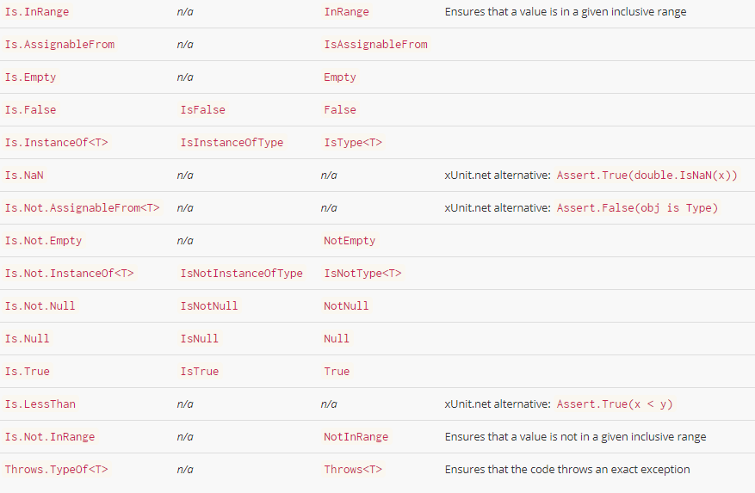
Assertions
Xunit vs Nunit vs MsTest
https://xunit.net/docs/comparisons
https://dingyuliang.me/unit-testing-frameworks-xunit-vs-nunit-vs-mstest-net-net-core/

Slide 35
Uygulama 2
Xunit Shared Context Xunit Parallelism

Slide 36
Unit testing best practices with .NET Core and .NET Standard

Slide 37
Naming your tests
The name of your test should consist of three parts:
The name of the method being tested.
The scenario under which it's being tested.
The expected behavior when the scenario is invoked.
Write minimally passing tests
The input to be used in a unit test should be the simplest possible in order to verify the behavior that you are currently testing.
Why?
Tests become more resilient to future changes in the codebase.
Closer to testing behavior over implementation.
[Fact]
public void Test_Single()
{
var stringCalculator = new StringCalculator();
var actual = stringCalculator.Add("0");
Assert.Equal(0, actual);
}
[Fact]
public void Add_SingleNumber_ReturnsSameNumber()
{
var stringCalculator = new StringCalculator();
var actual = stringCalculator.Add("42");
Assert.Equal(42, actual);
}
Best Practices
[Fact]
public void Add_SingleNumber_ReturnsSameNumber()
{
var stringCalculator = new StringCalculator();
var actual = stringCalculator.Add("0");
Assert.Equal(0, actual);
}
[Fact]
public void Add_SingleNumber_ReturnsSameNumber()
{
var stringCalculator = new StringCalculator();
var actual = stringCalculator.Add("0");
Assert.Equal(0, actual);
}
https://docs.microsoft.com/en-us/dotnet/core/testing/unit-testing-best-practices

Slide 38
Avoid magic strings
Naming variables in unit tests is as important, if not more important, than naming variables in production code. Unit tests should not contain magic strings.
Why?
Prevents the need for the reader of the test to inspect the production code in order to figure out what makes the value special.
Explicitly shows what you're trying to prove rather than trying to accomplish.
Avoid logic in tests
When writing your unit tests avoid manual string concatenation and logical conditions such as if, while, for, switch, etc.
Why?
Less chance to introduce a bug inside of your tests.
Focus on the end result, rather than implementation details.
[Fact]
public void Add_MultipleNumbers_ReturnsCorrectResults()
{
var stringCalculator = new StringCalculator();
var expected = 0;
var testCases = new[]
{ "0,0,0",
"0,1,2",
"1,2,3"};
foreach (var test in testCases)
{
Assert.Equal(expected, stringCalculator.Add(test));
expected += 3; }}
[Fact]
public void Add_BigNumber_ThrowsException()
{
var stringCalculator = new StringCalculator();
Action actual = () => stringCalculator.Add("1001");
Assert.Throws<OverflowException>(actual);
}
Best Practices
[Fact]
void Add_MaximumSumResult_ThrowsOverflowException()
{
var stringCalculator = new StringCalculator();
const string MAXIMUM_RESULT = "1001";
Action actual = () => stringCalculator.Add(MAXIMUM_RESULT);
Assert.Throws<OverflowException>(actual);
}
[Theory]
[InlineData("0,0,0", 0)]
[InlineData("0,1,2", 3)]
[InlineData("1,2,3", 6)]
public void Add_MultipleNumbers_ReturnsSumOfNumbers(string input, int expected)
{
var stringCalculator = new StringCalculator();
var actual = stringCalculator.Add(input);
Assert.Equal(expected, actual);
}

Slide 39
Prefer helper methods to setup and teardown
If you require a similar object or state for your tests, prefer a helper method than leveraging Setup and Teardown attributes if they exist.
Why?
Less confusion when reading the tests since all of the code is visible from within each test.
Less chance of setting up too much or too little for the given test.
Less chance of sharing state between tests which creates unwanted dependencies between them.
[Fact]
public void Add_TwoNumbers_ReturnsSumOfNumbers()
{
var stringCalculator = CreateDefaultStringCalculator();
var actual = stringCalculator.Add("0,1");
Assert.Equal(1, actual);
}
// more tests...
private StringCalculator CreateDefaultStringCalculator()
{
return new StringCalculator();
}
Best Practices
private readonly StringCalculator stringCalculator;
public StringCalculatorTests()
{
stringCalculator = new StringCalculator();
}
// more tests...
[Fact]
public void Add_TwoNumbers_ReturnsSumOfNumbers()
{
var result = stringCalculator.Add("0,1");
Assert.Equal(1, result);
}

Slide 40
Avoid multiple asserts
When writing your tests, try to only include one Assert per test. Common approaches to using only one assert include:
Create a separate test for each assert.
Use parameterized tests.
Why?
If one Assert fails, the subsequent Asserts will not be evaluated.
Ensures you are not asserting multiple cases in your tests.
Gives you the entire picture as to why your tests are failing.
[Theory]
[InlineData(null)]
[InlineData("a")]
public void Add_InputNullOrAlphabetic_ThrowsArgumentException(string input)
{
var stringCalculator = new StringCalculator();
Action actual = () => stringCalculator.Add(input);
Assert.Throws<ArgumentException>(actual);
}
Best Practices
[Fact]
public void Add_EdgeCases_ThrowsArgumentExceptions()
{
Assert.Throws<ArgumentException>(() => stringCalculator.Add(null));
Assert.Throws<ArgumentException>(() => stringCalculator.Add("a"));
}

Slide 41
Validate private methods by unit testing public methods
In most cases, there should not be a need to test a private method. Private methods are an implementation detail. You can think of it this way: private methods never exist in isolation. At some point, there is going to be a public facing method that calls the private method as part of its implementation. What you should care about is the end result of the public method that calls into the private one.
public string ParseLogLine(string input)
{
var sanitizedInput = TrimInput(input);
return sanitizedInput;
}
private string TrimInput(string input)
{
return input.Trim();
}
Best Practices
Test Code
public void ParseLogLine_ByDefault_ReturnsTrimmedResult()
{
var parser = new Parser();
var result = parser.ParseLogLine(" a ");
Assert.Equals("a", result);
}

Slide 42
Stub static references
public interface IDateTimeProvider{
DayOfWeek DayOfWeek();}
public int GetDiscountedPrice(int price, IDateTimeProvider dateTimeProvider){
if(dateTimeProvider.DayOfWeek() == DayOfWeek.Tuesday) {return price / 2;}
Else
{return price;}}
One of the principles of a unit test is that it must have full control of the system under test. This can be problematic when production code includes calls to static references (e.g. DateTime.Now). Consider the following code
public int GetDiscountedPrice(int price){
if(DateTime.Now.DayOfWeek == DayOfWeek.Tuesday)
{
return price / 2;
}
else
{
return price;
}}
You may try an approach such as
public void GetDiscountedPrice_ByDefault_ReturnsFullPrice()
{
var priceCalculator = new PriceCalculator();
var dateTimeProviderStub = new Mock<IDateTimeProvider>();
dateTimeProviderStub.Setup(dtp => dtp.DayOfWeek()).Returns(DayOfWeek.Monday);
var actual = priceCalculator.GetDiscountedPrice(2, dateTimeProviderStub);
Assert.Equals(2, actual);
}
public void GetDiscountedPrice_OnTuesday_ReturnsHalfPrice()
{
var priceCalculator = new PriceCalculator();
var dateTimeProviderStub = new Mock<IDateTimeProvider>();
dateTimeProviderStub.Setup(dtp => dtp.DayOfWeek()).Returns(DayOfWeek.Tuesday);
var actual = priceCalculator.GetDiscountedPrice(2, dateTimeProviderStub);
Assert.Equals(1, actual);
}
Best Practices
How can this code possibly be unit tested? You may try an approach such as
public void GetDiscountedPrice_ByDefault_ReturnsFullPrice() {
var priceCalculator = new PriceCalculator();
var actual = priceCalculator.GetDiscountedPrice(2);
Assert.Equals(2, actual) }
public void GetDiscountedPrice_OnTuesday_ReturnsHalfPrice(){
var priceCalculator = new PriceCalculator();
var actual = priceCalculator.GetDiscountedPrice(2);
Assert.Equals(1, actual);}
Testin yapıldı gün Salı değilse ilk test, salıysa ikinci test doğru çalışacak.

Slide 43
https://github.com/xunit/samples.xunit
https://github.com/xunit/samples.xunit/blob/master/SqlDataExample/DatabaseExamples.cs
https://xunit.net/#documentation
https://xunit.net/docs/capturing-output
https://xunit.net/docs/running-tests-in-parallel
https://xunit.net/docs/shared-context
https://andrewlock.net/creating-parameterised-tests-in-xunit-with-inlinedata-classdata-and-memberdata/
Xunit
Resources

Slide 44
Uygulama 3
Xunit dependencies
and Mocking

Slide 45
Behavioral Driven Development
SpecFlow

Slide 46
Behavior-driven development
In software engineering, behavior-driven development (BDD) is an Agile software development process that encourages collaboration among developers, QA and non-technical or business participants in a software project.
Although BDD is principally an idea about how software development should be managed by both business interests and technical insight, the practice of BDD does assume the use of specialized software tools to support the development process.
BDD is largely facilitated through the use of a simple domain-specific language (DSL) using natural-language constructs (e.g., English-like sentences) that can express the behaviour and the expected outcomes. Test scripts have long been a popular application of DSLs with varying degrees of sophistication. BDD is considered an effective technical practice especially when the "problem space" of the business problem to solve is complex.
https://en.wikipedia.org/wiki/Behavior-driven_development

Slide 47
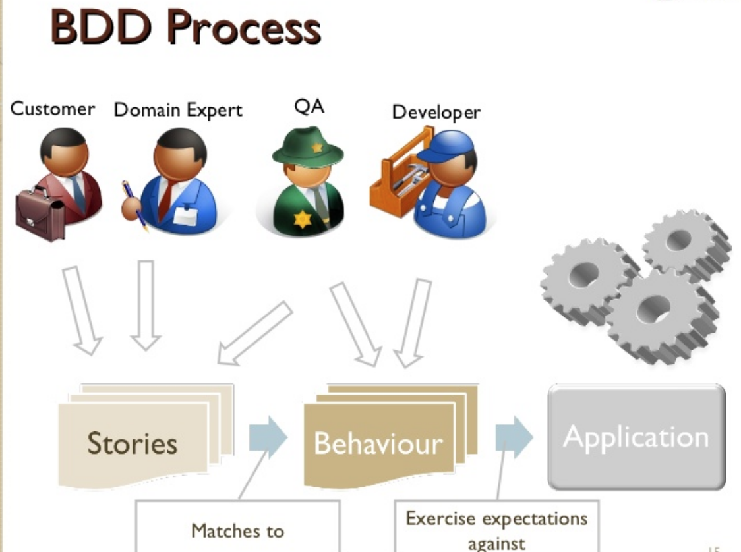

Slide 48
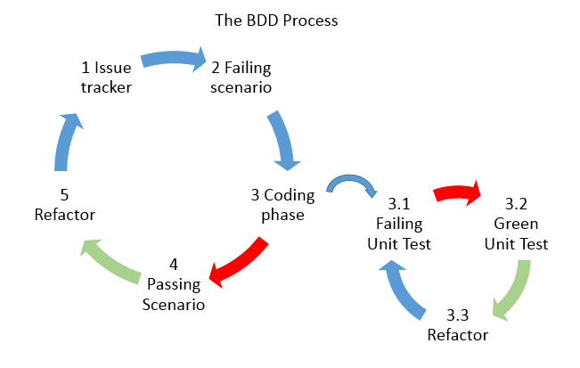

Slide 49
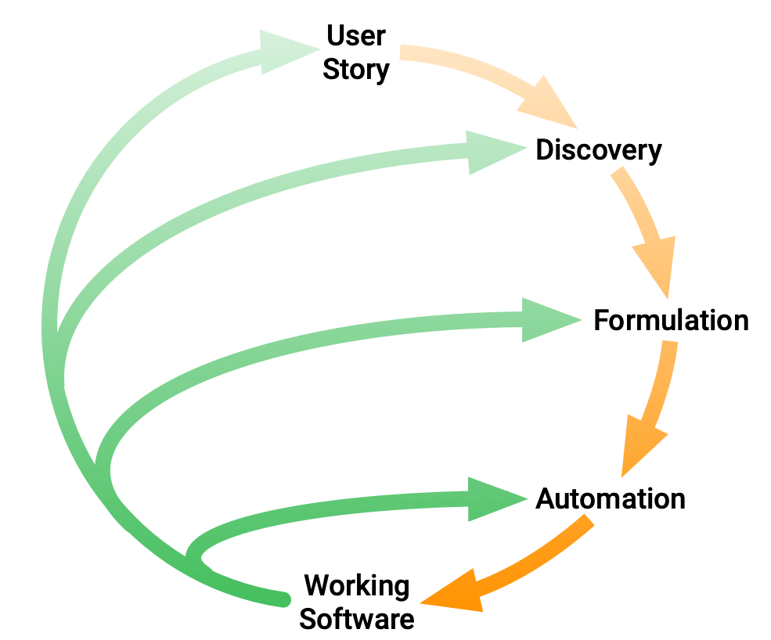
Cucumber
Cucumber is a software tool that supports behavior-driven development (BDD). Central to the Cucumber BDD approach is its ordinary language parser called Gherkin. It allows expected software behaviors to be specified in a logical language that customers can understand. As such, Cucumber allows the execution of feature documentation written in business-facing text. It is often used for testing other software. It runs automated acceptance tests written in a behavior-driven development (BDD) style.
Cucumber was originally written in the Ruby programming language. and was originally used exclusively for Ruby testing as a complement to the RSpec BDD framework. Cucumber now supports a variety of different programming languages through various implementations, including Java and JavaScript. The open source port of Cucumber in .Net is called SpecFlow.
https://cucumber.io/docs/bdd/

Slide 50
Features
A feature is a Use Case that describes a specific function of the software being tested. There are three parts to a Feature.
The Feature: keyword
The Feature name (on the same line as the keyword)
An optional description on the following lines
Scenarios
Each Feature is made of a collection of scenarios. A single scenario is a flow of events through the Feature being described and maps 1:1 with an executable test case for the system. Keeping with the example ATM withdrawal feature, a scenario might describe how a user requests money and what happens to their account.
Steps
The crux of a Scenario is defined by a sequence of Steps outlining the preconditions and flow of events that will take place. The first word of a step is a keyword, typically one of[24]
- Given - Describes the preconditions and initial state before the start of a test and allows for any pre-test setup that may occur
- When - Describes actions taken by a user during a test
- Then - Describes the outcome resulting from actions taken in the When clause
Occasionally, the combination of Given-When-Then uses other keywords to define conjunctions
https://cucumber.io/docs/bdd/ https://en.wikipedia.org/wiki/Cucumber_(software)

Slide 51
Steps
Tags Step definitions Hooks
https://cucumber.io/docs/bdd/ https://en.wikipedia.org/wiki/Cucumber_(software)

Slide 52
SpecFlow
https://specflow.org/

Slide 53
Uygulama 4
Xunit SpecFlow Example

Slide 54
Legacy Uygulamalar İçin Unit Test

Slide 55
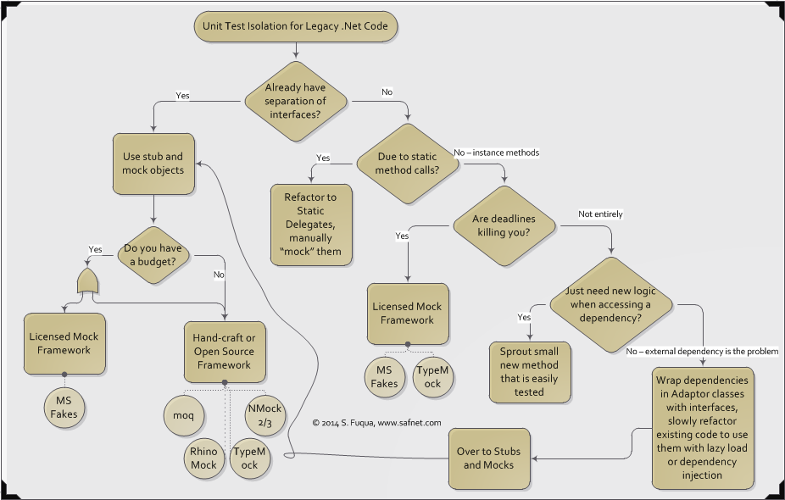
https://www.safnet.com/writing/tech/2014/08/unit-test-isolation-for-legacy-net-code.html
Testing for Legacy App
https://www.slideshare.net/StephenFuqua/refactoring-web-forms-for-test-automation
https://www.natmarchand.fr/aspnet-dependency-injection-net472/
https://vladdaraban.blog/unit-testing-asp-net-legacy-applications/
https://docs.microsoft.com/en-us/archive/msdn-magazine/2010/september/msdn-magazine-cutting-edge-better-web-forms-with-the-mvp-pattern
https://devblogs.microsoft.com/aspnet/use-dependency-injection-in-webforms-application/

Slide 56
Areas that Dependency Injection can be used
There are many areas you can use Dependency Injection in WebForms applications now. Here is a complete list.
- Pages and controls
- WebForms page
- User control
- Custom control
- IHttpHandler and IHttpHandlerFactory
- IHttpModule
- Providers
- BuildProvider
- ResourceProviderFactory
- Health monitoring provider
- Any ProviderBase based provider created by - System.Web.Configuration.ProvidersHelper.InstantiateProvider. e.g. custom sessionstate provider
Testing for Legacy App
https://devblogs.microsoft.com/aspnet/modern-asp-net-web-forms-development-dependency-injection/
https://devblogs.microsoft.com/aspnet/use-dependency-injection-in-webforms-application/

Slide 57
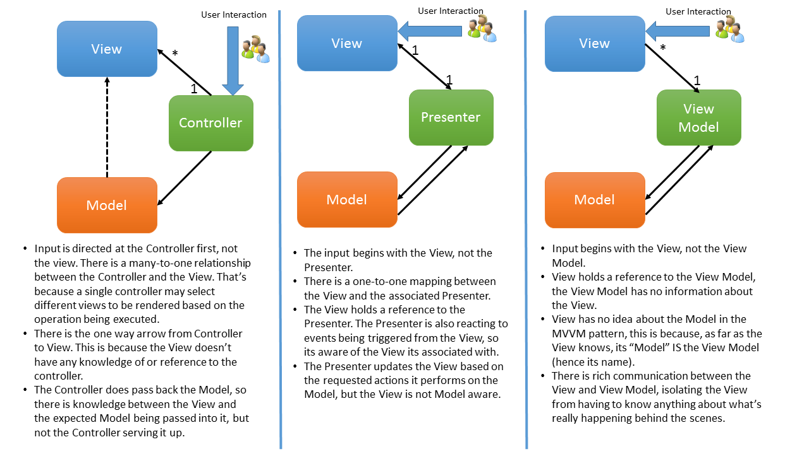
MVP- Model-View-Presenter
Testing for Legacy App
https://mytechnetknowhows.wordpress.com/2014/09/28/mvc-mvp-mvvm-demistified/
https://chainding.wordpress.com/2010/02/12/mvc-vs-mvp-vs-mvvm/
https://stackoverflow.com/questions/19996963/difference-between-asp-net-mvc-and-mvp-are-they-both-same/19997283
http://arun-architect.blogspot.com/2016/07/mvc-vs-mvp-vs-mvvm.html

Slide 58
Microsoft Fake for .net framework
A stub replaces a class with a small substitute that implements the same interface. To use stubs, you have to design your application so that each component depends only on interfaces, and not on other components. (By "component" we mean a class or group of classes that are designed and updated together and typically contained in an assembly.)
(aynı işi yapan başka bir class a aynı interface implement ediliyor ancak sadece belirli fonsiyonlar beklnen değerler ve Çalışma şekliyle yazılıyor. Daha sonra bu class fake’lenerek kullanılıyor.)
A shim modifies the compiled code of your application at run time so that instead of making a specified method call, it runs the shim code that your test provides. Shims can be used to replace calls to assemblies that you cannot modify, such as .NET assemblies.
(interface üzeinden fake’liyor daha sonra istediğimiz foksiyonları mockluyoruz)
Testing for Legacy App
https://docs.microsoft.com/en-us/visualstudio/test/isolating-code-under-test-with-microsoft-fakes?view=vs-2019

Slide 59
public class StringHelpers: IStringHelper
{
public string GetLower(string a)
{
if (a.ToLower() == "test")
{
a = "hello " + a;
}
else if (a.ToLower() == "hello")
{
a = a + " body";
}
else
{
a = "nothing";
}
return a.ToLower();
}
public string GetUpper(string a)
{
if (a.ToLower() == "test")
{
a = "hello" + a;
}
else if (a.ToLower() == "hello")
{
a = a + " body";
}
else
{
a = "nothing";
}
return a.ToUpper();
}
}
Code under test
public interface IStringHelper
{
string GetLower(string a);
string GetUpper(string a);
}
Stub vs Shim (Mole) in with Microsoft Fake Library
Bu kod yazıldıktan sonra test projesinde references üzernde sağ tıklanılarak add fakes seçilir daha sonra bu kodların yazılı olduğu proje seçilerek stub ve shim’lerin oluşturlması sağlanır.
Bu işlem yapıldığında references altında fakes diye bir klasör oluşturulduğu görülür.
Bir sonraki kodda stub ile shrim arasındaki fark görülebilir.
https://docs.microsoft.com/en-us/visualstudio/test/isolating-code-under-test-with-microsoft-fakes?view=vs-2019

Slide 60
[Fact]
Public void My_Test_Function(){
var stubIstringHelper = new Examples.LegacyHelper.Fakes.StubIStringHelper(); //IStringHelper Stub
stubIstringHelper.GetUpperString = (test) =>
{
if (test.Length < 5)
{
test = "beşten büyük yapıldı";
}
return test;
};
var a = stubIstringHelper.GetUpperString("test"); // sonuç: “beşten büyük yapıldı” olur.
var stubStringHelper = new Examples.LegacyHelper.Fakes.StubStringHelpers(); // StringHelper Stub
a = stubStringHelper.GetUpper("test"); // sonuç : “hello test” olur. Yani gerçekte ne varsa o yazar
çünkü interface den instance oluşturulmadı.
using (ShimsContext.Create()) // Shim
{
var stringHelperShim = new Examples.LegacyHelper.Fakes.ShimStringHelpers
{
GetUpperString = x => x.ToUpper()
};
var stringHelper = stringHelperShim.Instance;
a = stringHelper.GetUpper("test"); // sonuç : “TEST” olur. Çünki shimp içindeki GetUpper fonksiyonu yenisiyle değiştirildi.
}
Assert(true, true);
}
Test
Stub vs Shim (Mole) in with Microsoft Fake Library
https://docs.microsoft.com/en-us/visualstudio/test/isolating-code-under-test-with-microsoft-fakes?view=vs-2019

Slide 61
Integration Test

Slide 62
System Testing | Integration Testing
1. Testing the completed product to check if it meets the specification requirements. | 1. Testing the collection and interface modules to check whether they give the expected result
2. Both functional and non-functional testing are covered like sanity, usability, performance, stress an load . | 2.Only Functional testing is performed to check whether the two modules when combined give correct outcome.
3. It is a high level testing performed after integration testing | 3. It is a low level testing performed after unit testing
4. It is a black box testing technique so no knowledge of internal structure or code is required | 4. It is both black box and white box testing approach so it requires the knowledge of the two modules and the interface
5. It is performed by test engineers only | 5. Integration testing is performed by developers as well test engineers
6. Here the testing is performed on the system as a whole including all the external interfaces, so any defect found in it is regarded as defect of whole system | 6. Here the testing is performed on interface between individual module thus any defect found is only for individual modules and not the entire system
7. In System Testing the test cases are developed to simulate real life scenarios | 7. Here the test cases are developed to simulate the interaction between the two module
8. The System testing covers many different testing types like sanity, usability, maintenance, regression, retesting and performance | 8. Integration testing techniques includes big bang approach, top bottom , bottom to top and sandwich approach.

Slide 63
Integration Test, Functional Test
Integration Test Document
https://docs.microsoft.com/en-us/aspnet/core/test/integration-tests?view=aspnetcore-3.1
Example
https://github.com/aspnet/AspNetCore.Docs/tree/master/aspnetcore/test/integration-tests/samples/3.x/IntegrationTestsSample
Controller Testing
https://docs.microsoft.com/en-us/aspnet/core/mvc/controllers/testing?view=aspnetcore-3.1
https://fullstackmark.com/post/20/painless-integration-testing-with-aspnet-core-web-api
https://andrewlock.net/converting-integration-tests-to-net-core-3/

Slide 64
Rest API (Unit Testing – Integration Testing)
https://www.codingame.com/playgrounds/35462/creating-web-api-in-asp-net-core-2-0/part-1---web-api
https://www.codingame.com/playgrounds/35462/creating-web-api-in-asp-net-core-2-0/part-2---unit-tests
https://www.codingame.com/playgrounds/35462/creating-web-api-in-asp-net-core-2-0/part-3---integration-tests
https://www.infoq.com/articles/testing-aspnet-core-web-api/
https://www.norberteder.com/how-to-test-your-web-api-with-net-core/
https://fullstackmark.com/post/20/painless-integration-testing-with-aspnet-core-web-api

Slide 65
Apache JMeter
The Apache JMeter™ application is open source software, a 100% pure Java application designed to load test functional behavior and measure performance. It was originally designed for testing Web Applications but has since expanded to other test functions.
JMeter is not a browser
JMeter is not a browser, it works at protocol level. As far as web-services and remote services are concerned, JMeter looks like a browser (or rather, multiple browsers); however JMeter does not perform all the actions supported by browsers. In particular, JMeter does not execute the Javascript found in HTML pages. Nor does it render the HTML pages as a browser does (it's possible to view the response as HTML etc., but the timings are not included in any samples, and only one sample in one thread is ever displayed at a time).
https://jmeter.apache.org/
http://nadegegriesser.github.io/Integration-Tests-JMeter/
https://www.blazemeter.com/blog/testing-microservices-with-jmeter/

Slide 66
Uygulama 5
Integration Test Örnek Kod İncelemesi

Slide 67
Tools for More Fun

Slide 68
Fluent Assertions
Fluent Assertions is a set of .NET extension methods that allow you to more naturally specify the expected outcome of a TDD or BDD-style unit test. This enables a simple intuitive syntax that all starts with the following using statement:
Using FluentAssertion;
string actual = "ABCDEFGHI"; actual.Should().StartWith("AB").And.EndWith("HI").And.Contain("EF").And.HaveLength(9);
IEnumerable numbers = new[] { 1, 2, 3 }; numbers.Should().HaveCount(4, "because we thought we put four items in the collection");
Fluent Assertions
And Shouldly
https://fluentassertions.com/introduction

Slide 69
Shouldly
Shouldly is an assertion framework which focuses on giving great error messages when the assertion fails while being simple and terse.
This is the old Assert way:
Assert.That(contestant.Points, Is.EqualTo(1337));
For your troubles, you get this message, when it fails:
Expected 1337 but was 0
How it Should be:
contestant.Points.ShouldBe(1337);
Which is just syntax, so far, but check out the message when it fails:
contestant.Points should be 1337 but was 0
Fluent Assertions
And Shouldly
https://github.com/shouldly/shouldly

Slide 70
NSubstitute
NSubstitute is designed as a friendly substitute for .NET mocking libraries.
//Create:
var calculator = Substitute.For<ICalculator>();
//Set a return value:
calculator.Add(1, 2).Returns(3);
Assert.AreEqual(3, calculator.Add(1, 2));
//Check received calls:
calculator.Received().Add(1, Arg.Any<int>());
calculator.DidNotReceive().Add(2, 2);
//Raise events
calculator.PoweringUp += Raise.Event();
NSubstituteAnd FakeItEasy
https://weareadaptive.com/2014/09/30/why-nsubstitute/
https://fakeiteasy.readthedocs.io/en/stable/quickstart/
https://nsubstitute.github.io/

Slide 71
Fake It Easy
A .NET dynamic fake library for creating all types of fake objects, mocks, stubs etc.
// Creating a fake object is just dead easy!
// No mocks, no stubs, everything's a fake! var lollipop = A.Fake<ICandy>();
var shop = A.Fake<ICandyShop>();
// Easily set up a call to return a value
A.CallTo(() => shop.GetTopSellingCandy()).Returns(lollipop);
// Use your fake as you would an instance of the faked type.
var developer = new SweetTooth();
developer.BuyTastiestCandy(shop);
// Asserting uses the same syntax as configuring calls.
// There's no need to learn another syntax.
A.CallTo(() => shop.BuyCandy(lollipop)).MustHaveHappened();
NSubstituteAnd Fake It Easy
https://weareadaptive.com/2014/09/30/why-nsubstitute/
https://fakeiteasy.readthedocs.io/en/stable/quickstart/
https://nsubstitute.github.io/

Slide 72
AutoFixture is an open source library for .NET designed to minimize the 'Arrange' phase of your unit tests in order to maximize maintainability. Its primary goal is to allow developers to focus on what is being tested rather than how to setup the test scenario, by making it easier to create object graphs containing test data.
AutoFixture's support for xUnit.net is implemented in a separate assembly. AutoFixture itself has no dependency on xUnit.net, and if you use another unit testing framework, you can just ignore the existence of the Ploeh.AutoFixture.Xunit assembly.
AutoFixture, Auto Data and Auto Mock
https://github.com/AutoFixture/AutoFixture https://github.com/AutoFixture/AutoFixture/wiki/Cheat-Sheet
https://stackoverflow.com/questions/21195872/how-to-use-autodata-in-unit-tests-to-supply-n-objects-of-a-type-in-test-argument
https://engineering.thetrainline.com/an-introduction-to-xunit-moq-and-autofixture-995315f656f
https://github.com/MisterJames/GenFu
https://stackoverflow.com/questions/48573586/autofixture-nsubstitute-virtual-methods

Slide 73
GenFu
GenFu is a library you can use to generate realistic test data. It is composed of several property fillers that can populate commonly named properties through reflection using an internal database of values or randomly created data. You can override any of the fillers, give GenFu hints on how to fill them.
Genfu
https://github.com/AutoFixture/AutoFixture https://github.com/AutoFixture/AutoFixture/wiki/Cheat-Sheet
https://stackoverflow.com/questions/21195872/how-to-use-autodata-in-unit-tests-to-supply-n-objects-of-a-type-in-test-argument
https://engineering.thetrainline.com/an-introduction-to-xunit-moq-and-autofixture-995315f656f
https://github.com/MisterJames/GenFu

Slide 74
FlUrl (Fluent URL)
Flurl is a modern, fluent, asynchronous, testable, portable, buzzword-laden URL builder and HTTP client library for .NET.
// Flurl will use 1 HttpClient instance per host
var person = await "https://api.com"
.AppendPathSegment("person")
.SetQueryParams(new { a = 1, b = 2 })
.WithOAuthBearerToken("my_oauth_token")
.PostJsonAsync(new
{
first_name = "Claire",
last_name = "Underwood"
})
.ReceiveJson<Person>();
// fake & record all http calls in the test subject
using (var httpTest = new HttpTest()) {
// arrange
httpTest.RespondWith("OK", 200);
// act
await sut.CreatePersonAsync();
// assert
httpTest.ShouldHaveCalled("https://api.com/*")
.WithVerb(HttpMethod.Post)
.WithContentType("application/json");
}
FlUrl
https://flurl.dev/
https://flurl.dev/docs/testable-http/

Slide 75
Html Agility
This is an agile HTML parser that builds a read/write DOM and supports plain XPATH or XSLT (you actually don't HAVE to understand XPATH nor XSLT to use it, don't worry...). It is a .NET code library that allows you to parse "out of the web" HTML files. The parser is very tolerant with "real world" malformed HTML. The object model is very similar to what proposes System.Xml, but for HTML documents (or streams).
https://github.com/zzzprojects/html-agility-pack
Angle Sharp
AngleSharp is a .NET library that gives you the ability to parse angle bracket based hyper-texts like HTML, SVG, and MathML. XML without validation is also supported by the library. An important aspect of AngleSharp is that CSS can also be parsed. The included parser is built upon the official W3C specification. This produces a perfectly portable HTML5 DOM representation of the given source code and ensures compatibility with results in evergreen browsers.
https://github.com/AngleSharp/AngleSharp

Slide 76
Html Agility
This is an agile HTML parser that builds a read/write DOM and supports plain XPATH or XSLT (you actually don't HAVE to understand XPATH nor XSLT to use it, don't worry...). It is a .NET code library that allows you to parse "out of the web" HTML files. The parser is very tolerant with "real world" malformed HTML. The object model is very similar to what proposes System.Xml, but for HTML documents (or streams).
https://github.com/zzzprojects/html-agility-pack
Angle Sharp
AngleSharp is a .NET library that gives you the ability to parse angle bracket based hyper-texts like HTML, SVG, and MathML. XML without validation is also supported by the library. An important aspect of AngleSharp is that CSS can also be parsed. The included parser is built upon the official W3C specification. This produces a perfectly portable HTML5 DOM representation of the given source code and ensures compatibility with results in evergreen browsers.
https://github.com/AngleSharp/AngleSharp

Slide 77
https://www.codeproject.com/Articles/1079028/Build-Lambda-Expressions-Dynamically
https://github.com/sqlkata/querybuilder
https://github.com/dbelmont/ExpressionBuilder
https://github.com/morelinq/MoreLINQ
https://github.com/nreco/lambdaparser
https://github.com/StefH/System.Linq.Dynamic.Core
Expression Builders, Expression Parsers
https://github.com/LightBDD/LightBDD
https://github.com/danielgerlag/workflow-core

Slide 78
MyTested Asp.Net Core
https://mytestedasp.net/
https://github.com/ivaylokenov/MyTested.AspNetCore.Mvc
https://flurl.dev/

Slide 79
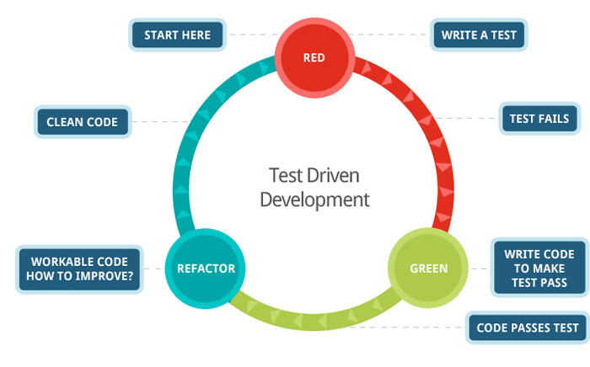
TDD (Test Driven Development)
https://docs.microsoft.com/en-us/visualstudio/test/quick-start-test-driven-development-with-test-explorer?view=vs-2019

Slide 80
Test Driven Development
Ve Uygulama
https://docs.microsoft.com/en-us/visualstudio/test/quick-start-test-driven-development-with-test-explorer?view=vs-2019

Slide 81
The End
Questions & Answers

Slide 82
Resources
http://softwaretestingfundamentals.com/unit-testing/
https://www.guru99.com/unit-testing-guide.html
https://stackify.com/unit-testing-basics-best-practices/
https://smartbear.com/learn/automated-testing/what-is-unit-testing/
https://www.wikizeroo.org/index.php?q=aHR0cHM6Ly9lbi53aWtpcGVkaWEub3JnL3dpa2kvVW5pdF90ZXN0aW5n
https://www.wikizeroo.org/index.php?q=aHR0cHM6Ly9lbi53aWtpcGVkaWEub3JnL3dpa2kvVW5pdF90ZXN0aW5n
https://xunit.net/docs/shared-context
https://www.programmingwithwolfgang.com/xunit-getting-started/
http://xunitpatterns.com/

