Slide 1
sequence
Prepared by:
Mathematical Science Department

Slide 2
LEARNING OUTCOMES
By the end of this chapter, student should be able to :
explain the terms sequence, arithmetic and geometric sequence,
identify arithmetic and geometric sequences,
calculate the terms in arithmetic and geometric sequences,
calculate the sum of terms in arithmetic and geometric sequences, and
apply the concepts of arithmetic and geometric sequences to some common problems in daily life.

Slide 3
What is Sequence?
A set of numbers which are written in specific order or following a specific rule.
For example,
0, 2, 4, 6, 8, …
1, 3, 9, 27, …
17, 12, 7, 2, -3, -8, -13.
The three sets of numbers above are an example of sequence since between adjacent values, it follows certain order or rule.
In this chapter, student will be learning two type of sequence: Arithmetics and Geometrics.

Slide 4
ARITHMETIC SEQUENCE
At the end of this subtopic, students should be
able to
recognise an arithmetic progression
find the n-th term of an arithmetic progression
find the sum of an arithmetic series

Slide 5
ARITHMETIC SEQUENCE
Consider this sequence:
5, 13, 21, 29,…
It starts with a particular first term, and to get the next term, add a fixed value to the previous term. In the above set of values, we add 8 to get the next term. The difference between consecutive terms is a constant.
i.e.,
5, 5 + 8, 5 + 8 + 8, 5 + 8 + 8 + 8, …
5, 5 + 8, 5 + 2(8), 5 + 3(8), …
5, 13, 21, 29, …

Slide 6
ARITHMETIC SEQUENCE (n^{th} term)
Definition:
An arithmetic progression is a sequence where each new term after the first is obtained by adding a constant d, called the common difference, to the preceding term. If the first term of the sequence is a then the arithmetic progression is
a, a + d, a + 2d, a + 3d, . . .
where the n^{th} term is given by the formula
T_{n} = a + (n − 1)d

Slide 7
ARITHMETIC SEQUENCE (n^{th} term)
(a) Write down the first five terms of the Arithmetic Sequence with first term 8 and common difference 7.
(b) Write down the first five terms of the Arithmetic Sequence with first term 2 and common difference −5.
(c) What is the common difference of the Arithmetic Sequence 11, −1, −13, −25, . . . ?
(d) Find the 17th term of the arithmetic progression with first term 5 and common difference 2.
(e) Write down the 10th and 19th terms of the Arithmetic Sequence
(i) 8, 11, 14, . . .,
(ii) 8, 5, 2 . . ..
(f) An Arithmetic Sequence is given by k, 2k/3, k/3, 0, . . ..
(i) Find the sixth term.
(ii) Find the n^{th} term.
(iii) If the 20th term is equal to 15, find k.

Slide 8
ARITHMETIC SEQUENCE (n^{th} term)
Solution
(a) Write down the first five terms of the Arithmetic Sequence with first term 8 and common difference 7. So, a = 8 and d = 7.
Use formula of
The sequence is 8, 15, 22, 29, 36, …

Slide 9
ARITHMETIC SEQUENCE (n^{th} term)
Solution
(b) Write down the first five terms of the Arithmetic Sequence with first term 2 and common difference −5. So, a = 2 and d = -5.
Use formula of
The sequence is 2, -3, -8, -13, -18, …

Slide 10
ARITHMETIC SEQUENCE (n^{th} term)
Solution
(c) What is the common difference of the Arithmetic Sequence 11, −1, −13, −25, . . . ?
Here, the common difference is simply the difference in any adjacent values. i.e.,
d = -1 -11 or -13 – (-1) or -25 – (-13)
= -12
Note: to find d, always take the higher order value and substract from a lower order value. i.e., d = T_{n} – T_{n-1}

Slide 11
ARITHMETIC SEQUENCE (n^{th} term)
Solution
Find the 17th term of the arithmetic progression with first term 5 and common difference 2.
Here, we are given a = 5 and d = 2. So, using the general formula for n^{th} term, we have
Solve (e) and (f) on your own. Check your answer with your instructor

Slide 12
ARITHMETIC SEQUENCE (sum of an arithmetic series)
The sum of the terms of an arithmetic progression gives an arithmetic series. If the starting value is a and the common difference is d then the sum of the first n terms is

Slide 13
ARITHMETIC SEQUENCE (sum of an arithmetic series)
Find the sum of the first 50 terms of the sequence
1, 3, 5, 7, 9, . . .
Solution:
a = 1 , d = 2 , n = 50
Use the formula of

Slide 14
ARITHMETIC SEQUENCE (sum of an arithmetic series)
An arithmetic progression has 3 as its first term. Also, the sum of the first 8 terms is twice the sum of the first 5 terms. Find the common difference.
Here, we are given a = 3 and S₈ = 2S₅.
Thus,

Slide 15
ARITHMETIC SEQUENCE (sum of an arithmetic series)
PRACTICE QUESTIONS
(a) Find the sum of the first 23 terms of the AP 4, −3, −10, . . .
(b) An arithmetic series has first term 4 and common difference 1/2 . Find
(i) the sum of the first 20 terms,
(ii) the sum of the first 100 terms.
(c) Find the sum of the arithmetic series with first term 1, common difference 3, and last term 100.
(d) The sum of the first 20 terms of an arithmetic series is identical to the sum of the first 22 terms. If the common difference is −2, find the first term.
TRY THE ABOVE QUESTIONS AND CHECK YOUR ANSWER WITH YOUR INSTRUCTOR

Slide 16
GEOMETRIC SEQUENCE
At the end of this subtopic, students should be able to
recognise a geometric progression
find the n^{th} term of a geometric progression
find the sum of a geometric series

Slide 17
GEOMETRIC SEQUENCE
Consider this sequence
2, 6, 18, 54,…
Each term in the sequence is 3 times the previous term and in the following sequence
1, -2, 4, -8,…
Each term is -2 times the previous term.
There is no common difference. Instead there is a common ratio (r), as the ratio of successive terms is always constant.

Slide 18
GEOMETRIC SEQUENCE (n-th term)
A geometric progression, or GP, is a sequence where each new term after the first is obtained by multiplying the preceding term by a constant r, called the common ratio. If the first term of the sequence is a then the geometric progression is
a, ar, ar2 , ar3 , . . .
where the n-th term is

Slide 19
GEOMETRIC SEQUENCE (n-th term)
How many terms are there in the geometric progression 2, 4, 8, . . . , 128 ?
Here, we have a = 2, r = 2 and last term T_{n} = 128. Using this information, we have the following solution,

Slide 20
GEOMETRIC SEQUENCE (n-th term)
Exercise
(a) Write down the first five terms of the geometric progression which has first term 1 and common ratio 12 .
(b) Find the 10th and 20th terms of the GP with first term 3 and common ratio 2.
(c) Find the 7th term of the GP 2, −6, 18, . . .,

Slide 21
GEOMETRIC SEQUENCE (sum of a geometric series)
The sum of the terms of a geometric progression gives a geometric series. If the starting value is a and the common ratio is r then the sum of the first n terms is

Slide 22
GEOMETRIC SEQUENCE (sum of a geometric series)
Find the sum of the geometric series 2, 6, 18, 54,… where there are 6 terms in the series.
Here we have a = 2, r = 3, and n = 6. Since r > 1, we get

Slide 23
GEOMETRIC SEQUENCE (sum of a geometric series)
Find the sum of the geometric series 8, -4, 2, -1, … where there are 5 terms in the series.
Here we have a = 8, r = - 1/2 , and n = 5. Since r < 1, we have

Slide 24
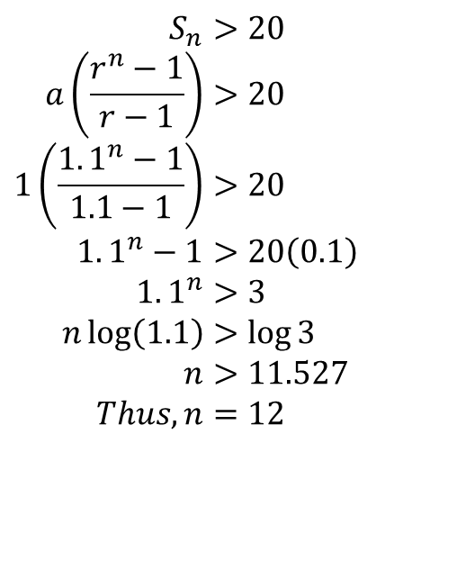
GEOMETRIC SEQUENCE (sum of a geometric series)
How many terms in the geometric progression
1, 1.1, 1.21, 1.331, . . .
will be needed so that the sum of the first n terms is greater than 20?
Here we have a = 1, r = 1.1, and S_{n} > 20. Thus, using the sum formula for r > 1, we have
$$S_{n}>20 \\ a\left(\frac{r^{n}−1}{r−1}\right)>20 \\ 1\left(\frac{1.1^{n}−1}{1.1−1}\right)>20 \\ 1.1^{n}−1>20\left(0.1\right) \\ 1.1^{n}>3 \\ n\log\left(1.1\right)>\log{3} \\ n>11.527 \\ Thus,n=12$$

Slide 25
GEOMETRIC SEQUENCE (sum of a geometric series)
Exercises (Try these yourselves)
(a) Find the sum of the first five terms of the GP with first term 3 and common ratio 2.
(b) Find the sum of the first 20 terms of the GP with first term 3 and common ratio 1.5.
(c) The sum of the first 3 terms of a geometric series is 37/8 . The sum of the first six terms is 3367/512 . Find the first term and common ratio.
(d) How many terms in the GP 4, 3.6, 3.24, . . . are needed so that the sum exceeds 35?

Slide 26
GEOMETRIC SEQUENCE (application of geometric sequence)
When Muaz started working in 2002, his starting salary was RM1,800. Every year his salary increases by 3% based on the previous year's salary. What is his salary in year 2011? (Hint given: if % included, how to determine r? if Increase, then r =1 + %, otherwise if decrease, r = 1 - %)
Here we have a = 1,800, r = 1 + 3% = 1.03, and n = 2002 until 2011 = 10 years.
So,
T₁₀ = ar⁽¹⁰ ⁻ ¹⁾ = 1800(1.03)⁹= RM 2,348.59

Slide 27
PAST YEAR QUESTIONS
MAC 2015
The 4th term of a geometric sequence is -96 and the 9th term is -3. Find:
the common ratio and the first term
the sum of the first five terms.
SEPT 2014
a) Given a sequence: 10, 30, 90, 270, 810, 2430....., find the sum of the first 10 terms
b) The fourth term of an arithmetic sequence is less than the fifth term by 3. The seventh term is three times the fifth term. Find
i) the common difference and the first term
ii) the sum of the first 12 terms
MAC 2014
Determine the number of terms for the following sequence:
71, 65, 59, …, -13
b) The fifth term of a geometric sequence is 504 and the first term is 8064. Determine the common ratio and the sum of the first ten terms of the sequence. Assume that the common ratio is positive.

