Slide 1
depreciation
Prepared by:
Mathematical Science Department

Slide 2
LEARNING OUTCOMES
By the end of this chapter, student should be able to :
explain the concept of depreciation,
Identify the terms used and its meaning related to depreciation,
differentiate the two methods used in this chapter,
calculate the depreciation using on straight line method,
calculate the depreciation using declining balance method.

Slide 3
Depreciation
Definition:
Depreciation is defined as the loss in value of capital assets such as vehicles, machinery tools and equipment due to usage over time.
Thus, in general the term depreciation refers to fall in the value or utility of fixed assets which are used in operations over the definite period of years. In other words, depreciation is the process of spreading the cost of fixed assets over the number of years during which benefit of the asset is received.
The fall in value or utility of fixed assets due to so many causes like wear and tear, decay, effluxion of time or obsolescence, replacement, breakdown, fall in market value etc.

Slide 4
Factors Affecting the Amount of Depreciation
The following factors are to be considered while charging the amount of depreciation :
The original cost of the asset.
The useful life of the asset.
Estimated scrap or residual value of the asset at the end of its life.
Selecting an appropriate method of depreciation.

Slide 5
Important Terms
Original cost (C) : The cost paid for the item including any sales tax, transportation charges, installation charges and other cost that incurred.
Salvage cost (S) : Cost at the end of its lifetime. It is also called scrap-value or trade-in-value or junkyard.
Useful life (n) : life expectancy or the number of years the asset is expected to last. Sometimes called as economic life.
Book value (BV) : The difference between the original cost and the accumulated depreciation to that date. May also refer as the market value or market price of an asset at certain years.
Total depreciation : difference between original cost and the salvage value.
Annual depreciation : the amount of depreciation in a year.
Accumulated depreciation : the total depreciation to date.

Slide 6
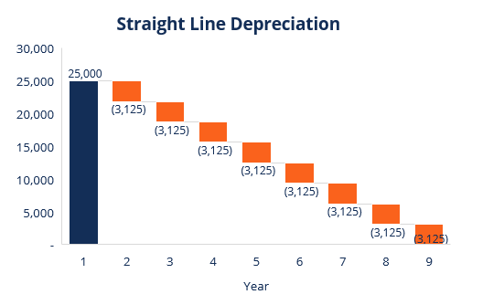
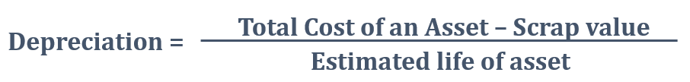
Method of depreciation 1. Straight Line Method
This method is also termed as Constant Charge Method. Under this method, depreciation is charged for every year will be the constant amount throughout the life of the asset.
Accordingly depreciation is calculated by deducting the scrap value from the original cost of an asset and the balance is divided by the number of years estimated as the life of the asset.
Source: https://corporatefinanceinstitute.com/resources/knowledge/accounting/types-depreciation-methods/

Slide 7
Important Formula used in Straight Line Method

Slide 8
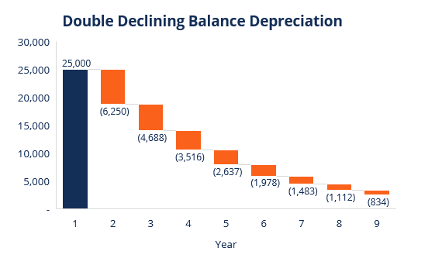
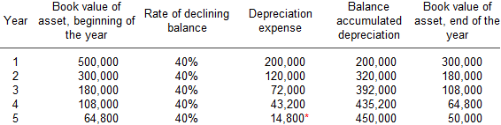
Method of depreciation 2. Declining Balance Method
The declining balance method produces the highest depreciation charges in the earlier years of the asset .
The book value of the asset remaining at the end of the depreciation year becomes the scrap value.
Source: https://corporatefinanceinstitute.com/resources/knowledge/accounting/types-depreciation-methods/

Slide 9
Important Formula used in Declining Balance Method
n = useful life in years
S =salvage value
C =cost

Slide 10
Example 1
Fantastic laundry bought a washing machine at RM10,000. It is estimated to last for 5 years and has salvage value of RM2,000. Find
the book value of the washing machine after 3 years using the straight line method
the annual rate and the amount of depreciation of the washing machine for the third year by using the declining balance method.

Slide 11
SOLUTION

Slide 12
SOLUTION
Example 2
Five years ago, Salleh bought a tractor, which currently has a value RM8,500. This tractor has a life expectancy of another 15 years. At the end of its life, the tractor will have a value of RM5,000. By using the straight line method, calculate the cost of the tractor. Then, calculate its annual depreciation.

Slide 13
Exercise
The depreciation for the third year of a machine is RM5,000. If the annual rate of depreciation is 2%, find the cost for the machine using declining balance method.
Raju owns Asset 1 and Asset 2 where details are given as follows:
i) The total depreciation for Asset 1 over its useful life is estimated to be RM12,000, calculate the price that should be offered by Raju if he wishes to sell the asset after using it for 5 years.
ii) Find the value of k if the book value of Asset 2 at the third year is RM15,000.
Item | Asset 1 | Asset 2
Cost (RM) | 25,530 | 25,000
Annual rate of depreciation (%) | 20 | k
Method of depreciation | Straight Line | Declining Balance

