Slide 1
Personal income tax
Prepared by:
Mathematical Science Department

Slide 2
LEARNING OUTCOMES
By the end of this chapter, student should be able to :
identify allowance deductions for income tax purposes,
determine chargeable income,
use the tax schedule to determine the tax amount,
recognize that tax rebate is allowed for a chargeable income of less than RM35,000 and that zakat is an allowable rebate, and
calculate tax payable.

Slide 3
INTRODUCTION
Income tax is the normal tax which is paid on your taxable (chargeable) income.
Two types of Assessment
Separate Assessment
Joint Assessment
Separate
Tax is calculated individually.
For instance : bachelor, husband only, wife only.
Husband the only one working (wife get relief and rebate).
Children are assessed under husband unless it is requested by wife.
Joint
Tax is calculated together.
For instance : husband + wife.
For Parents Medical Expenses, only husband part is calculated.

Slide 4
Calculation of tax consists of 5 PARTS
Aggregate Income
Donation
Reliefs
Taxable Income
Rebates

Slide 5

Aggregate Income
Annual Income (the salary for 12 months)
For joint assessment, the aggregate income must be the combination income of husband and wife.

Slide 6
Donation
CONTRIBUTION | AMOUNT
Gift of money to the Government, State Government or Local Authorities. | NIL
Gift of money to Approved Institutions or Organisations. | (Amount is limited to 7% of aggregate income)
Gift of money or cost of contribution in kind for any Approved Sports Activity or Sports Body. | (Amount is limited to 7% of aggregate income)
Gift of money or cost of contribution in kind for any Approved Project of National Interest Approved by Ministry of Finance. | (Amount is limited to 7% of aggregate income)
Gift of artifacts, manuscripts or paintings. | NIL
Gift of money for provision of Library Facilities or to Libraries. | NIL

Slide 7
Reliefs
 | INDIVIDUAL RELIEF TYPES | AMOUNT (RM)
1 | Self and Dependent | 9,000
2 | Husband/Wife/Alimony Payments | 4,000 (Limited)
3 | Children below 18 years, and each unmarried child of 18 years and above who is receiving full-time education ("A-Level", certificate, matriculation or preparatory courses). | 2,000
4 | Each unmarried child of 18 years and above that: (i) receiving further education in Malaysia in respect of an award of diploma or higher (excluding matriculation/preparatory courses). (ii) receiving further education outside Malaysia in respect of an award of degree or its equivalent (including Master or Doctorate). (iii) the instruction and educational establishment shall be approved by the relevant government authority. | 8,000
5 | Disabled child. Additional exemption of RM6,000 disable child age 18 years old and above, not married and pursuing diplomas or above qualification in Malaysia @ bachelor degree or above outside Malaysia in program and in Higher Education Institute that is accredited by related Government authorities | 6,000 8,000

Slide 8
Reliefs (cont. …)
 | INDIVIDUAL RELIEF TYPES | AMOUNT (RM)
6 | Life insurance and EPF | 7,000 (Limited)
7 | Medical expenses for parents | 5,000 (Limited)
8 | Medical expenses for serious diseases for self, spouse or child | 6,000 (Limited)
9 | Lifestyles – Expenses for the use / benefit of self, spouse or child in respect of: | 2,500 (Limited)
10 | Education Fees (Individual) | 7,000 (Limited)
11 | Net saving in SSPN's scheme (Total Deposit – Total Withdrawal in the assessment year) | 8,000 (Limited)
12 | Contribution to the Social Security Organization (SOCSO) | 250 (Limited)
13 | Insurance premium for education or medical benefit | 3000 (Limited)
Note: Refer to the tax reliefs notes from the LHDN for a complete information.

Slide 9
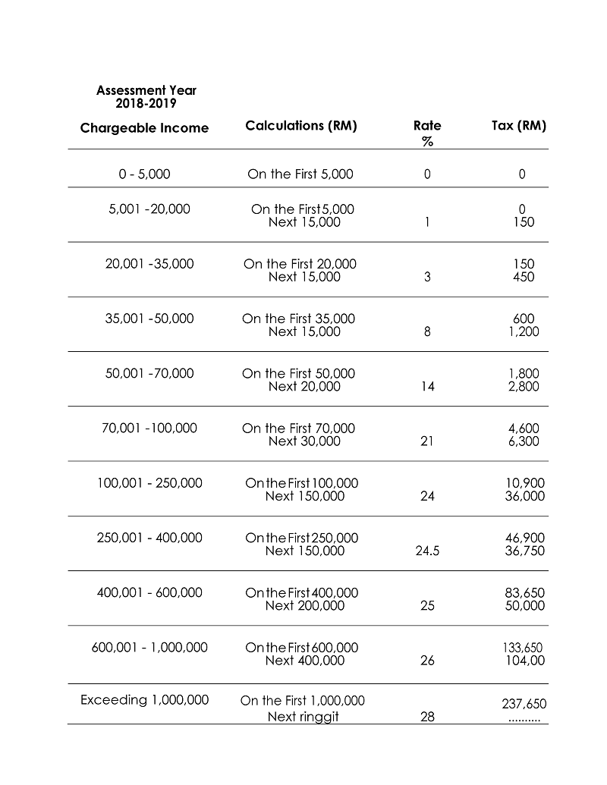
Taxable Income Tax Rate Schedule

Slide 10
Rebates
NO | TAX REBATE | AMOUNT (RM)
1 | Husband (taxable income below RM35 000) | 400
2 | Wife (taxable income below RM35 000) | 400
3 | Zakat | NIL

Slide 11
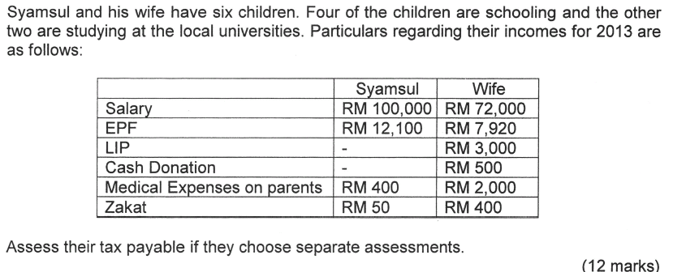
Example 1
2018

Slide 12
Tax Assessment for Syamsul
Aggregate Income |  |  | 100,000
Donation |  |  | (0)
 |  | Total Income | 100,000
Reliefs
Self | 9,000
Children
4 x 2000 | 8,000
2 x 8000 | 16,000
EPF + LIP | 7,000
Parents Medical Expenses | 400
 |  | Total Reliefs | (40,400)
 |  | Taxable Income | 59,600
From the taxable income
First 50,000 = 1,800 (from taxable table)
Balance = 59,600 – 50,000 = 9,600 @ 14%
Using Tax Rate
On the first 50 000 | 1,800
On the next 9,600 x 14% | 1,344
 |  | Total Tax | 3,144
Rebates
Zakat | 50
 |  | Total Rebates | (50)
 |  | Payable Tax | RM3,094

Slide 13
Tax Assessment for Syamsul’s Wife
Aggregate Income |  |  | 72,000
Donation |  |  | (500)
 |  | Total Income | 71,500
Reliefs
Self | 9,000
EPF + LIP | 7,000
Parents Medical Expenses | 2,000
 |  | Total Reliefs | (18,000)
 |  | Taxable Income | 53,500
From the taxable income
First 50,000 = 1,800 (from taxable table)
Balance = 53,500 – 50,000 = 3,500 @ 14%
Using Tax Rate
On the first 50 000 | 1,800
On the next 3,500 x 14% | 490
 |  | Total Tax | 2,290
Rebates
Zakat | 400
 |  | Total Rebates | (400)
 |  | Payable Tax | RM1,890

Slide 14
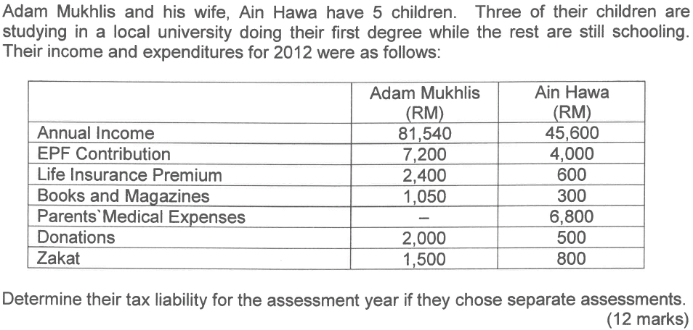
Example 2
2018

Slide 15
Tax Assessment for Adam Mukhlis
Aggregate Income |  |  | 81,540
Donation |  |  | (2,000)
 |  | Total Income | 79,540
Reliefs
Self | 9,000
Children
2 x 2000 | 4,000
3 x 8000 | 24,000
EPF + LIP | 7,000
Lifestyles | 1,050
 |  | Total Reliefs | (45,050)
 |  | Taxable Income | 34,490
From the taxable income
First 20,000 = 150 (from taxable table)
Balance = 34,490 – 20,000 = 14,490 @ 3%
Using Tax Rate
On the first 20 000 | 150
On the next 14,490 x 3% | 434.70
 |  | Total Tax | 584.70
Rebates
Zakat | 1,500
Self | 400 | Total Rebates | (1,900)
 |  | Payable Tax | RM 0

Slide 16
Tax Assessment for Ain Hawa
Aggregate Income |  |  | 45,600
Donation |  |  | (500)
 |  | Total Income | 45,100
Reliefs
Self | 9,000
EPF + LIP | 4,600
Lifestyles | 300
Parents Medical Expenses | 5,000
 |  | Total Reliefs | (18,900)
From the taxable income
First 20,000 = 150 (from taxable table)
Balance = 26,200 – 20,000 = 6,200 @ 3%
Using Tax Rate
On the first 20,000 | 150
On the next 6,200 x 6% | 186
 |  | Total Tax | 336
Rebates
Self | 400
Zakat | 800 | Total Rebates | (1,200)
 |  | Payable Tax | RM 0
 |  | Taxable Income | 26,200

Slide 17
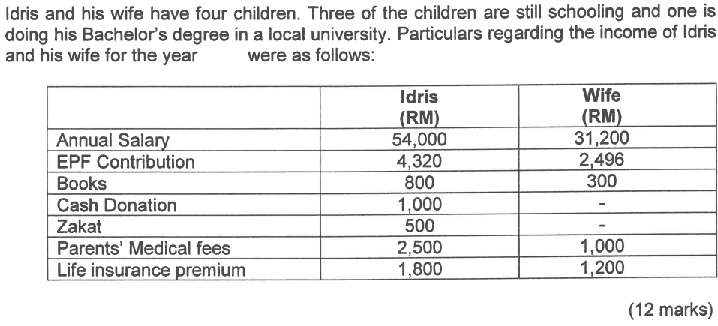
Example 3
2018

Slide 18
Joint Tax Assessment for Idris and his wife
Aggregate Income |  |  | 85,200
Donation |  |  | (1,000)
 |  | Total Income | 84,200
Reliefs
Self | 9,000
Wife | 4,000
Children: 3 x 2000 | 6,000
1 x 8000 | 8,000
EPF + LIP | 7,000
Lifestyles | 1,100
Parents Medical Fees | 2,500 | Total Reliefs | (37,600)
 |  | Taxable Income | 46,600
From the taxable income
First 35,000 = 600 (from taxable table)
Balance = 46,600 – 35,000 = 11,600 @ 8%
Using Tax Rate
On the first 35,000 | 600
On the next 11,600 x 8% | 928
 |  | Total Tax | 1,528
Rebates
Zakat | 500
 |  | Total Rebates | (500)
 |  | Payable Tax | RM 1,028

